Slide 1
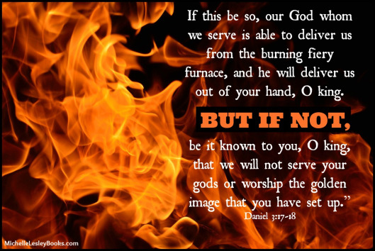
Daniel Chapter Three

Slide 2
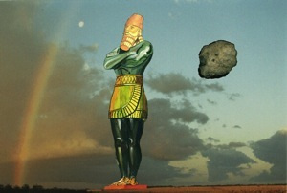
Review of Chapter 2

Slide 3
Review of Chapter 2
In his dream, Nebuchadnezzar saw standing before him a great image, excellent in splendor, and awesome in form (2:31).
“This image’s head was of fine gold, its chest and arms of silver, its belly and thighs of bronze, its legs of iron, its feet partly of iron and clay” (2:32-33).
This portion of the dream represented four kingdoms, and the transition from one to the next—from the present kingdom, Babylon, and then Medo-Persia, Greece, Rome.
This chapter serves a foundation for the latter half of the book. We will find out much more about these kingdoms.

Slide 4
Review of Chapter 2
Nebuchadnezzar also saw a stone cut without hands strike this image on its feet and iron and clay, causing the whole thing to be crushed to pieces and carried away by the wind (2:34-35).
This portion is explained in 2:44: “And in the days of these kings (fourth kingdom, Rome) the God of heaven will set up a kingdom which shall never be destroyed; and the kingdom shall not be left to other people; it shall break in pieces and consume all these kingdoms, and it shall stand forever.”
This is without question the Messianic kingdom, the same one of which we are a part!

Slide 5
Questions
“Nebuchadnezzar the king made an image of gold” (3:1), which essentially means he made another god.
Man makes a god—anything strike you as odd about that?
“Thus says the LORD, your Redeemer, and He who formed you from the womb: ‘I am the LORD, who makes all things…’” (Isaiah 44:24).
“Those who make an image, all of them are useless, and their precious things shall not profit; they are their own witnesses; they neither see nor know, that they be ashamed. Who would form a god or mold an image that profits him nothing?” (Isaiah 44:9-10).

Slide 6
Questions
This image of gold was how tall and how wide? (3:1).
Better present a strong case for this idol, because it sure can’t present it’s own.
“Present your case,” says the LORD. “Bring forth your strong arguments,” says the King of Jacob (Isa. 41:21).

Slide 7
Questions
T F Nebuchadnezzar invited a few close friends to the dedication of this image (3:2-3).

Slide 8
Questions
Think about the herald’s message in 3:4-6.
Think heralds for Jesus Christ might have a better message to proclaim?
The heralds we read about in Acts—what message did they consistently proclaim?
“How you turned to God from idols to serve the living and true God, and to wait for His Son from heaven, whom He raised from the dead…” (1 Thess. 1:9-10).

Slide 9
Questions
“ALL the people, nations, and languages fell down and worshiped…” (3:8). All except whom? (3:8-12).
The “Chaldeans” who accused them, do we still have folks like that around today?
“But sanctify the Lord God in your hearts, and always be ready to give a defense to everyone who asks you a reason for the hope that is in you, with meekness and fear; having a good conscience, that when they defame you as evildoers, those who revile your good conduct in Christ may be ashamed” (1 Peter 3:15-16).

Slide 10
Questions
Remember that prior to this, Nebuchadnezzar had promoted these three men (2:30). Would this perhaps make it MORE difficult to defy His order?
Goethe: “Most men can oppose their enemies, but it takes a special person to oppose his friends.”

Slide 11
Questions
Nebuchadnezzar was furious with these three men, but what offer did he make to them? (3:14-15).
“And who is the god who will deliver you from my hands?” (3:15). Remind you of anyone else in Biblical history?
“Who is the LORD, that I should obey His voice to let Israel go?” (Exodus 5:2).
Pharaoh received a “ten lesson correspondence course,” and Nebuchadnezzar is about to get his lesson, too.

Slide 12
Questions
What these three men said to the king (3:16-18)—what does that say about them?
When you know THE KING, other kings don’t scare you.
Think about how many people must have been encouraged by their response—at that time, and in every age since!
Think about the excuses they COULD have made (so young; away from home; everybody’s doing it; more useful alive than dead; it’s just an idol so why not just go through the motions; etc.).

Slide 13
Questions
And so into the fiery furnace they go, with what two additional stipulations from the king? (3:19-20).
So hot, in fact, that what happened to those who cast them into the furnace? (3:22).
Binding them in coats, trousers, turbans, and other garments will help make this miracle even more conspicuous.

Slide 14
Questions
What did the king see in the fire that really got his attention? (3:24-25).
How does Nebuchadnezzar later describe this being? (3:28).

Slide 15
Questions
T F These three men suffered a few minor burns, some smoke inhalation, but other than that, they were just fine (3:27).

Slide 16
Questions
Look at the praise the king offers in v. 28. Anything in this that might have been particularly difficult for him to admit?

Slide 17
Questions
The king’s decree in v. 29—what would happen to anyone who spoke anything amiss against “the God of Shadrach, Meshach, and Abed-Nego”?
Earlier, “Who is the god who will deliver you from my hands?” (3:15).
Now, “There is no other god who can deliver like this” (3:29).

Slide 18
Questions
These three men were promoted by the king (3:30), but whose esteem you think mattered more to them?

