Slide 1
Minor Prophets—Lesson 7
Introduction, Overview of Amos
Amos 1-3

Slide 2
Amos, the Man
“Among the sheepbreeders of Tekoa” (1:1), and “a tender of sycamore fruit” (7:14).
Other translations: sheepherders, herdsmen, shepherds
Sycamore was a fig-like fruit (NAS, ESV: “sycamore figs”).
“As a shepherd takes from the mouth of a lion two legs or a piece of an ear…” (3:12).
Tekoa was a small town in Judah, located about 12 miles s. of Jerusalem and 6 miles s. of Bethlehem.
Name means “burden-bearer,” and he lived up to it.

Slide 3
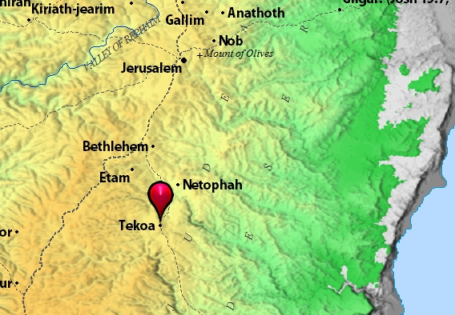

Slide 4
Date
According to 1:1, Amos prophesied during the days of Uzziah, king of Judah (767-740 B.C.), and Jeroboam II, king of Israel (793-752 B.C.).
Overlapping years, then, would be 767-752 B.C.
Both Israel and Judah were enjoying great material prosperity at this time, and we see that reflected in Amos’ prophecy.
Uzziah’s reign is described in 2 Kgs. 15; 2 Chron. 26; Jeroboam II’s reign is described in 2 Kgs. 14:23-29.

Slide 5
Target of His Message
Amos preached away from home—he was from Judah, but his principal target was the northern kingdom of Israel (although other nations are targeted at the beginning of his prophecy).
Amaziah to Amos: “Go, you seer! Flee to the land of Judah. There eat bread, and there prophesy. But never again prophesy at Bethel, for it is the king’s sanctuary, and it is the royal residence” (7:12-13).

Slide 6
Outline
Judgment on the nations, including Judah and Israel (1-2).
Three sermons, which detail Israel’s sins and describe the judgment to come upon them (3-6, each begins with “hear this word” in 3:1, 4:1, and 5:1).
Five visions, which give a picture of Israel’s judgment: (1) locusts, (2) fire, (3) plumb line, (4) basket of summer fruit, (5) Lord standing by the altar (7-9).

Slide 7
The Thunderous Voice of God
What a powerful introduction to Amos’ message! (1:2).
Look at everything He says He will do to these various nations—can’t help but fear and tremble!
“A lion has roared! Who will not fear? The Lord God has spoken! Who can but prophesy?” (3:8).

Slide 8
Judgment on Surrounding Nations
1:3-2:3: Judgment is announced against 6 nations. Which three are related to God’s chosen people?
Edom, Ammon, Moab
Which three are not?
Damascus (Syria); Philistia (names four different cities); Tyre (Phoenicia)
Sins: cruelty in war, involvement in slave trade, hatred toward Israel, vengeance

Slide 9
Judgment on Judah (s. kingdom)
For what reasons, according to 2:4-5?

Slide 10
Judgment on Israel (n. kingdom)
With what specific sins are they charged, in 2:6-8?
Injustice, oppression of the poor, immorality (probably connected to idolatrous feasts), false worship, etc.

Slide 11
Your Cup Runs Over
“For three transgressions…and for four”—what’s that all about?
Full and complete—their cup of iniquity was full.

Slide 12
“But where are the nine?” (Lk. 17:17).
Ingratitude—isn’t that the point in 2:9-12?

Slide 13
No Escape
No matter how skillful, swift, strong, mighty, or courageous you are (2:13-16).

Slide 14
Privilege and Responsibility
With greater privilege comes greater ____________?
Look at 3:1-2.

Slide 15
Punishment is Coming
3:11-15.

Slide 16
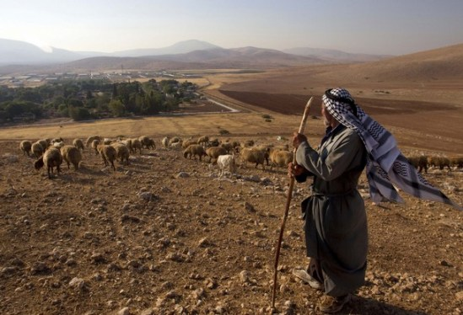
Minor Prophets—Lesson 8
Review
Amos 4-6

Slide 17
Review
“I was no prophet, nor was I a son of a prophet, but I was a sheep breeder and a tender of sycamore fruit. Then the Lord took me as I followed the flock, and the LORD said to me, ‘Go, prophesy to My people Israel’” (7:13-14).
He preached against Syria, Philistia, Tyre, Edom, Moab, Ammon, and Judah, but his main audience was Israel, the northern kingdom (although there may be times when he speaks to both Israel and Judah).

Slide 18
Review
He preached during prosperous times for both Israel and Judah, during the reigns of Jeroboam II in Israel, and Uzziah in Judah.
He preached to people whose cup of iniquity was overflowing: injustice, oppression of the poor, robbery, violence, immorality, idolatry, false worship, etc.
What magnified their iniquity was the fact God had chosen them from all the families of the earth and had blessed them in so many ways.

Slide 19
Questions
Who are these “cows (“kine”—ASV, KJV) of Bashan,” described in 4:1-3?

Slide 20
Questions
“Come to Bethel and transgress, at Gilgal multiply transgressions…” (4:4-5). Is God actually encouraging them to sin?

Slide 21
Questions
What phrase is repeated five times in 4:6-11?

Slide 22
Questions
Therefore, what?
Says who, according to 4:13?

Slide 23
Questions
Explain the phrase, “the virgin of Israel,” in 5:2. It’s because she was pure, right?

Slide 24
Questions
Any hope they might “live”? (5:4-6, 14-15, see also 5:8).

Slide 25
Questions
All they had unjustly taken from the poor (5:11-12)—would they be able to enjoy it?

Slide 26
Questions
“For I will pass through you…” (5:17). How is this different from what the Lord promised Israel when He struck Egypt with the 10th plague? (Ex. 12:13).

Slide 27
Questions
“Woe to you who…” (5:18).

Slide 28
Questions
What was the Lord’s attitude toward their feast days, assemblies, various offerings, and the music they played? (5:21-23).
What two things in particular was the Lord looking for in them, according to 5:24?

Slide 29
Questions
The “woe” beginning in 6:1—to whom is it addressed?

Slide 30
Questions
Who would get to go the head of the line? (6:3-7, esp. v. 7).

Slide 31
Questions
So many dead bodies from this destruction that they would be forced to do what? (6:10).

Slide 32
Questions
“Do horses run on rocks? Does one plow there with oxen?” (6:12). What’s the point?

Slide 33
Minor Prophets—Lesson 9
Review of Amos 1-6, using N.T. passages
Discussion of Amos 7-9

Slide 34
Review
“It is a fearful thing to fall into the hands of a living God” (Hebrews 10:31)—just ask Syria, Philistia, Phoenicia, Edom, Ammon, Moab, Judah, and Israel.
“Come now, you rich, weep and howl for your miseries that are coming upon you” (James 5:1)—not because they were rich, but because they had abused the poor (just like many in Israel had done).
“Beware of covetousness, for one’s life does not consist in the abundance of the things he possesses” (Luke 12:15).

Slide 35
Review
“Behold what manner of love the Father has bestowed on us that we should be called children of God” (1 Jn. 3:1)—yes a great privilege, but also a great responsibility (“you only have I known of all the families of the earth”— Amos 3:2).
“Of how much worse punishment, do you suppose, will he be thought worthy who has trampled the Son of God underfoot, counted the blood of the covenant by which he was sanctified a common thing, and insulted the Spirit of grace?” (Hebrews 10:29)—likewise Israel showed contempt for the blessings God gave them.

Slide 36
Review
“He who feeds on Me will live because of Me” (John 6:57)—recall that Amos urged God’s people to seek the Lord and live, to seek good and not evil.
“The crown of righteousness, which the Lord, the righteous judge, will give to me on that Day, and not to me only but also to all who have loved His appearing” (2 Tim. 4:8)—nothing wrong with desiring that Day IF we are right with the Lord. Sadly, that was NOT the case with Israel.

Slide 37
Review
“Hypocrites! Well did Isaiah prophesy about you, saying, ‘These people draw near to Me with their mouth, and honor Me with their lips, but their heart is far from Me. And in vain they worship Me, teaching as doctrines the commandments of men” (Matthew 15:7-9)—this passage highlights some of the very problems Israel had.
“The Lord is not slack concerning His promise, as some count slackness, but is longsuffering toward us, not willing that any should perish but that all should come to repentance” (2 Peter 3:9)—likewise showed longsuffering to Israel.

Slide 38
Overview of Chapters 7-9
These chapters feature five visions, all revealed to Amos by the Lord, and all depicting in some way the judgment to come upon Israel.
How are the first 2 different from the last 3?
The revelation of these visions is interrupted in 7:10-17, when ________, the priest of Bethel, tries to silence _____ (quite an exchange between these 2).

Slide 39
The First Two Visions (7:1-6)
What does the Lord GOD show Amos in the first two visions?
And how did Amos respond to both visions?
How did the LORD respond to Amos’ prayers of intercession?

Slide 40
The Third Vision (7:7-9)
In this vision Amos sees the LORD standing on a wall, with a plumb line in his hand. What is the purpose of a plumb line?
Acts 2:40: “Save yourselves from this crooked generation” (ESV). (See also Philippians 2:15).
First 2 visions: “it shall not be.” Now: “I will not ________________”
Note the specific words of judgment in v. 9.

Slide 41
Amaziah’s Complaint (7:10-17)
Amaziah first directs his complaint to Jeroboam, the king of Israel, and then speaks directly to Amos.
What does Amaziah “encourage” Amos to do?
Any indication Amos was motivated by “bread,” that he was a “hireling”? See John 10:12.
What dire consequences does Amos prophesy for Amaziah?

Slide 42
The Fourth Vision (8:1-14)
How would “a basket of summer fruit” be a fitting picture of Israel’s judgment?
Why were they in such a hurry to get the “New Moon” and “Sabbath” over?
Used measures smaller than the standard—“making the ephah small,” and then overcharged for the smaller amount—“and the shekel large” (8:5).
Their mourning was compared to what? (8:10).
What kind of famine will the Lord send? (8:11-14).

Slide 43
The Fifth Vision (9:1-10)
Amos sees the Lord standing by the altar, and then hears Him speak—what He says seems to indicate that what Israel has built is going to come crashing down on them (9:1).
Will there be any place of escape?
Would any be spared? (9:8-10).

Slide 44
Message of Hope (9:11-15)
The tabernacle or house of David (the rule of David’s house) departed from Israel when they left the kingdom, and ended for Judah when Coniah was carried away into captivity (Jeremiah 22:24-30).
“None of his descendants shall prosper, sitting on the throne of David, and ruling anymore in Judah” (Jer. 22:30).
So in whom would David’s throne be restored, according to Acts 15:14-18?
Notice the abundance of blessings—illustrated by planting and harvesting overtaking one another (9:13).

