Slide 1
Major Events of the Bible
creation
fall of man
flood
God’s covenant with Abraham
giving of the law/10 commandments
Christ- birth, life, death, resurrection, & ascension
establishment of the church

Slide 2
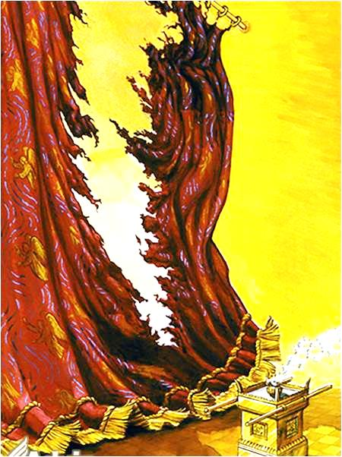
yj
The Tearing of the Veil

Slide 3
The veil’s…
purpose then
significance now
divider between the holy place and Most Holy Place
barrier between God and sinful man
barrier removed through Christ’s death
pathway to heaven now open

Slide 4
Old Covenant | New Covenant
Numerous sacrifices of bulls and goats. | One sacrifice- Christ’s own sinless blood.
Veil was a barrier between God and sinful man. | Christ (the veil) is the pathway to God and heaven.
Consequence of breaking the barrier was death. | It took Christ’s death to break the barrier (tear the veil).
No one could follow the high priest into the Most Holy Place. | All can follow Christ (our High Priest) into heaven (Most Holy Place).

