Slide 1
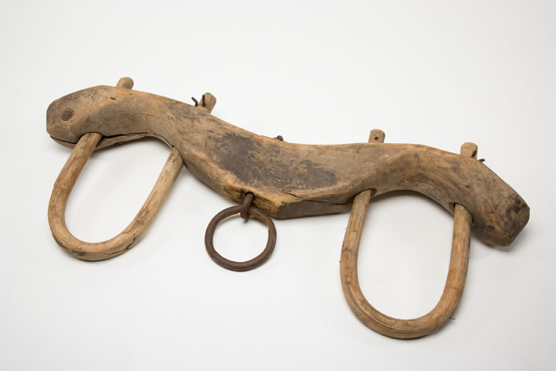
What part has a believer with an unbeliever?
2 Corinthians 6:15

Slide 2
NONE!
2 Corinthians 6:14-16
2 Corinthians 7:1
Proverbs 4:14-15

Slide 3
Relationships with unbelievers
We cannot and should not cut off all contact with unbelievers (salt, light).
1 Cor. 5:9-10; 10:27.
Our aim is to win them to the Lord— 1 Cor. 9:19-22; 14:23-24.
There can be a sinful separation from sinners, as with the Pharisees.

Slide 4
Relationships with unbelievers
Sinful separation:
“This man, if He were a prophet, would know who and what manner of woman this is who is touching Him, for she is a sinner” (Luke 7:39).
“This man receives sinners and eats with them” (Luke 15:2).

Slide 5
Relationships with unbelievers
Let’s be careful in trying to save others’ souls that we don’t lose our own.
Jude 1:22-23.
The yoke can become so unequal that they lead us away.
Titus 1:10-11; 2 John 1:9-11.

Slide 6
Relationships with unbelievers
We need to maintain the upper hand in our relationships with them.
Make sure we shine our light (Matt. 5:14-16; Eph. 5:11-14), that they know and respect our convictions.
Paul’s example: Acts 19:29-31; 27:1, 3, 43; 28:16.

Slide 7
Relationships with unbelievers
Do we have the “upper hand”?
Do we feel free to speak our convictions?
Do we ever steer the conversation away from spiritual things?
Do they know what they shouldn’t try to talk us into?
Have we made them better, or have they made us worse?
Why do we enjoy their friendship?

Slide 8
Relationships with unbelievers
Respect the warnings given in the Bible.
1 Corinthians 15:33; Proverbs 12:26; 22:24-25.
These warnings apply to both personal and online relationships.
Parents, we need to heed these warnings for ourselves and for our children.

Slide 9
Relationships with unbelievers
Prefer the company of believers.
A good gauge of one’s spirituality.
Prefer them for the good they can do us—Prov. 13:20.
Only among believers can we enjoy scenes like these: Acts 20:26-38; 21:3-6; 28:13-15.

