Slide 1
What about the
“Lost Gospels” ?

Slide 2

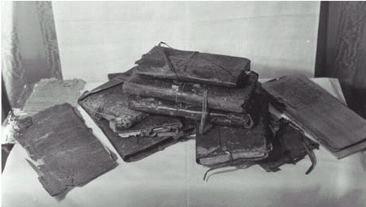
a.) What the issue is not (John 20:30; etc.)
b.) One example of pseudepigrapha popularized
in the “The LOST BOOKS OF THE BIBLE” 1926
(ridiculous / not taken seriously)
c.) A detailed look at the Nag Hammadi
“gospels,” etc., found in the 1940’s
(also ridiculous, but presented as serious)
d.) the gospel of Luke:
a contrast from a HISTORICAL view
permission: Institute For Antiquity And Christianity, Claremont, California

Slide 3
Did Jesus
(and his apostles & prophets)
say and do things
we don’t have a record of?
NOTE
the issue at hand is not:

Slide 4
John 20:30 ESV Now Jesus did many other signs in the presence of the disciples, which are not written in this book;
actions & words
Acts 2:40 ESV And with many other words he bore witness and continued to exhort them
Luke 1:1 ESV many have undertaken to compile a narrative of the things that have been accomplished among us
1 Cor. 5:9 ESV I wrote to you in my letter
writings and letters
Col. 4:16 ESV And when this letter has been read among you, have it also read in the church of the Laodiceans; and see that you also read the letter from Laodicea. (poss. Eph.?)

Slide 5
a.) What the issue is not (John 20:30; etc.)
b.) One example of pseudepigrapha popularized
in the “The LOST BOOKS OF THE BIBLE” 1926
(ridiculous / not taken seriously)
c.) A more detailed look at the Nag
Hammadi “gospels,” etc., found in the 1940’s
(also ridiculous, but presented as serious)
d.) the gospel of Luke:
a historical contrast
permission: Institute For Antiquity And Christianity, Claremont, California

Slide 6

1926
1979

Slide 7
The Infancy Gospel of Thomas
From "The Apocryphal New Testament“ M.R. James-Translation and Notes Oxford: Clarendon Press, 1924
http://gnosis.org/library/inftoma.htm
I, Thomas the Israelite, tell unto you, even all the brethren that are of the Gentiles, to make known unto you the works of the childhood of our Lord Jesus Christ…

Slide 8
The Infancy Gospel of Thomas
From "The Apocryphal New Testament“ M.R. James-Translation and Notes Oxford: Clarendon Press, 1924
http://gnosis.org/library/inftoma.htm
This little child Jesus when he was five years old was playing at the ford of a brook: and he gathered together the waters that flowed there into pools … And having made soft clay, he fashioned thereof twelve sparrows…
Jesus clapped his hands together and cried out to the sparrows and said to them: Go! and the sparrows took their flight and went away chirping...

Slide 9
The Infancy Gospel of Thomas
From "The Apocryphal New Testament“ M.R. James-Translation and Notes Oxford: Clarendon Press, 1924
http://gnosis.org/library/inftoma.htm
But the son of Annas the scribe was standing there with Joseph; and he took a branch of a willow and dispersed the waters which Jesus had gathered together. And when Jesus saw what was done, he was wroth and said unto him: O evil, ungodly, and foolish one, what hurt did the pools and the waters do thee? behold, now also thou shalt be withered like a tree, and shalt not bear leaves, neither root, nor fruit. And straightway that lad withered up wholly, but Jesus departed and went unto Joseph's house…

Slide 10
The Infancy Gospel of Thomas
From "The Apocryphal New Testament“ M.R. James-Translation and Notes Oxford: Clarendon Press, 1924
http://gnosis.org/library/inftoma.htm
After that again he went through the village, and a child ran and dashed against his shoulder. And Jesus was provoked and said unto him: Thou shalt not finish thy course. And immediately he fell down and died… And the parents of him that was dead came unto Joseph, and blamed him, saying: Thou that hast such a child canst not dwell with us in the village: or do thou teach him to bless and not to curse: for he slayeth our children.
And Joseph called the young child apart and admonished him… But Jesus said: I know that these thy words are not thine: nevertheless for thy sake I will hold my peace: but they shall bear their punishment. And straightway they that accused him were smitten with blindness.

Slide 11
but that is not what
people usually mean
when they say
“the Lost Gospels”

Slide 12
a.) What the issue is not (John 20:30; etc.)
b.) One example of pseudepigrapha popularized
in the “The LOST BOOKS OF THE BIBLE” 1926
(ridiculous / not taken seriously)
c.) A more detailed look at the Nag
Hammadi “gospels,” etc., found in the 1940’s
(also ridiculous, but presented as serious)
d.) the gospel of Luke:
a historical contrast
permission: Institute For Antiquity And Christianity, Claremont, California

Slide 13
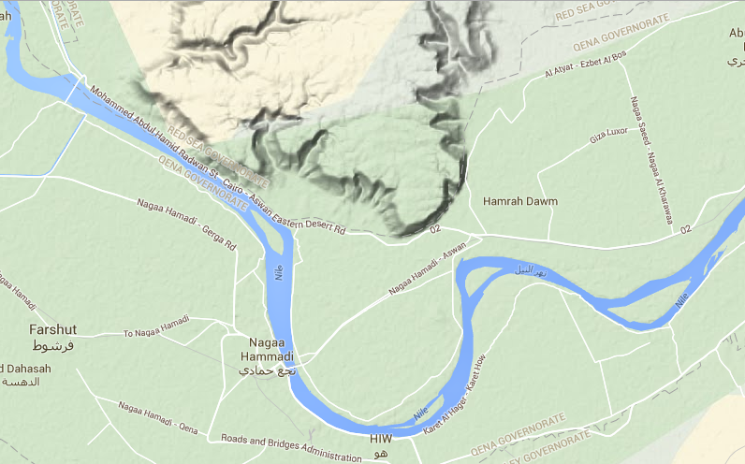
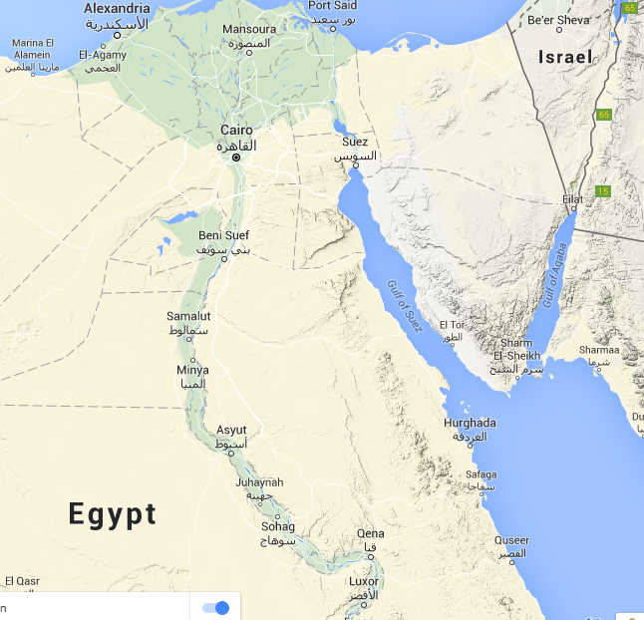
Berlin / Akhmim codex [pur.1896]
Gospel of Mary / Apocr. of John / Sophia of Jesus / Act of Peter
Gospel of Peter 1886
Akhmim
Nag Hammadi codices 1945
Nag Hammadi

Slide 14
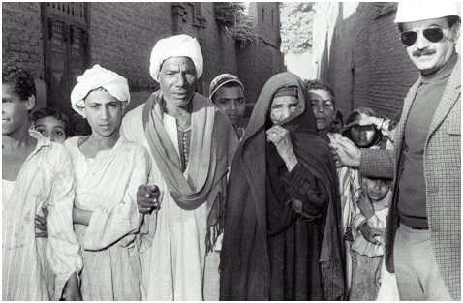
by permission:
Institute For Antiquity And Christianity, Claremont, California

Slide 15
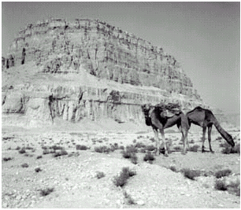
by permission:
Institute For Antiquity And Christianity, Claremont, California

Slide 16
Nag Hammadi Library
1945
permission:
Institute For Antiquity And Christianity, Claremont, California

Slide 17
DaVinci Code: The historian on NH& DSS
“These are photocopies of the Nag Hammadi and Dead Sea Scrolls, which I mentioned earlier,” Teabing said. “The earliest Christian records. Troublingly, they do not match up with the gospels in the Bible.” pg.266

Slide 18
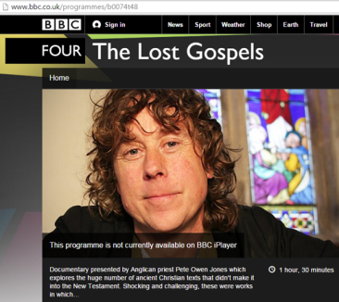
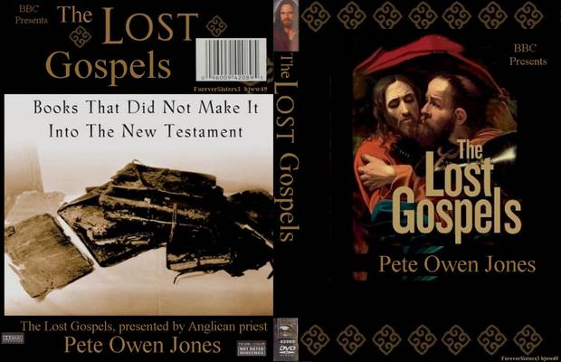
The Lost Gospels – BBC documentary brdcst: 2008/10

Slide 19
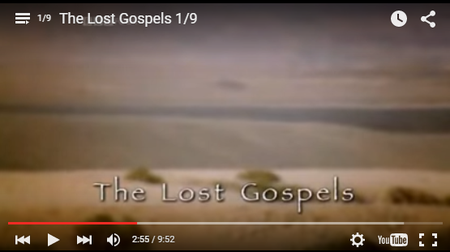
https://www.youtube.com/watch?v=-L7cQ3BrD5U&feature=player_embedded

Slide 20
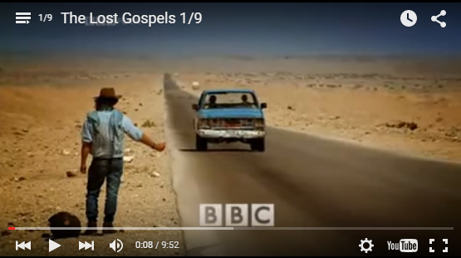
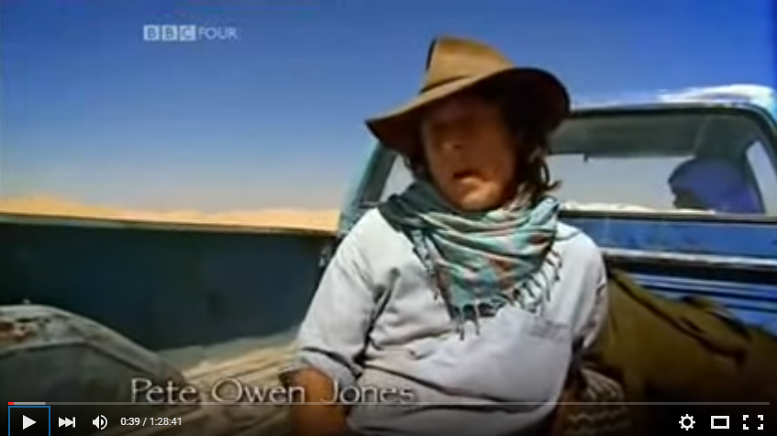
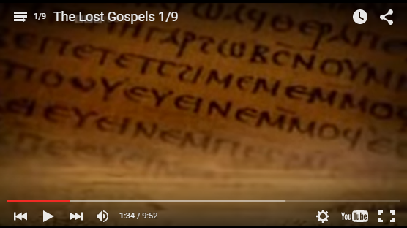
It was when I went hitch hiking as a teenager that I first read the NT… the driver who picked me up was a Christian, and we got talking. He said if I wanted to find out about God, I should read the gospels… and when I got home I read the four gospels, Mt, Mk. Lk. and John… That day was the first step on a journey that led to my ordination as a priest in the Church of England.
But what I didn’t know then, is that these gospels are only a fraction of the information we have about Jesus.
In fact … discoveries here in the Egyptian deserts have revealed that in the first 400 yrs after Jesus’ death there were in existence more than 20 gospels … and …other texts about Jesus. So why do we only know of the ones in the NT?

Slide 21
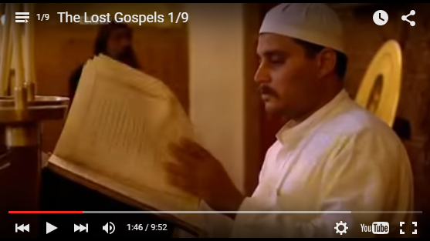
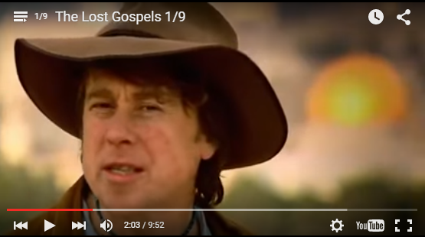
This is the story of a battle of words …
A battle in which texts fought against each other for acceptance in a fledgling faith.
If the gospel of Peter had won out, Christians today might believe that Jesus had never died. If the gospel of Philip had won, Mary Magdelene might have been hailed as the first pope. If the infancy narrative of James had been accepted, I would have learned in Sunday School that a child named Jesus caused his teacher to wither on the spot just for reprimanding him in class.

Slide 22
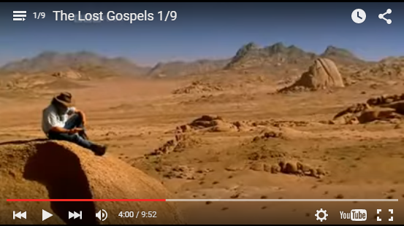
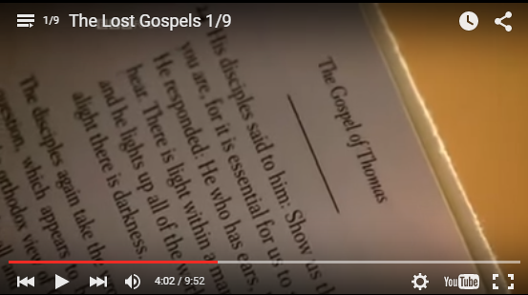
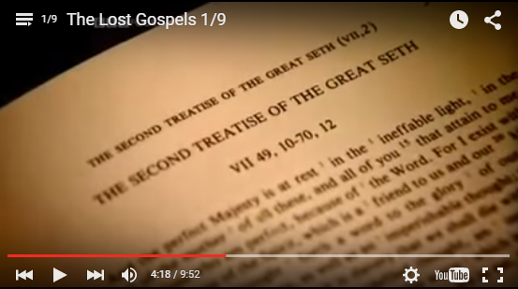
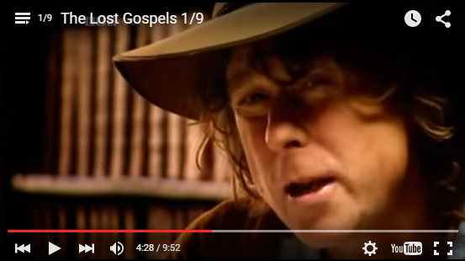
This film is my journey
to uncover this treasure trove
of lost literature.
These lost gospels were discarded by the leaders of the early church as heretical, and were left out of the NT.
These texts have reawakened in me a new fascination in Christianity

Slide 23
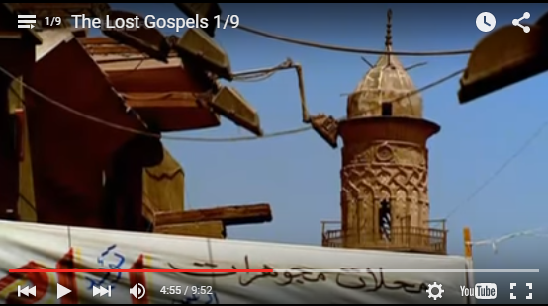
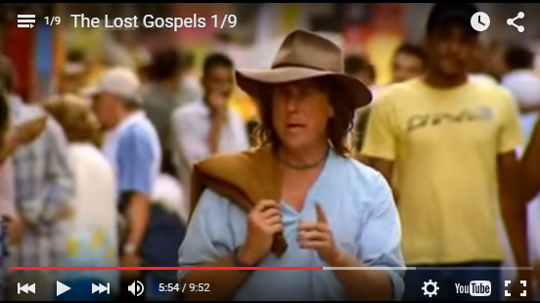
My Journey begins in Egypt.
…Alexandria was home to Athanasius: one of the most powerful and colorful bishops in Christian history, who lived and worked in the city in the 4th c. A.D…. He wrote every year to all the Christians in his jurisdiction, to tell them when to celebrate Easter…
In his 39th letter, written in 367 AD, he had something more controversial to say. What Athanasius included in his letter was a list… he named the 27 books which we now know make up the canon of NT scripture. And he made it clear, he made it very clear, that it was these, and only these, that the church approved of as scripture. Any other book, he said, should not be read.
At a single stroke he condemned a wealth of literature that had, up until that point, been regarded as Christian.

Slide 24
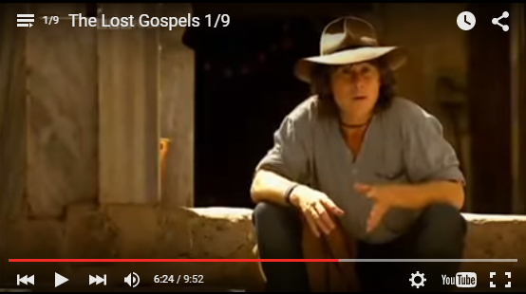
The gospels of Mt, Mk., Luke, and John were permitted. But those of Mary, Philip and Peter were condemned.
The Acts of the Apostles was considered to be educational, but the Acts of Tecla, were shunned.
The first and second letters of Paul to the Corinthians were allowed, but I’m afraid the 3rd one, didn’t make it.

Slide 25
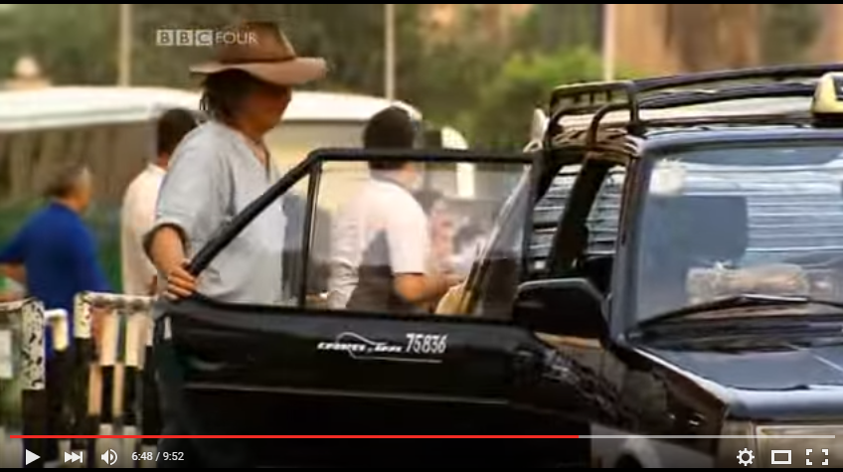
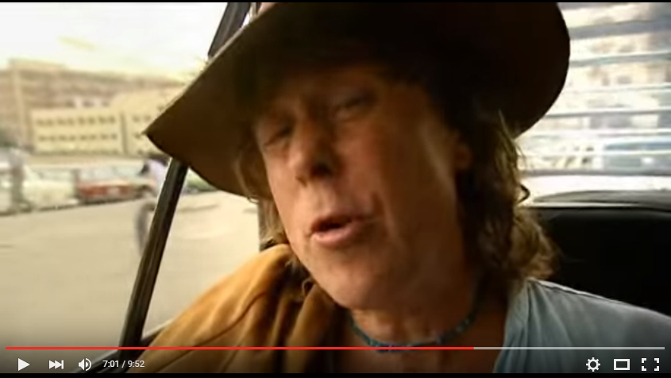
Athansius’ edict was remarkable because it was the first time any one in the church’s top echelons of the church hierarchy had suggested only certain books would be tolerated.
After nearly 2,000 yrs those texts … remained a complete mystery to us, really, all we have are scant references to them, found in the writings of their enemies, the early church fathers, who only mentioned them purely to condemn them...
And perhaps, this might have remained the case, if it wasn’t for a chance find in December, 1945, a discovery that forced scholars to completely rethink the nature of early Christianity.

Slide 26
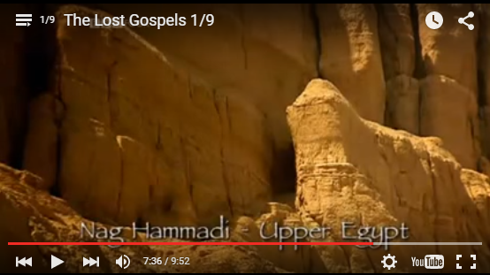
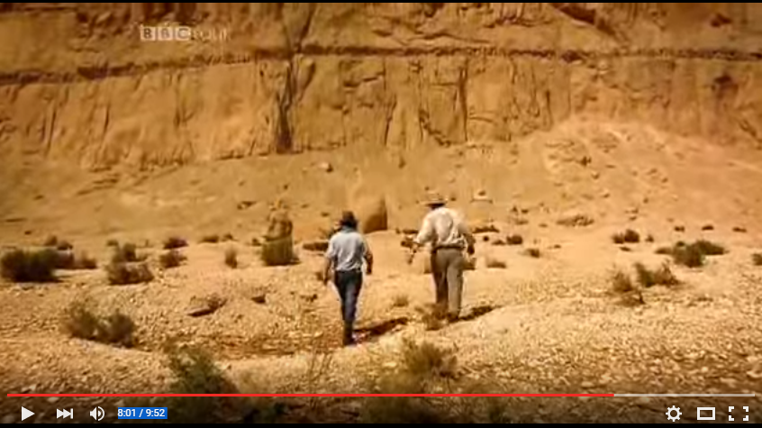
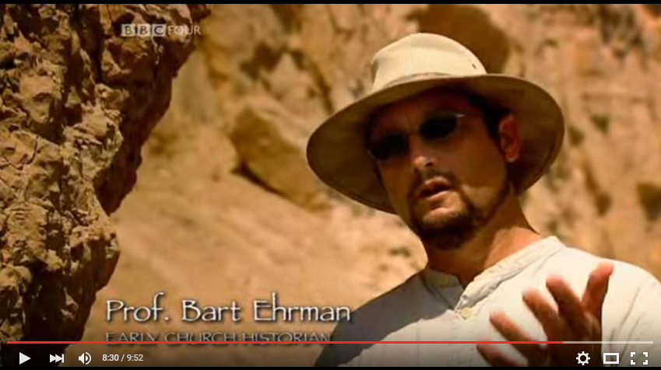
[B.E.]: “Well, this is where they discovered the manuscripts. There were 7 farm hands from the nearby village… out digging for…a nitrate rich soil in this area … one of them hit something in the ground …it was a skeleton, next to the skeleton, they found a jar, an earthenware jar … they were afraid to open the jar because they thought, uh, there might be an evil genie inside… after some reflection, they realized there might be gold inside, and so they smashed into it with their mattocks, and uh, there wasn’t gold or genie, there were, uh, some codices, some books.”

Slide 27
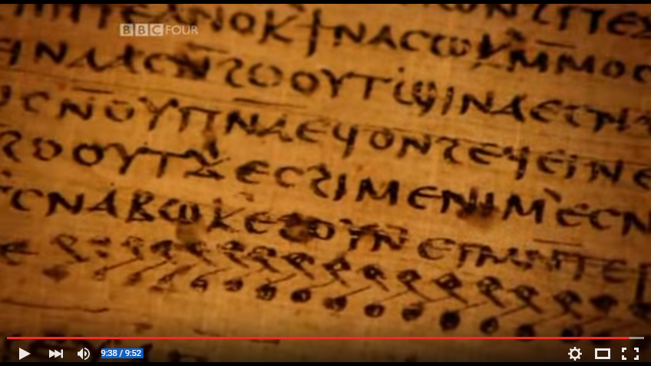
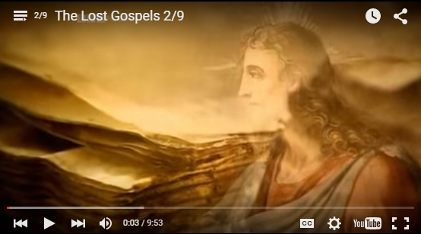
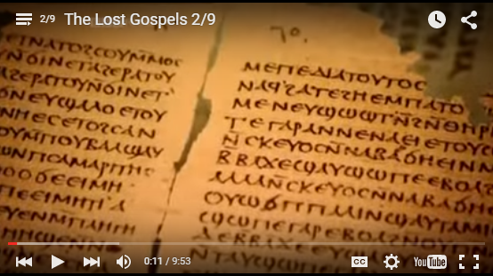
The books formed the most significant collection of lost Christian writings. The manuscripts date from the 4th century, but some scholars believe they may have been composed much earlier. They include several gospels about Jesus, but the man they describes is unrecognizable from the man described in the traditional books of the NT.
This was a Jesus that didn’t die, who took revenge on his enemies, and who kissed Mary Magdalene on the mouth. These were shocking and challenging texts, never before seen by a western scholar.
And although it was known they’d existed in antiquity, they’d been lost for nearly one and a half thousand years.

Slide 28
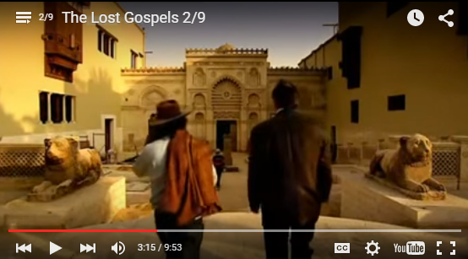
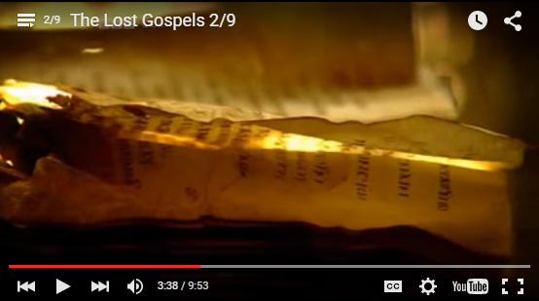
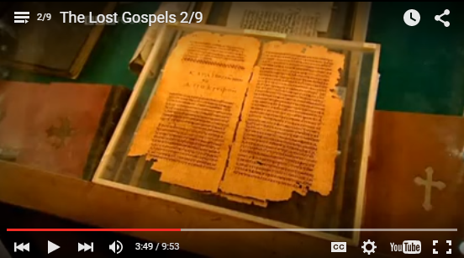
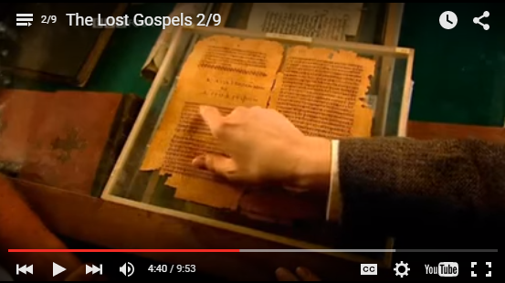
Cairo: This is the Coptic Museum, and it’s here that the Nag Hammadi Scrolls are now housed.
Amongst the mss found were many fragments of gospels not included in the NT. One such text is the Gospel of Thomas, unusual because it was discovered in entirety.
It’s attributed to, although not proven to be, the work of one of Jesus disciples… Thomas… The gospel penned in his name is a collection of 114 sayings ascribed to Jesus, written in coptic, the language of Egypt.
“These are the secret words that the living Jesus spoke, and Didymus Judas Thomas wrote them down.”

Slide 29
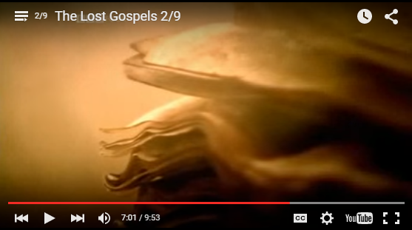
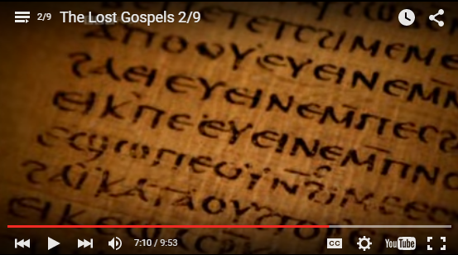
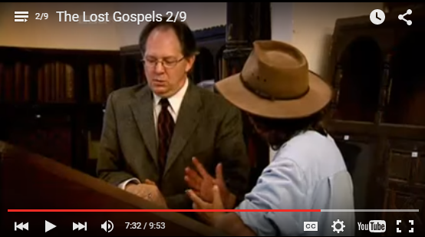
Scholarly debate has raged over the historical accuracy of Thomas’ gospel… Although the physical manuscript of Thomas can be dated to the early 4th century, there is speculation that the content of the gospel is far older. The logic goes, that if it was written in the first century, it could well be older than the canonical gospel. And if that’s the case, it’s the nearest will ever get to the historical Jesus.
So is this the earliest info about Jesus that we have?
It could be. Because this form… transmitting simply what J said, what he taught, is what scholars have for hundreds of years assumed was the more original form... So the Gospel of Thomas, certainly according to its form, could well be historically older, earlier, than any of the gospels in the Bible.
Prof. Stephen Emmel
Coptologist

Slide 30
ff to last interview…

Slide 31
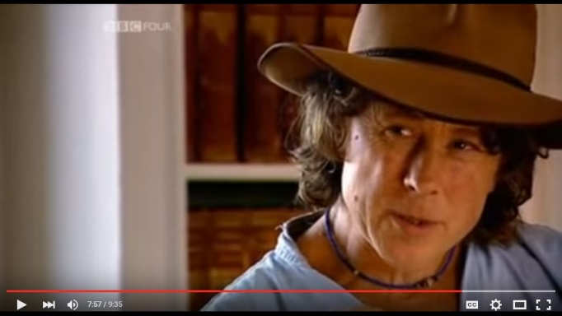
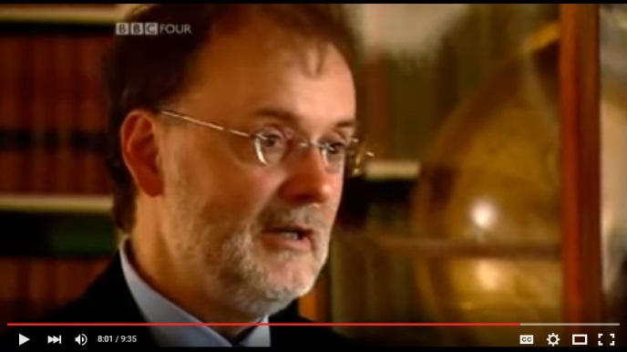
What about the gospel of Thomas, the gospel of Peter?
Gospel of Peter, Gospel of Thomas, Gospel of Mary, Gospel of Philip – all of these explicitly claim to be written by those figures and these figures are… apostolic generation figures, and yet all four of them were not included …
One of the things they had going against them was that it appears they were written, actually in their present form at least, significantly later than the canonical gospels...

Slide 32
Now let’s consider some facts…

Slide 33
In his 39th letter, written in 367 AD… he made it clear, he made it very clear, that it was these, and only these, that the church approved of as scripture. Any other book, he said, should not be read. At a single stroke he condemned a wealth of literature that had, up until that point, been regarded as Christian.
Athansius’ edict was remarkable
because it was the first time any one in
the church’s top echelons of the church hierarchy had suggested only certain
books would be tolerated.

Slide 34
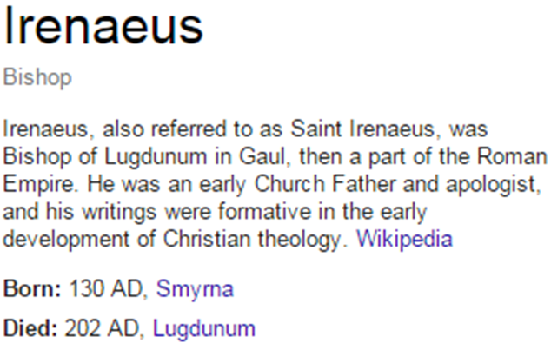
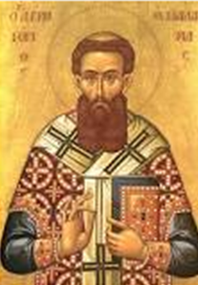
AGAINST HERESIES Bk.3 .11.8
ca. 180 A.D.
It is not possible that the Gospels can be either more or fewer in number than they are. For, since there are four zones of the world in which we live, and four principal winds, while the Church is scattered throughout all the world, and the "pillar and ground" of the Church is the Gospel and the spirit of life; it is fitting that she should have four pillars … the Gospel under four aspects, but bound together by one Spirit. www.earlychristianwritings.com/text/irenaeus-book3.html

Slide 35

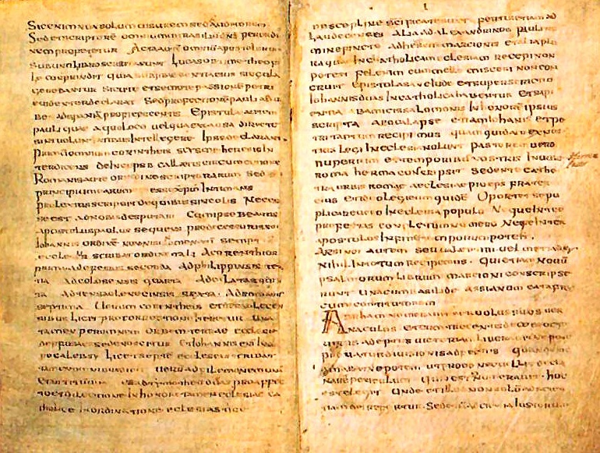
THE MURATORIAN FRAGMENT orig. from ca. 170 AD.
contains a copy of a text from c. 170 AD:
“Hermas wrote The Shepherd very recently, in our times,
in the city of Rome, while bishop Pius, his brother, was occupying the chair of the church of the city of Rome.”
EXTANT MANUSCRIPT
discovered in Italy by
Ludovico
Antonio
Muratori
in Italy and published
in 1740
ca.
170 AD
c.7th
cent.
died 157
The third book of the Gospel is that according to Luke. Luke, the well-known physician … composed it in his own name, according to [the general] belief… The fourth of the Gospels is that of John, [one] of the disciples.
Tr.: Metzger

Slide 36
Nag Hammadi Library
1945
permission:
Institute For Antiquity And Christianity, Claremont, California

Slide 37
Nag Hammadi Library
Addit. Mss
Pr. of Ap. Paul
Apoc. of James
Gos. of Truth (2)
Treat. on Resur.
Tripartite Tractate
Apoc. of John (4)
Gos. of Thomas
Gos. of Philip
Hypostasis of Arch.
Origin of World (2)
Exeg. on the Soul
Thomas the Cont.
Gos. of Egyptians
Eugnostos (2)
Sophia J.C. (cf. BC)
Dial. Savior
Apoc. of Paul
1 Apoc. of Ja.
2 Apoc. of Ja.
Apoc. of Adam
Acts of Ptr & 12
Thunder, perf mind
Auth. Teaching
Cncpt. of Grt Power
Plato, Republic
Dicourses on 8th 9th
Pr Thanks w/scr nt
Asclepius 21-29
Paraph. of Shem
2 Tr. of Grt Seth
Apoc. of Peter
Teach of Silvanus
3 Steles of Seth
Zostrianos
Ep. of Ptr to Philp
Melchizedek
Thought of Norea
Test. Of Truth
Marsanes
Interp. Knowledge
Valent. Exposition
  on baptism A
  on baptism B
  on Eucharist A
  on Eucharist B
Allogenes
Hypsiphrone
Sentences Sextus
Hypsiphrone
Sentenc. of Sextus
Fragments
Trim. Protennoia
BERLIN
CODEX
Gos. of Mary
Apoc. of John
Sophia J.C.
Act of Ptr
1896
Gos.
of Peter
[disc. in Akhmim
1886]

Slide 38
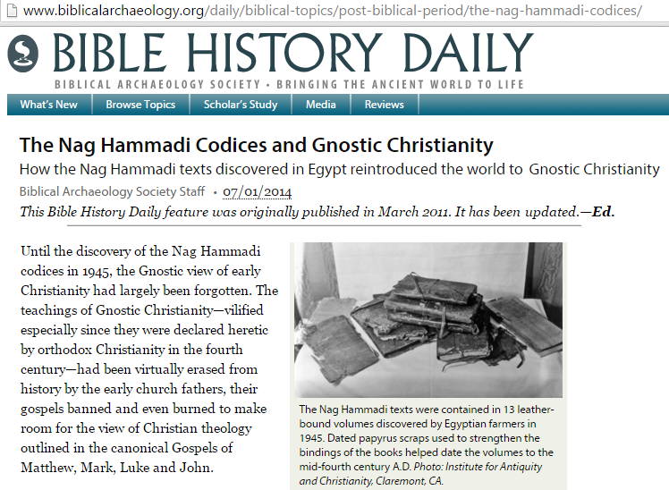
dates from cartonnage
within bindings of Cod. VII:
341 A.D.
346 A.D.
348 A.D.
Nag Hammadi Library
J.M. Robinson;
pg.16
Dated papyrus scraps used to strengthen the bindings of the books helped date the
volumes to the
mid-fourth century A.D.

Slide 39
Nag Hammadi Texts
written later, not apostolic
unreliable
contradict not only NT but also Gen.
contents include: polytheism & nonsense

Slide 40
Gnostic “gospel of Philip”
Later production, clearly written after earlier accounts:
The apostles who were before us had these names for him: “Jesus, the Nazorean, Messiah,” GOP.62
“the Samaritan gave nothing but wine and oil to the wounded man” GOP.78
“That is why the word says, “Already the ax is laid at the root of the trees” GOP.83

Slide 41
Gnostic “apoc. of John”
Contradictions not ltd. to the NT.
Sheds “new info” not just on events from the first century
– but from thousands of years earlier as well:
“Not as Moses said”
again & again.
Example:
How did Noah escape the flood?
It is not as Moses said, ‘They hid themselves in an ark.’ but they hid themselves in a place, not only Noah, but many other people … They went into a place and hid themselves in a luminous cloud.
- Apoc. Of Jn. .29

Slide 42
Substitutes from writing
&
“puts the words in Jesus’ mouth”…

Slide 43
Eugnostos, the Blessed, to those who are his.
Rejoice in this, that you know. Greetings!
I want you to know that all men born from the foundation of the world until now are dust. While they have inquired about God, who he is and what he is like, they have not found him.
The wisest among them have speculated about the truth from the ordering of the world.
And the speculation has not reached the truth.
For the ordering is spoken of in three (different) opinions by all the philosophers; hence they do not agree.
I want you to know that all men born
from the foundation of the world until now are dust. While they have inquired about God,
who he is and what he is like, they have not found him.
The wisest among them have speculated
about the truth from the ordering of the world.
And the speculation has not reached the truth.
For the ordering is spoken of
in three (different) opinions
by all the philosophers;
hence they do not agree…
After he rose from the dead, his twelve disciples and seven women continued to be his followers …the Savior appeared … And he said: "Peace be to you, My peace I give you!" And they all marveled and were afraid. The Savior laughed and said to them: "What are you thinking about? Are you perplexed? What are you searching for?"
Philip said: "For the underlying reality of the universe and the plan."
The Savior said to them:
"I want you to know that all men are born on earth from the foundation of the world until now, being dust, while they have inquired about God,
who he is and what he is like, have not found him.
Now the wisest among them have speculated
from the ordering of the world and (its) movement.
But their speculation has not reached the truth.
For it is said that the ordering is
directed in three ways,
by all the philosophers, (and)
hence they do not agree…
text
from
Eugnostos
the blessed
reset in this text as Sophia of Jesus
“Eugnostos begins as a formal letter written by a teacher…
It is without apparent Christian influence…it was used by a Christian gnostic editor as he composed the Sophia of Jesus Christ.”
Placing the two tractates together…allows one to see the process by which a non-Christian tractate was modified…into a Christian gnostic one.
D.M.Parrott; Intro & Tr.
The Nag Hammadi Library
J.M.Robinson Ed.
"I want you to know that all men are born on earth from the foundation of the world until now, being dust, while they have inquired about God,
who he is and what he is like, have not found him.
Now the wisest among them have speculated
from the ordering of the world and (its) movement.
But their speculation has not reached the truth.
For it is said that the ordering is
directed in three ways,
by all the philosophers, (and)
hence they do not agree…

Slide 44
some general gnostic traits...
    appeal to special “knowledge”
    mystic / secrets
    knowledge of “deep” things
    many levels of deities and powers
    the creator of this world was evil
    salvation through “knowledge”
    some ascetic / some promiscous

Slide 45
Some of the N.T. references to gnosticism:
Col. 2:18
“worship of angels, taking his stand on visions he has seen, inflated without cause by his fleshly mind”
2 Tim.2:17-18
“Hymenaus and Philetus, men who have gone astray from the truth saying that the resurrection is past already”
2 Jn.7
“those who do not acknowledge Jesus Christ as coming in the flesh”
2Tim.6:20
“avoiding worldly and empty chatter and the opposing arguments of what is falsely called ‘knowledge’ ”

Slide 46
Gnostic “apoc. of John”
From the intro to Apoc. Of John, by Frederick Wisse The Nag Hammadi Library, J. Robinson, Harper & Rowe
Sophia, consort of the Great Spirit, wanted to reproduce.
She does so w/o consent of her consort.
The result was that “something came out of her which was imperfect and different…”
When she saw … I “it changed into a form of a lion-faced serpent … She cast it away from here … that no one of the immortals might see it, for she had created it in ignorance.”
“And she called his name Yaltabaoth.”

Slide 47
Gnostic “gospel of Philip”
Some said, “Mary conceived by the holy spirit.” They are in error. J 55.23-24
Those who say that the lord died first and (then) rose up are in error, for he rose up first and then died. J56.16-19
Those who say they will die first and then rise are in error. 73

Slide 48
continuing now with the
MOST CELEBRATED of the Nag Hammadi texts…

Slide 49
Gnostic “gospels” ?
    The “Gospel of Thomas” …

Slide 50
GOSPEL OF THOMAS (114 sayings):
These are the secret sayings which the living Jesus spoke and which Didymos Judas Thomas wrote down.
(1) And he said, "Whoever finds the interpretation of these sayings will not experience death."
(2) Jesus said, "Let him who seeks continue seeking until he finds. When he finds, he will become troubled. When he becomes troubled, he will be astonished, and he will rule over the All."
(3) Jesus said, "If those who lead you say to you, 'See, the kingdom is in the sky,' then the birds of the sky will precede you. If they say to you, 'It is in the sea,' then the fish will precede you. Rather, the kingdom is inside of you, and it is outside of you. When you come to know yourselves, then you will become known, and you will realize that it is you who are the sons of the living father. But if you will not know yourselves, you dwell in poverty and it is you who are that poverty."
(4) Jesus said, "The man old in days will not hesitate to ask a small child seven days old about the place of life, and he will live. For many who are first will become last, and they will become one and the same."
(5) Jesus said, "Recognize what is in your sight, and that which is hidden from you will become plain to you . For there is nothing hidden which will not become manifest."
(6) His disciples questioned him and said to him, "Do you want us to fast? How shall we pray? Shall we give alms? What diet shall we observe?" Jesus said, "Do not tell lies, and do not do what you hate, for all things are plain in the sight of heaven. For nothing hidden will not become manifest, and nothing covered will remain without being uncovered."
(7) Jesus said, "Blessed is the lion which becomes man when consumed by man; and cursed is the man whom the lion consumes, and the lion becomes man."
(8) And he said, "The man is like a wise fisherman who cast his net into the sea and drew it up from the sea full of small fish. Among them the wise fisherman found a fine large fish. He threw all the small fish back into the sea and chose the large fish without difficulty. Whoever has ears to hear, let him hear."
(9) Jesus said, "Now the sower went out, took a handful (of seeds), and scattered them. Some fell on the road; the birds came and gathered them up. Others fell on the rock, did not take root in the soil, and did not produce ears. And others fell on thorns; they choked the seed(s) and worms ate them. And others fell on the good soil and it produced good fruit: it bore sixty per measure and a hundred and twenty per measure."
(10) Jesus said, "I have cast fire upon the world, and see, I am guarding it until it blazes."
(11) Jesus said, "This heaven will pass away, and the one above it will pass away. The dead are not alive, and the living will not die. In the days when you consumed what is dead, you made it what is alive. When you come to dwell in the light, what will you do? On the day when you were one you became two. But when you become two, what will you do?"
(12) The disciples said to Jesus, "We know that you will depart from us. Who is to be our leader?“ Jesus said to them, "Wherever you are, you are to go to James the righteous, for whose sake heaven and earth came into being."
(13) Jesus said to his disciples, "Compare me to someone and tell me whom I am like." Simon Peter said to him, "You are like a righteous angel." Matthew said to him, "You are like a wise philosopher." Thomas said to him, "Master, my mouth is wholly incapable of saying whom you are like." Jesus said, "I am not your master. Because you have drunk, you have become intoxicated from the bubbling spring which I have measured out." And he took him and withdrew and told him three things. When Thomas returned to his companions, they asked him, "What did Jesus say to you?" Thomas said to them, "If I tell you one of the things which he told me, you will pick up stones and throw them at me; a fire will come out of the stones and burn you up."
(14) Jesus said to them, "If you fast, you will give rise to sin for yourselves; and if you pray, you will be condemned; and if you give alms, you will do harm to your spirits. When you go into any land and walk about in the districts, if they receive you, eat what they will set before you, and heal the sick among them. For what goes into your mouth will not defile you, but that which issues from your mouth - it is that which will defile you."
(15) Jesus said, "When you see one who was not born of woman, prostrate yourselves on your faces and worship him. That one is your father."
(16) Jesus said, "Men think, perhaps, that it is peace which I have come to cast upon the world. They do not know that it is dissension which I have come to cast upon the earth: fire, sword, and war. For there will be five in a house: three will be against two, and two against three, the father against the son, and the son against the father. And they will stand solitary."
(17) Jesus said, "I shall give you what no eye has seen and what no ear has heard and what no hand has touched and what has never occurred to the human mind."
(18) The disciples said to Jesus, "Tell us how our end will be." Jesus said, "Have you discovered, then, the beginning, that you look for the end? For where the beginning is, there will the end be. Blessed is he who will take his place in the beginning; he will know the end and will not experience death."
(19) Jesus said, "Blessed is he who came into being before he came into being. If you become my disciples and listen to my words, these stones will minister to you. For there are five trees for you in Paradise which remain undisturbed summer and winter and whose leaves do not fall. Whoever becomes acquainted with them will not experience death."
(20) The disciples said to Jesus, "Tell us what the kingdom of heaven is like." He said to them, "It is like a mustard seed. It is the smallest of all seeds. But when it falls on tilled soil, it produces a great plant and becomes a shelter for birds of the sky."
(21) Mary said to Jesus, "Whom are your disciples like?" He said, "They are like children who have settled in a field which is not theirs. When the owners of the field come, they will say, 'Let us have back our field.' They (will) undress in their presence in order to let them have back their field and to give it back to them. Therefore I say, if the owner of a house knows that the thief is coming, he will begin his vigil before he comes and will not let him dig through into his house of his domain to carry away his goods. You, then, be on your guard against the world. Arm yourselves with great strength lest the robbers find a way to come to you, for the difficulty which you expect will (surely) materialize. Let there be among you a man of understanding. When the grain ripened, he came quickly with his sickle in his hand and reaped it. Whoever has ears to hear, let him hear."
(22) Jesus saw infants being suckled. He said to his disciples, "These infants being suckled are like those who enter the kingdom." They said to him, "Shall we then, as children, enter the kingdom?“ Jesus said to them, "When you make the two one, and when you make the inside like the outside and the outside like the inside, and the above like the below, and when you make the male and the female one and the same, so that the male not be male nor the female female; and when you fashion eyes in the place of an eye, and a hand in place of a hand, and a foot in place of a foot, and a likeness in place of a likeness; then will you enter the kingdom."
(23) Jesus said, "I shall choose you, one out of a thousand, and two out of ten thousand, and they shall stand as a single one."
(24) His disciples said to him, "Show us the place where you are, since it is necessary for us to seek it." He said to them, "Whoever has ears, let him hear. There is light within a man of light, and he lights up the whole world. If he does not shine, he is darkness."
(25) Jesus said, "Love your brother like your soul, guard him like the pupil of your eye."
(26) Jesus said, "You see the mote in your brother's eye, but you do not see the beam in your own eye. When you cast the beam out of your own eye, then you will see clearly to cast the mote from your brother's eye."
(27) <Jesus said,> "If you do not fast as regards the world, you will not find the kingdom. If you do not observe the Sabbath as a Sabbath, you will not see the father."
(28) Jesus said, "I took my place in the midst of the world, and I appeared to them in flesh. I found all of them intoxicated; I found none of them thirsty. And my soul became afflicted for the sons of men, because they are blind in their hearts and do not have sight; for empty they came into the world, and empty too they seek to leave the world. But for the moment they are intoxicated. When they shake off their wine, then they will repent."
(29) Jesus said, "If the flesh came into being because of spirit, it is a wonder. But if spirit came into being because of the body, it is a wonder of wonders. Indeed, I am amazed at how this great wealth has made its home in this poverty."
(30) Jesus said, "Where there are three gods, they are gods. Where there are two or one, I am with him."
(31) Jesus said, "No prophet is accepted in his own village; no physician heals those who know him."
(32) Jesus said, "A city being built on a high mountain and fortified cannot fall, nor can it be hidden."
(33) Jesus said, "Preach from your housetops that which you will hear in your ear. For no one lights a lamp and puts it under a bushel, nor does he put it in a hidden place, but rather he sets it on a lampstand so that everyone who enters and leaves will see its light."
(34) Jesus said, "If a blind man leads a blind man, they will both fall into a pit."
(35) Jesus said, "It is not possible for anyone to enter the house of a strong man and take it by force unless he binds his hands; then he will (be able to) ransack his house."
(36) Jesus said, "Do not be concerned from morning until evening and from evening until morning about what you will wear."
(37) His disciples said, "When will you become revealed to us and when shall we see you?" Jesus said, "When you disrobe without being ashamed and take up your garments and place them under your feet like little children and tread on them, then will you see the son of the living one, and you will not be afraid"
(38) Jesus said, "Many times have you desired to hear these words which I am saying to you, and you have no one else to hear them from. There will be days when you will look for me and will not find me."
(39) Jesus said, "The pharisees and the scribes have taken the keys of knowledge (gnosis) and hidden them. They themselves have not entered, nor have they allowed to enter those who wish to. You, however, be as wise as serpents and as innocent as doves."
(40) Jesus said, "A grapevine has been planted outside of the father, but being unsound, it will be pulled up by its roots and destroyed."
(41) Jesus said, "Whoever has something in his hand will receive more, and whoever has nothing will be deprived of even the little he has."
(42) Jesus said, "Become passers-by."
(43) His disciples said to him, "Who are you, that you should say these things to us?" <Jesus said to them,> "You do not realize who I am from what I say to you, but you have become like the Jews, for they (either) love the tree and hate its fruit (or) love the fruit and hate the tree."
(44) Jesus said, "Whoever blasphemes against the father will be forgiven, and whoever blasphemes against the son will be forgiven, but whoever blasphemes against the holy spirit will not be forgiven either on earth or in heaven."
(45) Jesus said, "Grapes are not harvested from thorns, nor are figs gathered from thistles, for they do not produce fruit. A good man brings forth good from his storehouse; an evil man brings forth evil things from his evil storehouse, which is in his heart, and says evil things. For out of the abundance of the heart he brings forth evil things."
(46) Jesus said, "Among those born of women, from Adam until John the Baptist, there is no one so superior to John the Baptist that his eyes should not be lowered (before him). Yet I have said, whichever one of you comes to be a child will be acquainted with the kingdom and will become superior to John."
(47) Jesus said, "It is impossible for a man to mount two horses or to stretch two bows. And it is impossible for a servant to serve two masters; otherwise, he will honor the one and treat the other contemptuously. No man drinks old wine and immediately desires to drink new wine. And new wine is not put into old wineskins, lest they burst; nor is old wine put into a new wineskin, lest it spoil it. An old patch is not sewn onto a new garment, because a tear would result."
(48) Jesus said, "If two make peace with each other in this one house, they will say to the mountain, 'Move Away,' and it will move away."
(49) Jesus said, "Blessed are the solitary and elect, for you will find the kingdom. For you are from it, and to it you will return."
(50) Jesus said, "If they say to you, 'Where did you come from?', say to them, 'We came from the light, the place where the light came into being on its own accord and established itself and became manifest through their image.' If they say to you, 'Is it you?', say, 'We are its children, we are the elect of the living father.' If they ask you, 'What is the sign of your father in you?', say to them, 'It is movement and repose.'"
(51) His disciples said to him, "When will the repose of the dead come about, and when will the new world come?" He said to them, "What you look forward to has already come, but you do not recognize it."
(52) His disciples said to him, "Twenty-four prophets spoke in Israel, and all of them spoke in you." He said to them, "You have omitted the one living in your presence and have spoken (only) of the dead."
(53) His disciples said to him, "Is circumcision beneficial or not?" He said to them, "If it were beneficial, their father would beget them already circumcised from their mother. Rather, the true circumcision in spirit has become completely profitable."
(54) Jesus said, "Blessed are the poor, for yours is the kingdom of heaven."
(55) Jesus said, "Whoever does not hate his father and his mother cannot become a disciple to me. And whoever does not hate his brothers and sisters and take up his cross in my way will not be worthy of me."
(56) Jesus said, "Whoever has come to understand the world has found (only) a corpse, and whoever has found a corpse is superior to the world."
(57) Jesus said, "The kingdom of the father is like a man who had good seed. His enemy came by night and sowed weeds among the good seed. The man did not allow them to pull up the weeds; he said to them, 'I am afraid that you will go intending to pull up the weeds and pull up the wheat along with them.' For on the day of the harvest the weeds will be plainly visible, and they will be pulled up and burned."
(58) Jesus said, "Blessed is the man who has suffered and found life."
(59) Jesus said, "Take heed of the living one while you are alive, lest you die and seek to see him and be unable to do so."
(60) <They saw> a Samaritan carrying a lamb on his way to Judea. He said to his disciples, "That man is round about the lamb." They said to him, "So that he may kill it and eat it.“ He said to them, "While it is alive, he will not eat it, but only when he has killed it and it has become a corpse.“ They said to him, "He cannot do so otherwise.“ He said to them, "You too, look for a place for yourself within repose, lest you become a corpse and be eaten."
(61) Jesus said, "Two will rest on a bed: the one will die, and the other will live." Salome said, "Who are you, man, that you ... have come up on my couch and eaten from my table?“ Jesus said to her, "I am he who exists from the undivided. I was given some of the things of my father.“ <...> "I am your disciple.“ <...> "Therefore I say, if he is destroyed, he will be filled with light, but if he is divided, he will be filled with darkness.“
(62) Jesus said, "It is to those who are worthy of my mysteries that I tell my mysteries. Do not let your left (hand) know what your right (hand) is doing."
(63) Jesus said, "There was a rich man who had much money. He said, 'I shall put my money to use so that I may sow, reap, plant, and fill my storehouse with produce, with the result that I shall lack nothing.' Such were his intentions, but that same night he died. Let him who has ears hear."
(64) Jesus said, "A man had received visitors. And when he had prepared the dinner, he sent his servant to invite the guests. He went to the first one and said to him, 'My master invites you.' He said, 'I have claims against some merchants. They are coming to me this evening. I must go and give them my orders. I ask to be excused from the dinner.‘ He went to another and said to him, 'My master has invited you.' He said to him, 'I have just bought a house and am required for the day. I shall not have any spare time.' He went to another and said to him, 'My master invites you.' He said to him, 'My friend is going to get married, and I am to prepare the banquet. I shall not be able to come. I ask to be excused from the dinner.'
He went to another and said to him, 'My master invites you.' He said to him, 'I have just bought a farm, and I am on my way to collect the rent. I shall not be able to come. I ask to be excused.' The servant returned and said to his master, 'Those whom you invited to the dinner have asked to be excused.' The master said to his servant, 'Go outside to the streets and bring back those whom you happen to meet, so that they may dine.' Businessmen and merchants will not enter the places of my father."
(65) He said, "There was a good man who owned a vineyard. He leased it to tenant farmers so that they might work it and he might collect the produce from them. He sent his servant so that the tenants might give him the produce of the vineyard. They seized his servant and beat him, all but killing him. The servant went back and told his master. The master said, 'Perhaps he did not recognize them.' He sent another servant. The tenants beat this one as well. Then the owner sent his son and said, 'Perhaps they will show respect to my son.' Because the tenants knew that it was he who was the heir to the vineyard, they seized him and killed him. Let him who has ears hear."
(66) Jesus said, "Show me the stone which the builders have rejected. That one is the cornerstone."
(67) Jesus said, "If one who knows the all still feels a personal deficiency, he is completely deficient."
(68) Jesus said, "Blessed are you when you are hated and persecuted. Wherever you have been persecuted they will find no place."
(69) Jesus said, "Blessed are they who have been persecuted within themselves. It is they who have truly come to know the father. Blessed are the hungry, for the belly of him who desires will be filled."
(70) Jesus said, "That which you have will save you if you bring it forth from yourselves. That which you do not have within you will kill you if you do not have it within you."
(71) Jesus said, "I shall destroy this house, and no one will be able to build it [...]."
(72) A man said to him, "Tell my brothers to divide my father's possessions with me." He said to him, "O man, who has made me a divider?“ He turned to his disciples and said to them, "I am not a divider, am I?"
(73) Jesus said, "The harvest is great but the laborers are few. Beseech the Lord, therefore, to send out laborers to the harvest."
(74) He said, "O Lord, there are many around the drinking trough, but there is nothing in the cistern."
(75) Jesus said, "Many are standing at the door, but it is the solitary who will enter the bridal chamber."
(76) Jesus said, "The kingdom of the father is like a merchant who had a consignment of merchandise and who discovered a pearl. That merchant was shrewd. He sold the merchandise and bought the pearl alone for himself. You too, seek his unfailing and enduring treasure where no moth comes near to devour and no worm destroys."
(77) Jesus said, "It is I who am the light which is above them all. It is I who am the all. From me did the all come forth, and unto me did the all extend. Split a piece of wood, and I am there. Lift up the stone, and you will find me there."
(78) Jesus said, "Why have you come out into the desert? To see a reed shaken by the wind? And to see a man clothed in fine garments like your kings and your great men? Upon them are the fine garments, and they are unable to discern the truth."
(79) A woman from the crowd said to him, "Blessed are the womb which bore you and the breasts which nourished you." He said to her, "Blessed are those who have heard the word of the father and have truly kept it. For there will be days when you will say, 'Blessed are the womb which has not conceived and the breasts which have not given milk.'"
(80) Jesus said, "He who has recognized the world has found the body, but he who has found the body is superior to the world."
((81) Jesus said, "Let him who has grown rich be king, and let him who possesses power renounce it."
(82) Jesus said, "He who is near me is near the fire, and he who is far from me is far from the kingdom."
[83) Jesus said, "The images are manifest to man, but the light in them remains concealed in the image of the light of the father. He will become manifest, but his image will remain concealed by his light."
(84) Jesus said, "When you see your likeness, you rejoice. But when you see your images which came into being before you, and which neither die not become manifest, how much you will have to bear!"
(85) Jesus said, "Adam came into being from a great power and a great wealth, but he did not become worthy of you. For had he been worthy, he would not have experienced death."
(86) Jesus said, "The foxes have their holes and the birds have their nests, but the son of man has no place to lay his head and rest."
(87) Jesus said, "Wretched is the body that is dependent upon a body, and wretched is the soul that is dependent on these two."
(88) Jesus said, "The angels and the prophets will come to you and give to you those things you (already) have. And you too, give them those things which you have, and say to yourselves, 'When will they come and take what is theirs?'"
(89) Jesus said, "Why do you wash the outside of the cup? Do you not realize that he who made the inside is the same one who made the outside?"
(90) Jesus said, "Come unto me, for my yoke is easy and my lordship is mild, and you will find repose for yourselves."
(91) They said to him, "Tell us who you are so that we may believe in you." He said to them, "You read the face of the sky and of the earth, but you have not recognized the one who is before you, and you do not know how to read this moment."
(92) Jesus said, "Seek and you will find. Yet, what you asked me about in former times and which I did not tell you then, now I do desire to tell, but you do not inquire after it."
(93) <Jesus said,> "Do not give what is holy to dogs, lest they throw them on the dung-heap. Do not throw the pearls to swine, lest they [...] it [...]."
(94) Jesus said, "He who seeks will find, and he who knocks will be let in."
(95) Jesus said, "If you have money, do not lend it at interest, but give it to one from whom you will not get it back."
(96) Jesus said, "The kingdom of the father is like a certain woman. She took a little leaven, concealed it in some dough, and made it into large loaves. Let him who has ears hear."
(97) Jesus said, "The kingdom of the father is like a certain woman who was carrying a jar full of meal. While she was walking on the road, still some distance from home, the handle of the jar broke and the meal emptied out behind her on the road. She did not realize it; she had noticed no accident. When she reached her house, she set the jar down and found it empty."
(98) Jesus said, "The kingdom of the father is like a certain man who wanted to kill a powerful man. In his own house he drew his sword and stuck it into the wall in order to find out whether his hand could carry through. Then he slew the powerful man."
(99) The disciples said to him, "Your brothers and your mother are standing outside." He said to them, "Those here who do the will of my father are my brothers and my mother. It is they who will enter the kingdom of my father."
(100) They showed Jesus a gold coin and said to him, "Caesar's men demand taxes from us." He said to them, "Give Caesar what belongs to Caesar, give God what belongs to God, and give me what is mine."
(101) <Jesus said,> "Whoever does not hate his father and his mother as I do cannot become a disciple to me. And whoever does not love his father and his mother as I do cannot become a disciple to me. For my mother [...], but my true mother gave me life."
(102) Jesus said, "Woe to the Pharisees, for they are like a dog sleeping in the manger of oxen, for neither does he eat nor does he let the oxen eat."
(103) Jesus said, "Fortunate is the man who knows where the brigands will enter, so that he may get up, muster his domain, and arm himself before they invade."
(104) They said to Jesus, "Come, let us pray today and let us fast." Jesus said, "What is the sin that I have committed, or wherein have I been defeated? But when the bridegroom leaves the bridal chamber, then let them fast and pray."
(105) Jesus said, "He who knows the father and the mother will be called the son of a harlot."
(106) Jesus said, "When you make the two one, you will become the sons of man, and when you say, 'Mountain, move away,' it will move away."
(107) Jesus said, "The kingdom is like a shepherd who had a hundred sheep. One of them, the largest, went astray. He left the ninety-nine sheep and looked for that one until he found it. When he had gone to such trouble, he said to the sheep, 'I care for you more than the ninety-nine.'"
(108) Jesus said, "He who will drink from my mouth will become like me. I myself shall become he, and the things that are hidden will be revealed to him."
(109) Jesus said, "The kingdom is like a man who had a hidden treasure in his field without knowing it. And after he died, he left it to his son. The son did not know (about the treasure). He inherited the field and sold it. And the one who bought it went plowing and found the treasure. He began to lend money at interest to whomever he wished."
(110) Jesus said, "Whoever finds the world and becomes rich, let him renounce the world."
(111) Jesus said, "The heavens and the earth will be rolled up in your presence. And the one who lives from the living one will not see death." Does not Jesus say, "Whoever finds himself is superior to the world?"
(112) Jesus said, "Woe to the flesh that depends on the soul; woe to the soul that depends on the flesh."
(113) His disciples said to him, "When will the kingdom come?" <Jesus said,> "It will not come by waiting for it. It will not be a matter of saying 'here it is' or 'there it is.' Rather, the kingdom of the father is spread out upon the earth, and men do not see it."
(114) Simon Peter said to him, "Let Mary leave us, for women are not worthy of life.“ Jesus said, "I myself shall lead her in order to make her male, so that she too may become a living spirit resembling you males. For every woman who will make herself male will enter the kingdom of heaven.“
114
“sayings”
texts
No
Nazareth
No
Sea of Gal.
No
Jerusalem
No
Healings
No
Crucifixion
No
Empty tomb

Slide 51
GOSPEL OF THOMAS (114 sayings):
These are the secret sayings which the living Jesus spoke and which Didymos Judas Thomas wrote down.
(1) And he said, "Whoever finds the interpretation of these sayings will not experience death."
(2) Jesus said, "Let him who seeks continue seeking until he finds. When he finds, he will become troubled. When he becomes troubled, he will be astonished, and he will rule over the All."
(3) Jesus said, "If those who lead you say to you, 'See, the kingdom is in the sky,' then the birds of the sky will precede you. If they say to you, 'It is in the sea,' then the fish will precede you. Rather, the kingdom is inside of you, and it is outside of you. When you come to know yourselves, then you will become known, and you will realize that it is you who are the sons of the living father. But if you will not know yourselves, you dwell in poverty and it is you who are that poverty."
(4) Jesus said, "The man old in days will not hesitate to ask a small child seven days old about the place of life, and he will live. For many who are first will become last, and they will become one and the same."
(5) Jesus said, "Recognize what is in your sight, and that which is hidden from you will become plain to you . For there is nothing hidden which will not become manifest."
(6) His disciples questioned him and said to him, "Do you want us to fast? How shall we pray? Shall we give alms? What diet shall we observe?" Jesus said, "Do not tell lies, and do not do what you hate, for all things are plain in the sight of heaven. For nothing hidden will not become manifest, and nothing covered will remain without being uncovered."
(7) Jesus said, "Blessed is the lion which becomes man when consumed by man; and cursed is the man whom the lion consumes, and the lion becomes man."
(8) And he said, "The man is like a wise fisherman who cast his net into the sea and drew it up from the sea full of small fish. Among them the wise fisherman found a fine large fish. He threw all the small fish back into the sea and chose the large fish without difficulty. Whoever has ears to hear, let him hear."
(9) Jesus said, "Now the sower went out, took a handful (of seeds), and scattered them. Some fell on the road; the birds came and gathered them up. Others fell on the rock, did not take root in the soil, and did not produce ears. And others fell on thorns; they choked the seed(s) and worms ate them. And others fell on the good soil and it produced good fruit: it bore sixty per measure and a hundred and twenty per measure."
(10) Jesus said, "I have cast fire upon the world, and see, I am guarding it until it blazes."
(11) Jesus said, "This heaven will pass away, and the one above it will pass away. The dead are not alive, and the living will not die. In the days when you consumed what is dead, you made it what is alive. When you come to dwell in the light, what will you do? On the day when you were one you became two. But when you become two, what will you do?"
(12) The disciples said to Jesus, "We know that you will depart from us. Who is to be our leader?“ Jesus said to them, "Wherever you are, you are to go to James the righteous, for whose sake heaven and earth came into being."
(13) Jesus said to his disciples, "Compare me to someone and tell me whom I am like." Simon Peter said to him, "You are like a righteous angel." Matthew said to him, "You are like a wise philosopher." Thomas said to him, "Master, my mouth is wholly incapable of saying whom you are like." Jesus said, "I am not your master. Because you have drunk, you have become intoxicated from the bubbling spring which I have measured out." And he took him and withdrew and told him three things. When Thomas returned to his companions, they asked him, "What did Jesus say to you?" Thomas said to them, "If I tell you one of the things which he told me, you will pick up stones and throw them at me; a fire will come out of the stones and burn you up."
(14) Jesus said to them, "If you fast, you will give rise to sin for yourselves; and if you pray, you will be condemned; and if you give alms, you will do harm to your spirits. When you go into any land and walk about in the districts, if they receive you, eat what they will set before you, and heal the sick among them. For what goes into your mouth will not defile you, but that which issues from your mouth - it is that which will defile you."
(15) Jesus said, "When you see one who was not born of woman, prostrate yourselves on your faces and worship him. That one is your father."
(16) Jesus said, "Men think, perhaps, that it is peace which I have come to cast upon the world. They do not know that it is dissension which I have come to cast upon the earth: fire, sword, and war. For there will be five in a house: three will be against two, and two against three, the father against the son, and the son against the father. And they will stand solitary."
(17) Jesus said, "I shall give you what no eye has seen and what no ear has heard and what no hand has touched and what has never occurred to the human mind."
(18) The disciples said to Jesus, "Tell us how our end will be." Jesus said, "Have you discovered, then, the beginning, that you look for the end? For where the beginning is, there will the end be. Blessed is he who will take his place in the beginning; he will know the end and will not experience death."
(19) Jesus said, "Blessed is he who came into being before he came into being. If you become my disciples and listen to my words, these stones will minister to you. For there are five trees for you in Paradise which remain undisturbed summer and winter and whose leaves do not fall. Whoever becomes acquainted with them will not experience death."
(20) The disciples said to Jesus, "Tell us what the kingdom of heaven is like." He said to them, "It is like a mustard seed. It is the smallest of all seeds. But when it falls on tilled soil, it produces a great plant and becomes a shelter for birds of the sky."
(21) Mary said to Jesus, "Whom are your disciples like?" He said, "They are like children who have settled in a field which is not theirs. When the owners of the field come, they will say, 'Let us have back our field.' They (will) undress in their presence in order to let them have back their field and to give it back to them. Therefore I say, if the owner of a house knows that the thief is coming, he will begin his vigil before he comes and will not let him dig through into his house of his domain to carry away his goods. You, then, be on your guard against the world. Arm yourselves with great strength lest the robbers find a way to come to you, for the difficulty which you expect will (surely) materialize. Let there be among you a man of understanding. When the grain ripened, he came quickly with his sickle in his hand and reaped it. Whoever has ears to hear, let him hear."
(22) Jesus saw infants being suckled. He said to his disciples, "These infants being suckled are like those who enter the kingdom." They said to him, "Shall we then, as children, enter the kingdom?“ Jesus said to them, "When you make the two one, and when you make the inside like the outside and the outside like the inside, and the above like the below, and when you make the male and the female one and the same, so that the male not be male nor the female female; and when you fashion eyes in the place of an eye, and a hand in place of a hand, and a foot in place of a foot, and a likeness in place of a likeness; then will you enter the kingdom."
(23) Jesus said, "I shall choose you, one out of a thousand, and two out of ten thousand, and they shall stand as a single one."
(24) His disciples said to him, "Show us the place where you are, since it is necessary for us to seek it." He said to them, "Whoever has ears, let him hear. There is light within a man of light, and he lights up the whole world. If he does not shine, he is darkness."
(25) Jesus said, "Love your brother like your soul, guard him like the pupil of your eye."
(26) Jesus said, "You see the mote in your brother's eye, but you do not see the beam in your own eye. When you cast the beam out of your own eye, then you will see clearly to cast the mote from your brother's eye."
(27) <Jesus said,> "If you do not fast as regards the world, you will not find the kingdom. If you do not observe the Sabbath as a Sabbath, you will not see the father."
(28) Jesus said, "I took my place in the midst of the world, and I appeared to them in flesh. I found all of them intoxicated; I found none of them thirsty. And my soul became afflicted for the sons of men, because they are blind in their hearts and do not have sight; for empty they came into the world, and empty too they seek to leave the world. But for the moment they are intoxicated. When they shake off their wine, then they will repent."
(29) Jesus said, "If the flesh came into being because of spirit, it is a wonder. But if spirit came into being because of the body, it is a wonder of wonders. Indeed, I am amazed at how this great wealth has made its home in this poverty."
(30) Jesus said, "Where there are three gods, they are gods. Where there are two or one, I am with him."
(31) Jesus said, "No prophet is accepted in his own village; no physician heals those who know him."
(32) Jesus said, "A city being built on a high mountain and fortified cannot fall, nor can it be hidden."
(33) Jesus said, "Preach from your housetops that which you will hear in your ear. For no one lights a lamp and puts it under a bushel, nor does he put it in a hidden place, but rather he sets it on a lampstand so that everyone who enters and leaves will see its light."
(34) Jesus said, "If a blind man leads a blind man, they will both fall into a pit."
(35) Jesus said, "It is not possible for anyone to enter the house of a strong man and take it by force unless he binds his hands; then he will (be able to) ransack his house."
(36) Jesus said, "Do not be concerned from morning until evening and from evening until morning about what you will wear."
(37) His disciples said, "When will you become revealed to us and when shall we see you?" Jesus said, "When you disrobe without being ashamed and take up your garments and place them under your feet like little children and tread on them, then will you see the son of the living one, and you will not be afraid"
(38) Jesus said, "Many times have you desired to hear these words which I am saying to you, and you have no one else to hear them from. There will be days when you will look for me and will not find me."
(39) Jesus said, "The pharisees and the scribes have taken the keys of knowledge (gnosis) and hidden them. They themselves have not entered, nor have they allowed to enter those who wish to. You, however, be as wise as serpents and as innocent as doves."
(40) Jesus said, "A grapevine has been planted outside of the father, but being unsound, it will be pulled up by its roots and destroyed."
(41) Jesus said, "Whoever has something in his hand will receive more, and whoever has nothing will be deprived of even the little he has."
(42) Jesus said, "Become passers-by."
(43) His disciples said to him, "Who are you, that you should say these things to us?" <Jesus said to them,> "You do not realize who I am from what I say to you, but you have become like the Jews, for they (either) love the tree and hate its fruit (or) love the fruit and hate the tree."
(44) Jesus said, "Whoever blasphemes against the father will be forgiven, and whoever blasphemes against the son will be forgiven, but whoever blasphemes against the holy spirit will not be forgiven either on earth or in heaven."
(45) Jesus said, "Grapes are not harvested from thorns, nor are figs gathered from thistles, for they do not produce fruit. A good man brings forth good from his storehouse; an evil man brings forth evil things from his evil storehouse, which is in his heart, and says evil things. For out of the abundance of the heart he brings forth evil things."
(46) Jesus said, "Among those born of women, from Adam until John the Baptist, there is no one so superior to John the Baptist that his eyes should not be lowered (before him). Yet I have said, whichever one of you comes to be a child will be acquainted with the kingdom and will become superior to John."
(47) Jesus said, "It is impossible for a man to mount two horses or to stretch two bows. And it is impossible for a servant to serve two masters; otherwise, he will honor the one and treat the other contemptuously. No man drinks old wine and immediately desires to drink new wine. And new wine is not put into old wineskins, lest they burst; nor is old wine put into a new wineskin, lest it spoil it. An old patch is not sewn onto a new garment, because a tear would result."
(48) Jesus said, "If two make peace with each other in this one house, they will say to the mountain, 'Move Away,' and it will move away."
(49) Jesus said, "Blessed are the solitary and elect, for you will find the kingdom. For you are from it, and to it you will return."
(50) Jesus said, "If they say to you, 'Where did you come from?', say to them, 'We came from the light, the place where the light came into being on its own accord and established itself and became manifest through their image.' If they say to you, 'Is it you?', say, 'We are its children, we are the elect of the living father.' If they ask you, 'What is the sign of your father in you?', say to them, 'It is movement and repose.'"
(51) His disciples said to him, "When will the repose of the dead come about, and when will the new world come?" He said to them, "What you look forward to has already come, but you do not recognize it."
(52) His disciples said to him, "Twenty-four prophets spoke in Israel, and all of them spoke in you." He said to them, "You have omitted the one living in your presence and have spoken (only) of the dead."
(53) His disciples said to him, "Is circumcision beneficial or not?" He said to them, "If it were beneficial, their father would beget them already circumcised from their mother. Rather, the true circumcision in spirit has become completely profitable."
(54) Jesus said, "Blessed are the poor, for yours is the kingdom of heaven."
(55) Jesus said, "Whoever does not hate his father and his mother cannot become a disciple to me. And whoever does not hate his brothers and sisters and take up his cross in my way will not be worthy of me."
(56) Jesus said, "Whoever has come to understand the world has found (only) a corpse, and whoever has found a corpse is superior to the world."
(57) Jesus said, "The kingdom of the father is like a man who had good seed. His enemy came by night and sowed weeds among the good seed. The man did not allow them to pull up the weeds; he said to them, 'I am afraid that you will go intending to pull up the weeds and pull up the wheat along with them.' For on the day of the harvest the weeds will be plainly visible, and they will be pulled up and burned."
(58) Jesus said, "Blessed is the man who has suffered and found life."
(59) Jesus said, "Take heed of the living one while you are alive, lest you die and seek to see him and be unable to do so."
(60) <They saw> a Samaritan carrying a lamb on his way to Judea. He said to his disciples, "That man is round about the lamb." They said to him, "So that he may kill it and eat it.“ He said to them, "While it is alive, he will not eat it, but only when he has killed it and it has become a corpse.“ They said to him, "He cannot do so otherwise.“ He said to them, "You too, look for a place for yourself within repose, lest you become a corpse and be eaten."
(61) Jesus said, "Two will rest on a bed: the one will die, and the other will live." Salome said, "Who are you, man, that you ... have come up on my couch and eaten from my table?“ Jesus said to her, "I am he who exists from the undivided. I was given some of the things of my father.“ <...> "I am your disciple.“ <...> "Therefore I say, if he is destroyed, he will be filled with light, but if he is divided, he will be filled with darkness.“
(62) Jesus said, "It is to those who are worthy of my mysteries that I tell my mysteries. Do not let your left (hand) know what your right (hand) is doing."
(63) Jesus said, "There was a rich man who had much money. He said, 'I shall put my money to use so that I may sow, reap, plant, and fill my storehouse with produce, with the result that I shall lack nothing.' Such were his intentions, but that same night he died. Let him who has ears hear."
(64) Jesus said, "A man had received visitors. And when he had prepared the dinner, he sent his servant to invite the guests. He went to the first one and said to him, 'My master invites you.' He said, 'I have claims against some merchants. They are coming to me this evening. I must go and give them my orders. I ask to be excused from the dinner.‘ He went to another and said to him, 'My master has invited you.' He said to him, 'I have just bought a house and am required for the day. I shall not have any spare time.' He went to another and said to him, 'My master invites you.' He said to him, 'My friend is going to get married, and I am to prepare the banquet. I shall not be able to come. I ask to be excused from the dinner.'
He went to another and said to him, 'My master invites you.' He said to him, 'I have just bought a farm, and I am on my way to collect the rent. I shall not be able to come. I ask to be excused.' The servant returned and said to his master, 'Those whom you invited to the dinner have asked to be excused.' The master said to his servant, 'Go outside to the streets and bring back those whom you happen to meet, so that they may dine.' Businessmen and merchants will not enter the places of my father."
(65) He said, "There was a good man who owned a vineyard. He leased it to tenant farmers so that they might work it and he might collect the produce from them. He sent his servant so that the tenants might give him the produce of the vineyard. They seized his servant and beat him, all but killing him. The servant went back and told his master. The master said, 'Perhaps he did not recognize them.' He sent another servant. The tenants beat this one as well. Then the owner sent his son and said, 'Perhaps they will show respect to my son.' Because the tenants knew that it was he who was the heir to the vineyard, they seized him and killed him. Let him who has ears hear."
(66) Jesus said, "Show me the stone which the builders have rejected. That one is the cornerstone."
(67) Jesus said, "If one who knows the all still feels a personal deficiency, he is completely deficient."
(68) Jesus said, "Blessed are you when you are hated and persecuted. Wherever you have been persecuted they will find no place."
(69) Jesus said, "Blessed are they who have been persecuted within themselves. It is they who have truly come to know the father. Blessed are the hungry, for the belly of him who desires will be filled."
(70) Jesus said, "That which you have will save you if you bring it forth from yourselves. That which you do not have within you will kill you if you do not have it within you."
(71) Jesus said, "I shall destroy this house, and no one will be able to build it [...]."
(72) A man said to him, "Tell my brothers to divide my father's possessions with me." He said to him, "O man, who has made me a divider?“ He turned to his disciples and said to them, "I am not a divider, am I?"
(73) Jesus said, "The harvest is great but the laborers are few. Beseech the Lord, therefore, to send out laborers to the harvest."
(74) He said, "O Lord, there are many around the drinking trough, but there is nothing in the cistern."
(75) Jesus said, "Many are standing at the door, but it is the solitary who will enter the bridal chamber."
(76) Jesus said, "The kingdom of the father is like a merchant who had a consignment of merchandise and who discovered a pearl. That merchant was shrewd. He sold the merchandise and bought the pearl alone for himself. You too, seek his unfailing and enduring treasure where no moth comes near to devour and no worm destroys."
(77) Jesus said, "It is I who am the light which is above them all. It is I who am the all. From me did the all come forth, and unto me did the all extend. Split a piece of wood, and I am there. Lift up the stone, and you will find me there."
(78) Jesus said, "Why have you come out into the desert? To see a reed shaken by the wind? And to see a man clothed in fine garments like your kings and your great men? Upon them are the fine garments, and they are unable to discern the truth."
(79) A woman from the crowd said to him, "Blessed are the womb which bore you and the breasts which nourished you." He said to her, "Blessed are those who have heard the word of the father and have truly kept it. For there will be days when you will say, 'Blessed are the womb which has not conceived and the breasts which have not given milk.'"
(80) Jesus said, "He who has recognized the world has found the body, but he who has found the body is superior to the world."
((81) Jesus said, "Let him who has grown rich be king, and let him who possesses power renounce it."
(82) Jesus said, "He who is near me is near the fire, and he who is far from me is far from the kingdom."
[83) Jesus said, "The images are manifest to man, but the light in them remains concealed in the image of the light of the father. He will become manifest, but his image will remain concealed by his light."
(84) Jesus said, "When you see your likeness, you rejoice. But when you see your images which came into being before you, and which neither die not become manifest, how much you will have to bear!"
(85) Jesus said, "Adam came into being from a great power and a great wealth, but he did not become worthy of you. For had he been worthy, he would not have experienced death."
(86) Jesus said, "The foxes have their holes and the birds have their nests, but the son of man has no place to lay his head and rest."
(87) Jesus said, "Wretched is the body that is dependent upon a body, and wretched is the soul that is dependent on these two."
(88) Jesus said, "The angels and the prophets will come to you and give to you those things you (already) have. And you too, give them those things which you have, and say to yourselves, 'When will they come and take what is theirs?'"
(89) Jesus said, "Why do you wash the outside of the cup? Do you not realize that he who made the inside is the same one who made the outside?"
(90) Jesus said, "Come unto me, for my yoke is easy and my lordship is mild, and you will find repose for yourselves."
(91) They said to him, "Tell us who you are so that we may believe in you." He said to them, "You read the face of the sky and of the earth, but you have not recognized the one who is before you, and you do not know how to read this moment."
(92) Jesus said, "Seek and you will find. Yet, what you asked me about in former times and which I did not tell you then, now I do desire to tell, but you do not inquire after it."
(93) <Jesus said,> "Do not give what is holy to dogs, lest they throw them on the dung-heap. Do not throw the pearls to swine, lest they [...] it [...]."
(94) Jesus said, "He who seeks will find, and he who knocks will be let in."
(95) Jesus said, "If you have money, do not lend it at interest, but give it to one from whom you will not get it back."
(96) Jesus said, "The kingdom of the father is like a certain woman. She took a little leaven, concealed it in some dough, and made it into large loaves. Let him who has ears hear."
(97) Jesus said, "The kingdom of the father is like a certain woman who was carrying a jar full of meal. While she was walking on the road, still some distance from home, the handle of the jar broke and the meal emptied out behind her on the road. She did not realize it; she had noticed no accident. When she reached her house, she set the jar down and found it empty."
(98) Jesus said, "The kingdom of the father is like a certain man who wanted to kill a powerful man. In his own house he drew his sword and stuck it into the wall in order to find out whether his hand could carry through. Then he slew the powerful man."
(99) The disciples said to him, "Your brothers and your mother are standing outside." He said to them, "Those here who do the will of my father are my brothers and my mother. It is they who will enter the kingdom of my father."
(100) They showed Jesus a gold coin and said to him, "Caesar's men demand taxes from us." He said to them, "Give Caesar what belongs to Caesar, give God what belongs to God, and give me what is mine."
(101) <Jesus said,> "Whoever does not hate his father and his mother as I do cannot become a disciple to me. And whoever does not love his father and his mother as I do cannot become a disciple to me. For my mother [...], but my true mother gave me life."
(102) Jesus said, "Woe to the Pharisees, for they are like a dog sleeping in the manger of oxen, for neither does he eat nor does he let the oxen eat."
(103) Jesus said, "Fortunate is the man who knows where the brigands will enter, so that he may get up, muster his domain, and arm himself before they invade."
(104) They said to Jesus, "Come, let us pray today and let us fast." Jesus said, "What is the sin that I have committed, or wherein have I been defeated? But when the bridegroom leaves the bridal chamber, then let them fast and pray."
(105) Jesus said, "He who knows the father and the mother will be called the son of a harlot."
(106) Jesus said, "When you make the two one, you will become the sons of man, and when you say, 'Mountain, move away,' it will move away."
(107) Jesus said, "The kingdom is like a shepherd who had a hundred sheep. One of them, the largest, went astray. He left the ninety-nine sheep and looked for that one until he found it. When he had gone to such trouble, he said to the sheep, 'I care for you more than the ninety-nine.'"
(108) Jesus said, "He who will drink from my mouth will become like me. I myself shall become he, and the things that are hidden will be revealed to him."
(109) Jesus said, "The kingdom is like a man who had a hidden treasure in his field without knowing it. And after he died, he left it to his son. The son did not know (about the treasure). He inherited the field and sold it. And the one who bought it went plowing and found the treasure. He began to lend money at interest to whomever he wished."
(110) Jesus said, "Whoever finds the world and becomes rich, let him renounce the world."
(111) Jesus said, "The heavens and the earth will be rolled up in your presence. And the one who lives from the living one will not see death." Does not Jesus say, "Whoever finds himself is superior to the world?"
(112) Jesus said, "Woe to the flesh that depends on the soul; woe to the soul that depends on the flesh."
(113) His disciples said to him, "When will the kingdom come?" <Jesus said,> "It will not come by waiting for it. It will not be a matter of saying 'here it is' or 'there it is.' Rather, the kingdom of the father is spread out upon the earth, and men do not see it."
(114) Simon Peter said to him, "Let Mary leave us, for women are not worthy of life.“ Jesus said, "I myself shall lead her in order to make her male, so that she too may become a living spirit resembling you males. For every woman who will make herself male will enter the kingdom of heaven.“
(31) Jesus said, "No prophet is accepted in his own village; no physician heals those who know him."
(26) Jesus said, "You see the mote in your brother's eye, but you do not see the beam in your own eye"
(107) Jesus said, "The kingdom is like a shepherd who had a hundred sheep. One of them, the largest, went astray. He left the ninety-nine sheep and looked for that one until he found it.'"
some:
parallel
(or near parallel)
to NT texts
(34) Jesus said, "If a blind man leads a blind man, they will both fall into a pit."
(44) Jesus said.. "whoever blasphemes against the holy spirit will not be forgiven either on earth or in heaven."
(73) Jesus said, "The harvest is great but the laborers are few.."

Slide 52
(47) Jesus said,
"It is impossible for a man to mount two horses or to stretch two bows. And it is impossible for a servant to serve two masters; otherwise, he will honor the one and treat the other contemptuously.
at least 1x:
sounds
feasible
[cf.Matt.
6:24]

Slide 53
(64) Jesus said, "A man had received visitors. And when he had prepared the dinner, he sent his servant to invite the guests.
He went to the first one and said to him, 'My master invites you.' He said, 'I have claims against some merchants. They are coming to me this evening. I must go and give them my orders. I ask to be excused from the dinner.'
He went to another and said to him, 'My master has invited you.' He said to him, 'I have just bought a house and am required for the day. I shall not have any spare time.'
He went to another and said to him, 'My master invites you.' He said to him, 'My friend is going to get married, and I am to prepare the banquet. I shall not be able to come. I ask to be excused from the dinner.'
He went to another and said to him, 'My master invites you.' He said to him, 'I have just bought a farm, and I am on my way to collect the rent. I shall not be able to come. I ask to be excused.'
The servant returned and said to his master, 'Those whom you invited to the dinner have asked to be excused.' The master said to his servant, 'Go outside to the streets and bring back those whom you happen to meet, so that they may dine.' Businessmen and merchants will not enter the places of my father."
the rejected invitation
familiar narratives
w/ missed
applic.

Slide 54
(109) Jesus said, "The kingdom is like a man who had a hidden treasure in his field without knowing it. And after he died, he left it to his son. The son did not know (about the treasure). He inherited the field and sold it. And the one who bought it went plowing and found the treasure. He began to lend money at interest to whomever he wished."
the treasure in the field
familiar narratives
w/ missed
applic.

Slide 55
(109) Jesus said, "The kingdom is like a man who had a hidden treasure in his field without knowing it. And after he died, he left it to his son. The son did not know (about the treasure). He inherited the field and sold it. And the one who bought it went plowing and found the treasure. He began to lend money at interest to whomever he wished."
the treasure in the field
familiar narratives
w/ missed
applic.

Slide 56
(14) Jesus said to them, "If you fast, you will give rise to sin for yourselves; and if you pray, you will be condemned; and if you give alms, you will do harm to your spirits…
?!?

Slide 57
(19) Blessed is he who came into being before he came into being…
?!?

Slide 58
(97) Jesus said, "The kingdom of the father is like a certain woman who was carrying a jar full of meal. While she was walking on the road, still some distance from home, the handle of the jar broke and the meal emptied out behind her on the road. She did not realize it; she had noticed no accident. When she reached her house, she set the jar down and found it empty.“
?!?

Slide 59
(114) Simon Peter said to him, "Let Mary leave us, for women are not worthy of life." Jesus said, "I myself shall lead her in order to make her male, so that she too may become a living spirit resembling you males. For every woman who will make herself male will enter the kingdom of heaven."
?!?

Slide 60
Galatians 1:8

Slide 61
a.) What the issue is not (John 20:30; etc.)
b.) One example of pseudepigrapha popularized
in the “The LOST BOOKS OF THE BIBLE” 1926
(ridiculous / not taken seriously)
c.) A detailed look at the Nag Hammadi
“gospels,” etc., found in the 1940’s
(also ridiculous, but presented as serious)
d.) the gospel of Luke:
a contrast from a HISTORICAL view
permission: Institute For Antiquity And Christianity, Claremont, California

Slide 62
Compare to the historical nature of Luke / Acts

Slide 63
Sir William Mitchell Ramsay
(1851 - 1939)
“… a Scottish writer, New Testament scholar and archaelologist. He was the first Professor of Classical Archaeology at Oxford University and pioneered the study of antiquity in what is today western Turkey…
Greece and Turkey remained the focus of Ramsay's research for the remainder of his academic career. He was known for his expertise in the historic geography and topography of Asia Minor and of its political, social, cultural and religious history. ” wikipedia.com

Slide 64
Sir William M. Ramsay
“Works that profess to be historical are of various kinds and trustworthy in varying degrees…
There is, finally, the historical work of the highest order… Great historians are the rarest of writers…
…stating in the following chapters reasons for placing the author of Acts among the writers of first rank.”
Saint Paul the Traveller & the Roman Citizen, p.2-4

Slide 65
Sir William M. Ramsay
“I may fairly claim to have entered on this investigation without any prejudice in favour of the conclusion which I shall now attempt to justify to the reader. On the contrary, I began with a mind unfavourable to it, for the ingenuity and apparent completeness of the Tubingen theory had at one time convinced me. . .

Slide 66
Sir William M. Ramsay
“...but more recently I found myself often brought in contact with the Book of Acts as an authority for the topography, antiquities, and society of Asia Minor. It was gradually borne in upon me that in various details the narrative showed marvelous truth”
St. Paul the Traveller & the Roman Citizen, pg.8

Slide 67
details of a first hand witness in the sea voyages in Acts
Notes:
sse

Slide 68
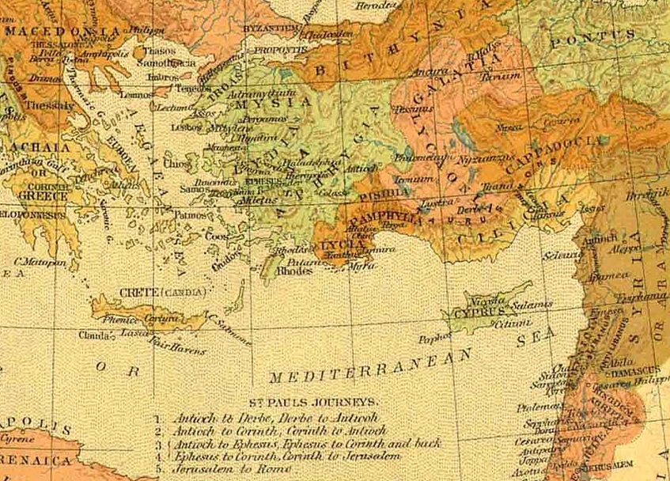
Paul’s journeys
14.26
“they sailed to Antioch”
13.4
“they … sailed to Cyprus”
1st missionary
journey
Acts 13-14
13.13
“Paul and his company set sail from Paphos, and came to Perga”
Notes:
And keep in mind also the Pharisaic view that eternal life was in the Law of Moses.
In Jn. 5 Jesus spoke of them searching those scriptures and
“THINKING that in THEM you have eternal life.”
But like a bright light shining under a bed, Law doesn’t remove dirt, law shows where the dirt is.
As Jesus continued in John 5.45:
I don’t need to accuse you, the one that accuses you IS MOSES, on whom YOU SET YOUR HOPE.
As for the Gentiles, recall Pharisees among the disciples demanding Torah compliance for the Gentiles:
Ac.15.5:
“It is necessary to circumcise them, and to charge them to keep the law of Moses.“
In contrast to the Phar. View, which P knew well, Paul declared trust in Christ.

Slide 69
Paul’s journeys
“we” from Troas
to Philippi
16.6-8
“they”
2nd missionary
journey
Acts 15:36-18:22
Notes:
And keep in mind also the Pharisaic view that eternal life was in the Law of Moses.
In Jn. 5 Jesus spoke of them searching those scriptures and
“THINKING that in THEM you have eternal life.”
But like a bright light shining under a bed, Law doesn’t remove dirt, law shows where the dirt is.
As Jesus continued in John 5.45:
I don’t need to accuse you, the one that accuses you IS MOSES, on whom YOU SET YOUR HOPE.
As for the Gentiles, recall Pharisees among the disciples demanding Torah compliance for the Gentiles:
Ac.15.5:
“It is necessary to circumcise them, and to charge them to keep the law of Moses.“
In contrast to the Phar. View, which P knew well, Paul declared trust in Christ.

Slide 70
Paul’s journeys
“we”
from Philippi back to Jerusalem
“he”
up to Macedonia
3rd missionary
journey
Acts 18:23-21:16
Notes:
And keep in mind also the Pharisaic view that eternal life was in the Law of Moses.
In Jn. 5 Jesus spoke of them searching those scriptures and
“THINKING that in THEM you have eternal life.”
But like a bright light shining under a bed, Law doesn’t remove dirt, law shows where the dirt is.
As Jesus continued in John 5.45:
I don’t need to accuse you, the one that accuses you IS MOSES, on whom YOU SET YOUR HOPE.
As for the Gentiles, recall Pharisees among the disciples demanding Torah compliance for the Gentiles:
Ac.15.5:
“It is necessary to circumcise them, and to charge them to keep the law of Moses.“
In contrast to the Phar. View, which P knew well, Paul declared trust in Christ.

Slide 71
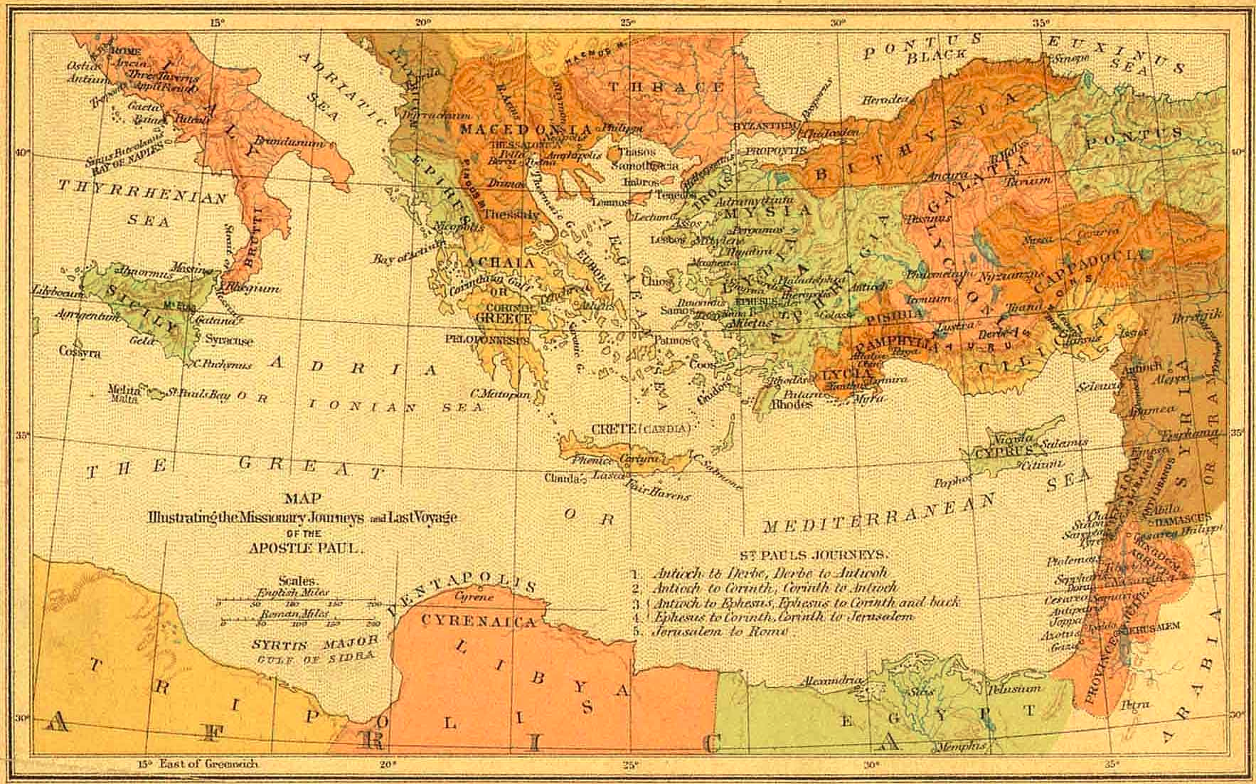
letters from Paul the prisoner
journey to Rome
As a prisoner
Acts 27-28:16

Slide 72
sea voyages in Acts
“they sailed”
“we sailed”
13.4
13.13
14.26
17.15
18.18,19
18.21,22
16.11
20.6
20.13-16
20.38-21.3
21.5-7
chapter 27
Notes:
sse

Slide 73
16.11 “Setting sail therefore from Troas we made a straight course to Samothrace and the day following to Neapolis”
18.21,22“we sailed away from Philippi after the days of the unleavened bread, and came to them to Troas in five days”
20.13-16“But we, going before to the ship, set sail for Asos, there intending to take in Paul: for so he had appointed, intending himself to go by land. And when we met him at Asos we took him in, and came to Mitylene. And sailing from thence, we came the following day over against Chios, the next day we touched at Samos: and the day after, we came to Miletus, for Paul had determined to sail past Ephesus, that he might not have to spend time in Asia, for he was hastening, if it were possible for him, to be at Jerusalem the day of Pentecost.”
20.38-21.3 “They brought him on his way to the ship. And when it came to pass that we were parted from them and set sail, we came with a straight course unto Cos, and the next day unto Rhodes, and from thence unto Patara: and having found a ship crossing over to Phoenicia, we went aboard and set sail, and when we had come in sight of Cyprus, leaving it on the left hand, we sailed unto Tyre, for their the ship was to unlade her burden.”
21.5-7 “they all, with wives and children, brought us on our way… and kneeling down on the beach, we prayed and bade each other farewell; we went on board the ship, but they returned home again. And when we had finished the voyage from Tyre, we arrived at Ptolemais”
sea voyages in Acts
“they sailed”
“we sailed”
13.4 “they sailed to Cyprus”
13.13 “Paul and his company set sail from Paphos and came to Perga”
14.26 “they sailed to Antioch”
17.15 “they that conducted Paul brought him as far as Athens”
18.18,19 “they sailed thence for Syria … they came to Ephesus”
18.21,22“he set sail from Ephesus … landed at Caeserea”
20.13-16“But we, going before to the ship, set sail for Asos, there intending to take in Paul: for so he had appointed, intending himself to go by land. And when we met him at Asos we took him in, and came to Mitylene. And sailing from thence, we came the following day over against Chios, the next day we touched at Samos: and the day after, we came to Miletus, for Paul had determined to sail past Ephesus, that he might not have to spend time in Asia, for he was hastening, if it were possible for him, to be at Jerusalem the day of Pentecost.”
20.38-21.3 “They brought him on his way to the ship. And when it came to pass that we were parted from them and set sail, we came with a straight course unto Cos, and the next day unto Rhodes, and from thence unto Patara: and having found a ship crossing over to Phoenicia, we went aboard and set sail, and when we had come in sight of Cyprus, leaving it on the left hand, we sailed unto Tyre, for their the ship was to unlade her burden.”
21.5-7 “they all, with wives and children, brought us on our way… and kneeling down on the beach, we prayed and bade each other farewell; we went on board the ship, but they returned home again. And when we had finished the voyage from Tyre, we arrived at Ptolemais”
16.11 “Setting sail therefore from Troas we made a straight course to Samothrace and the day following to Neapolis”
20.6 “we sailed away from Philippi after the days of the unleavened bread, and came to them to Troas in five days”
ch. 27!
Notes:
sse

