Slide 1
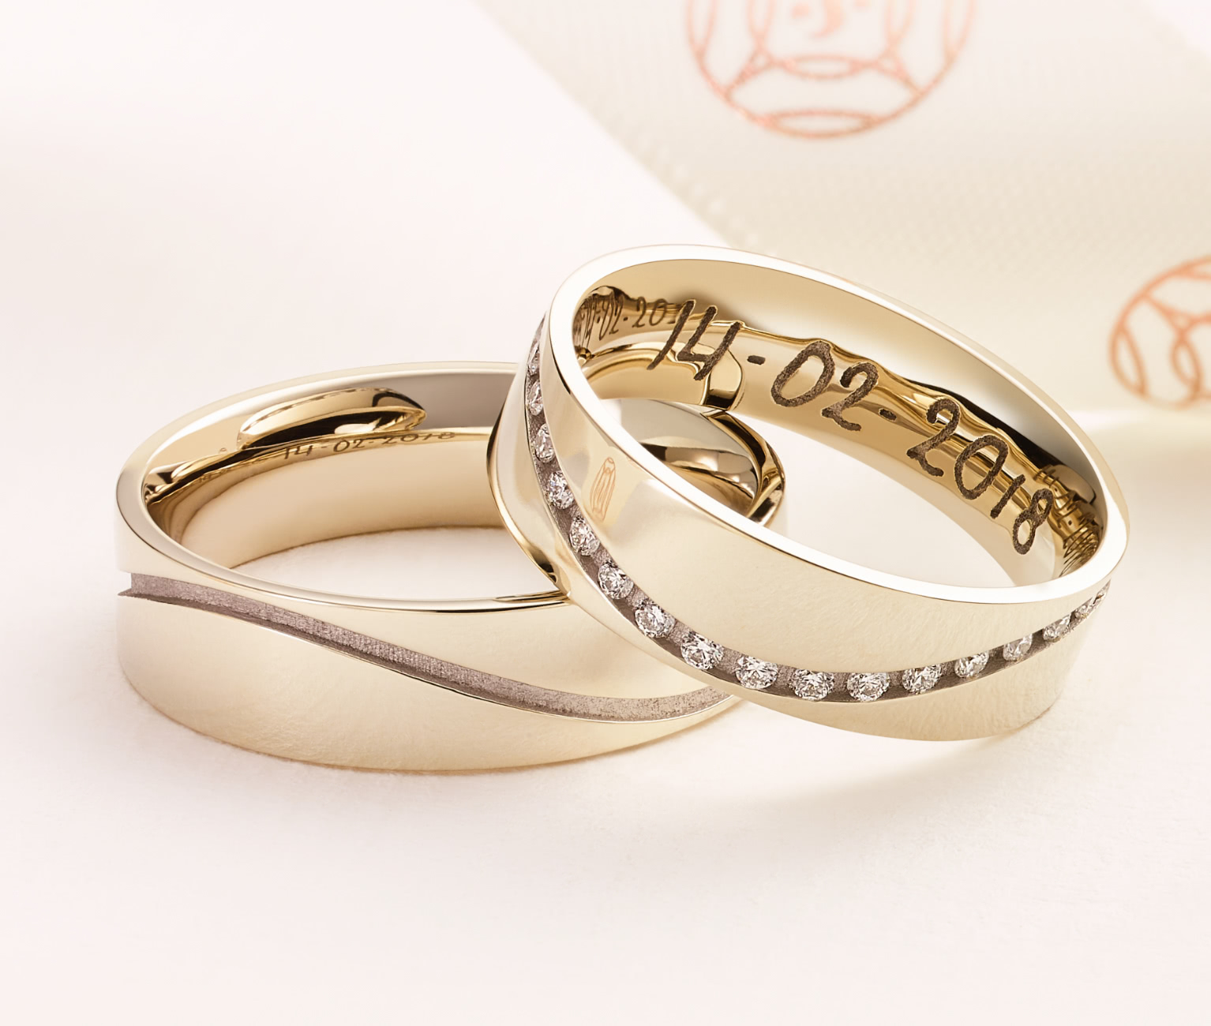
The Ideal Marriage
Between two people already married to Christ (2 Cor. 11:2)

Slide 2
Reason #1
Their faithfulness to Christ will make them faithful to each other (Matt. 19:3-6).

Slide 3
Reason #2
The love they learned from Christ is the love they’ll show to each other (1 John 3:16-18; 1 Cor. 13:1-8).

Slide 4
Reason #3
Because Christ’s relationship to the church is their model, they will reflect that same relationship in their marriage (Eph. 5:22-33).

Slide 5
Reason #4
Because they are so thankful for their salvation in Christ, they will work together to save others (Acts 26:29; 18:26; Luke 19:10).

Slide 6
Reason #5
Giving, attending, raising children, etc.—no conflict in these things, because Christ’s priorities are their priorities (Matthew 6:33; Luke 10:38-42; 2 Cor. 9:6-7; Ephesians 6:1-4; Hebrews 10:24-25).

Slide 7
Reason #6
Nothing will ever mean more to each one than to help the other be “in the presence of our Lord Jesus Christ at His coming” (1 Thess. 2:19-20).

