Slide 1
Lesson 7
Joshua 1-4

Slide 2
Key Events in Joshua
1--God’s Charge to Joshua
2--Spies Sent to Jericho
3--Crossing the Jordan
4--Memorial Stones Set Up
5—Circumcision, Passover
6--Conquest of Jericho
7--Ai Defeats Israel; Achan Punished
8--Israel Defeats Ai
9—Treaty with Gibeonites
10--Five Kings Defeated
11--More Conquests
12--List of Kings Conquered
13-19--Land Divided
20--Cities of Refuge
21--Cities Given to Priests and Levites
22--E. Tribes Return Home
23-24--Farewell Speeches

Slide 3
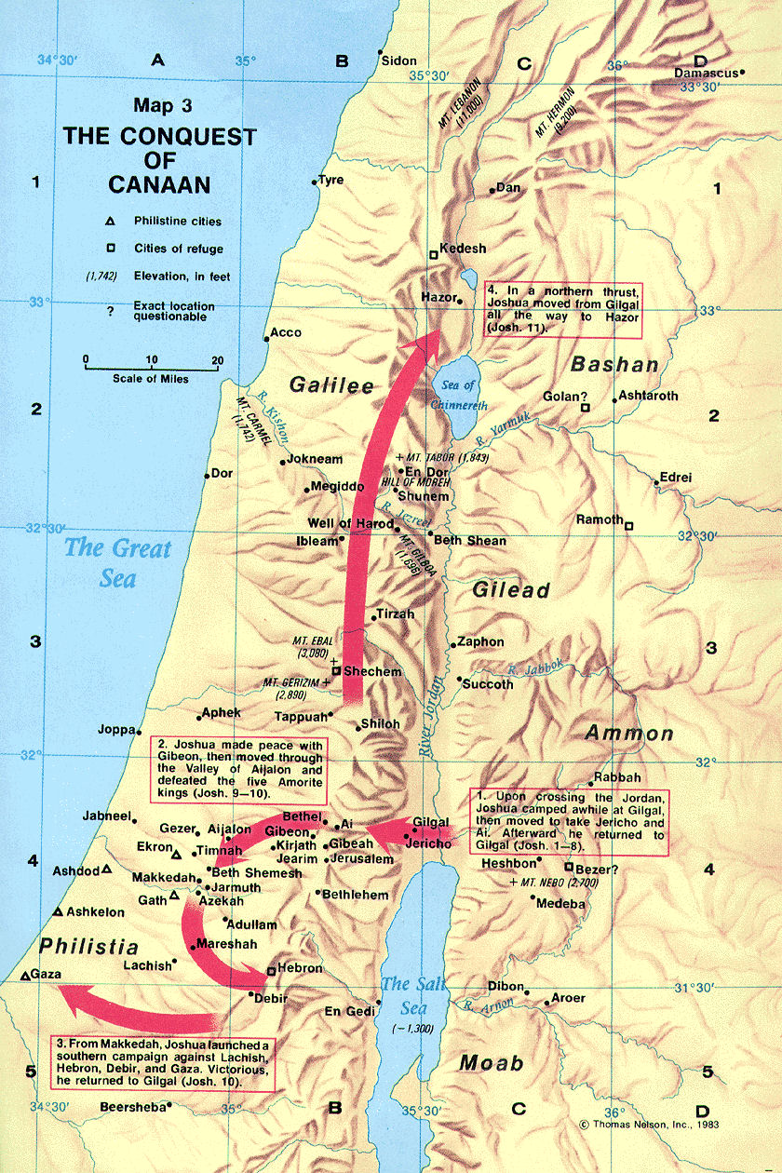

Slide 4
Gifts from God
Different forms of “give” appear 8 times in ch. 1.
Most have reference to land of Canaan, but what else does He promise to give them? (1:13, 15).
REST: Deut. 12:10-11; 28:64-65; look for fulfillment of this later in Joshua.
N.T. references?

Slide 5
Be Strong and Courageous
How many times did the LORD say this to Joshua in vv. 6-9?
Who else said this to Joshua?
#22 in supplement hymnal
“Be strong in the Lord and in the power of His might” (Ephesians 6:10).

Slide 6
Standing on the Promises
What would Joshua and his fellow-Israelites need to remember when faced with a superior army or a heavily fortified city?
“No man…” (1:5).
“I will never…” (1:5).
The LORD your God is with you…” (1:8).

Slide 7
Keep Your Nose in the Book
To make his way “prosperous” and to have “good success,” what did Joshua need to do?

Slide 8
“By faith…Rahab did not perish…” (Hebrews 11:31).
How did Rahab come to have faith? (2:8-11).
Where else is Rahab mentioned in the N.T.?
Matthew 1:5; James 2:25.
Who besides Rahab demonstrates faith? (2:14).

Slide 9
“Here’s Your Sign” (3:5)
What sign or wonder is performed in chapter 3?
Condition of the Jordan River at this time?
Purpose of this sign? (3:7; 4:14; 3:10)

Slide 10
Memorialized in Stone (4:7)
In what two places were stones set up?
“When your children ask…” (4:6-7, 21-24)

