Slide 1
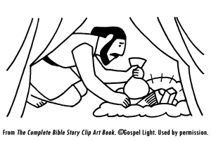
The Stages of Sin
Illustrated by Achan’s Sin (Joshua 7)

Slide 2
Background
Joshua 6:17-19
Don’t take any of the accursed things—these things belong to the LORD.
“make the camp of Israel and curse, and trouble it” (v. 18).

Slide 3
Background
Looks like everything is going well through the rest of chapter 6.
They take the city of Jericho (20-21), but they fulfill a promise made earlier, to spare Rahab and her family (22, 25).
Notice v. 24.

Slide 4
Background
Not so fast…they go up against Ai next, and see 7:4-5.
Joshua’s reaction (and the elders), and the Lord’s reply (7:6-13).
It is determined that Achan was the one who took some of the accursed things (7:14-18).

Slide 5
Confrontation (7:19-21)
“saw…coveted…took…hid”
Eve: Genesis 3:6-8.
David: 2 Samuel 11:1-4.

Slide 6
What To Do About It
Sometimes we can avoid the first stage.
If not, we can still avoid coveting.
Even when the desire is strong, we can keep from “taking.”
And even if we do see, covet, and take, we must not hide.

Slide 7
What To Do About It
What we see in our “mind’s eye” is often the problem.
James 1:14-15.
Need to “lust after” good things.
Philippians 4:8.
What if we sang more, prayed more, studied more? Went to gospel meetings more, spent more time around spiritually minded people?

