Slide 1
Lesson 11
Joshua 18-22

Slide 2
Key Events in Joshua
1--God’s Charge to Joshua
2--Spies Sent to Jericho
3--Crossing the Jordan
4--Memorial Stones Set Up
5—Circumcision, Passover
6--Conquest of Jericho
7--Ai Defeats Israel; Achan Punished
8--Israel Defeats Ai
9—Treaty with Gibeonites
10--Five Kings Defeated (South)
11--More Conquests (North)
12--List of Kings Conquered
13-19--Land Divided
20--Cities of Refuge
21—48 Cities Given to Priests and Levites
22--Eastern Tribes Return Home
23-24--Farewell Speeches

Slide 3
So far…
The following 5 tribes have received their inheritance: Reuben, Gad, Manasseh, Ephraim, and Judah.
Now, as they gather at Shiloh, what does Joshua say to the other 7 tribes?
Contrast: “Then the children of Judah came to Joshua in Gilgal…” (14:6).

Slide 4
Survey the Land
What procedure does Joshua tell them to use?
What about the territories already occupied by the other five tribes? What about Levi?

Slide 5
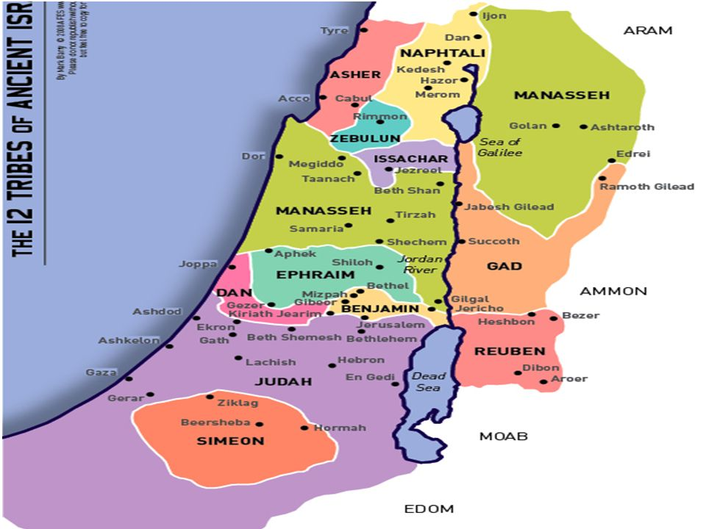
Also a Bethlehem in Zebulun
Joshua’s inheritance: Timnath Serah
12,000 sq. miles, less than ¼ size of AL. 150 miles from Dan to Beersheba; 55 miles from Gaza to Dead Sea

Slide 6
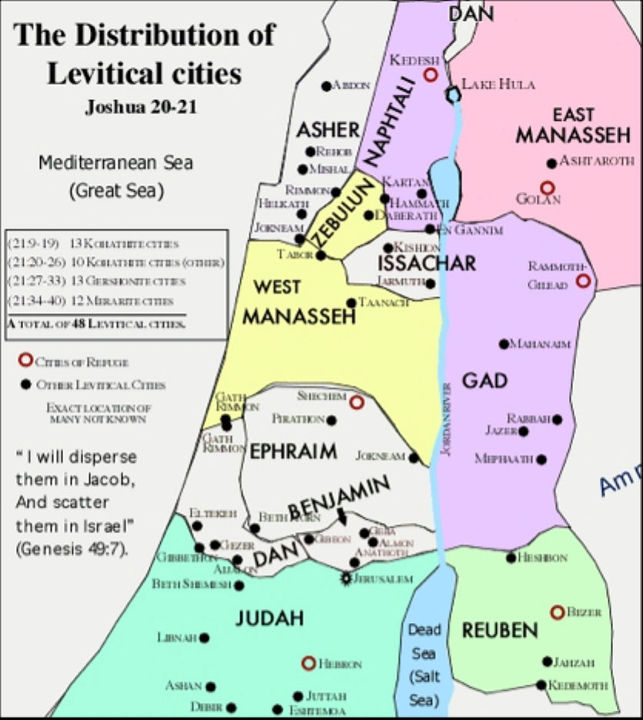

Slide 7
Kohath, Gershon, Merari
Who are these men?
“The sons of Levi were Gershon, Kohath, and Merari” (Genesis 46:11).
Descendants formed the 3 branches of Levites.
From which branch did the priests come? But had to be direct descendants of whom?
Priests (13); remaining Kohathites (10); Gershonites (13), Merarites (12).

Slide 8
Unfulfilled Land Promise?
Joshua 21:43-45
Numbers 34:1-15: God describes in detail the borders of the land He is giving Israel.
Not all the enemies have been driven out, and they don’t yet occupy all the land God promised them, but He has given it to them.
See Deut. 19:8-9.

Slide 9
Conflict Resolution
As Reuben, Gad, and ½ tribe of Manasseh returned home, they stopped at the Jordan River and built what?
Why did this alarm the other tribes?
Deuteronomy 12:13-14.
Other incidents they brought up?
They questioned these tribes about what they had done, and what was their response?

