Slide 1
Luke
Lesson 3 – Chapter 2

Slide 2
Luke 2
Birth of Jesus 2:1-21
Joseph and Mary travel to Bethlehem
Register for census v3
Joseph was of the house of David v4

Slide 3
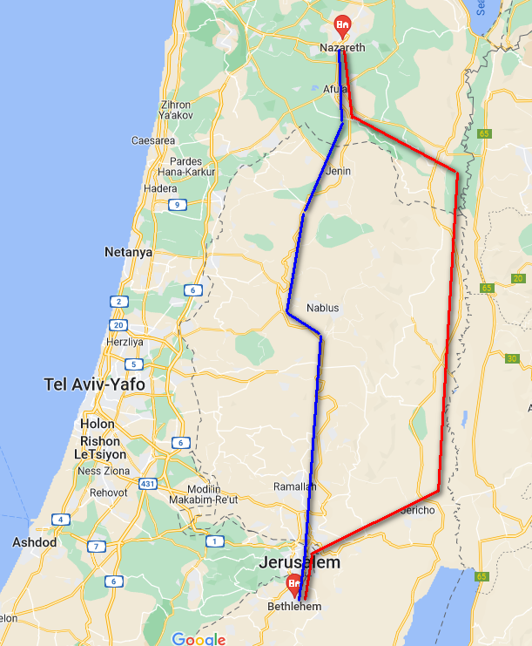
Luke 2
Red Line - Jordan Valley Route
(~95 miles)
Blue Line - Trade Route (~80 miles)
Approximately a
four day trip

Slide 4
Luke 2
Birth of Jesus 2:1-21
Joseph and Mary travel to Bethlehem
Register for census v3
Joseph was of the house of David v4
Jesus was laid in a manger (trough) v7
Same country (region) shepherds see an angel v8
Understandable afraid v9
Announcement of the birth of Jesus
Given a sign
Joseph and Mary name the child Jesus (1:31)

Slide 5
Luke 2
Jesus presented to God – 2:22 - 40
After Mary’s days of purification
40 days from the birth of a male child (Lev 12)
Two doves/pigeons offered.
Simeon is at the temple then
Just, Devout, Holy Spirit was with him.
Would not die before he saw Jesus
Jesus is called the Consolation of Israel
Anna a prophetess
Thankful to God for providing a Redeemer
Joseph and Mary return to Nazareth

Slide 6
Luke 2
Jesus at the Temple – 2:41 - 52
Jesus, now 12 years old was in Jerusalem for the Passover
The family left for home, but Jesus stayed behind
A day’s journey later they discovered his absence
Three days later they found Him in the temple
Listening and asking questions
Those there were astonished at His understanding and answers

Slide 7
Luke 2
Jesus at the Temple – 2:41 - 52
Frantic parents – Why did you do this to us?
Jesus –
“Why did you seek me?”
“I must be about My Father’s business”
They didn’t understand v50
Jesus returned with them and was subject to them v51
Jesus increased in wisdom, stature, and favor with God and men.

Slide 8
Luke 2
Observations:
First time Luke is included in the New Testament account is Acts 16:10 “we sought to go to Macedonia” (During 2nd journey of Paul)
We’re not given the account of Luke’s conversion
Luke doesn’t include himself in his gospel.
Luke speaks from Mary’s perspective.
Joseph isn’t interviewed
Luke gives a compelling account of all these events.
Luke’s command of the Greek language leads us to think he is Greek. (We can’t be sure)

Slide 9
The Gospels
Book
Audience
Christ is
Matthew
Jews
King
Mark
Romans
A Servant
Luke
Greeks
A Perfect
Man
John
Universal
God (Deity)

Slide 10
Luke 2
Observations:
Why is the city of Jesus birth significant?
Micah 5:2
Considering the magnitude of this event, what is striking about how the news is delivered to the world?
By Shepherds v17-18
The first resting place of Jesus is a trough
By contrast, the scribes and Pharisees in Matt 23:2-12
If not for who the Child was, the event is unremarkable.

Slide 11
Luke 2
Observations:
The Confirmation of Jesus
Shepherds – Told by angels a Savior has been born v11
Simeon – A just and devout man
Was promised that God was going to send a Consolation (comfort) to Israel v26
Anna – A widow and servant of God
Gave thanks to God for a Redeemer v38

Slide 12
Luke 2
Observations:
Was the sacrifice in the temple for Jesus.
Lev 12:8
Simeon’s statements
I have seen Your salvation, prepared for all peoples v30-31
A light to the Gentiles and glory to Israel v32
Destined for the fall and rise of many in Israel v34
1 Cor 1:23-24; Rom 9:32-33; 1 Pet 2:8
A sword will pierce through your own soul also v35

Slide 13
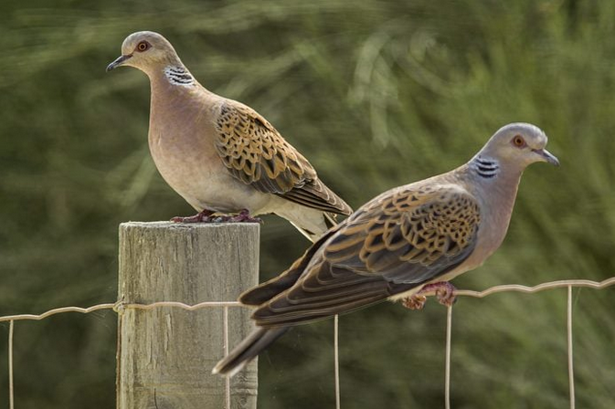

Slide 14
Luke 2
Next week:
Ministry of John the Baptist.
Genealogy of Jesus.

