Slide 1
Lesson 9
Isaiah 21-23

Slide 2
In the midst of a section entitled…
God is sovereign over ALL nations (chs. 13-27).

Slide 3
Judgment pronounced against…
In previous lessons…
In tonight’s lesson…
Assyria
Babylon
Philistia
Moab
Syria (Damascus)
Israel (northern kingdom)
Ethiopia
Egypt
Babylon (again)
Edom
Arabia
Judah (Jerusalem)
Tyre

Slide 4
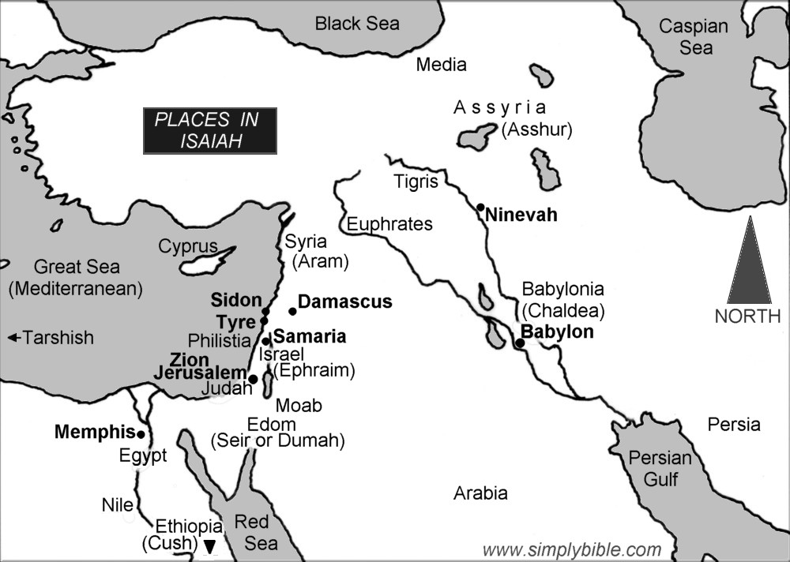

Slide 5
Think about how all this relates to God’s eternal plan…
To redeem people from “every tribe and tongue and people and nation” (Rev. 5:9).

