Slide 1
Minor Prophets
Obadiah (?)
Joel (?)
Jonah (790-780)
Amos (760-750)
Hosea (750-725)
Micah (735-700)
Zephaniah (630-625)
Nahum (630-612)
Habakkuk (612-606)
Haggai (520)
Zechariah (520-518)
Malachi (445-432)
Why do we call them “minor”?
Isaiah, Jeremiah, Ezekiel—each of these longer than these 12 put together.

Slide 2
Themes ( 6 things to look for)
Prevailing conditions when each prophet spoke.
The “Day of the LORD”—used to describe judgments against the wicked and deliverance of the righteous.
God’s merciful calls to repentance.
Preservation of a remnant, from which the Messiah would come.
God’s concern for all nations—for their behavior, and ultimately for their salvation in Christ.
The coming of a new King and a new Kingdom.

Slide 3
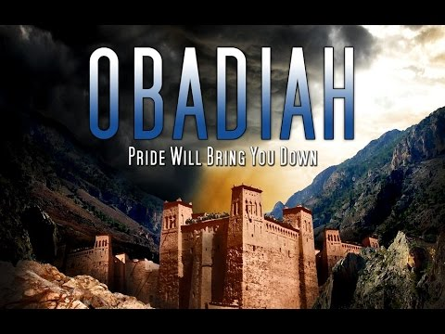
“Whoever hates his brother is a murderer” (1 John 3:15).
“But on Mount Zion…shall be deliverance”
(1:17).
“The pride of your heart has deceived you…I will bring you down” (1:3-4).

Slide 4
Who is Obadiah?
Your guess is as good as mine.
Obadiah means “servant of the LORD”—a very common name among the Jews.
In fact, 13 different men in the O.T. bear this name.

Slide 5
Date of This Prophecy
Verses 11-14 describe an attack on Jerusalem, which can likely be narrowed down to two possibilities:
Destruction of Jerusalem in 586 B.C. by the Babylonians.
The days of Jehoram when the Philistines and Arabians attacked the city (around 845 B.C.). Details of this attack found in 2 Chron. 21:8-10, 16-17.
Evidence for earlier date: (1) verse 11 indicates more than one nation involved; (2) lack of details if later date; (3) language indicates people still living in the city.

Slide 6
Questions
*About what nation is the vision of Obadiah concerning?
“Thus says the LORD GOD concerning Edom…” (1:1).
*T F The Edomites were the descendants of Jacob.
Esau (1:6, 8, 9, 18, 19, 21).
*T F The Edomites were related to Jacob.
“Your brother” (1:10, 12).

Slide 7
Questions
*What had their pride caused them to ask? (What did they say in their heart?)
“Who will bring me down to the ground?”
And what is the answer at the end of v. 4?
“You who dwell in the clefts of the rock” (1:3). “Edom was nestled in a narrow mountainous strip about 100 miles long and 20 miles wide” (Harkrider).
“The mountainous area on either side of the Arabah was noted for its steep canyons, impregnable mountain strongholds, and well-protected coves” (Hailey).

Slide 8
Questions
How would Edom’s destroyers be different from thieves and grape gatherers? (5-6).
They typically leave some behind, but God won’t! And that includes the things you’ve hidden (6).

Slide 9
Questions
What about “the men in your confederacy” (their allies)—wouldn’t they be able to help? (7).
“deceive you and prevail against you…lay a trap for you” (7).
And their “wise men”—surely their counsel would help deliver Edom, right? (8-9).
“Your mighty men, O Teman, shall be dismayed” (9).
Teman known for its wise men (Jer. 49:7); in fact, Eliphaz, one of Job’s friends, was from Teman (Job 2:11).

Slide 10
Questions
*When had Edom rejoiced over the children of Judah? (10-14, esp. v. 12).
*What had Edom stood in the crossway (crossroads, (fork of the road) to do?
Problems between Israel and Edom go all the way back to Jacob and Esau, and continued between the two nations (starting with Edom’s refusal to allow Israel to pass through their land on the way to Canaan—Numbers 20:14-21).

Slide 11
Questions
*T F The day of the LORD always refers to the second coming of Christ.
*When the day of the LORD comes, what reward shall be given to Edom? (15-16).

Slide 12
Discussion of Verses 17-21
Several things point to a Messianic fulfillment…

Slide 13
(1) The Use of Mount Zion
“But on Mount Zion there will be those who escape” (NAS), indicating a stronghold, a place of refuge.
“But you have come to Mount Zion and to the city of the living God, the heavenly Jerusalem…we are receiving a kingdom which cannot be shaken” (Heb. 12:22, 28).

Slide 14
(2) House of Jacob
“The house of Jacob shall possess their possessions” (1:17).
“And He will reign over the house of Jacob forever, and of His kingdom there will be no end” (Luke 1:33).

Slide 15
(3) All this talk about possessing
“I see Him, but not now; I behold Him, but not near; a Star shall come out of Jacob; a Scepter shall rise out of Israel, and batter the brow of Moab, and destroy all the sons of tumult. And Edom shall be a possession; Seir also, his enemies, shall be a possession, while Israel does valiantly” (Numbers 24:17-18).
“On that day I will raise up the tabernacle of David, which has fallen down, and repair its damages; I will raise up its ruins, and rebuild it as in the days of old; that they may possess the remnant of Edom, and all the Gentiles who are called by my name,” says the LORD who does this thing” (Amos 9:11-12).
Acts 15:13-18 confirms this prophecy was fulfilled in Christ.

