Slide 1
Lessons from the life of King Ahab
1 Kings 16:29-33

Slide 2
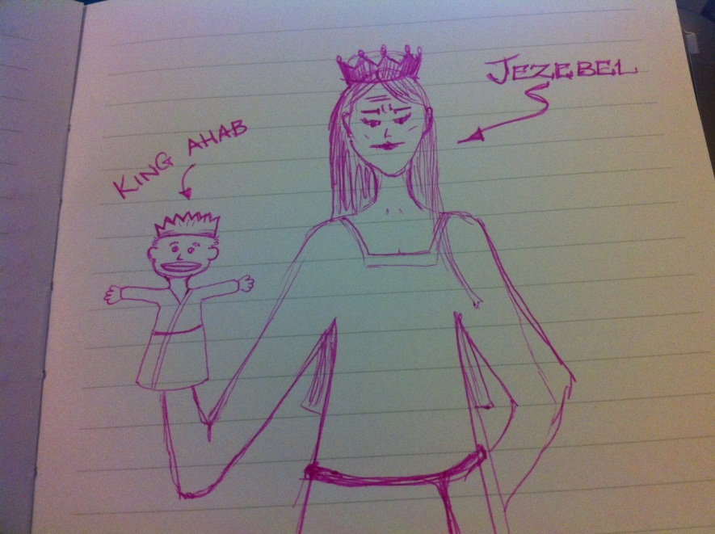
King Ahab
He let the wrong person influence him.
Elijah vs. Jezebel
1 Kings 16:31; 21:25.
Competing influences in our life.
2 Timothy 3:13-15.

Slide 3
King Ahab
The goodness of God did NOT lead him to repentance.
Romans 2:4-5.
God was good to Ahab.
1 Kings18:17-40.
1 Kings 20:13-14, 22-28.
1 Kings 21:27-29.
Do we need to repent?
2 Peter 3:9-10.

Slide 4
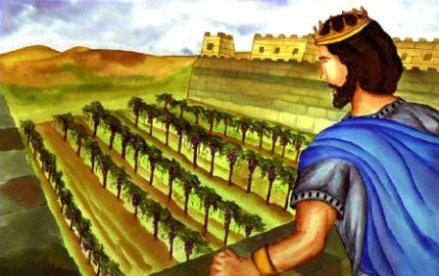
King Ahab
He pouted when he didn’t get what he wanted.
1 Kings 21:1-7.
Mark 10:42-45; Philippians 2:3-4.

Slide 5
King Ahab
He had an “itching ears” attitude toward the truth.
2 Timothy 4:2-4.
1 Kings 22:1-8.
2 Thessalonians 2:9-12.

