Slide 1
Continuing a series of lessons
Based on 1 Timothy 5:16

Slide 2
Quick Review
Lesson #1: Do not let the local church be burdened with establishing or supporting schools.
Lesson #2: Do not let the local church be burdened with providing in any way for the recreation and entertainment of its members (social activities).
Lesson #3-5: Do not let the church be burdened with building “fellowship halls” and kitchens, with providing social meals for its members.

Slide 3
Beginning Tonight
Do not let the local church be burdened with organizational ties to other local churches.

Slide 4
Have you given much thought to the organizational structure or lack thereof in different churches?

Slide 5
Some very tightly controlled:
Roman Catholic Church
Mormon Church
Some link local churches, but not as tightly:
Southern Baptist Convention
Others completely independent:
Many communities have a few churches like this.
Perhaps even some that would not use the description, “church of Christ.”

Slide 6
Southern Baptist Convention
GA State Conv.
AL State Conv.
FL State Conv.
East Liberty Baptist Association
Troy-Salem Baptist Association
(75)
Autauga Baptist Association
First Baptist
Crestview Baptist
Calvary Baptist
(27)

Slide 7
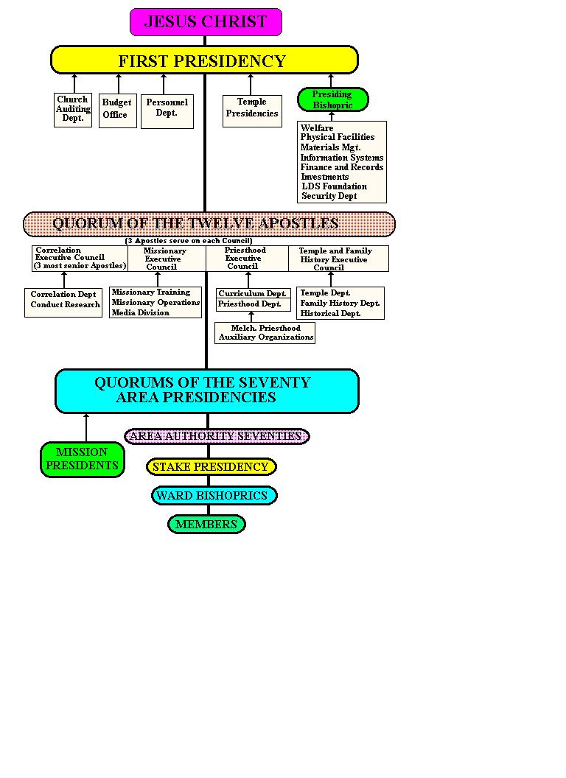

Slide 8
What does the N.T. teach?
Should each local church be independent, or should there be some structural ties (associations, conventions, dioceses, etc.)?
Should there be some level(s) of organization above the local church?
Should a local church ever give any degree of control to another church, to some other organization or institution, or to some man or group of men outside that local church?

Slide 9
Let’s first examine some statements made by different authors.
Statements we’ll later evaluate against the Scriptures

Slide 10
Leroy Brownlow: “In speaking of the autonomy of the church we mean the autonomy of the local church or congregation...defined as ‘right of self-government; a self-governing state; an independent body.’ In the first century each congregation was such, that is independent of every other congregation. There was no tyranny of one church over another. The church in Rome or Jerusalem had no authority over churches in other communities. Men outside the congregation had no right to exercise authority and power within the congregation…

Slide 11
The elders and deacons in one congregation had no authority to exercise despotic rule or any other kind of rule over the elders and deacons in another congregation. Each church was free and independent, under the teaching of Christ and the apostles, to govern itself, carry on its own work, and manage its own affairs. There was no system of church government larger or smaller than the congregation. All congregations had the same head, foundation, and mission; preached the same gospel...But each was independent to direct its own work!”

Slide 12
Roy Cogdill: “Autonomy means self-government. God gave to the congregation the right of self-government. Each local church is subject to Christ and His authority alone. This right of self-government depends in its actual application upon two other scriptural principles characteristic of each church of Christ: the principle of the independence of each church and the equality of all the churches of Christ.”

Slide 13
Aubrey Belue: “Every N.T. church was autonomous (self-governing under Christ); independent (no ties that bind it or its work to any other church); and equal (not inferior to or in submission to any other church in any of its functions).”

Slide 14
Questions
Were these men correct? Does the N.T. teach it, or is it simply a tradition of some churches?
If there is autonomy and independence, is it complete or limited?
What does autonomy allow a church to do?
Can churches have any ties without endangering their independence?

Slide 15
A Brief History Lesson
Organizational changes were among the first major departures from the truth.
One elder was elevated above the others, and given the title of bishop.
Soon, it was argued that one bishop could rule over the church and its elders.
Then, bishops in larger churches gradually began to exercise influence over smaller churches (each had their own diocese).
Bishops in five major cities became known as the “five patriarchs,” and eventually one claimed to be “universal bishop.”

Slide 16
What do we learn from this?
When people become comfortable with one departure, it’s pretty easy to become comfortable with more.
Any tendency toward centralization of power, control, or oversight should always raise red flags.
In other words, it should concern us greatly when men or churches elsewhere try to oversee what’s done here.

Slide 17
Three Principles
Churches are NOT autonomous, at least in one sense of the word.
Yet, there is a sense in which they ARE independent and autonomous.
This independence does NOT mean they should ignore other local churches.

Slide 18
#1 Local churches are NOT autonomous
Autonomy is from the Greek words for “self” and “law,” and so it means self-governing.
Independent means “not subject to control by others; not affiliated with a larger controlling unit.”

Slide 19
#1 Local churches are NOT autonomous
There is a “larger controlling unit”—one lawgiver who possesses all authority.
Matt. 28:18-20; Eph. 5:23-24; 1 Peter 5:2-4.
Every local church should be guided by the same truth or law.
Acts 16:5; 1 Corinthians 4:17; (note problem in 1 Corinthians 11).

Slide 20
(#2) Local churches ARE autonomous
Each is under the authority of Christ, but autonomous and independent in relation to each other.
In the N.T., we cannot find any evidence for any type of organization linking local churches together—strict or loose.

Slide 21
CHRIST
CHRIST
CHRIST
Church at Troas
Overseen by its own elders.
Church at Corinth
Overseen by its own elders
Church at Ephesus
Overseen by its own elders
These local churches never joined together to form anything larger than the local church.

