Slide 1
Opening Passages
“I thank my God…for your fellowship in the gospel” (Philippians 1:3, 5).
I want to especially thank Lynn.
And Brad Sullivan.
“When he had greeted them, he told in detail those things which God had done among the Gentiles through his ministry” (Acts 21:19).

Slide 2
Day 1, Wednesday, August 17
Arrive at Nairobi airport about 6 a.m., where we are picked up by Wilson and Jack.
After stops to eat breakfast and exchange money, we arrive our hotel about 11:30 a.m.
Brad and I sleep for a few hours, and then Wilson and Jack come to the hotel to plan the next two weeks’ activities.

Slide 3
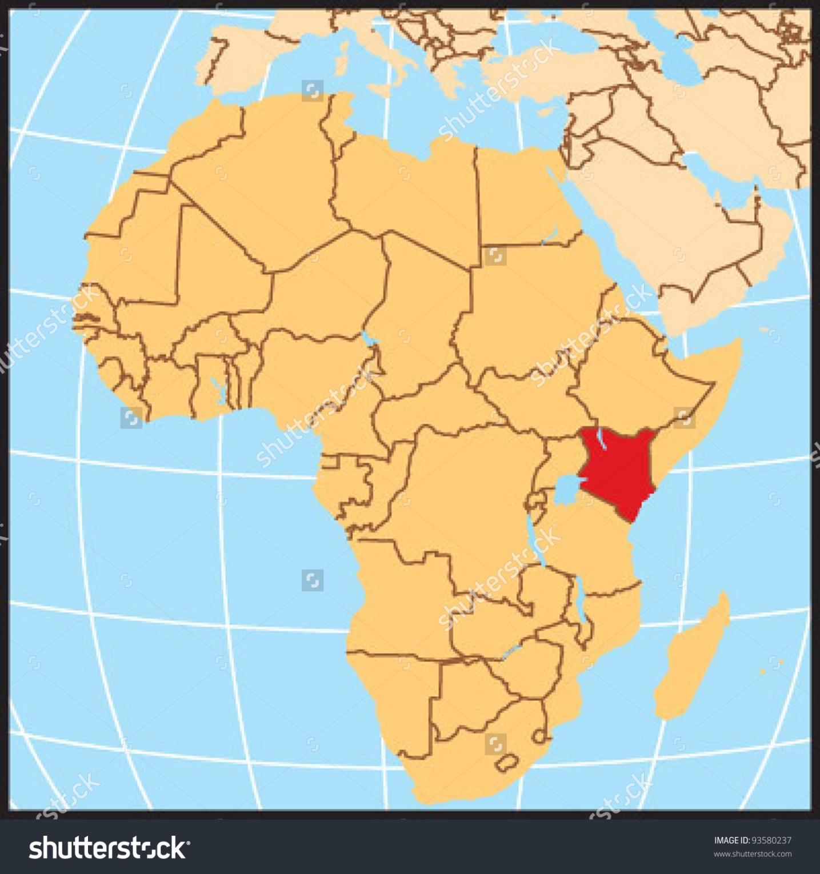

Slide 4
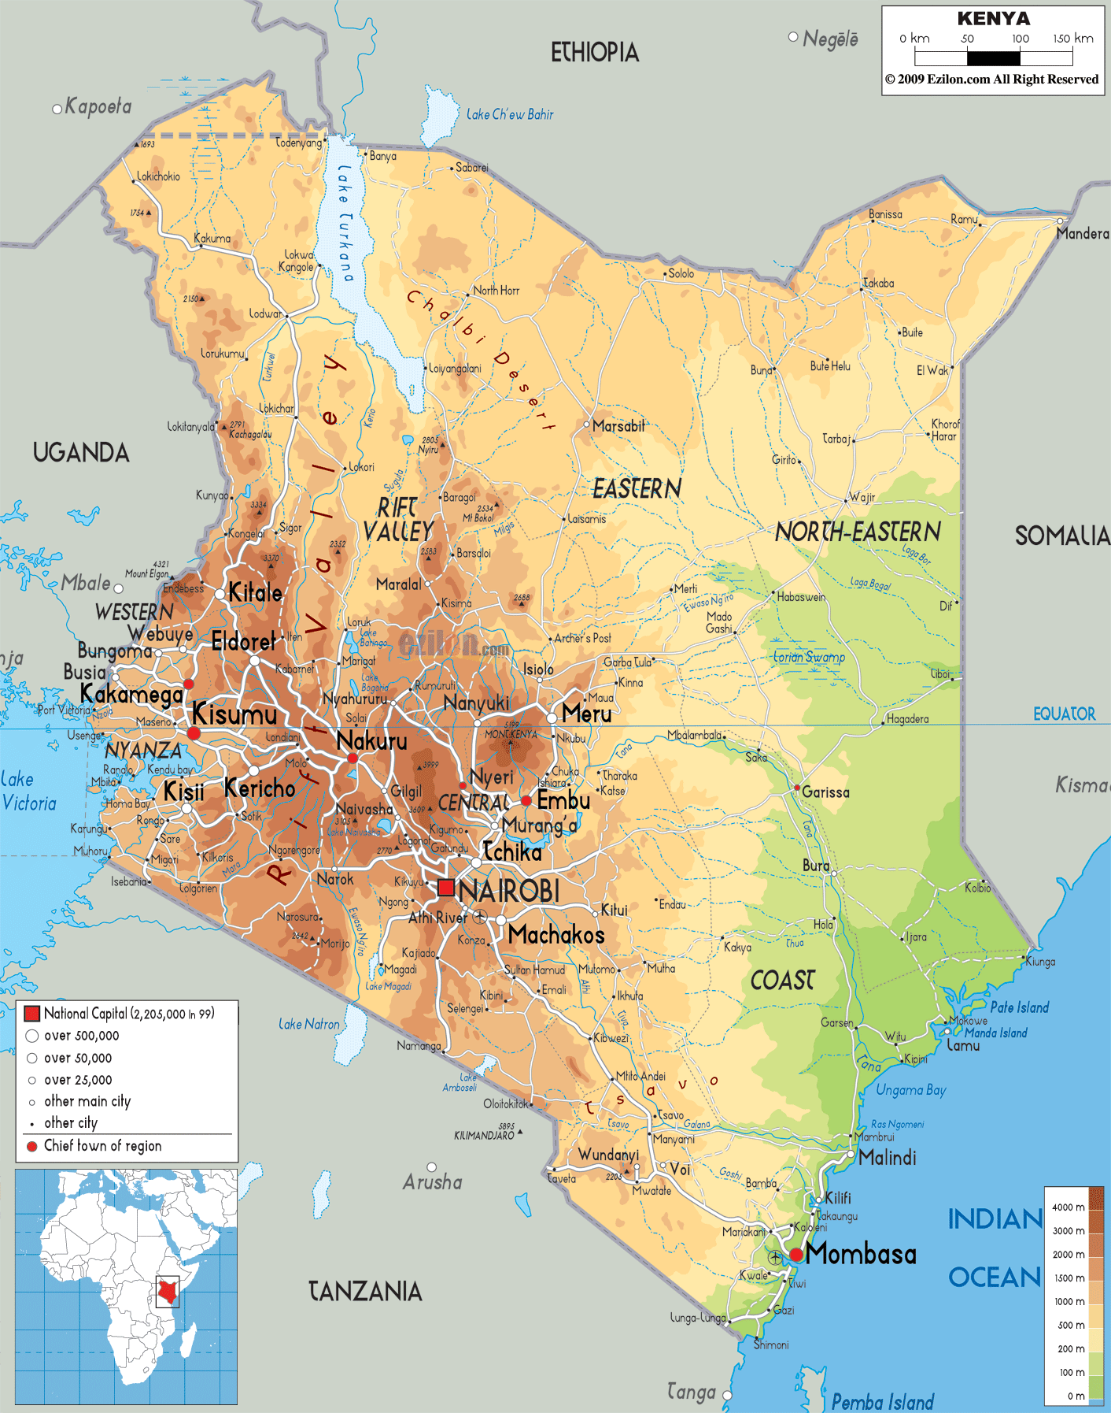

Slide 5
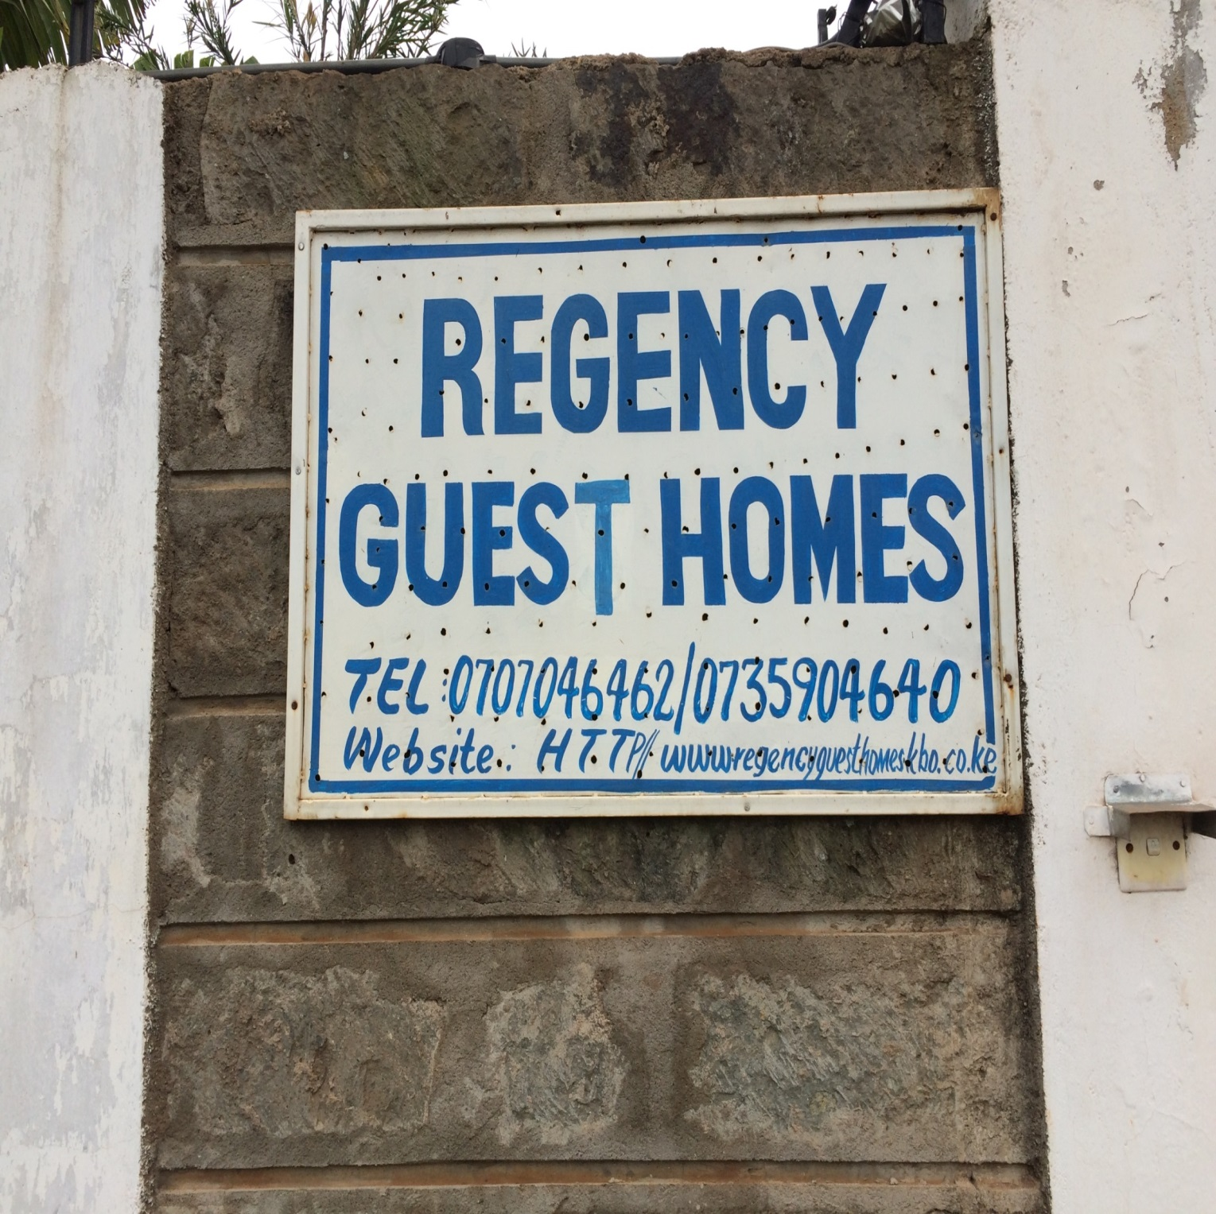

Slide 6
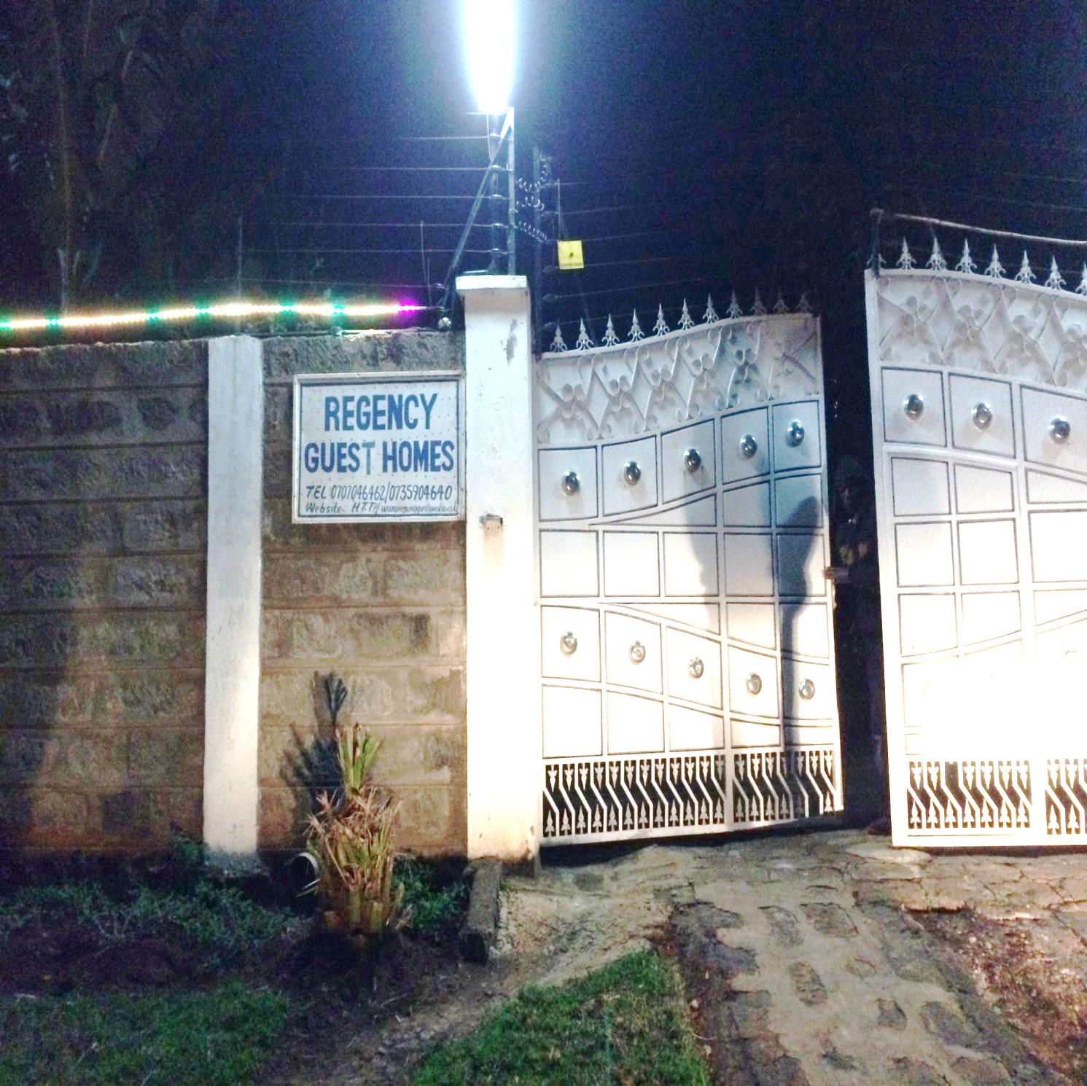

Slide 7
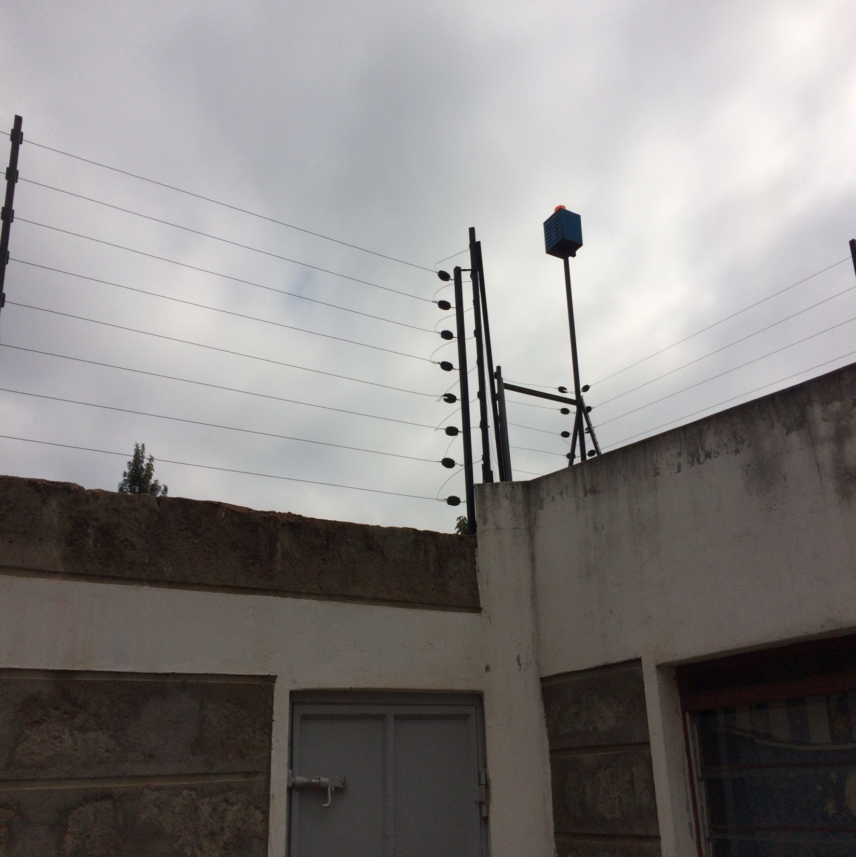

Slide 8
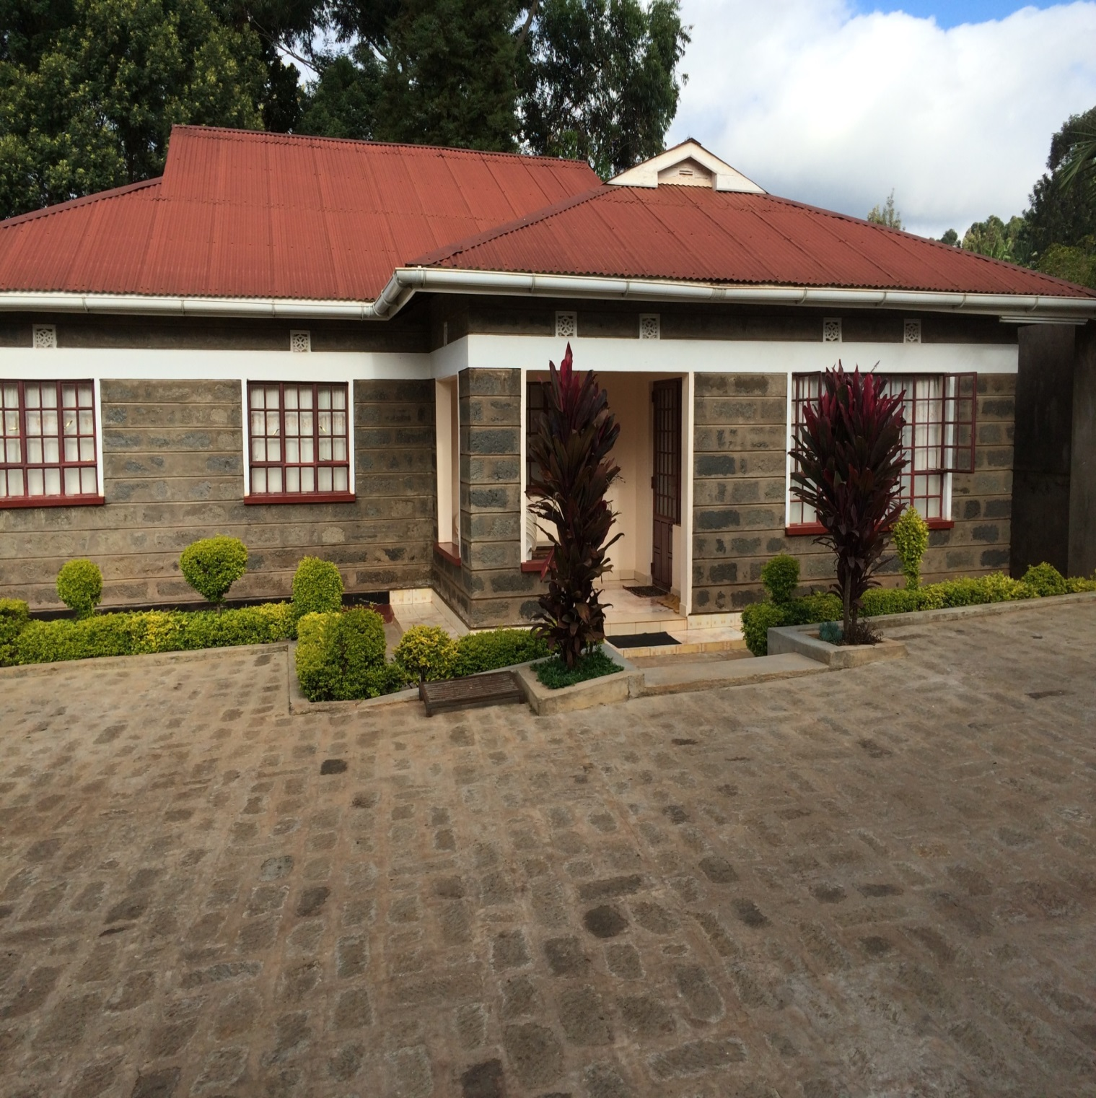

Slide 9
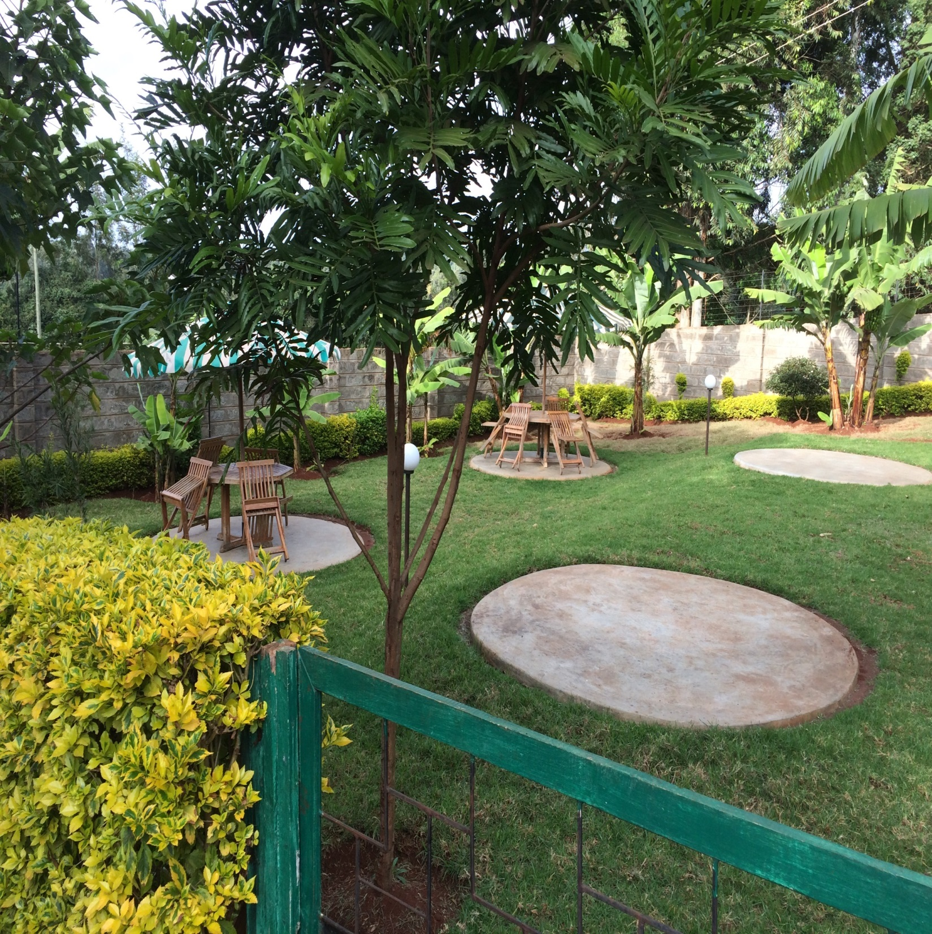

Slide 10
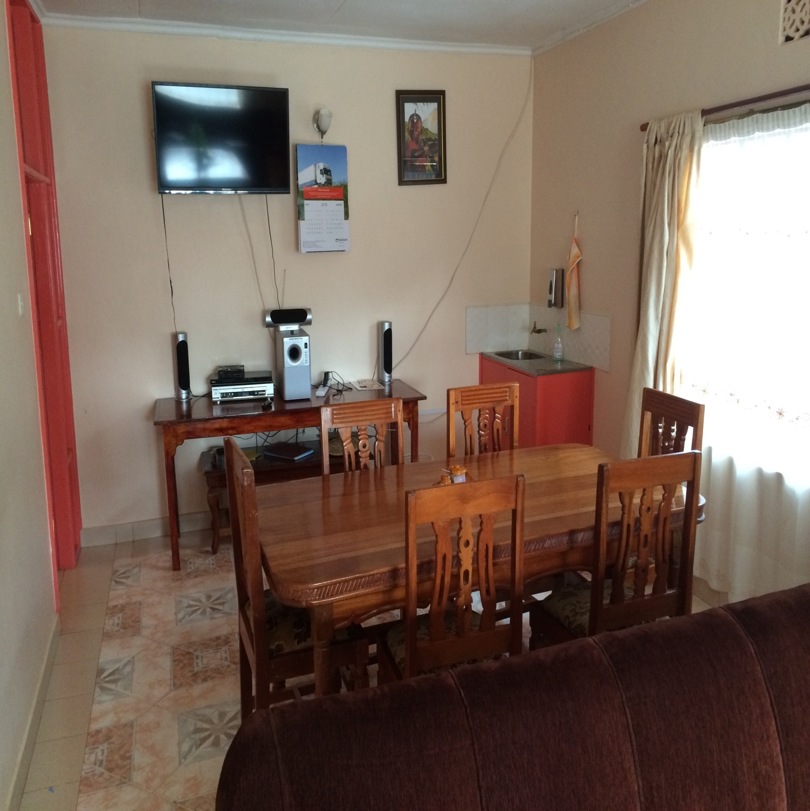

Slide 11
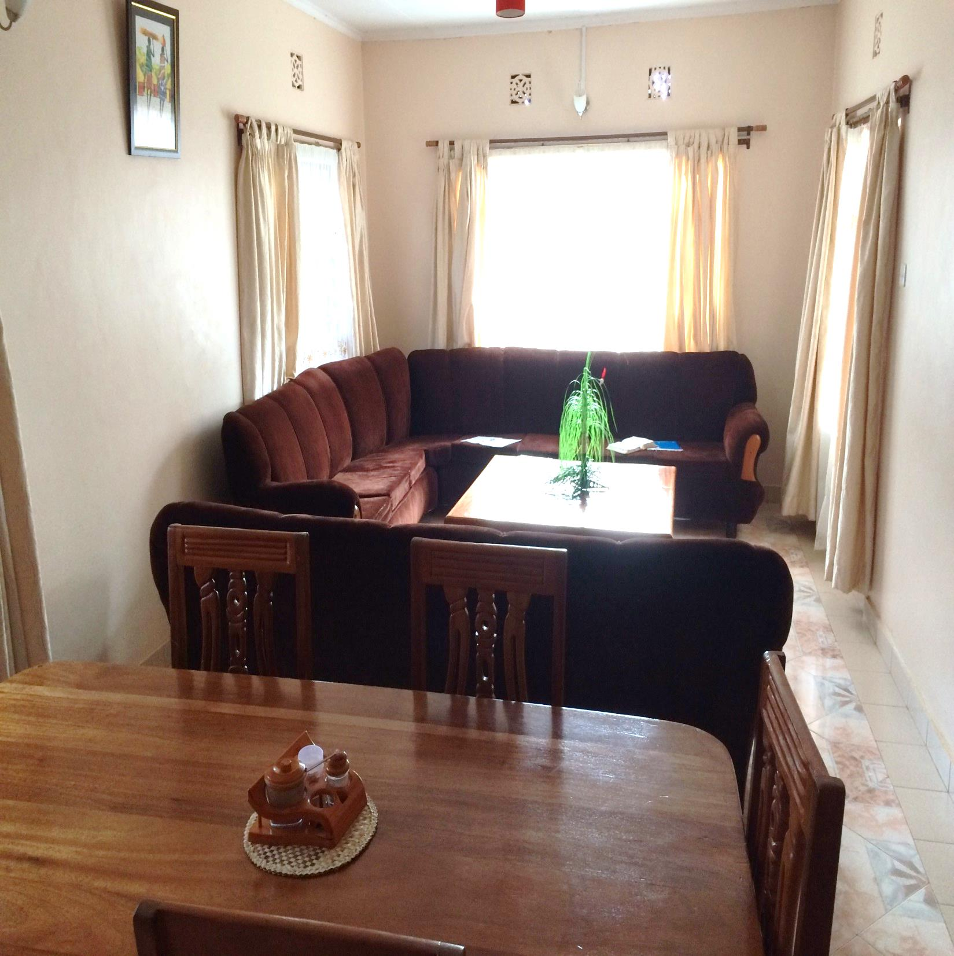

Slide 12
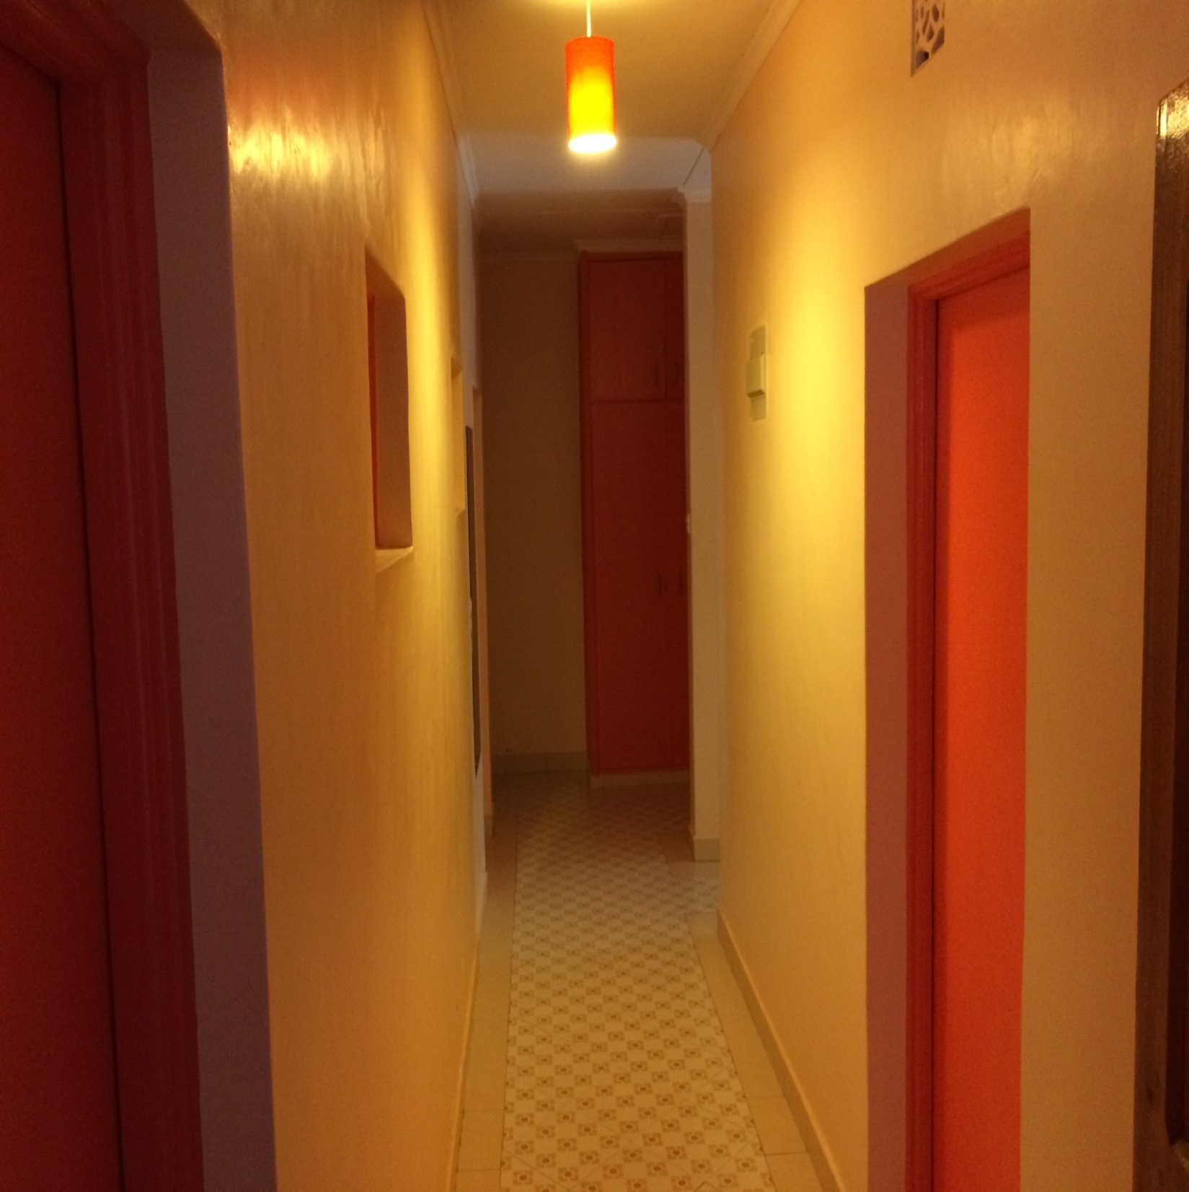

Slide 13
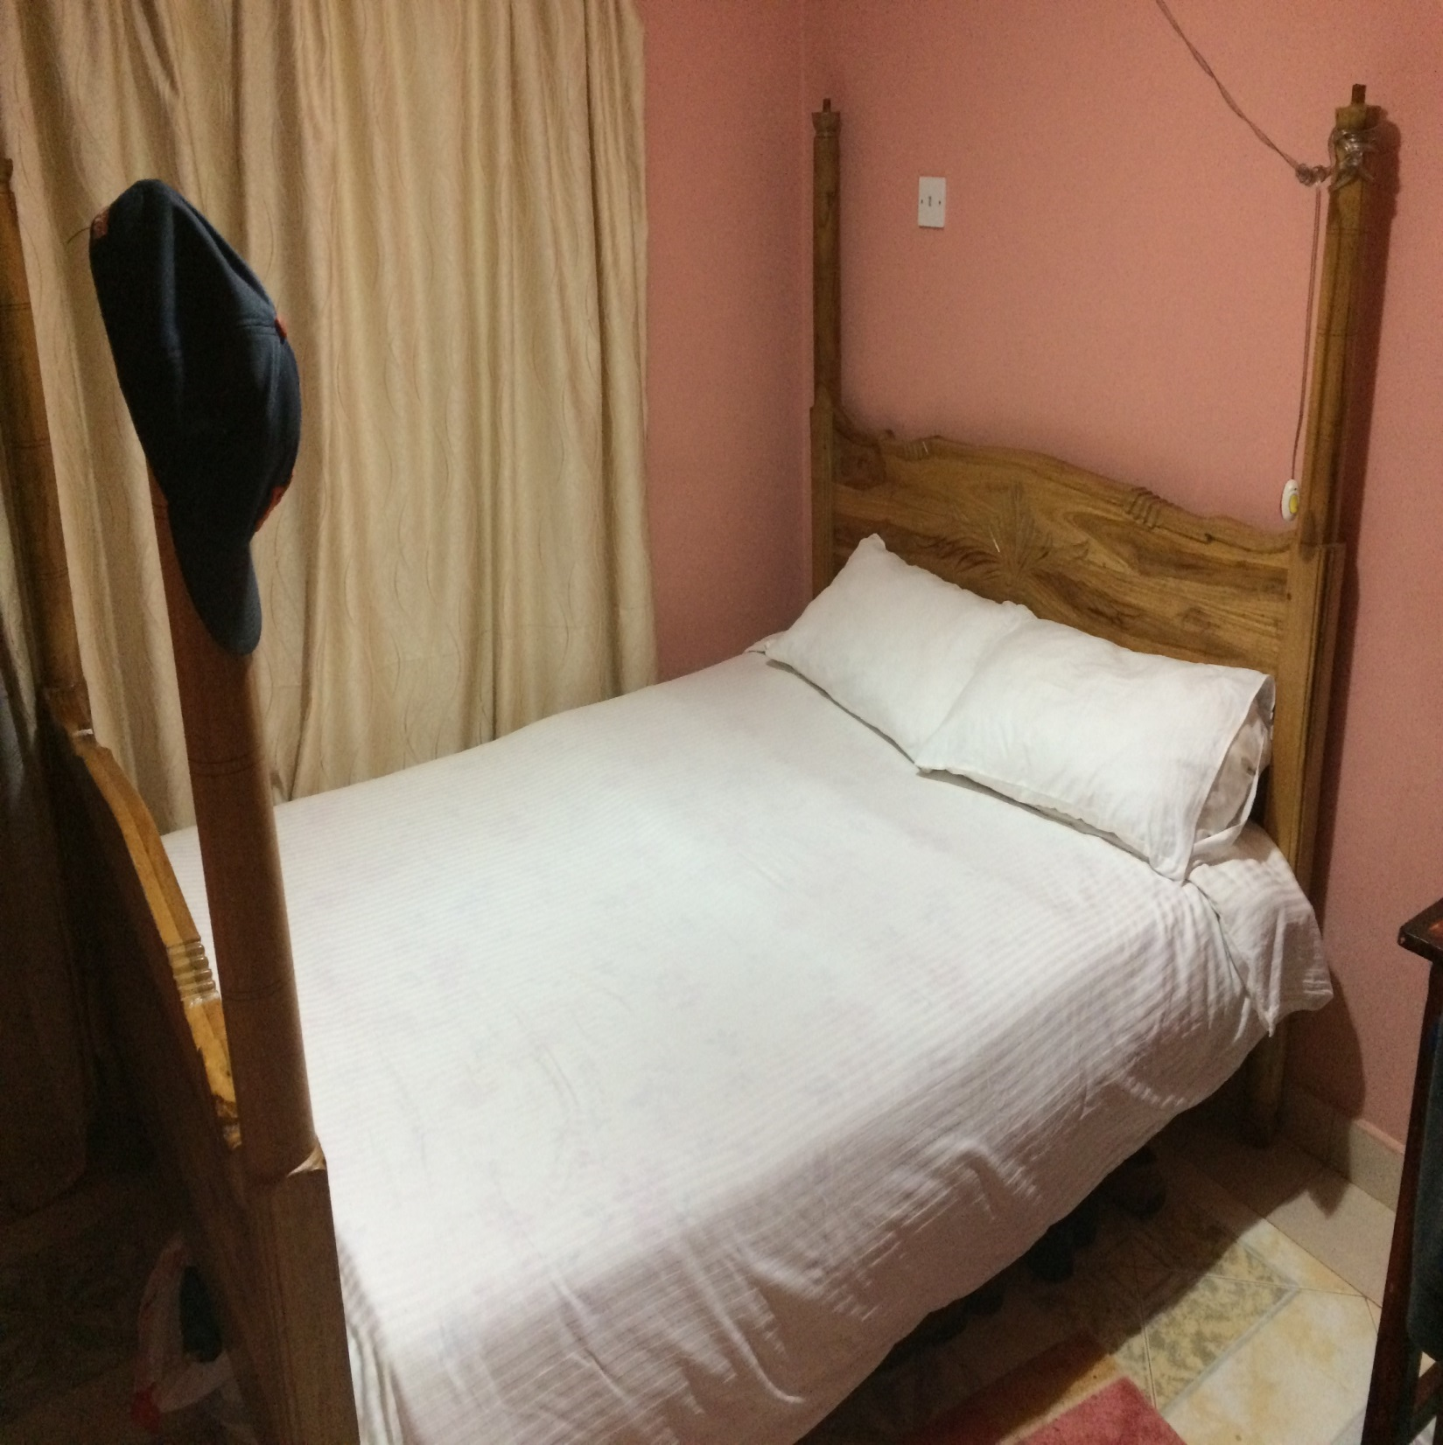

Slide 14
Day 2, Thursday, August 18
Preacher training classes, from 9 a.m. till 12 p.m.
3 sessions: Brad introduced Revelation; I talked about the general story line; and then we each discussed the value of books like Ezekiel and Daniel in understanding Revelation.
Samuel, Richard, Elijah, Jack, and Wilson were present (asked and answered many questions).
Off topic, one asked about Sabbatarians and their observance of the 7th day.

Slide 15
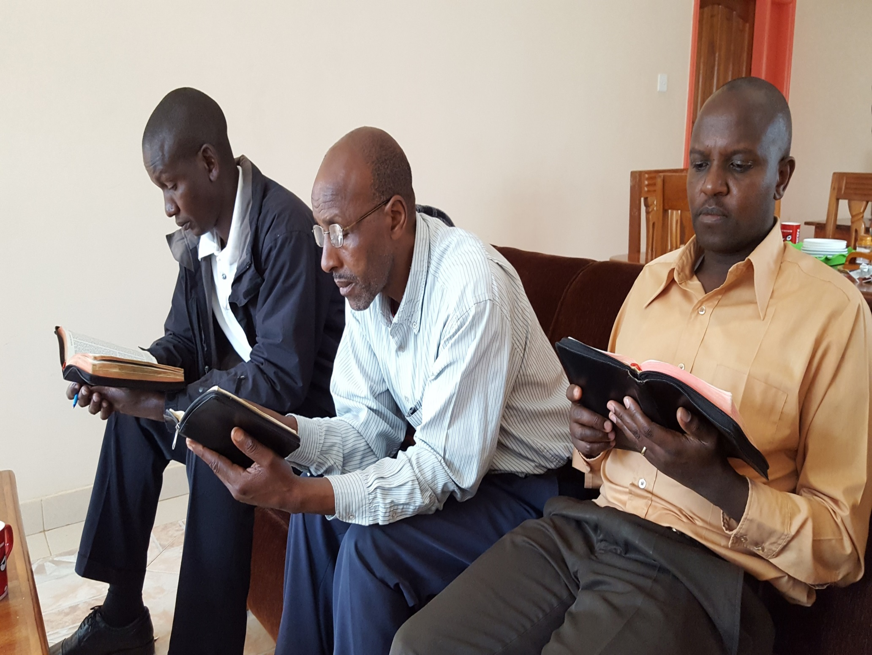

Slide 16
Day 2, Thursday, August 18
Afternoon study with brethren from Mukurwe-ini, from 2:30 till 4:30 p.m.
I surveyed Philippians, with an emphasis on the mind of a Christian; Brad spoke on the parable of the sower.
Two ladies who were not Christians attended. Jack had an extended discussion with one of them (Lydia) after the lessons. Maintained her baptism as a child was valid.
Afterwards, some ladies prepared us food and drink.

Slide 17
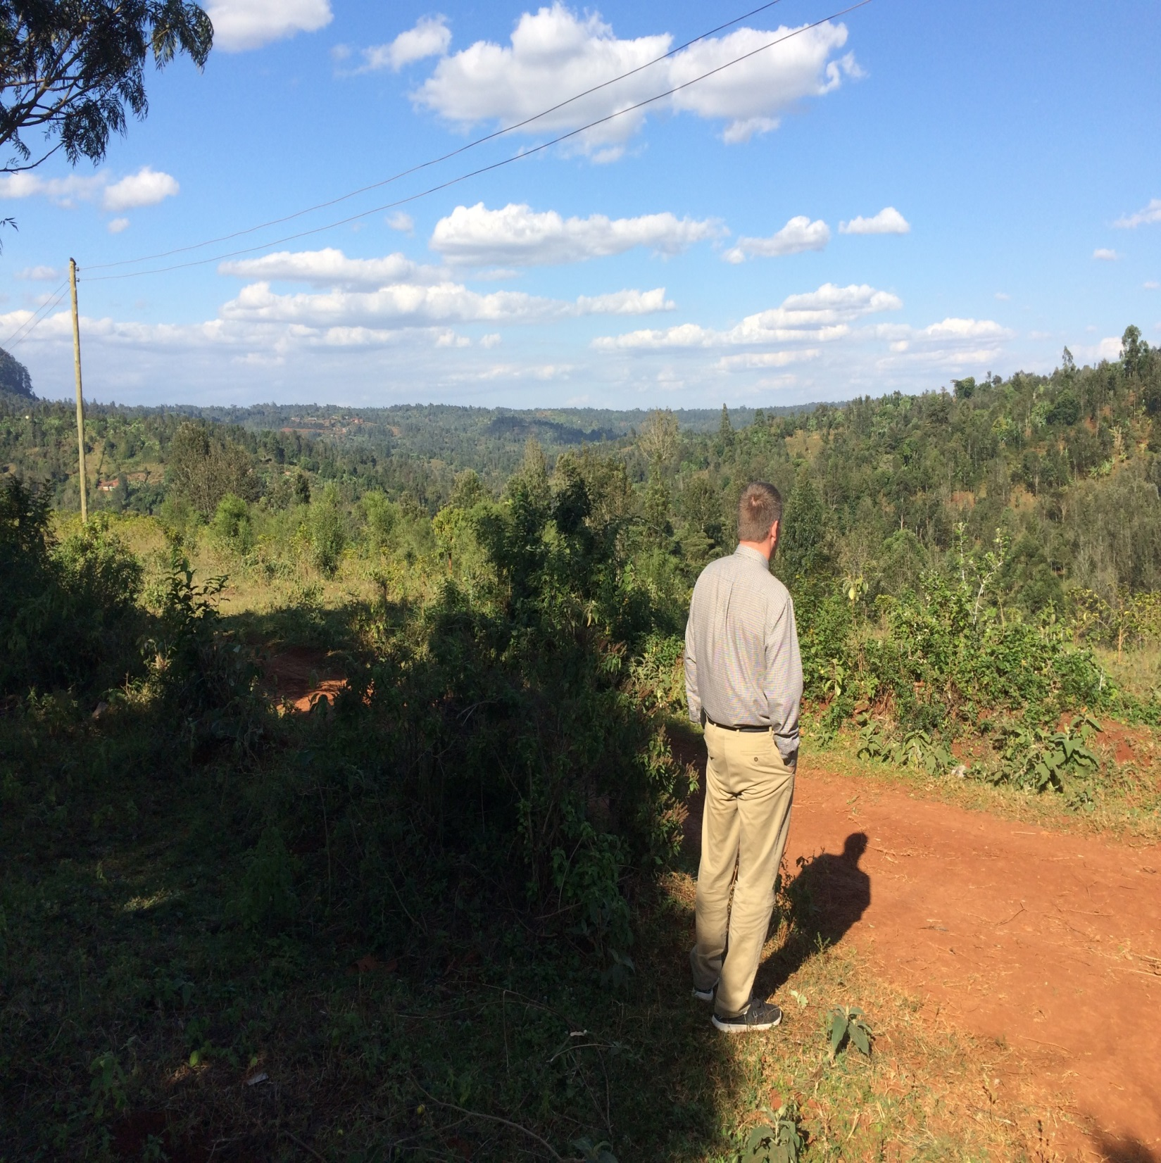

Slide 18
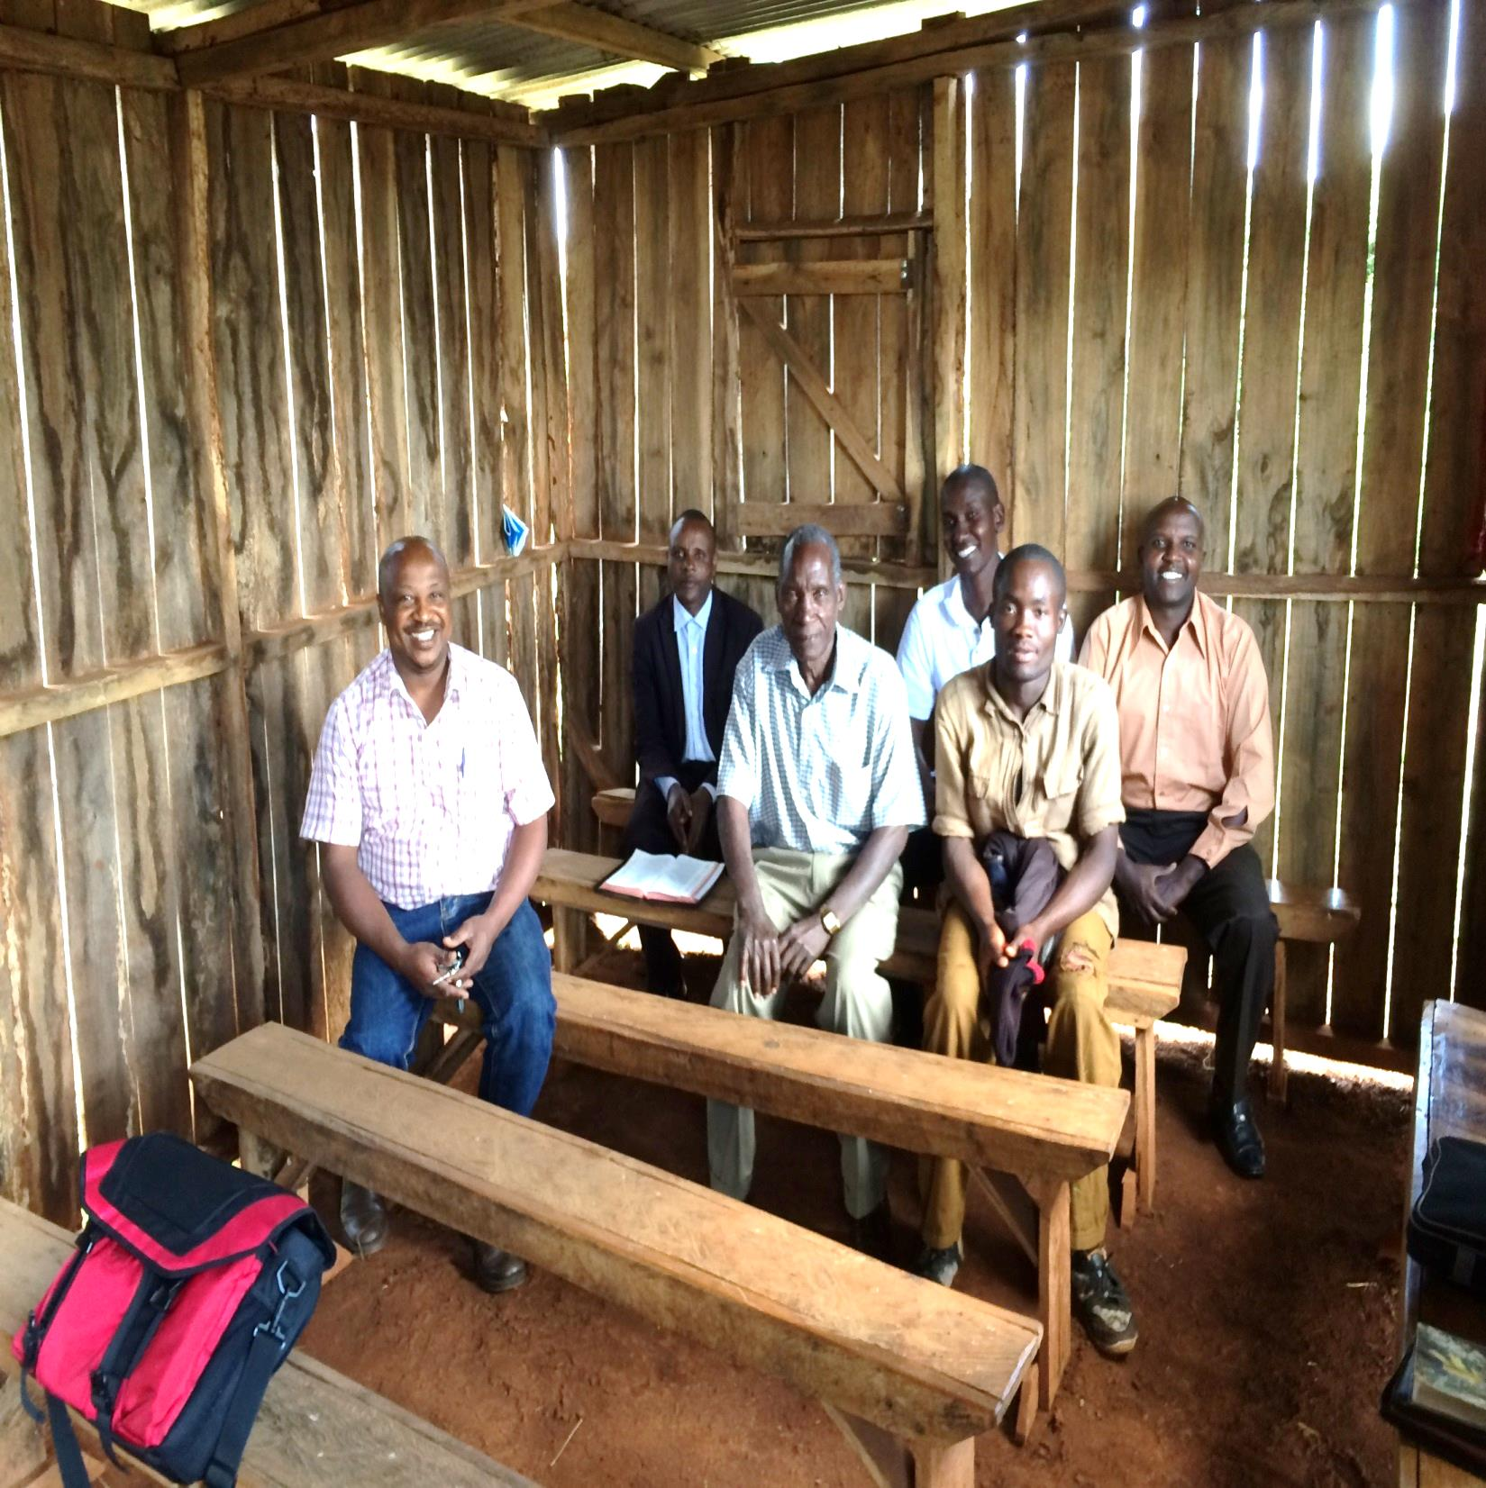

Slide 19
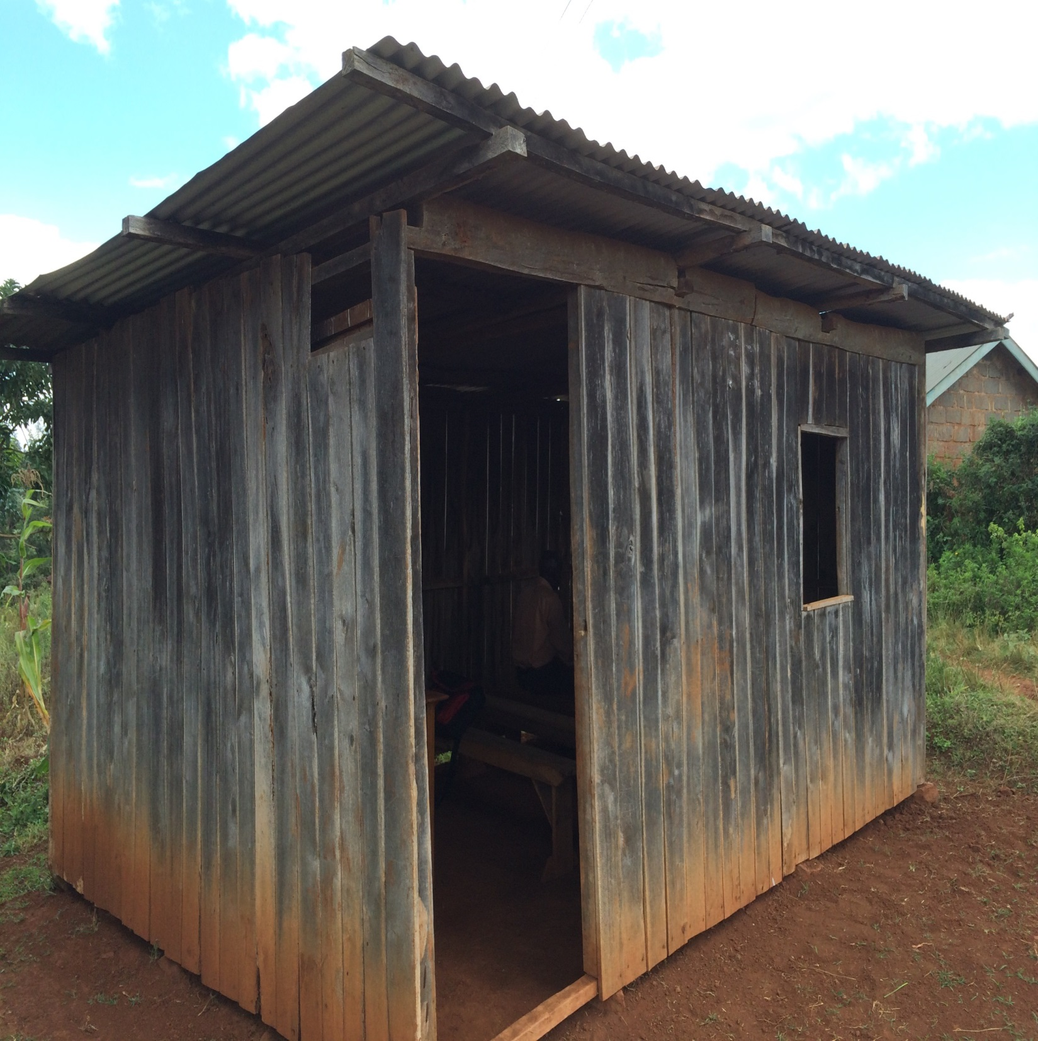

Slide 20
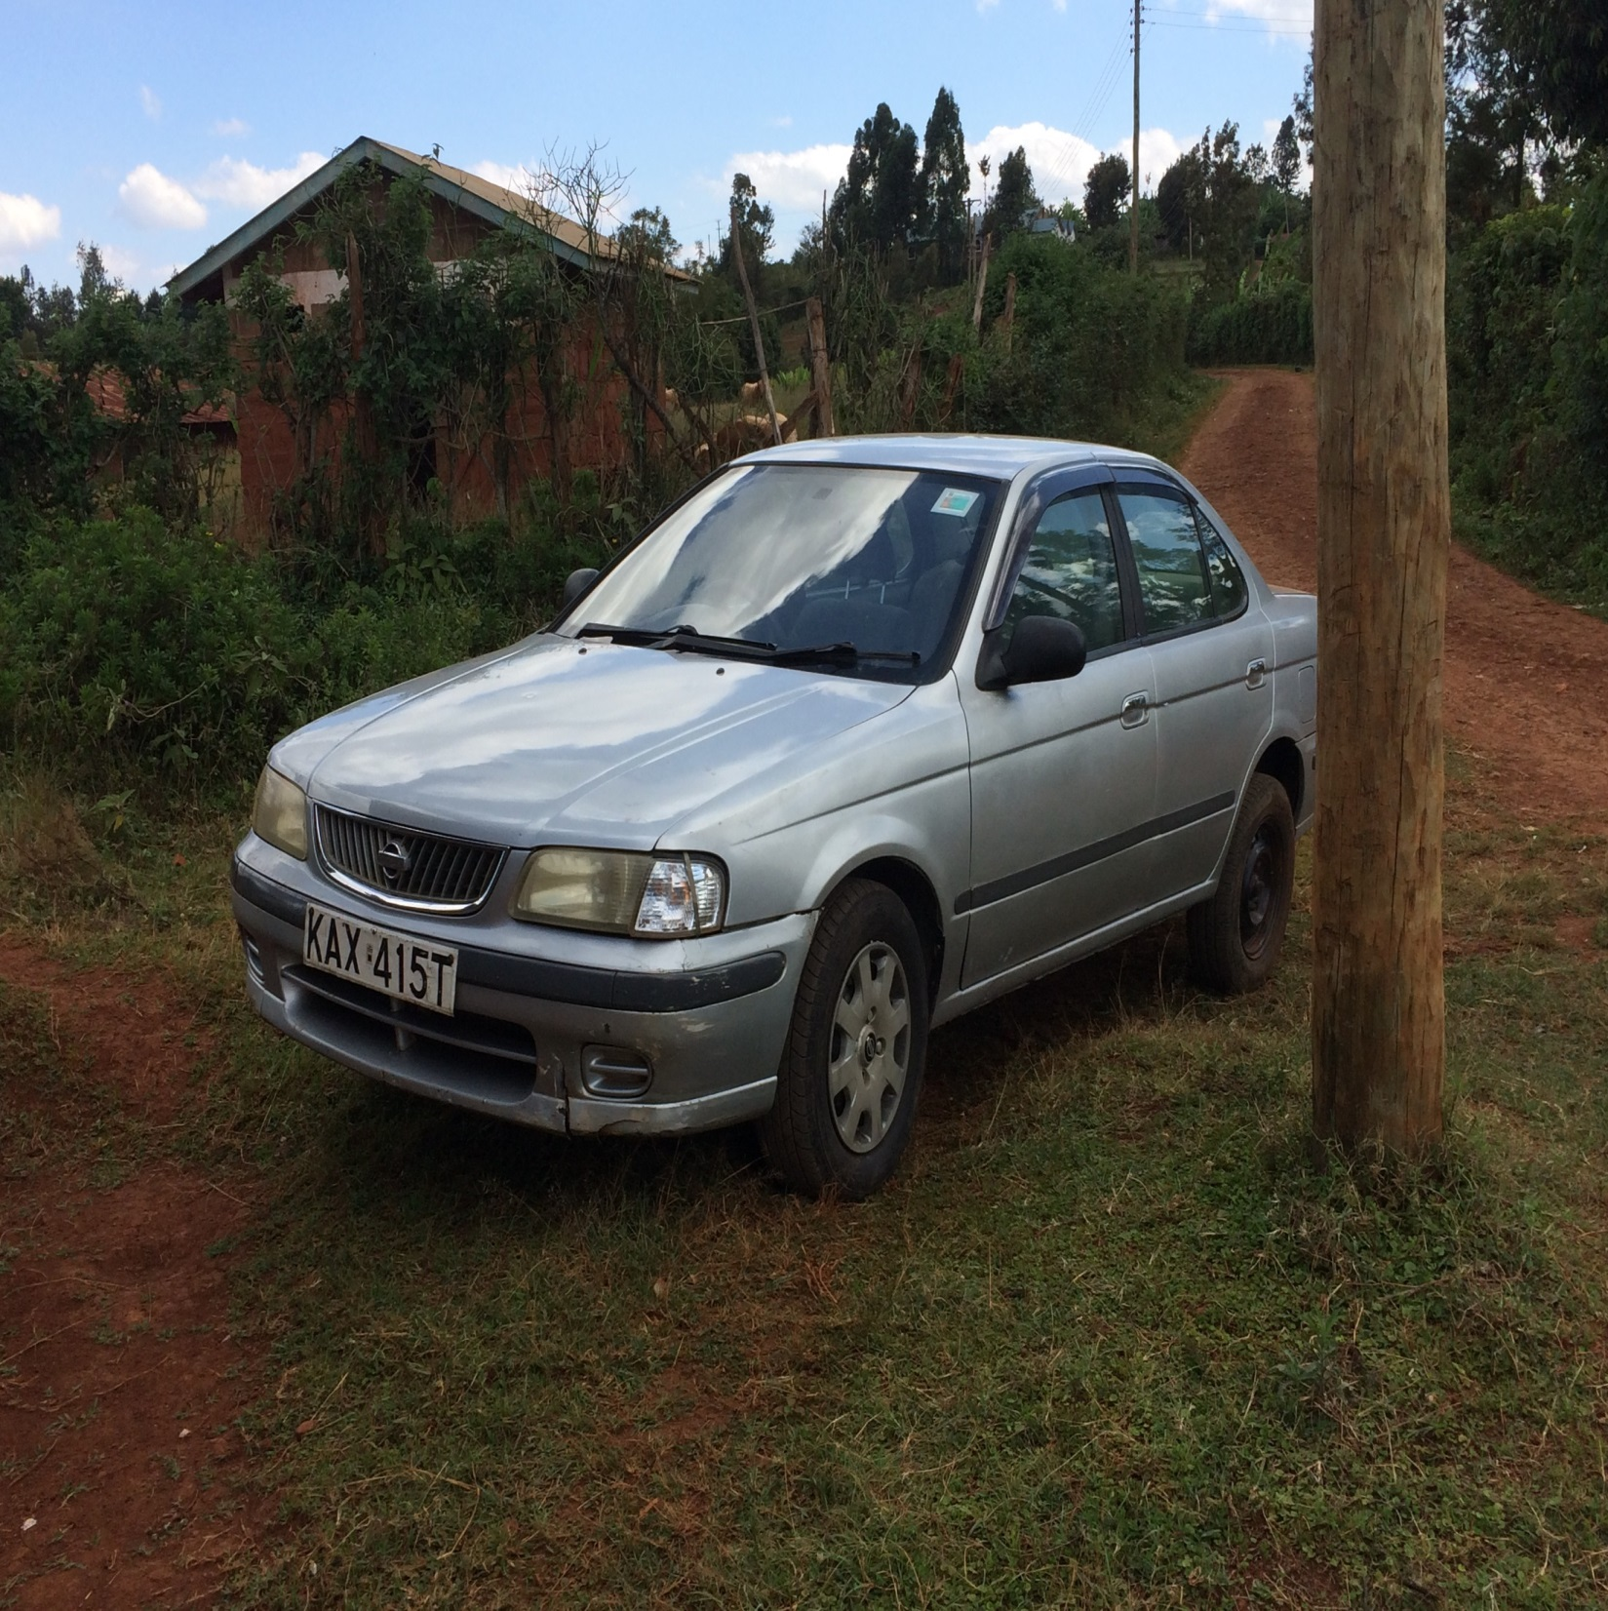

Slide 21
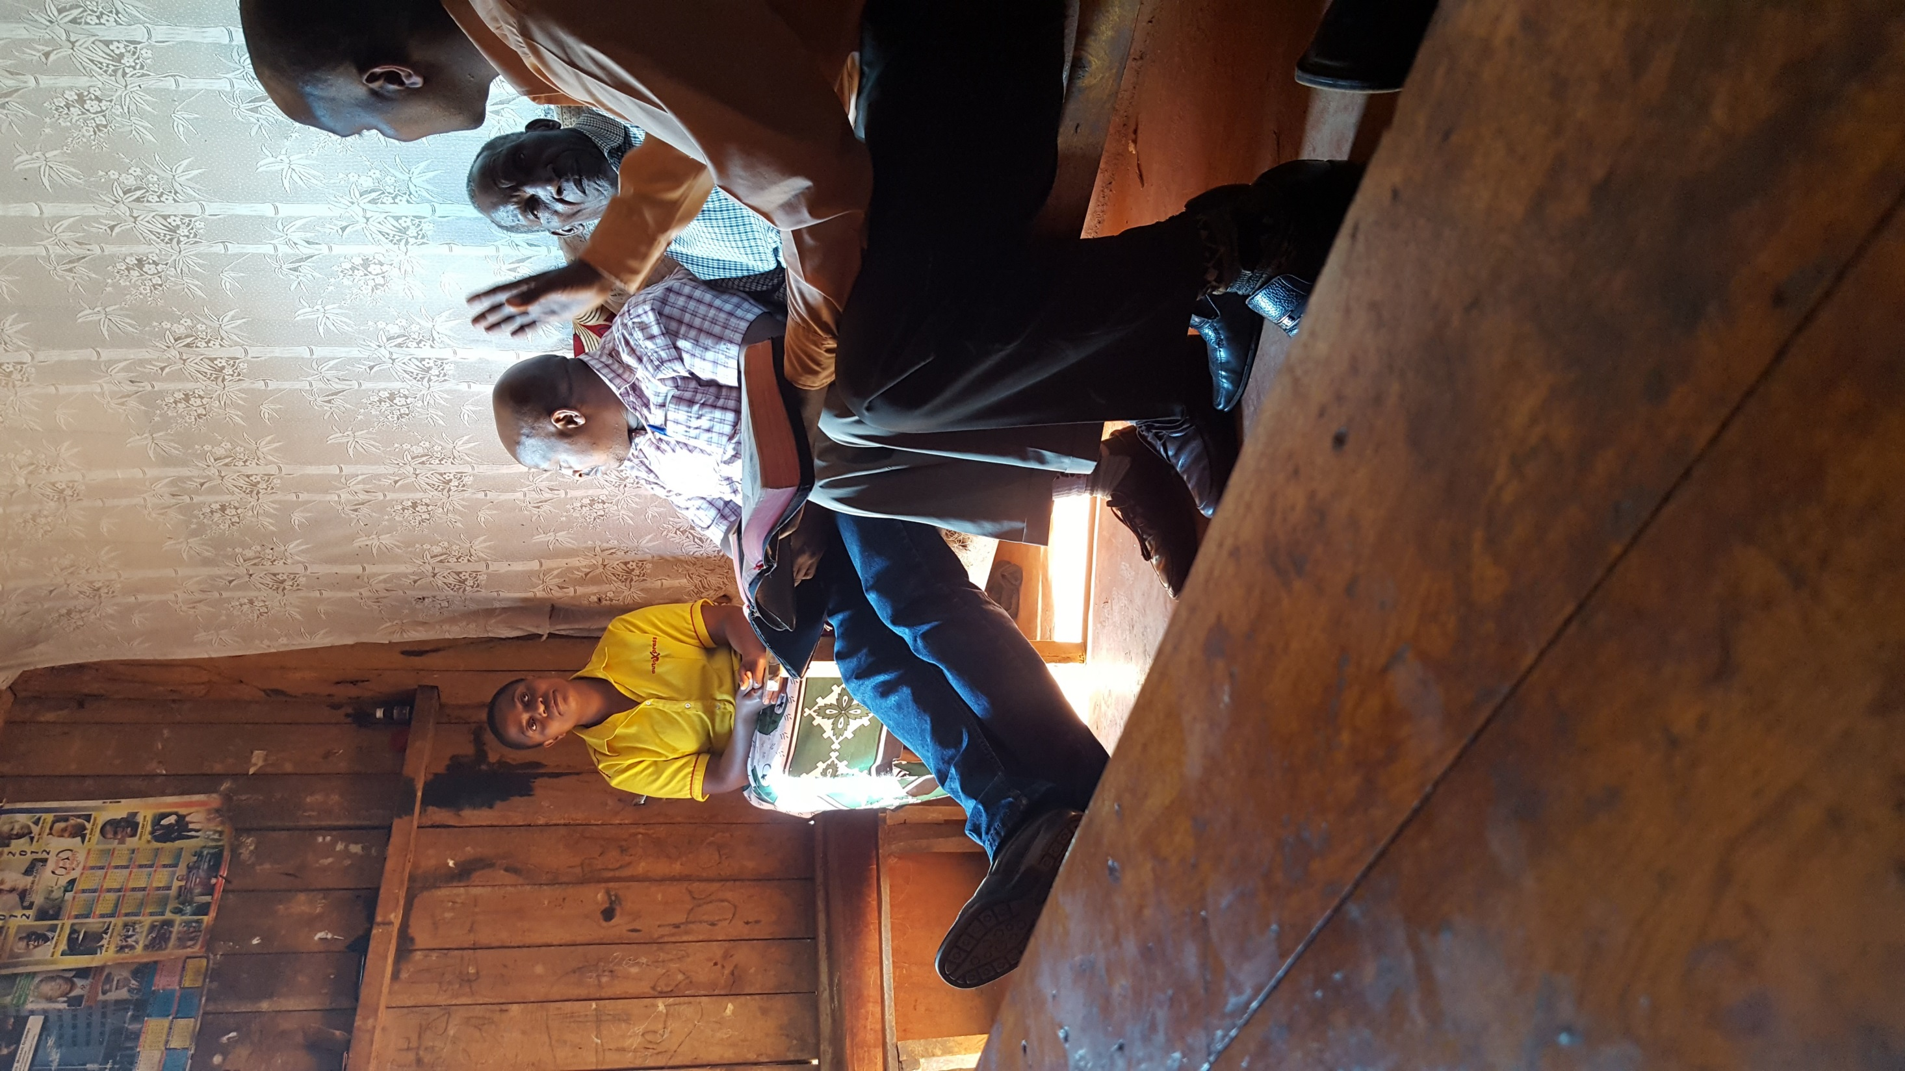

Slide 22
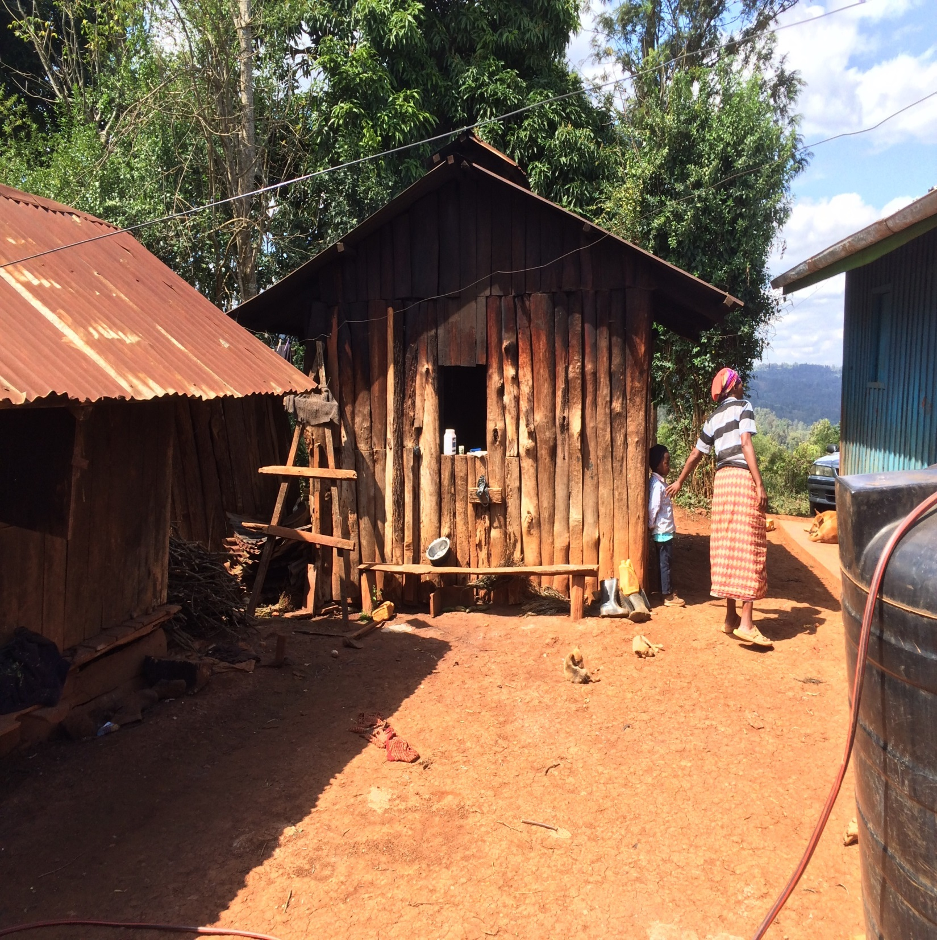

Slide 23
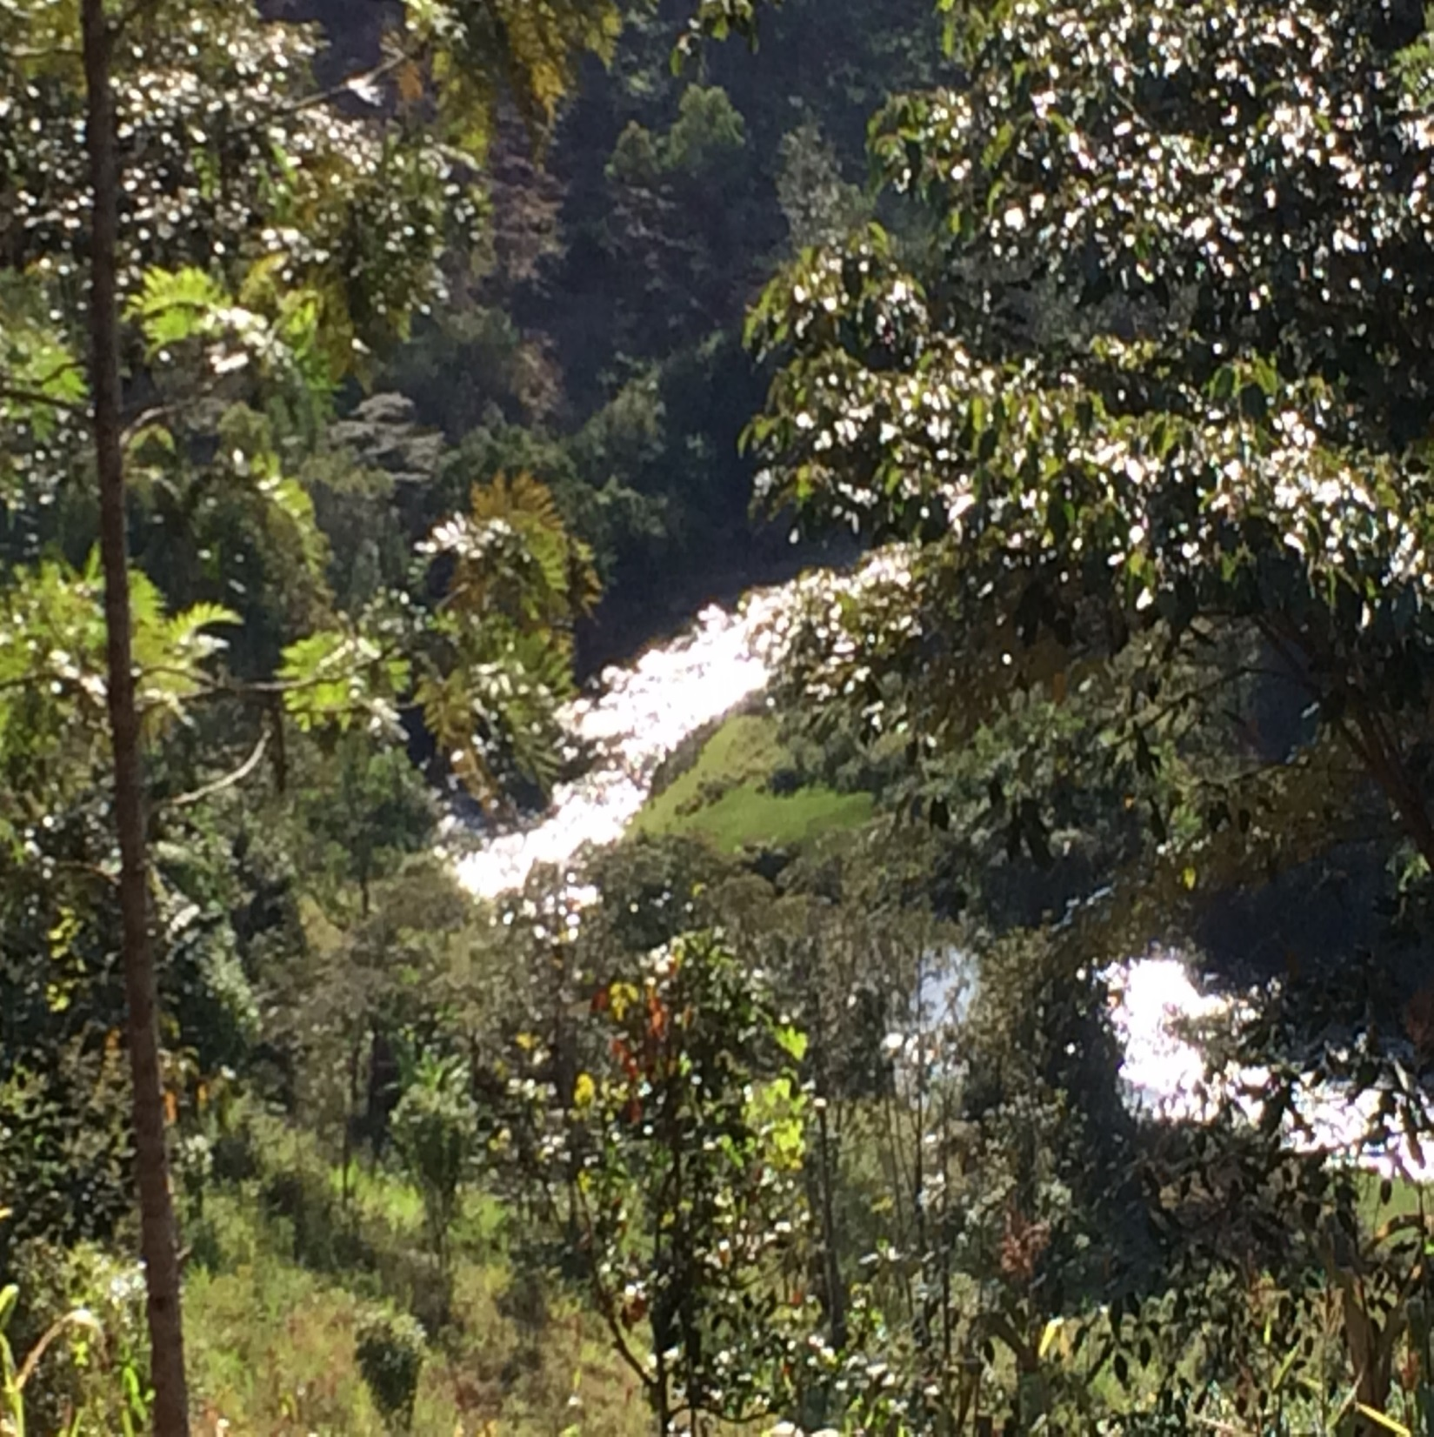

Slide 24
Day 2, Thursday, August 18
Some in the village nearby were having a “wake,” and the custom is to invite others to speak a word of encouragement.
I preached on the doctrine of salvation by faith only; Brad spoke from Ecclesiastes 7:1-4.
Several ladies expressed an interest in further study, as well as a Presbyterian minister. These ladies were in the “Women’s Guild” of the Presbyterian church.
We were there from 5:30 p.m. till 6:30 p.m.

Slide 25
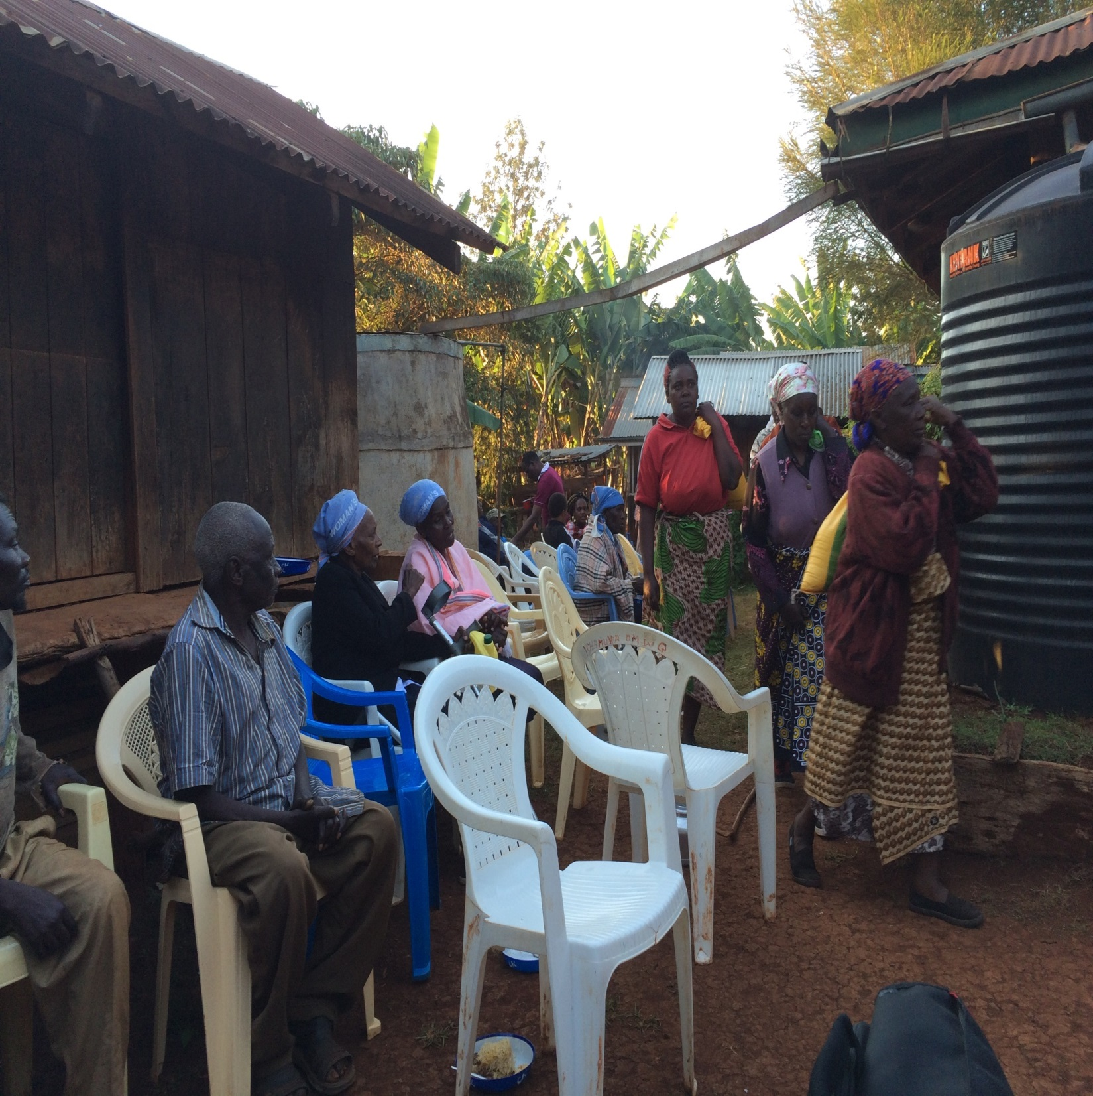

Slide 26
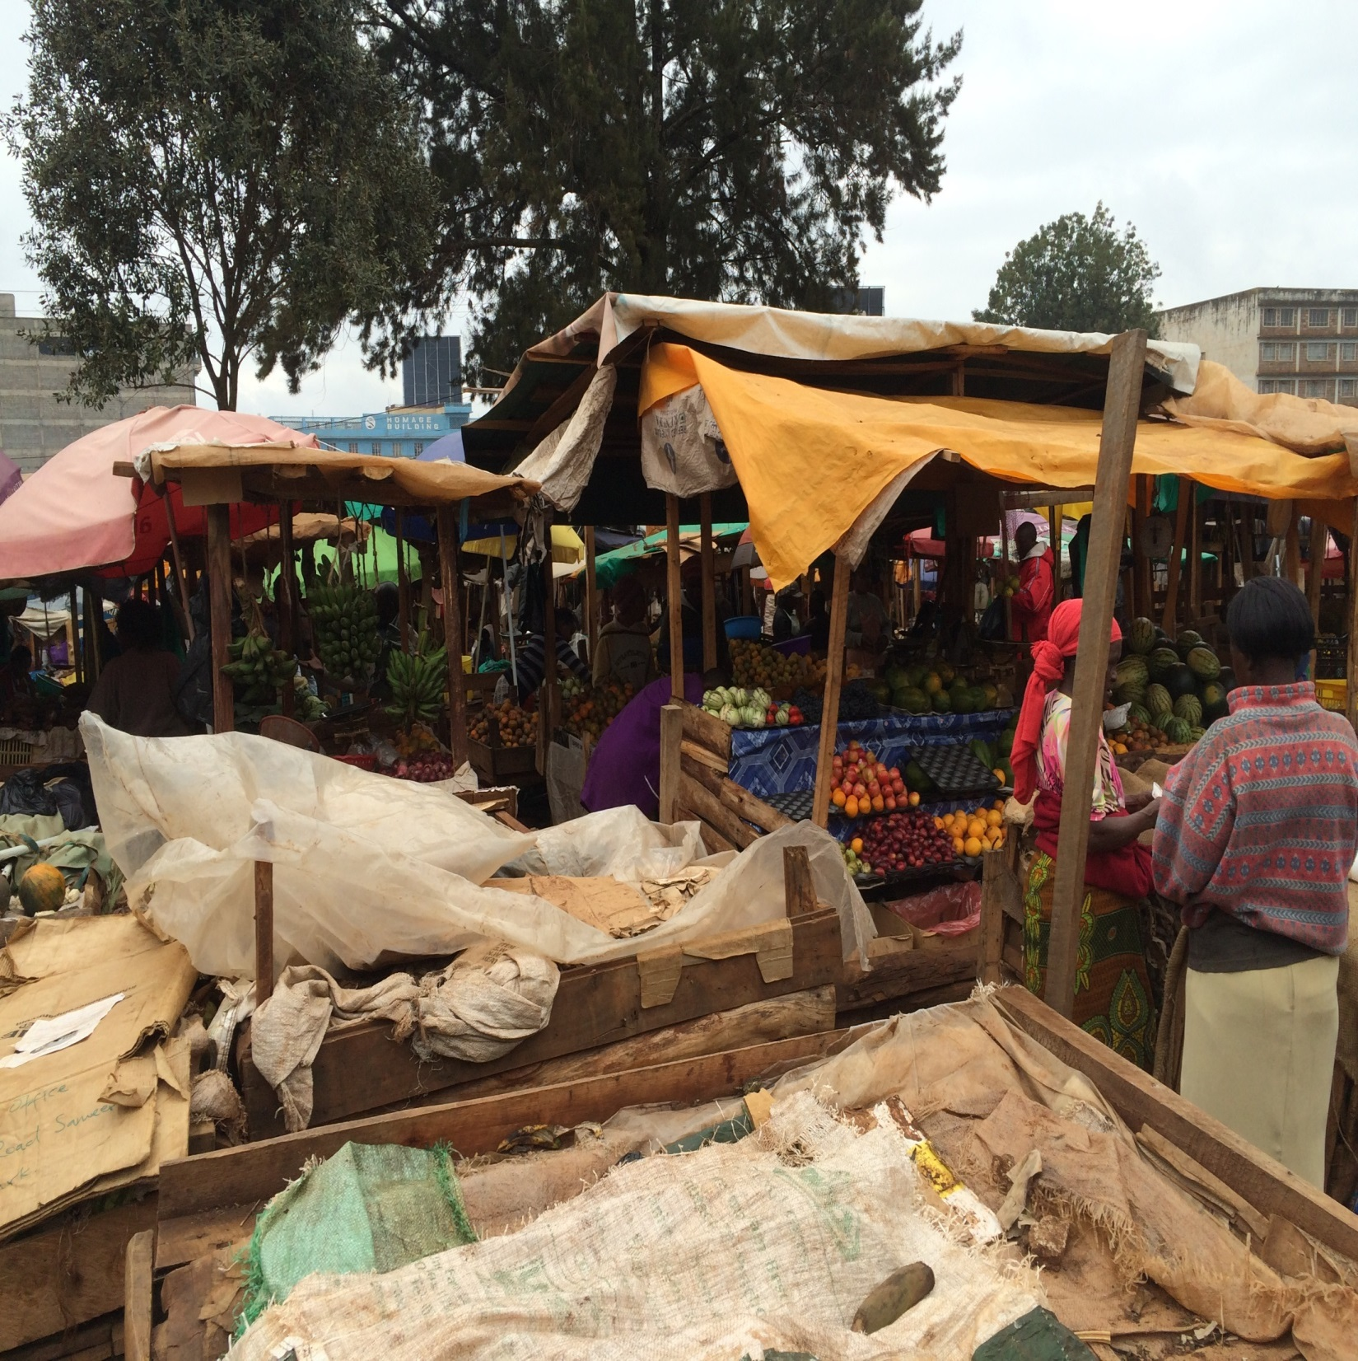

Slide 27
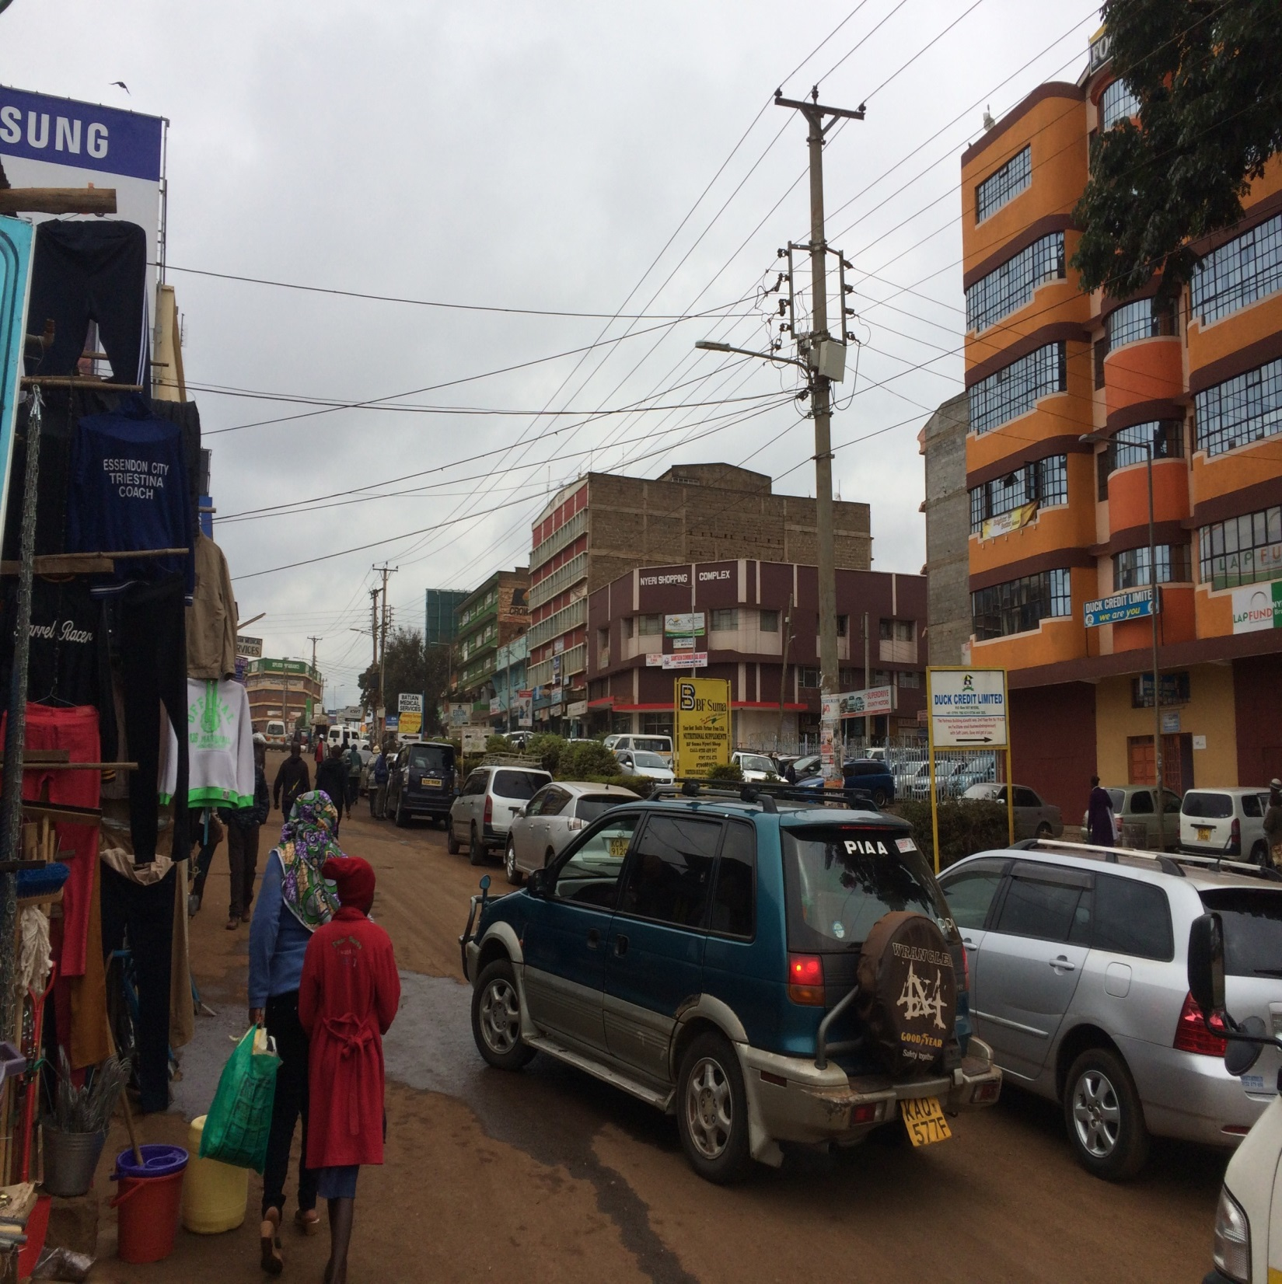

Slide 28
Day 3, Friday, August 19
Morning study with brethren at Endarasha, from 10:30 till 12:30.
Brad preached on “Don’t Be Afraid of the Truth”; I preached on “From Heaven, or From Men,” with a look at 5 different doctrines.
Talked extensively with a lady afterwards who had recited the “sinner’s prayer.” Did not respond, but follow up studies will be made by John (local preacher).
“Spectator sport”; rough drive; flat tire.

Slide 29
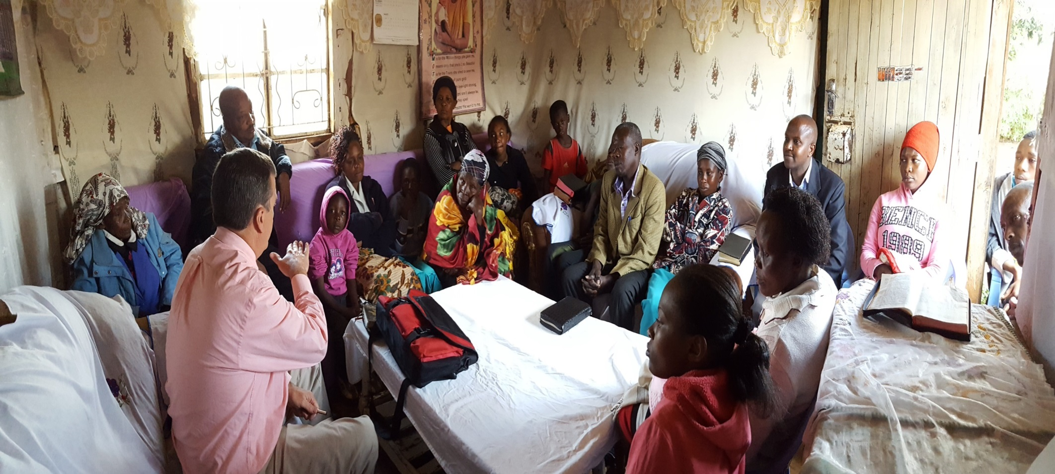

Slide 30
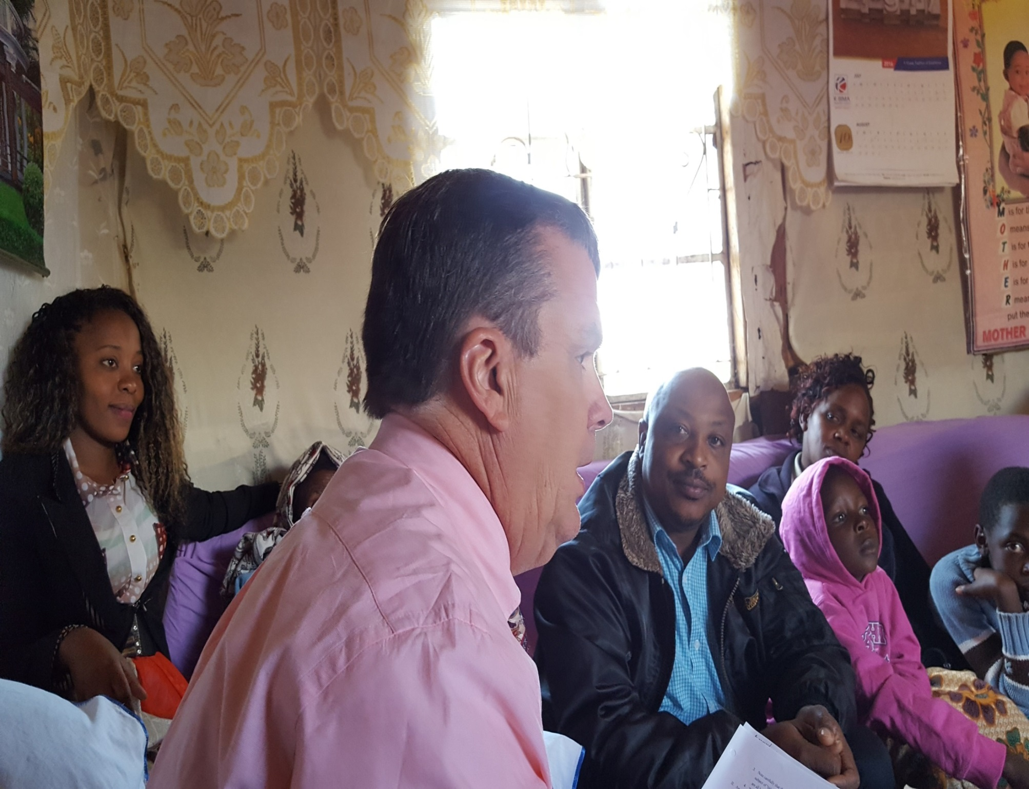

Slide 31
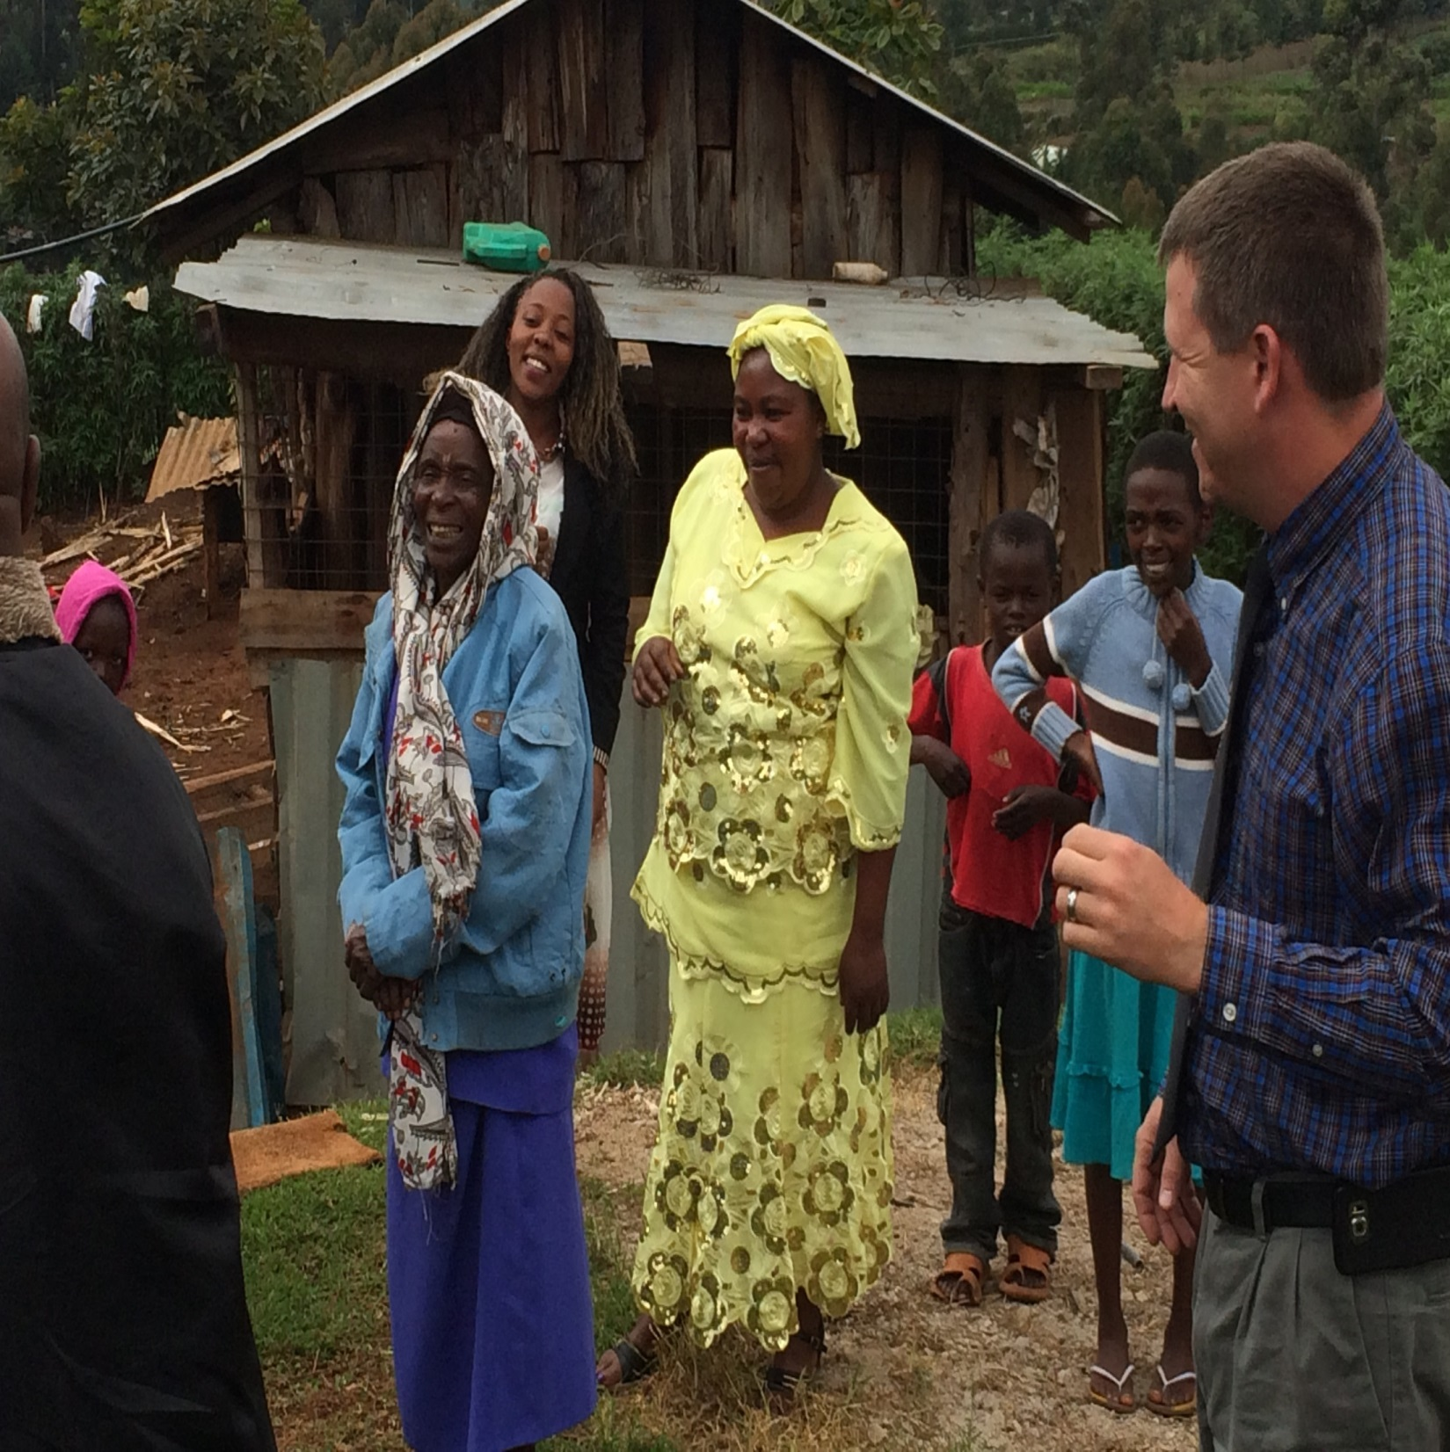

Slide 32
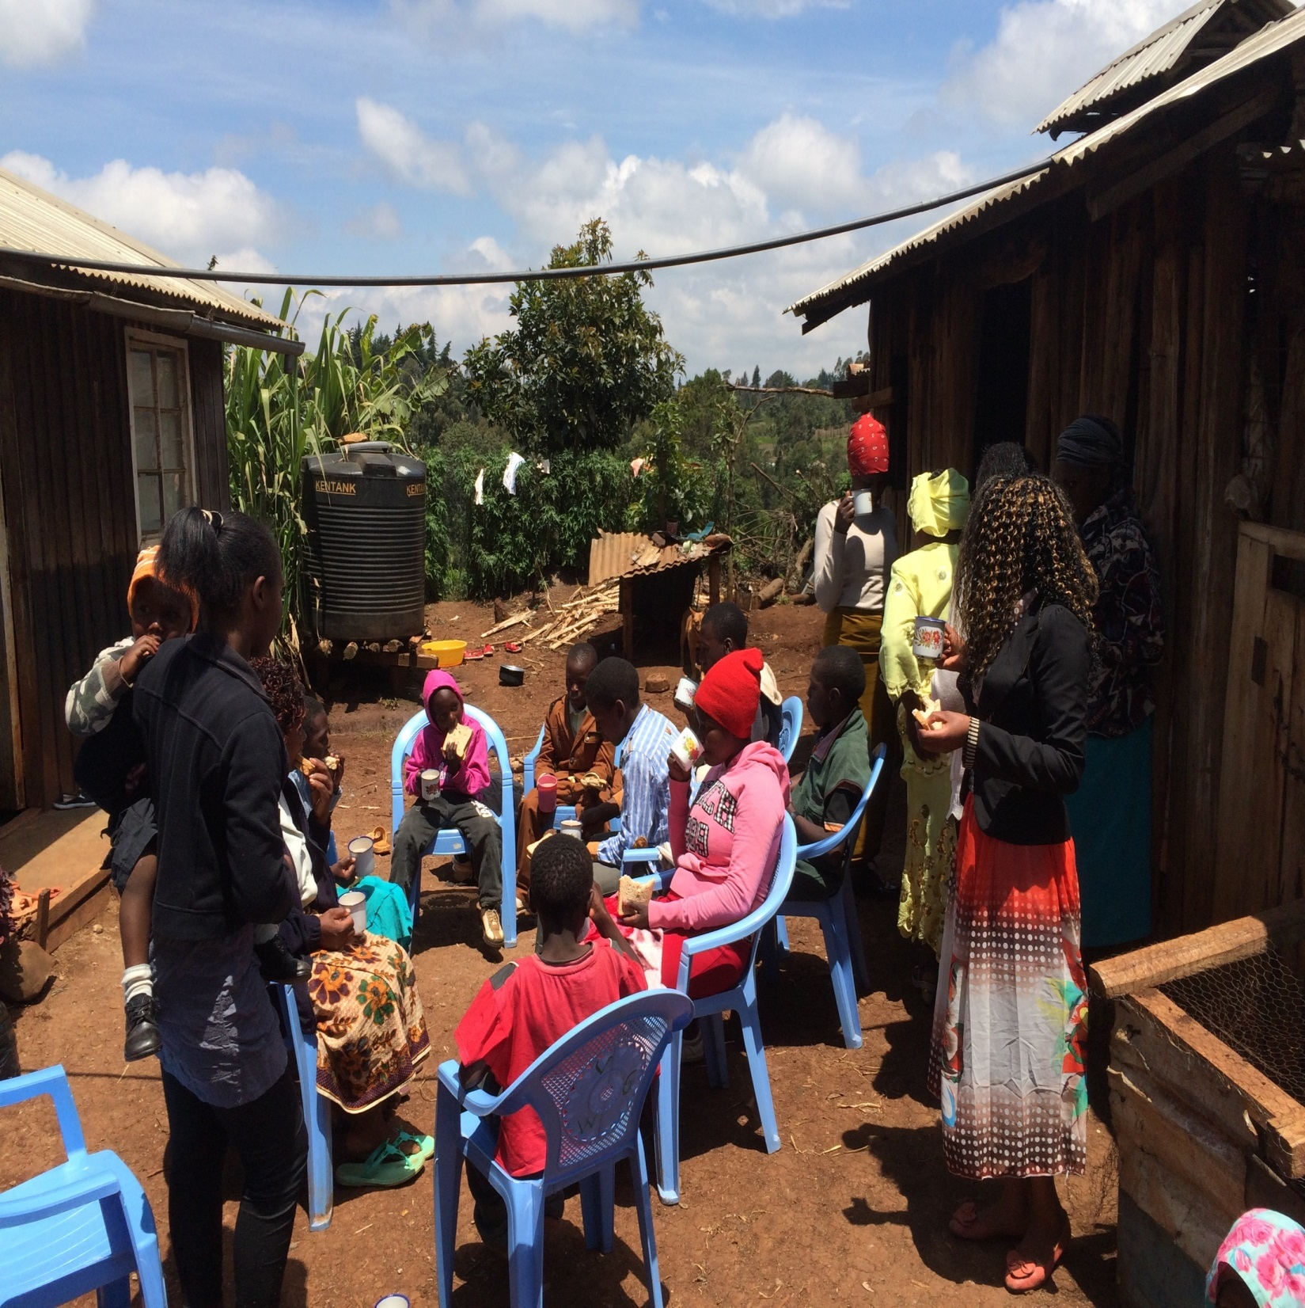

Slide 33
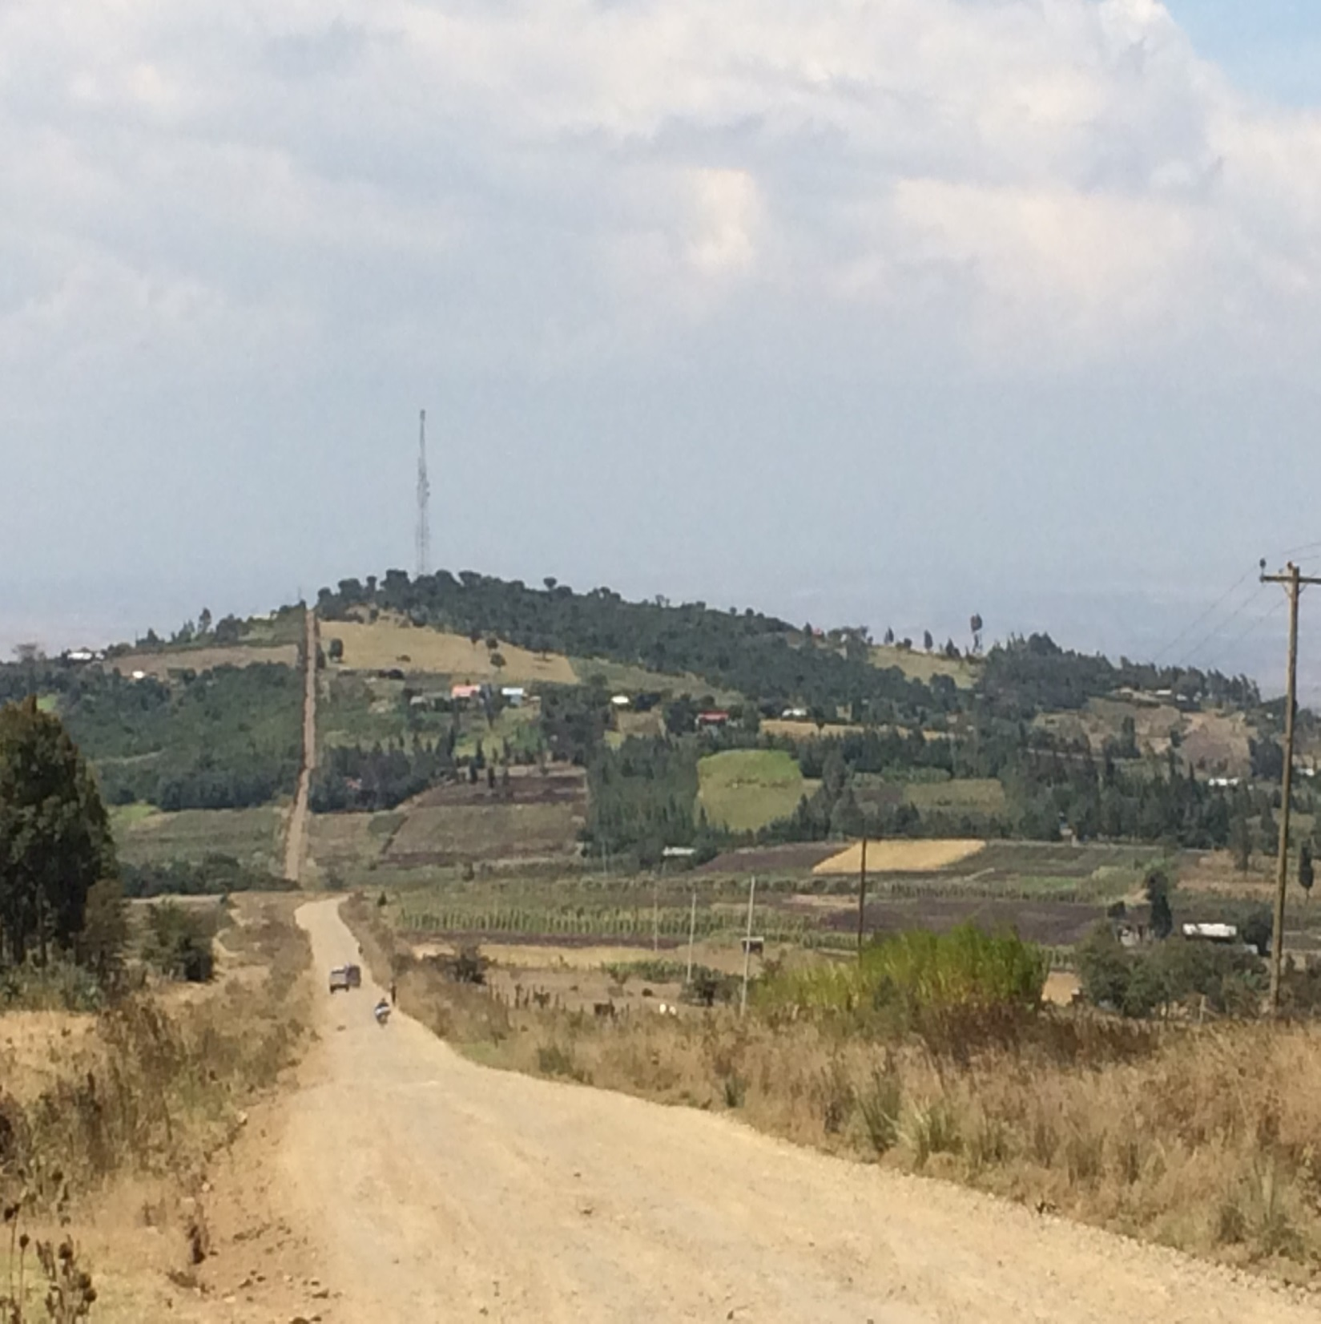

Slide 34
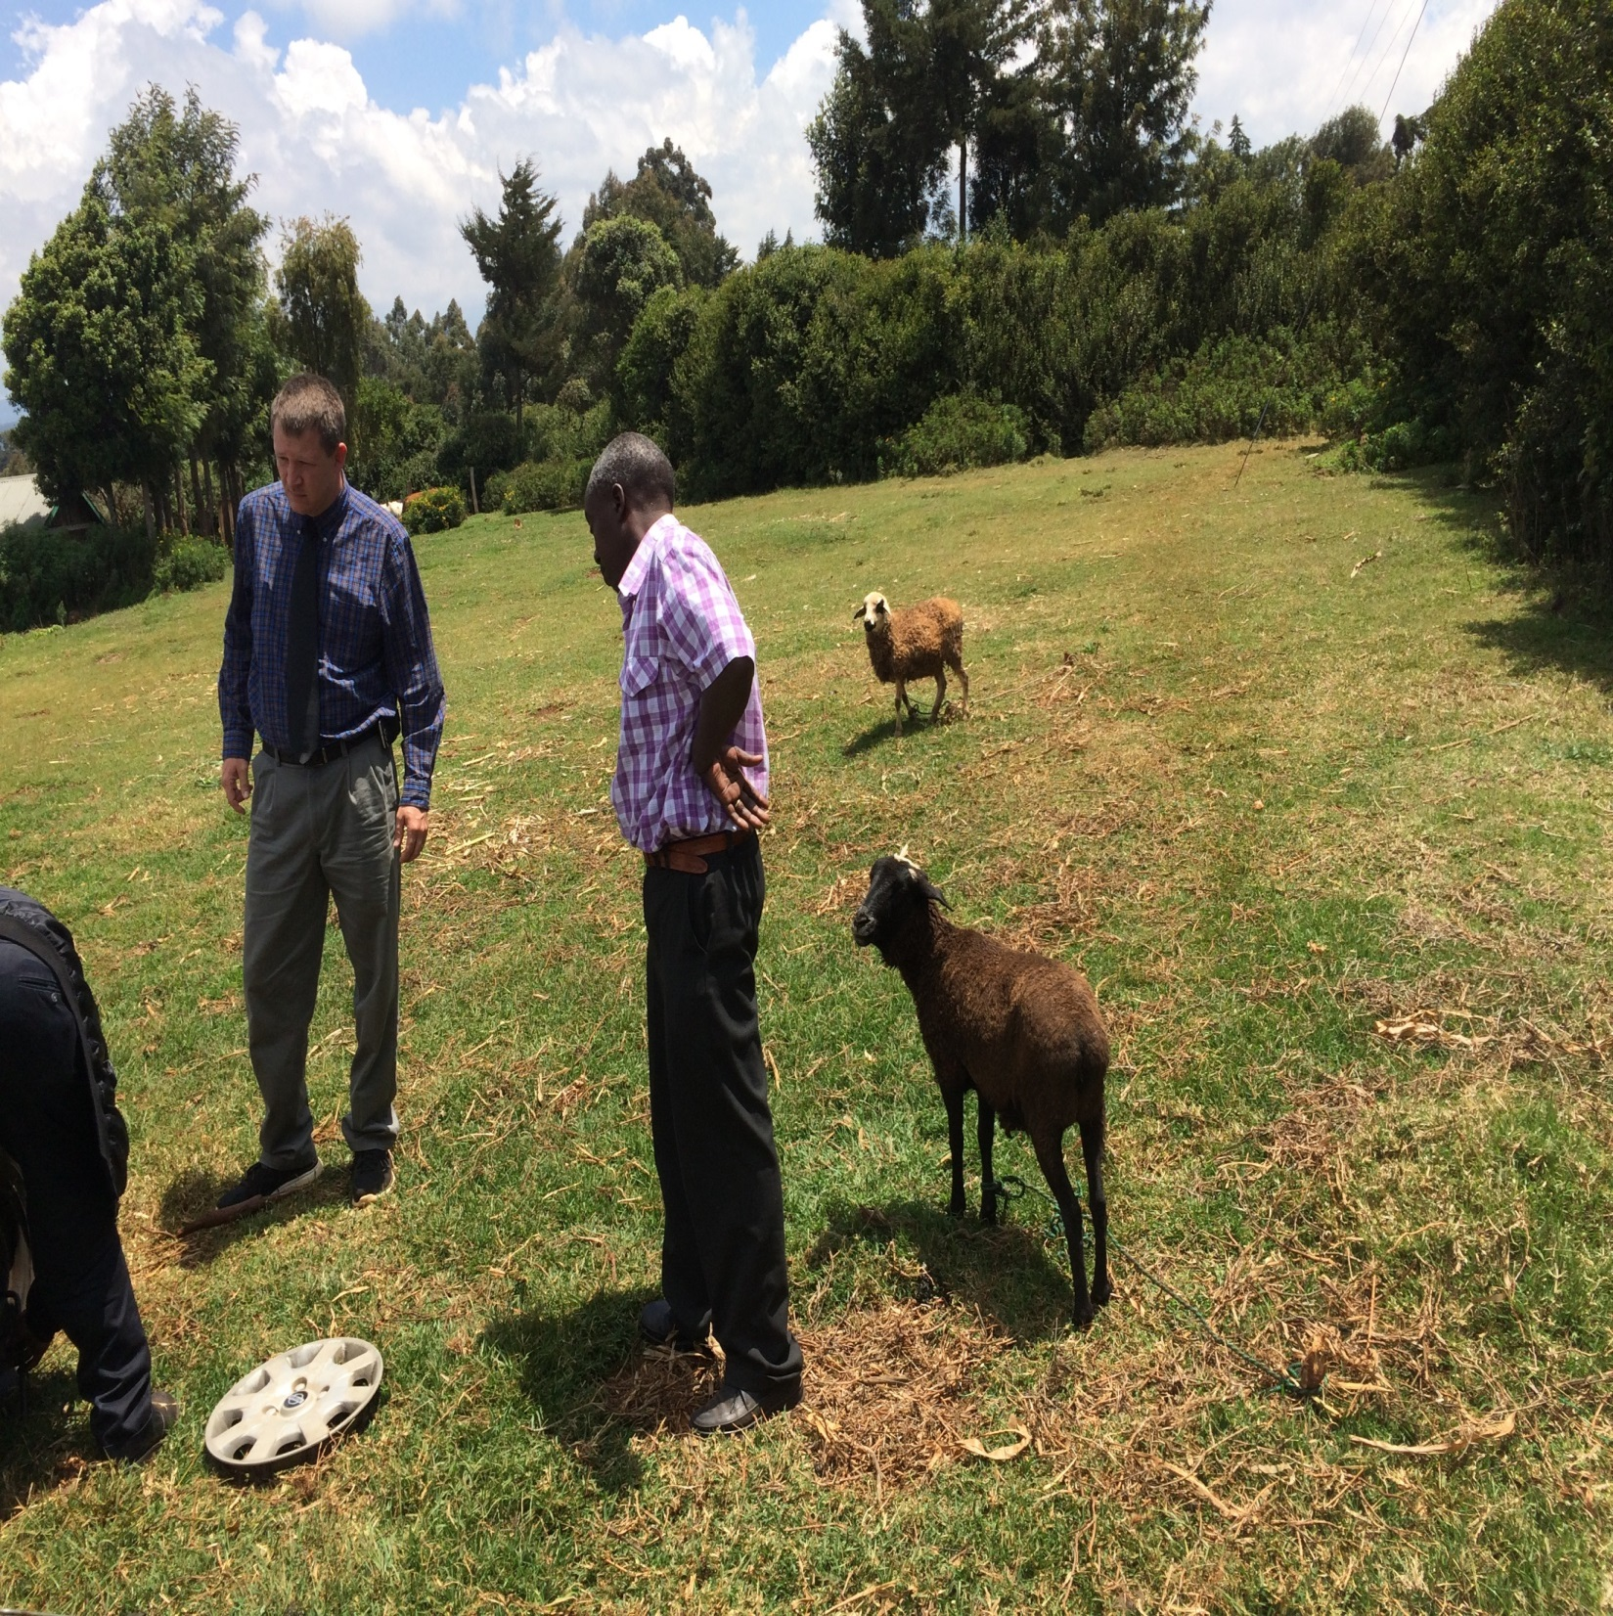

Slide 35
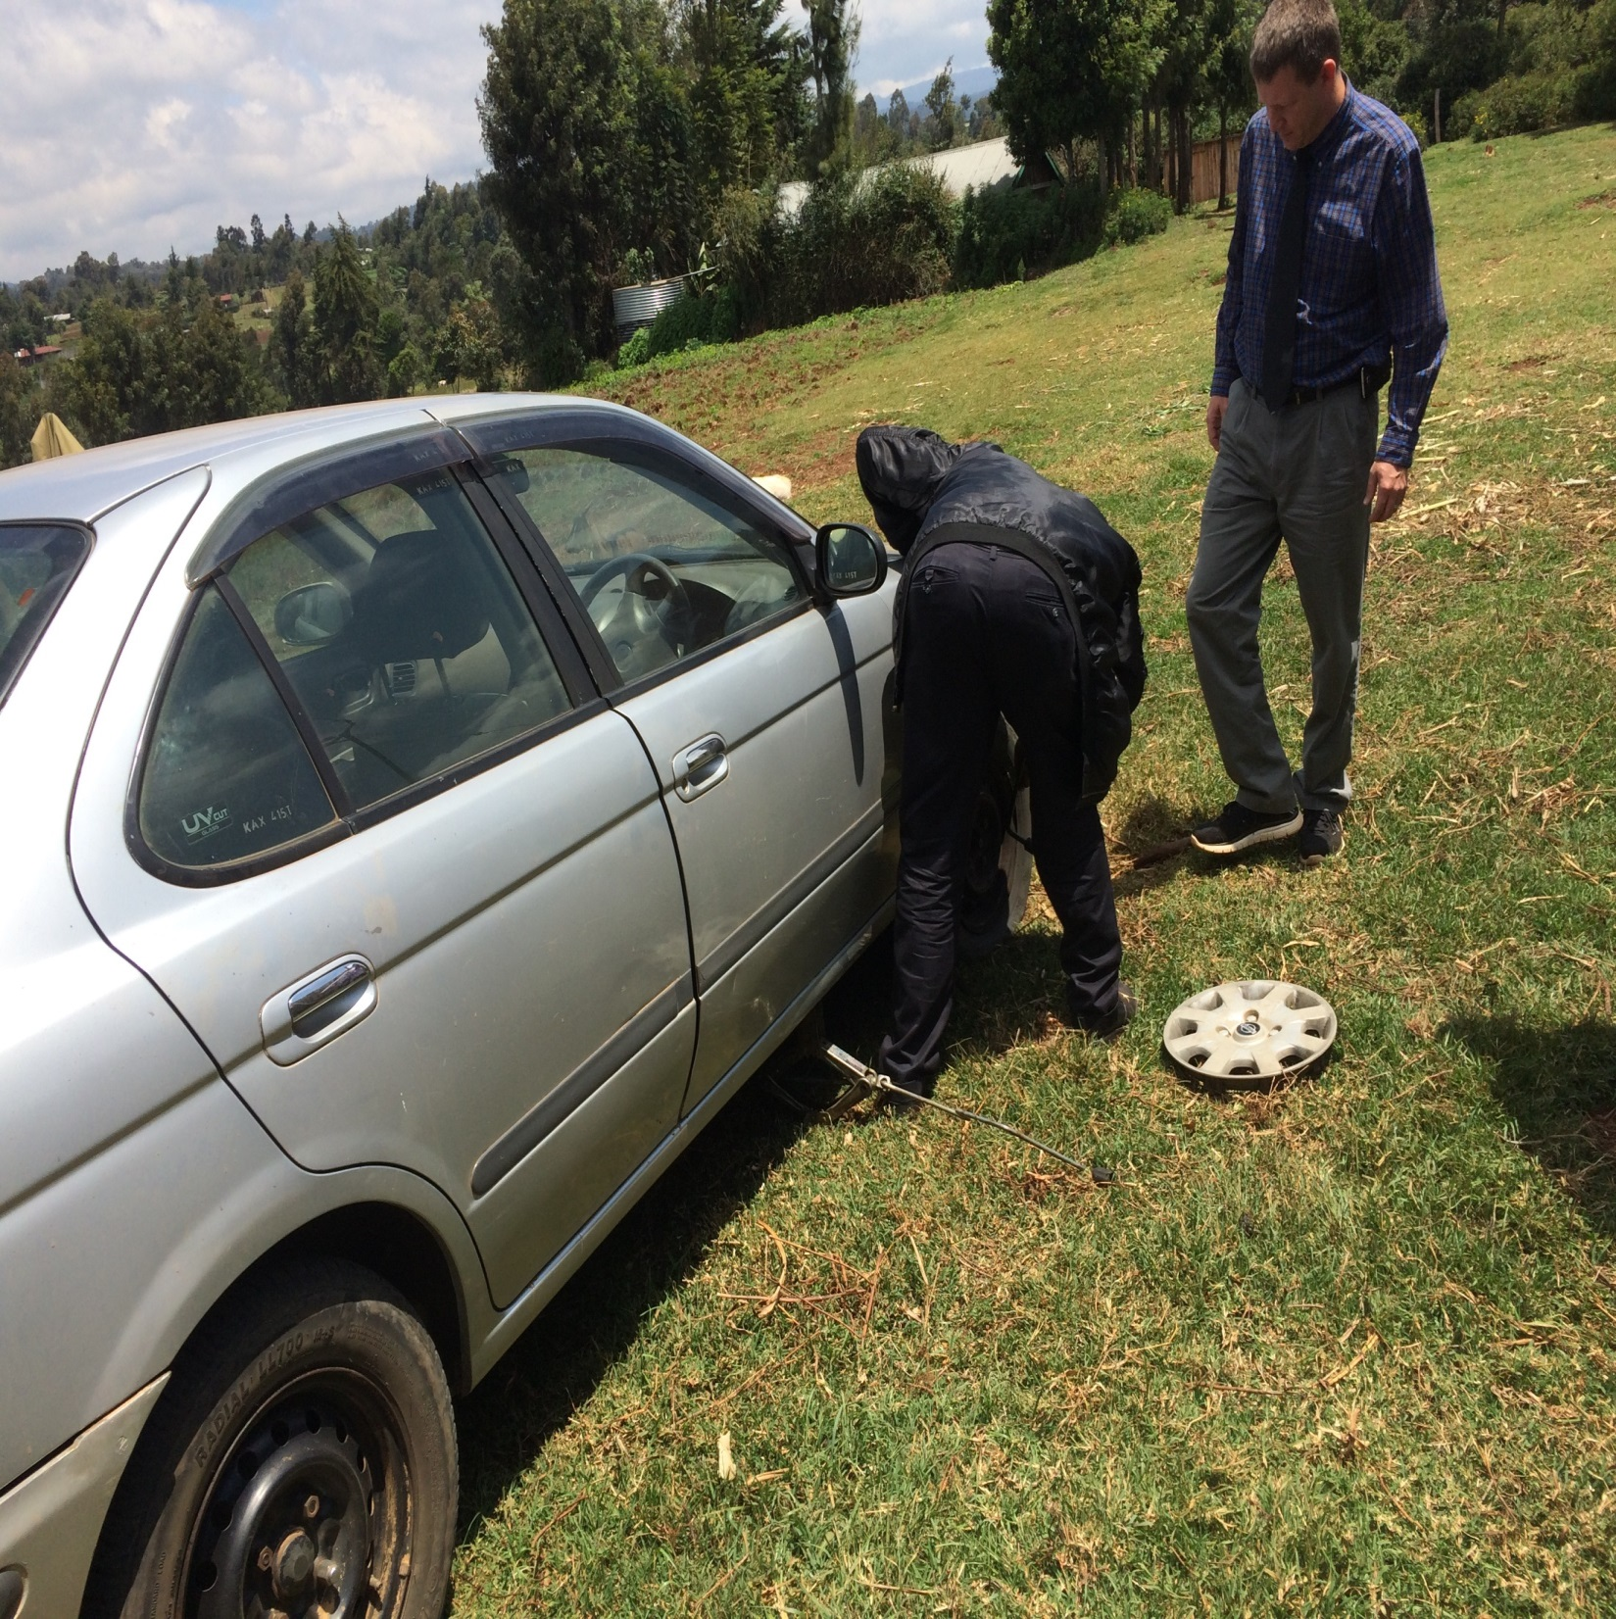

Slide 36
Day 3, Friday, August 19
Preacher training studies from 2:45 till 6 p.m.
Continued studies in Revelation. Brad presented a lesson on chapters 2-3; I outlined chapters 1-11, Brad 12-14, I finished with chapters 15-22.
Seven were present: Wilson, Jack, Stephen (Wilson’s son), Elijah, Samuel, Peter, and John. Richard came toward the end.

Slide 37
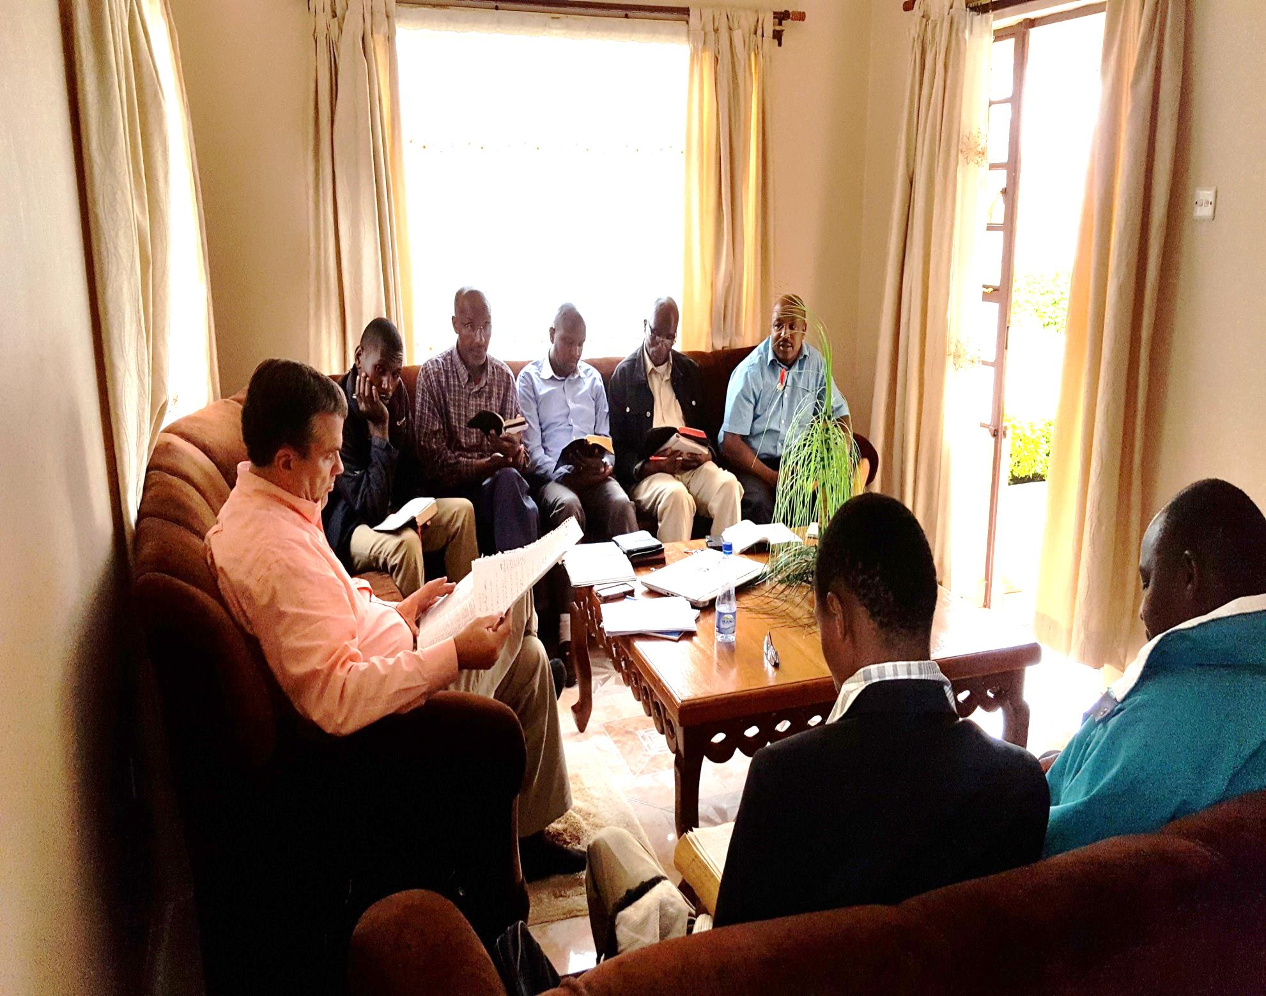

Slide 38
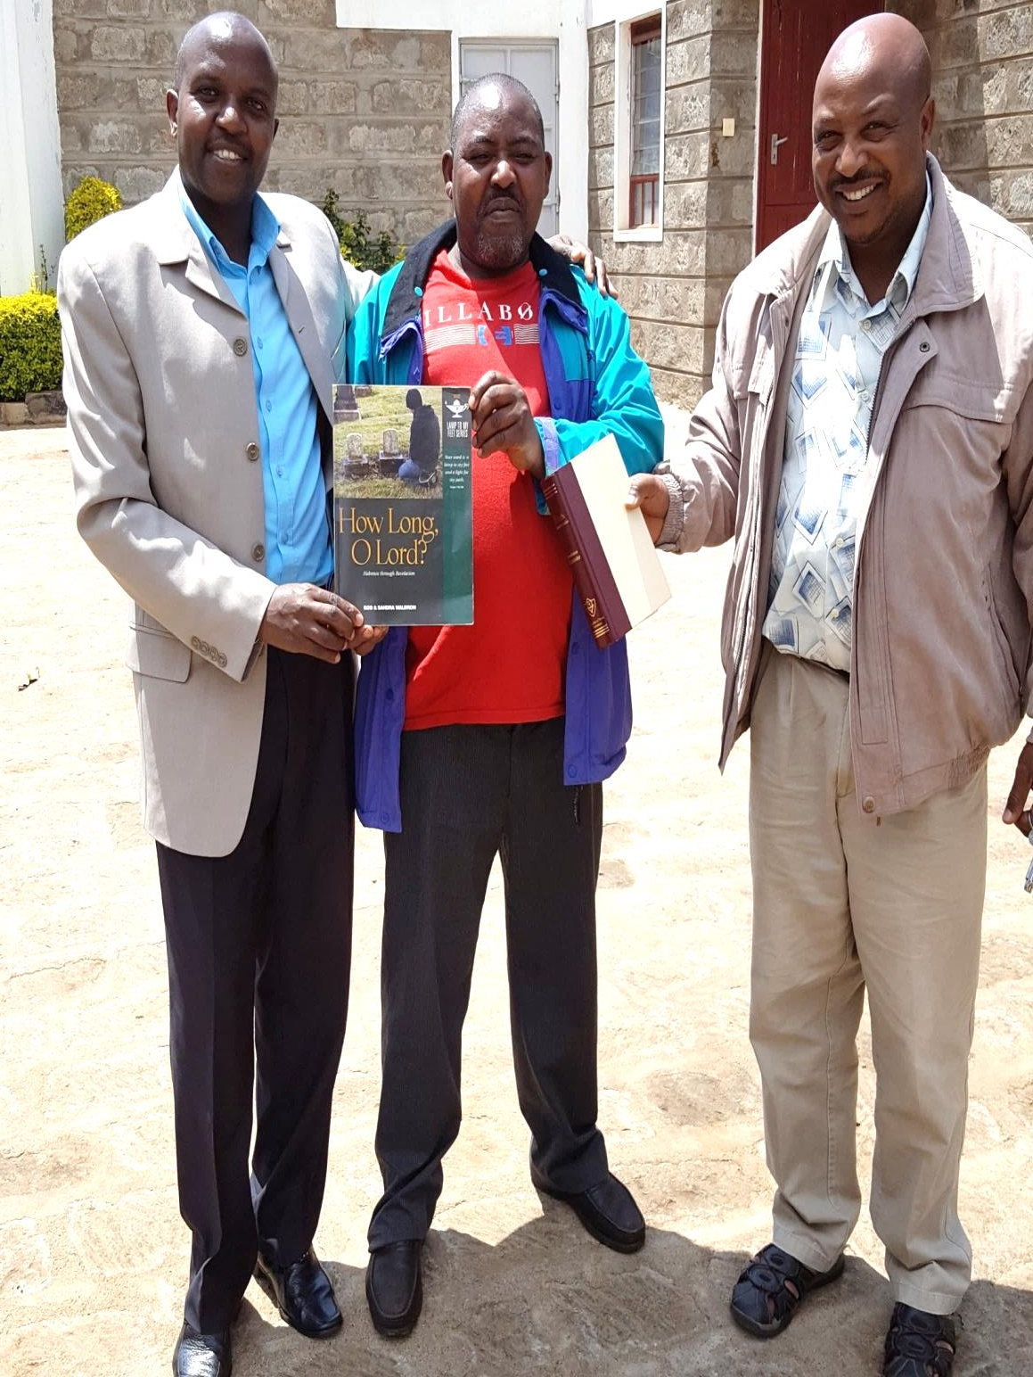

Slide 39
Day 4, Saturday, August 20
Preacher training studies scheduled for 9 a.m., but Richard brought a visitor, a man named Apollo.
Turned into a long Bible study with him. Discussed the authority of the N.T., baptism, elders and deacons, thief on the cross, the sinner’s prayer, etc. Went till 11:30.
Went immediately into further study of Revelation: I discussed the 1000 year reign (ch. 20); Brad discussed the 144,000 (chs. 7, 14).
Left at 2:15 for studies at Kagonye.

Slide 40
Day 4, Saturday, August 20
Studies with brethren at Kagonye, from 3:30 till 5.
I spoke on the need for doctrinal purity (much needed); Brad spoke on the need to develop teachers.
First time we encountered singing in the native tongue (Kikuru).
We then sang on the way back to Nyeri—Brad and I in English, the others in Kikuru.

Slide 41
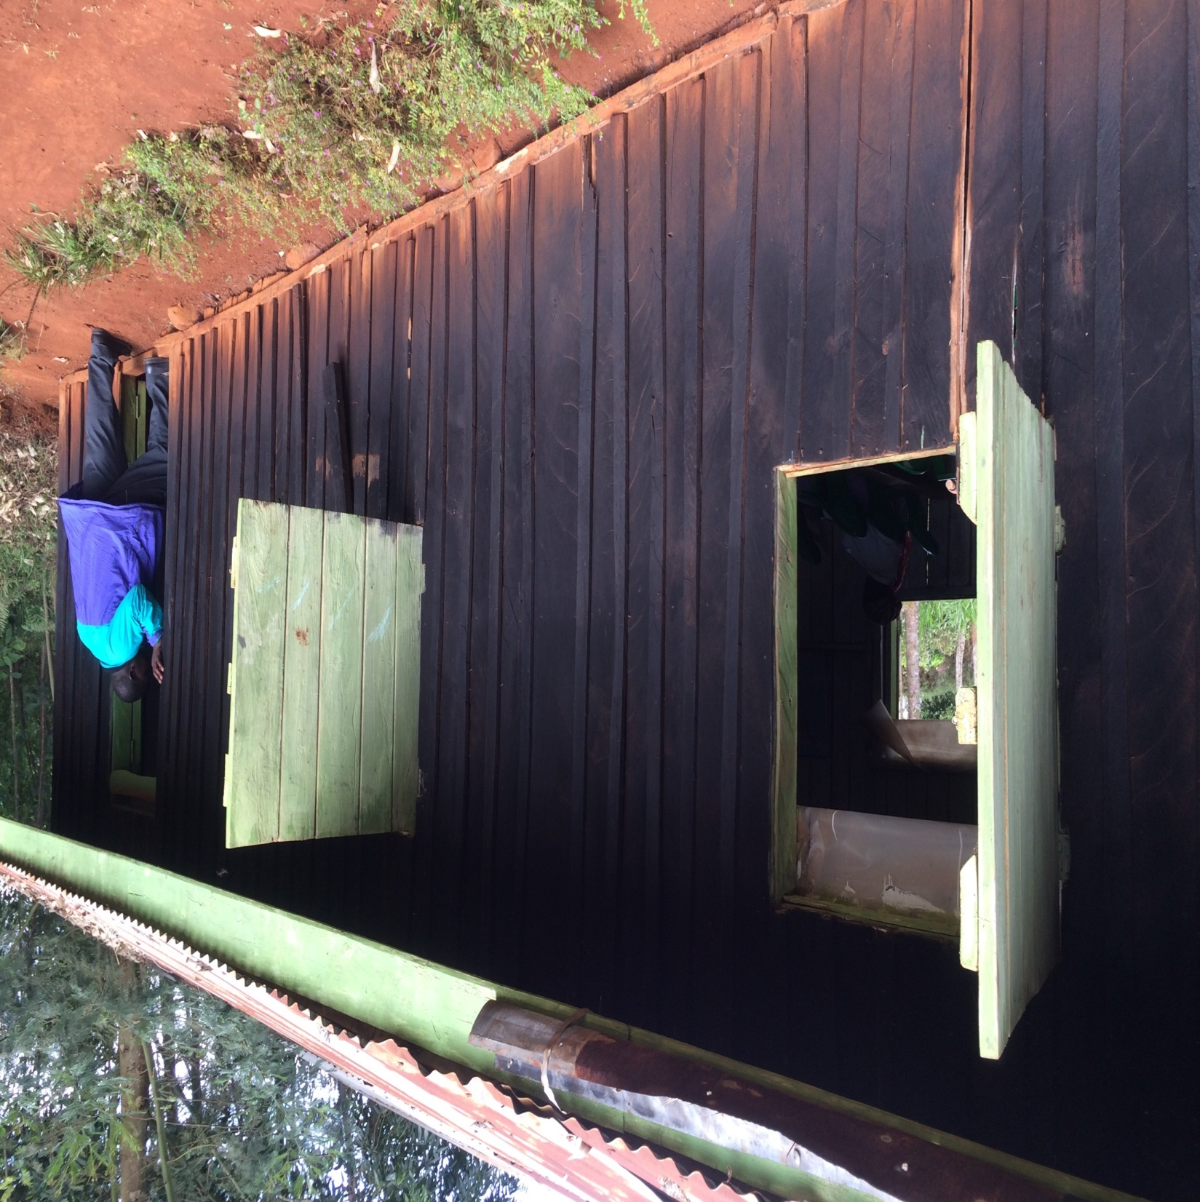

Slide 42
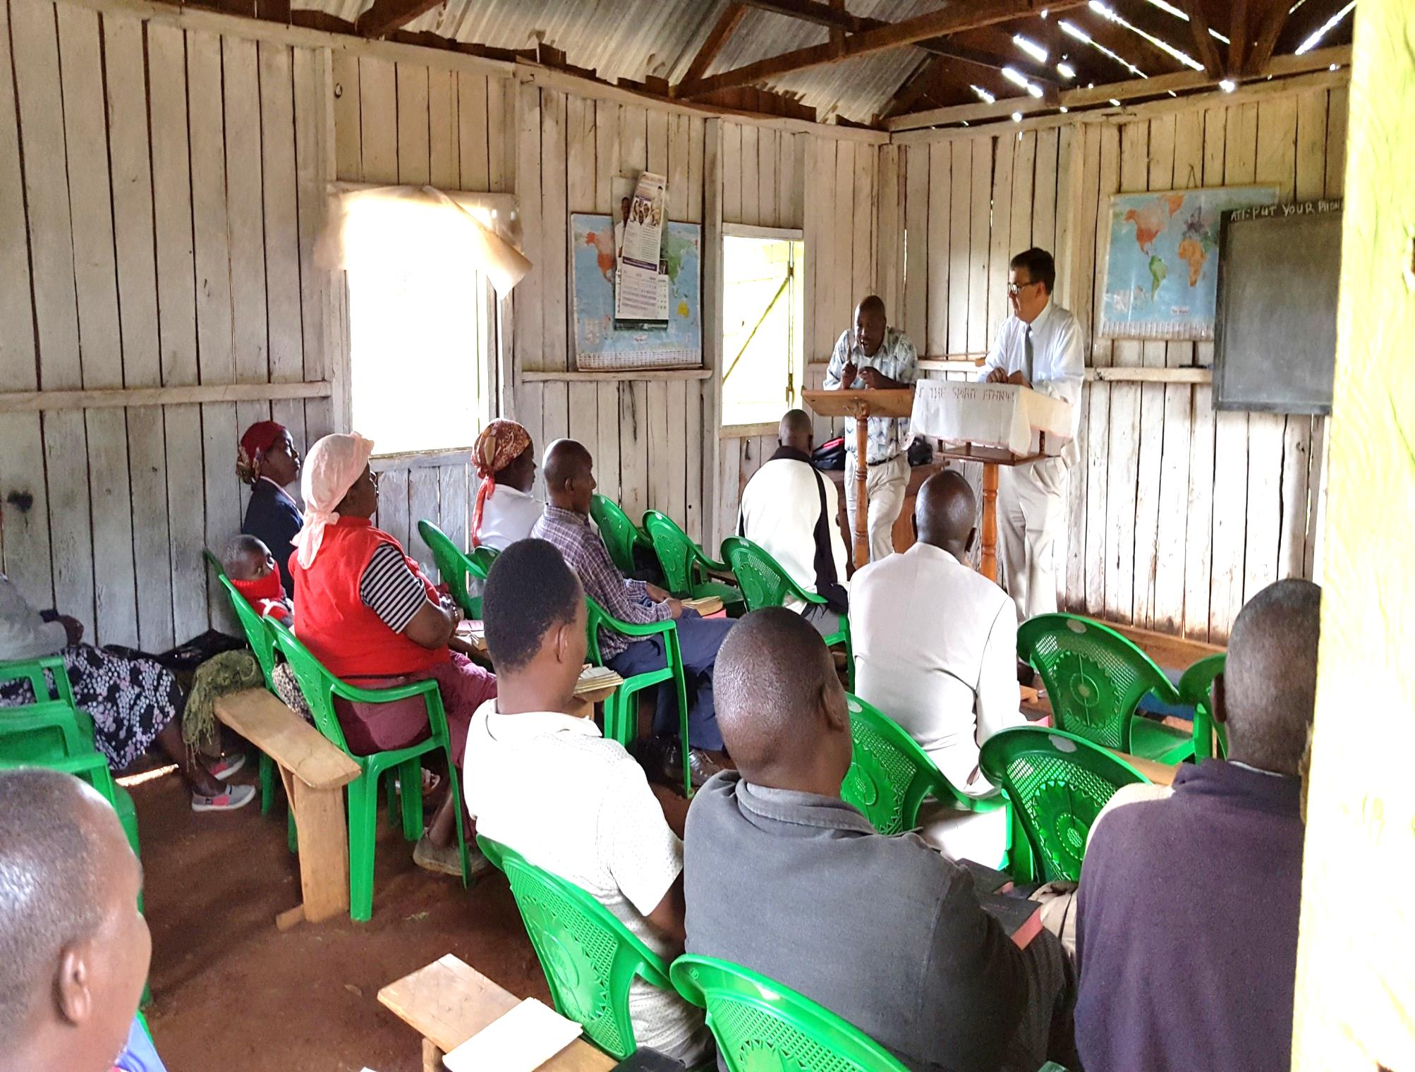

Slide 44
Day 5, Sunday, August 21
Brad and I split up for worship services. I went with Jack to Gatitu; Brad went with Wilson to Mutathi-ini.
I taught a young people’s class on the duties of children, from Proverbs. During worship, I taught on obstacles to liberal giving (per request).
We sang three songs in Kikuru, and three in English.
Two young men who were present, Alex and Solomon, asked to be baptized after services.

Slide 45
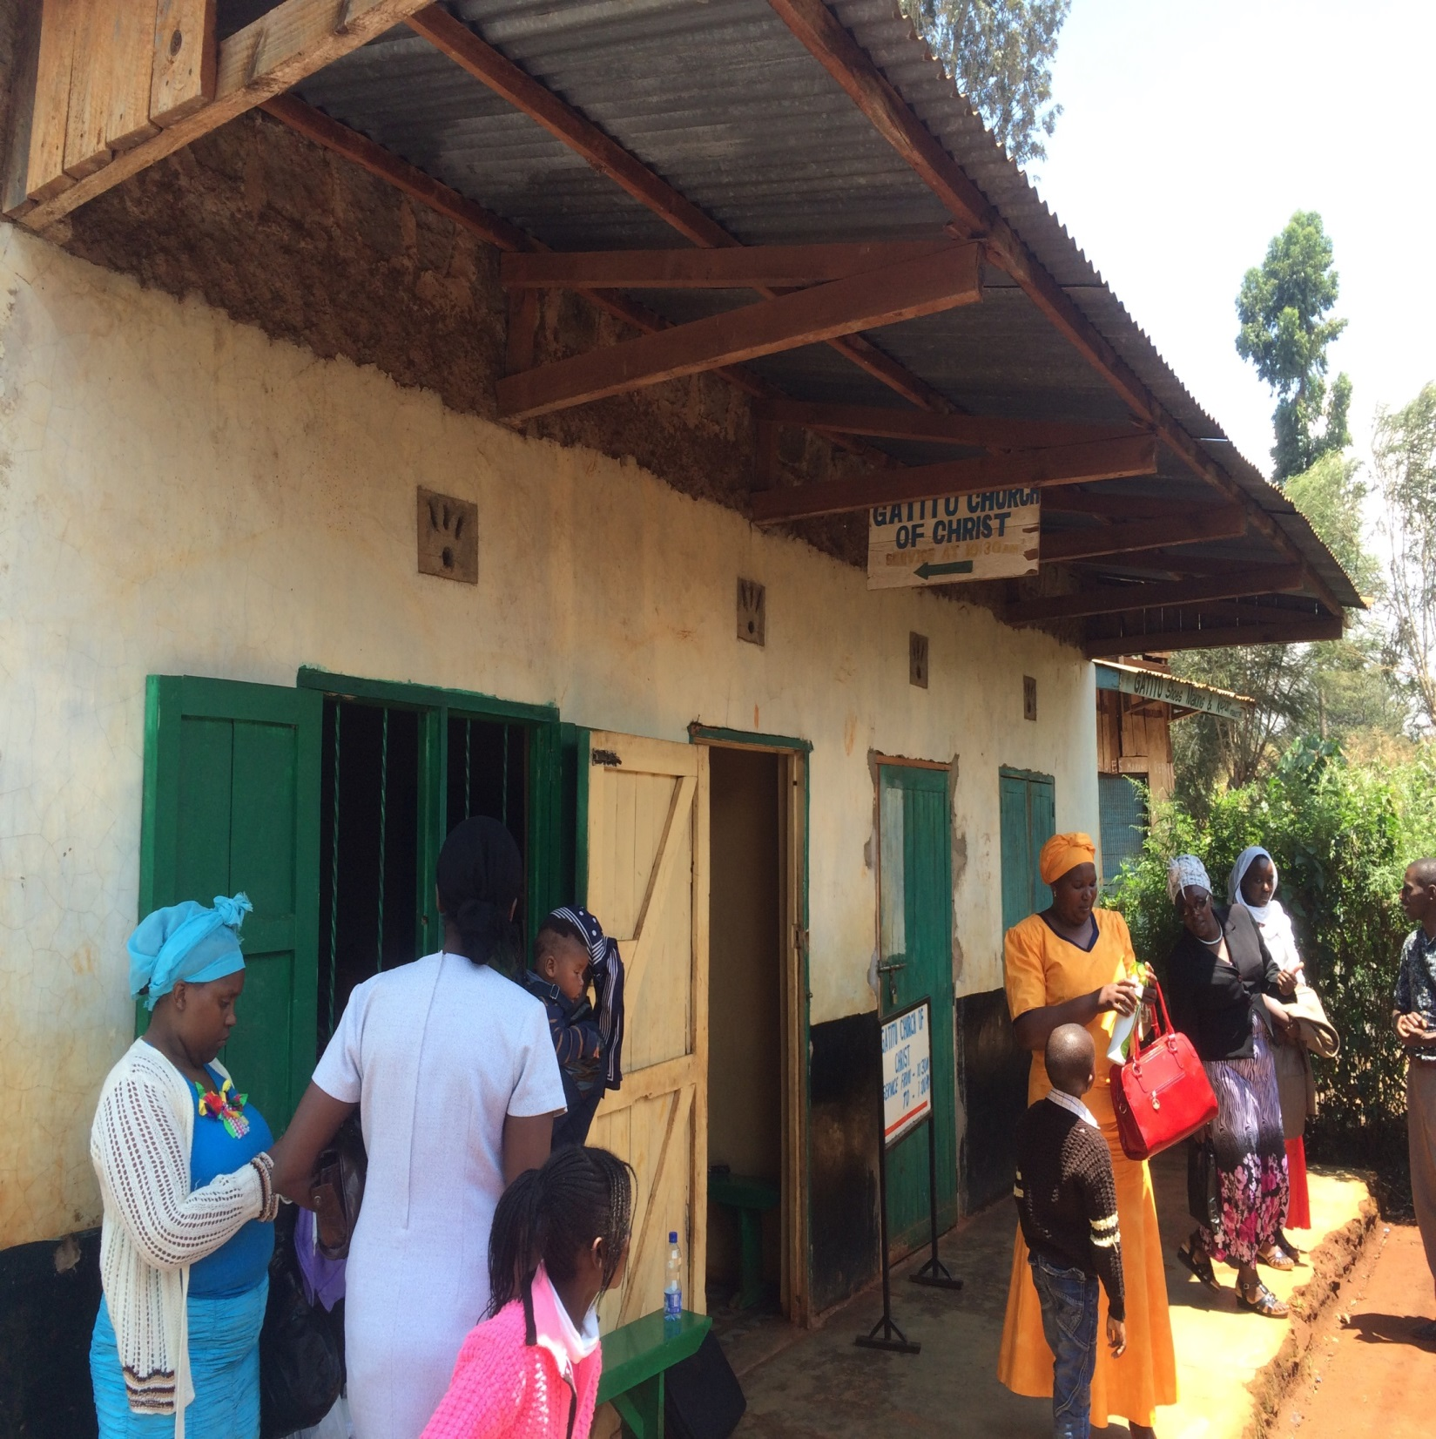

Slide 46
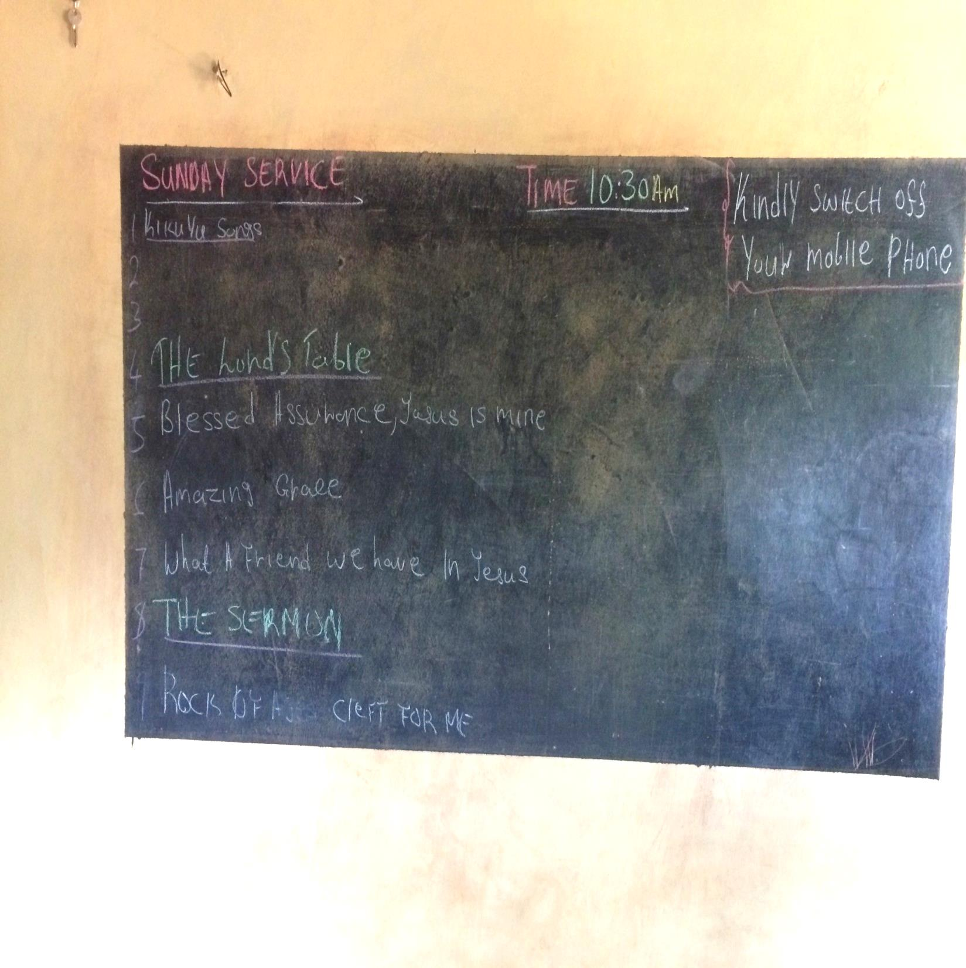

Slide 47
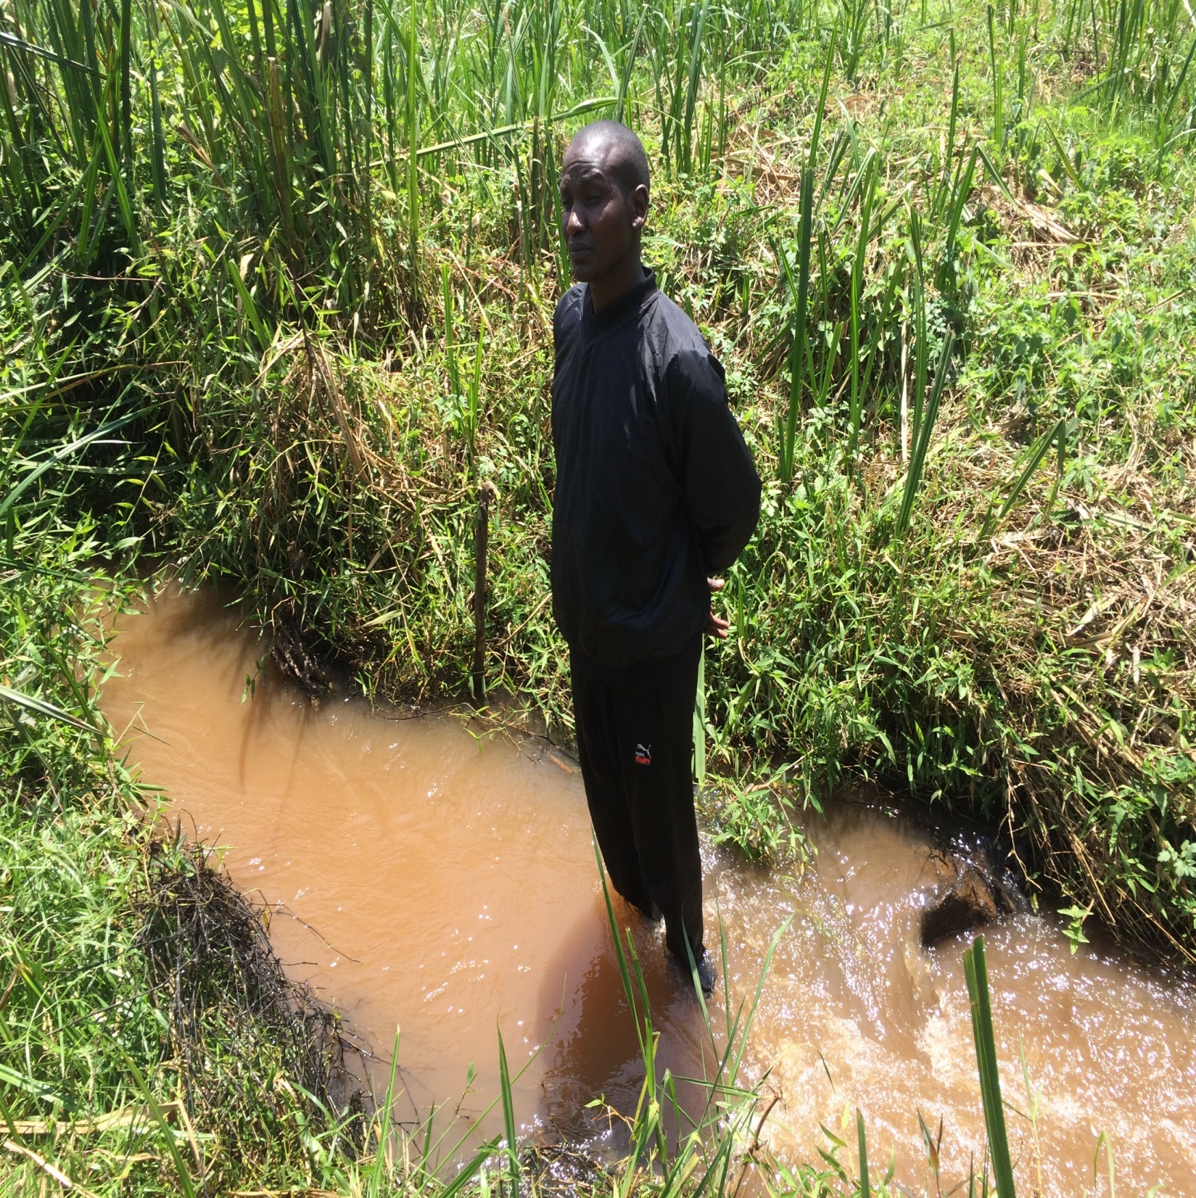

Slide 48
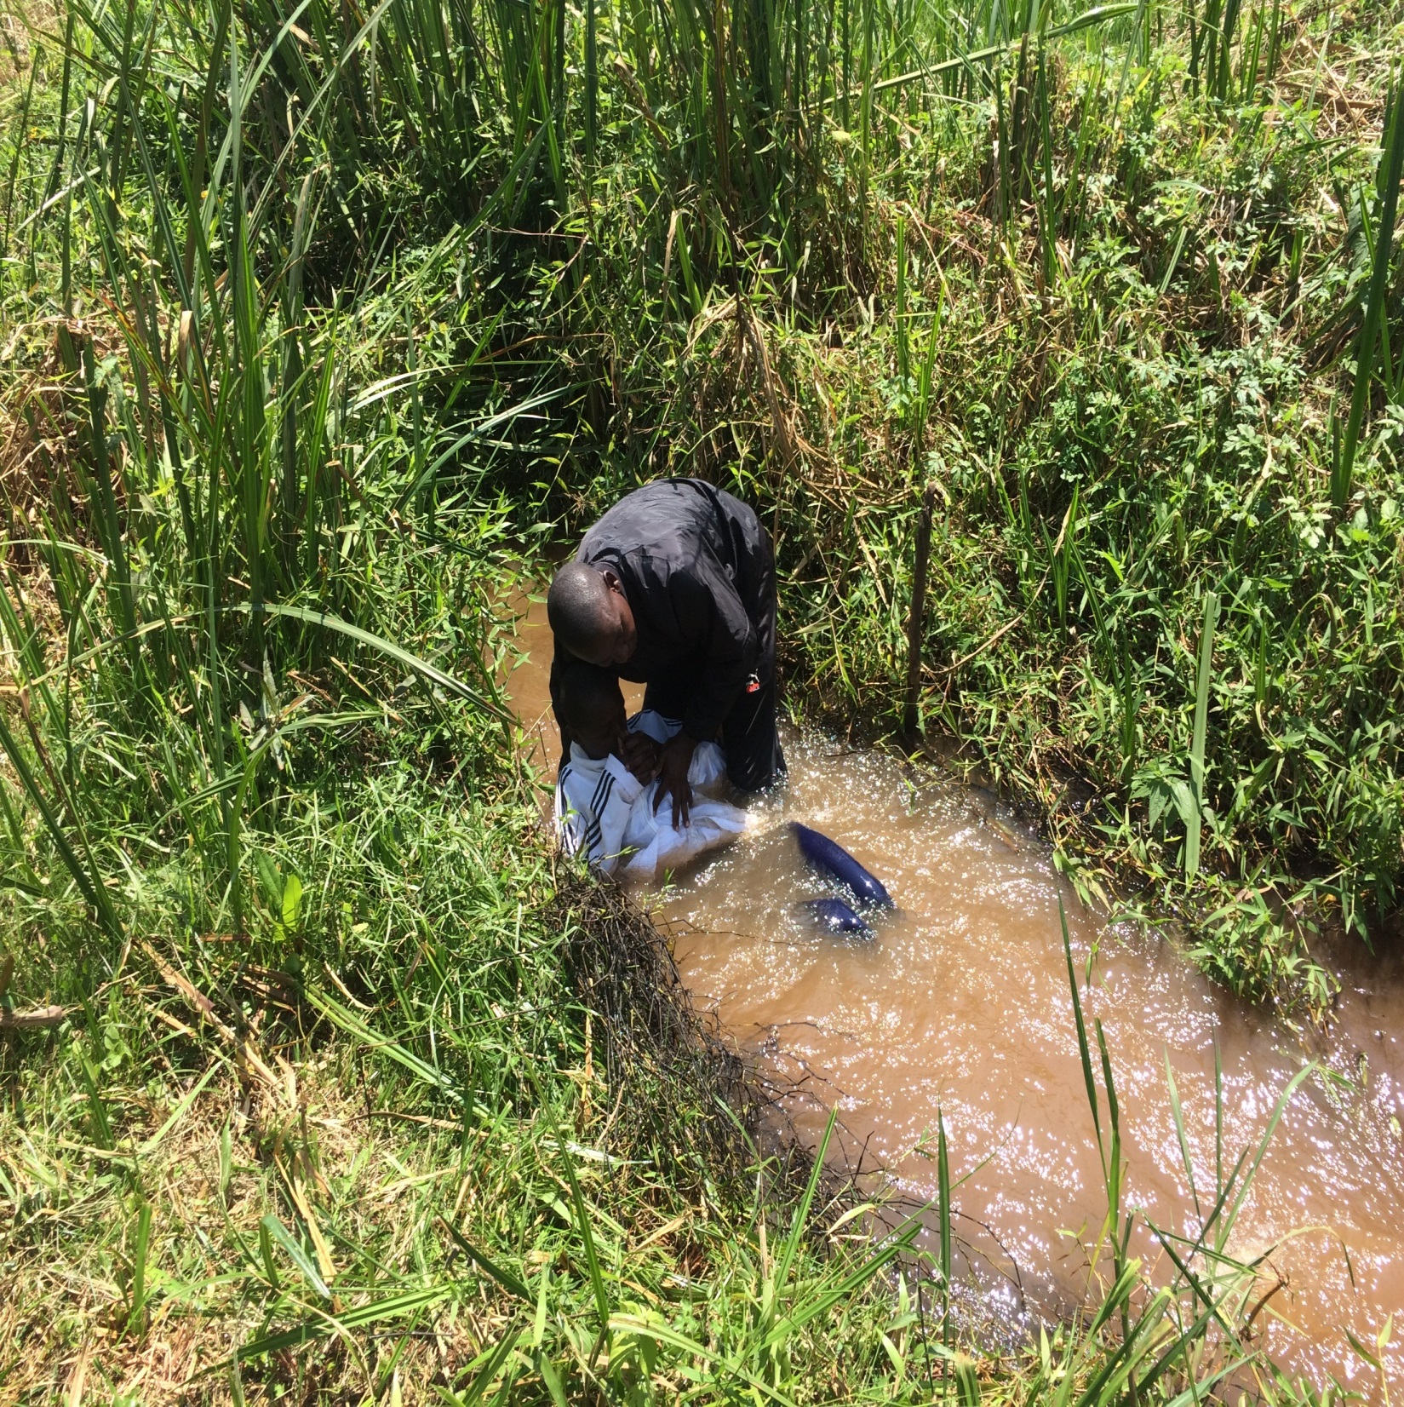

Slide 49
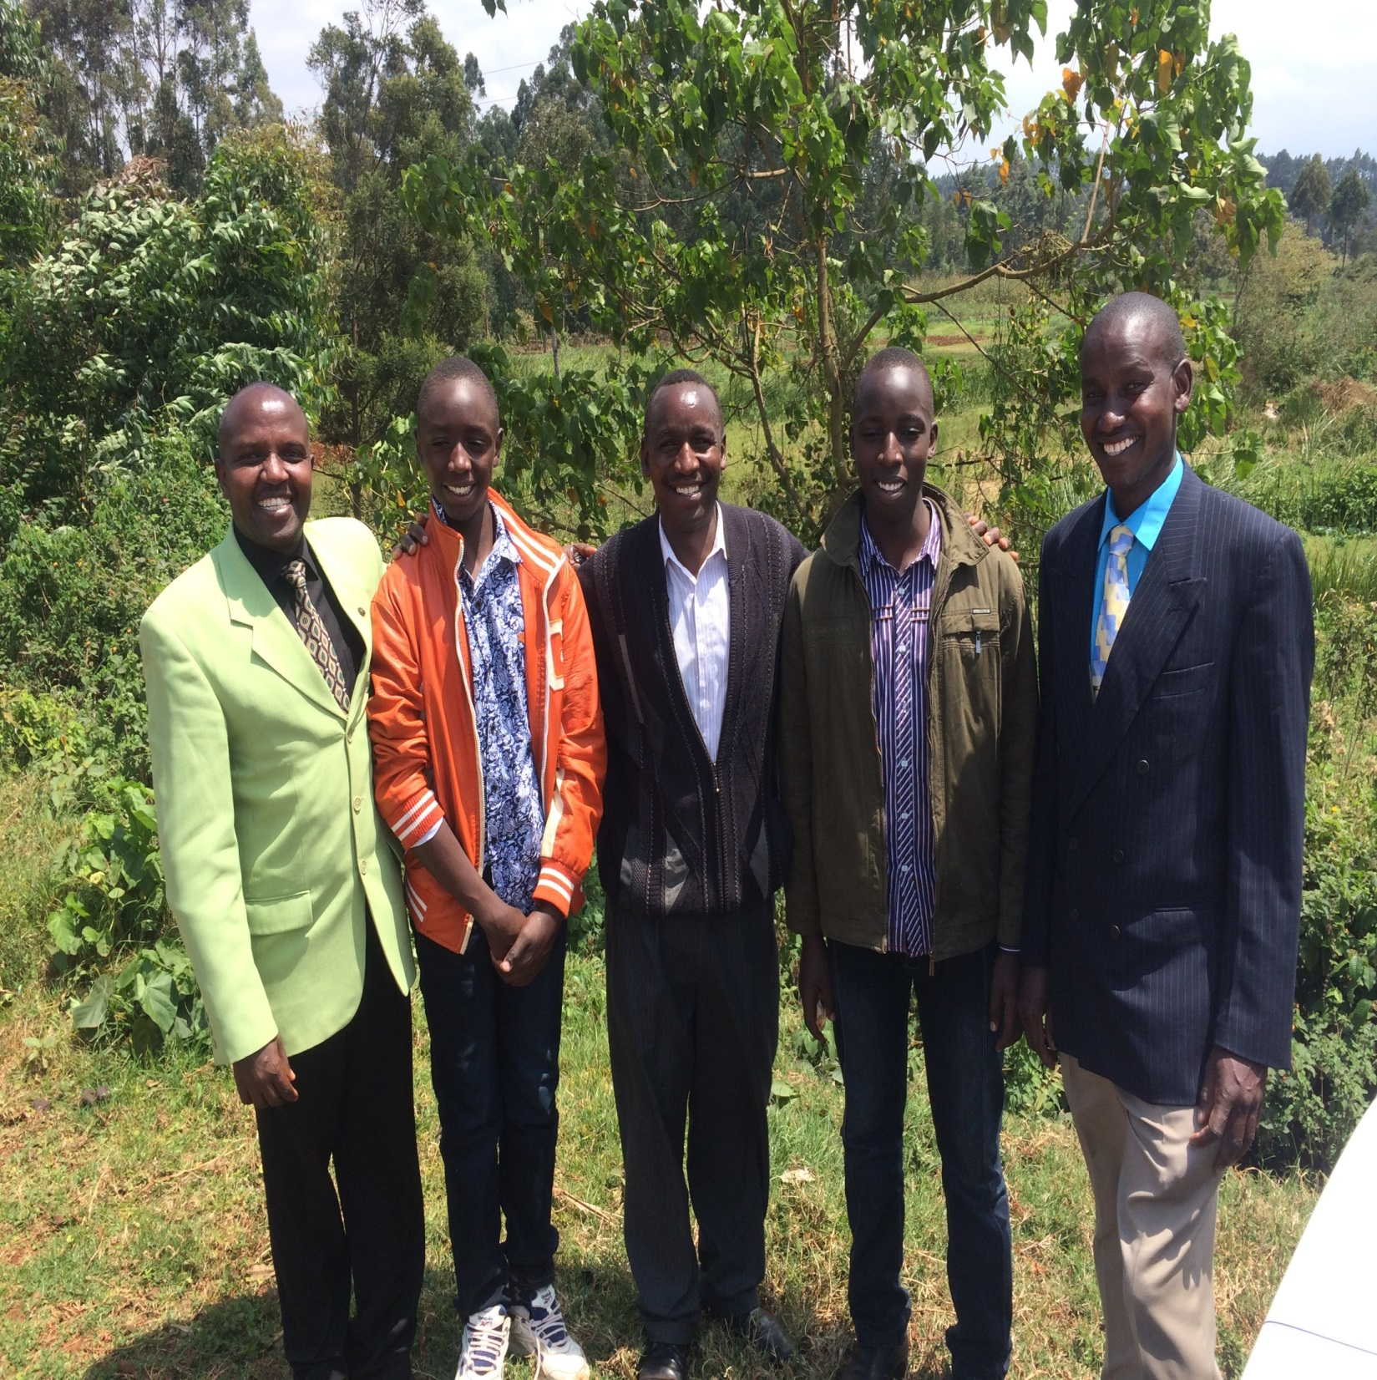

Slide 50
Day 5, Sunday, August 21
After lunch, we were invited to go back out to Mukurwe-ini, where some ladies we studied with earlier were anxious to learn more.
Brad presented a lesson on the plan of salvation to Lydia, Pauline, and an elderly woman (John’s wife).
Lydia was very anxious to be baptized, and so began the journey down the mountainside to the river Gura.

Slide 51
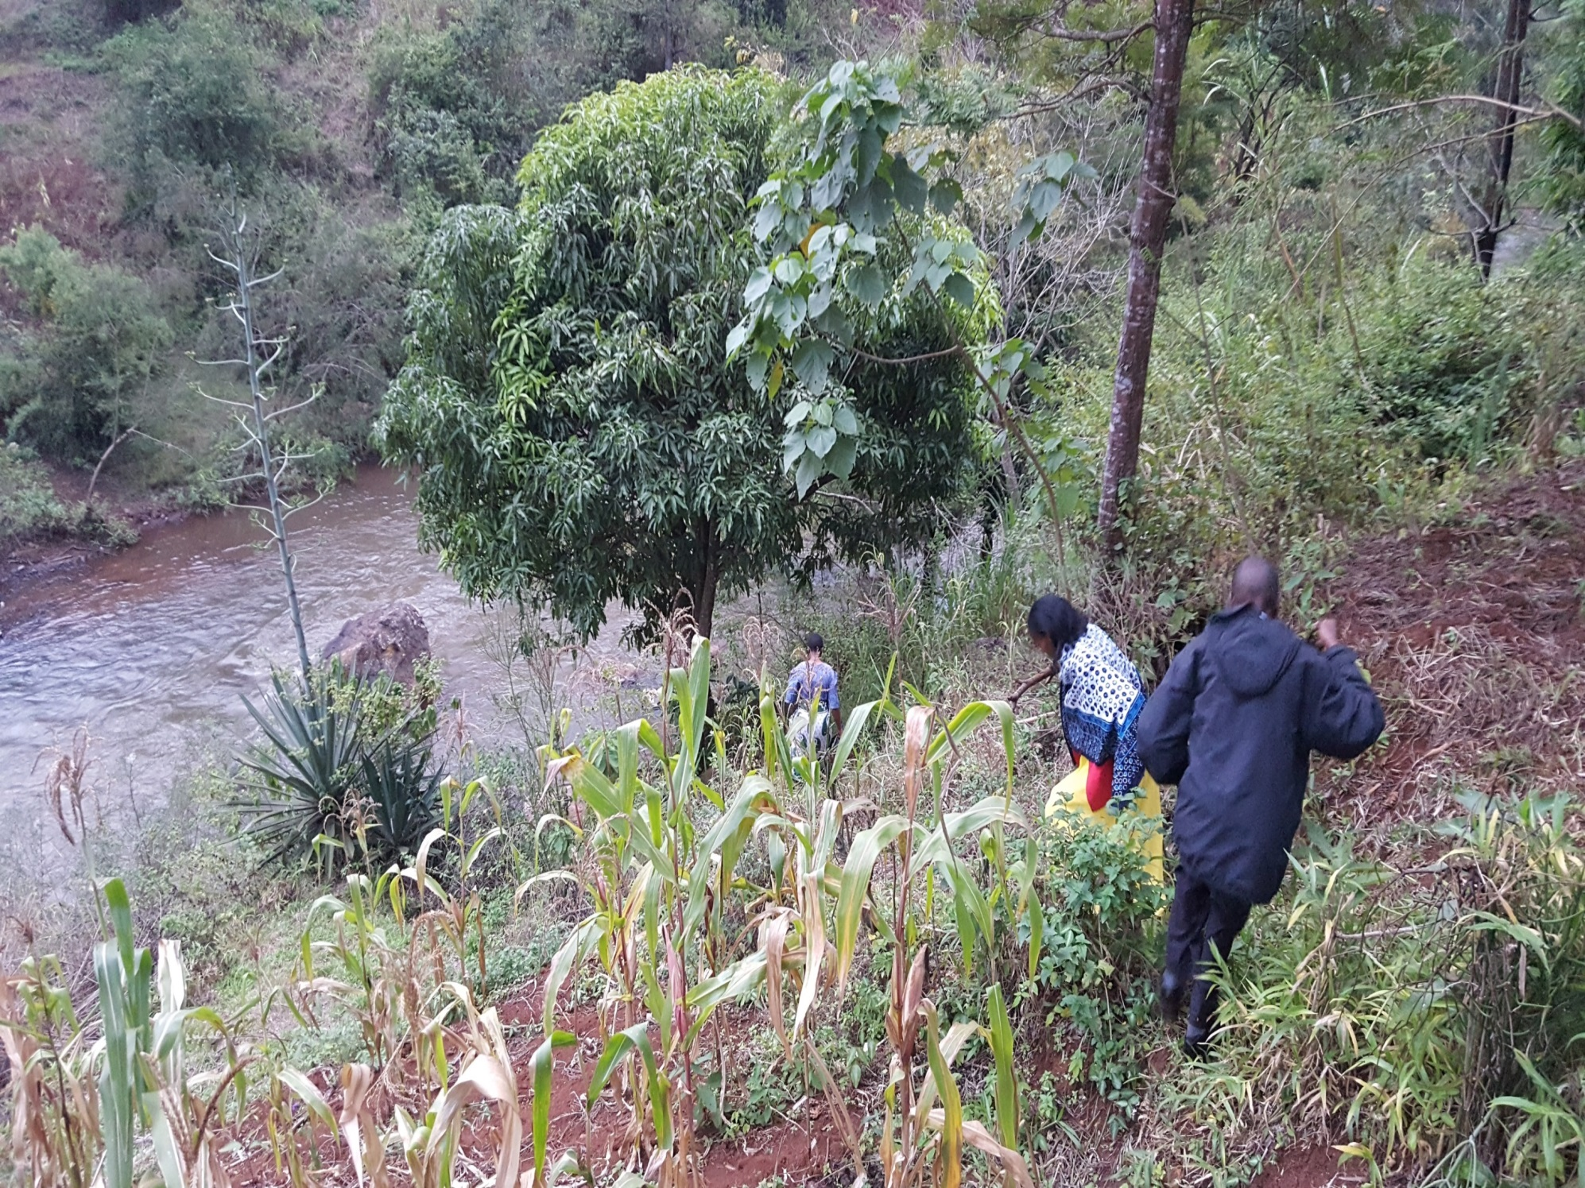

Slide 52
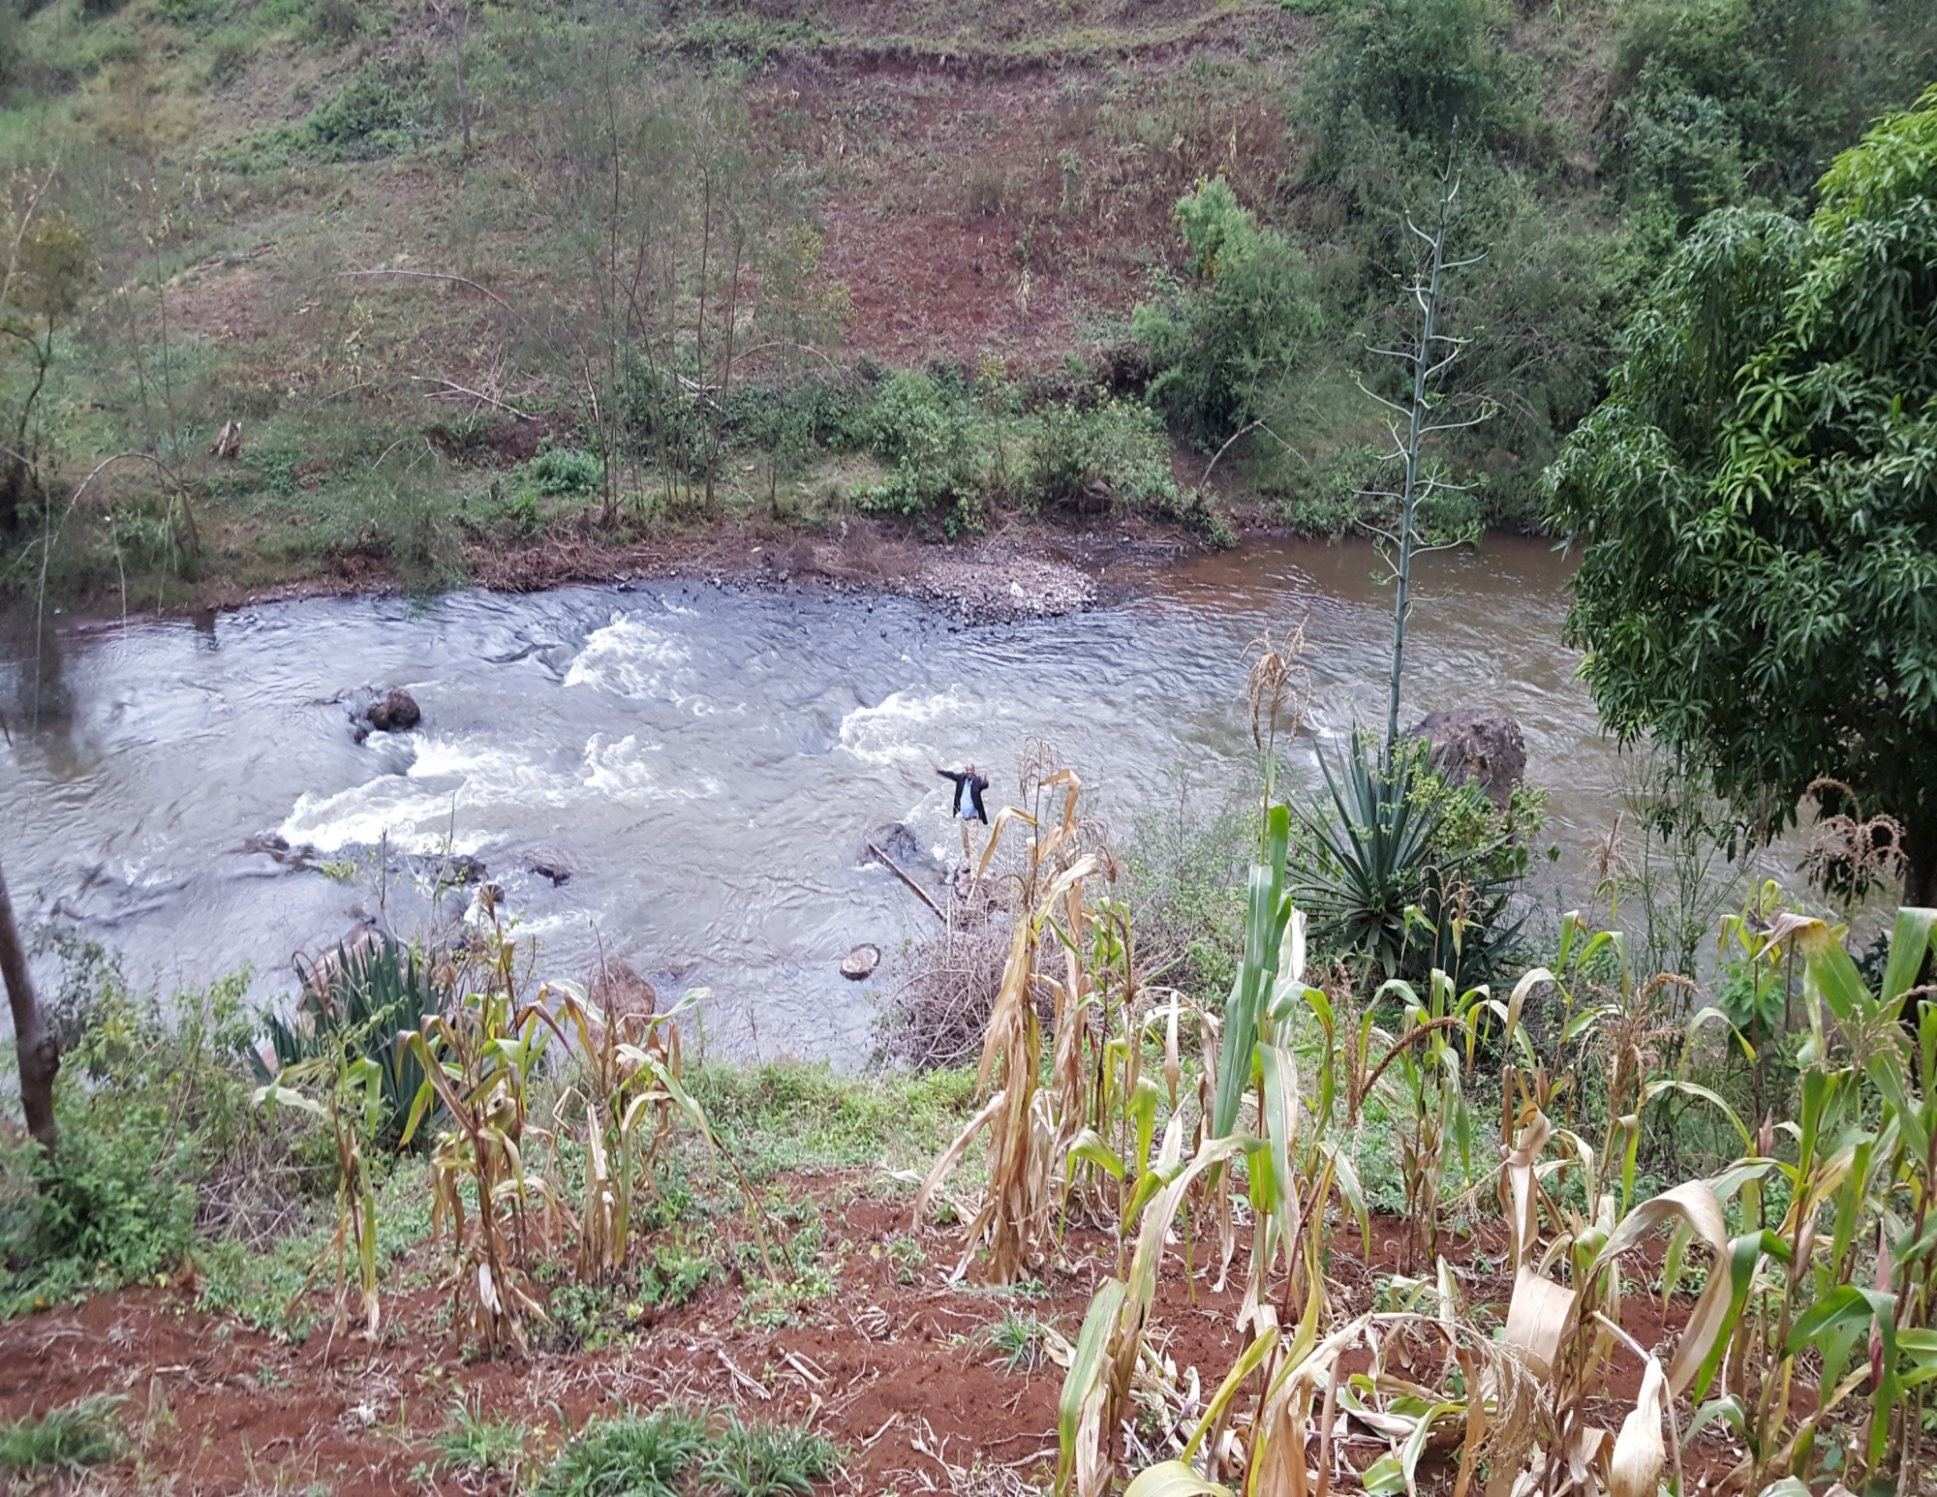

Slide 55
