Slide 1
Day 6, Monday, August 22
Back to Mukurwe-ini, where we found Lydia still beaming.
More good news. The elderly lady (John’s wife) indicated she wanted to be baptized. She couldn’t make it down the mountain so they drove her to a place where it was easier to access the river.
Brad went with them, while I stayed to study further with Pauline. Wilson accompanied me to translate.

Slide 3
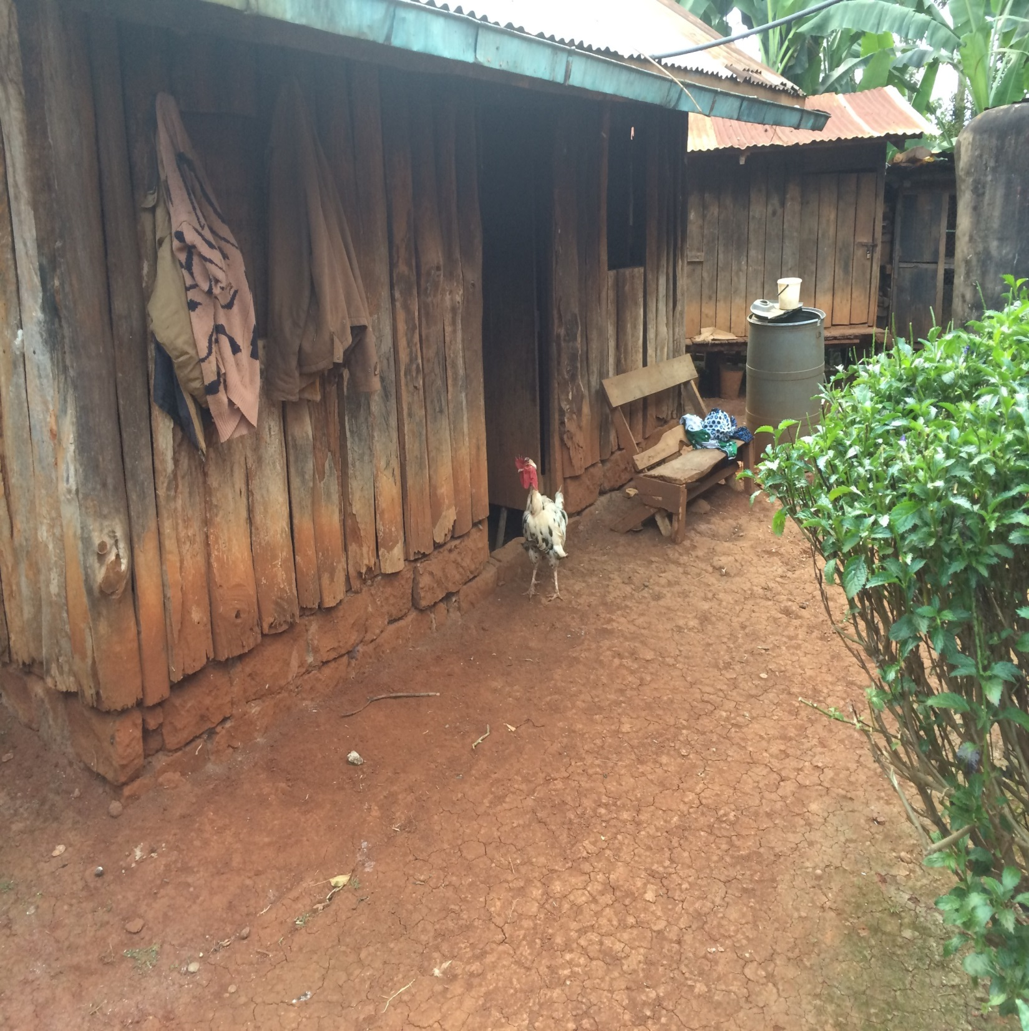

Slide 4
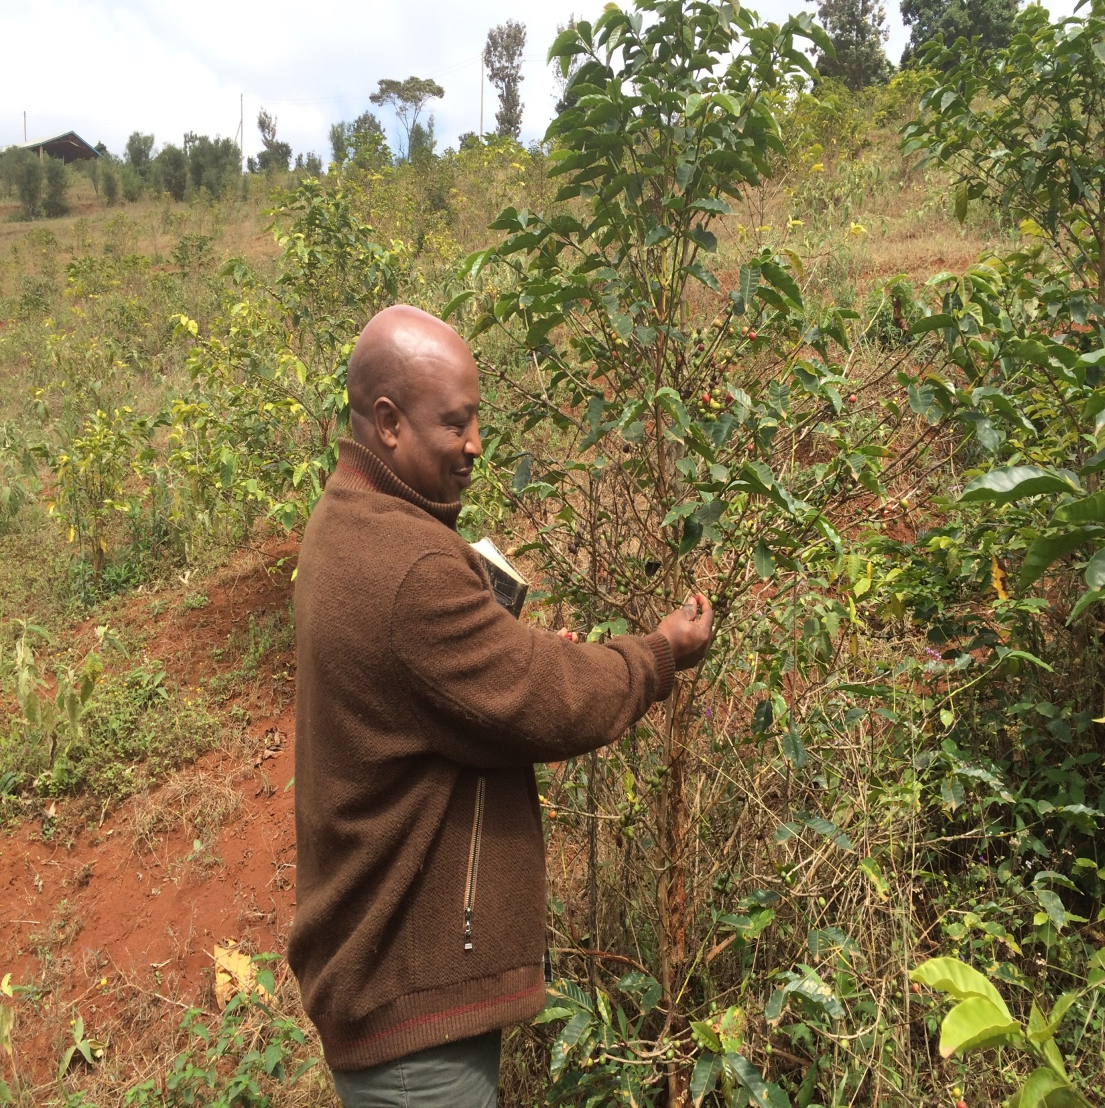

Slide 5
Day 6, Monday, August 22
Left Brad at Mukurwe-ini to study with others, while Jack and Richard accompanied me to Farm View Academy.
I was given an opportunity to preach to 7 staff members in the courtyard of the school. Preached on “Why I Cannot Be a Member of Any Denomination.”
Very attentive, with some great questions and comments made afterwards.

Slide 6
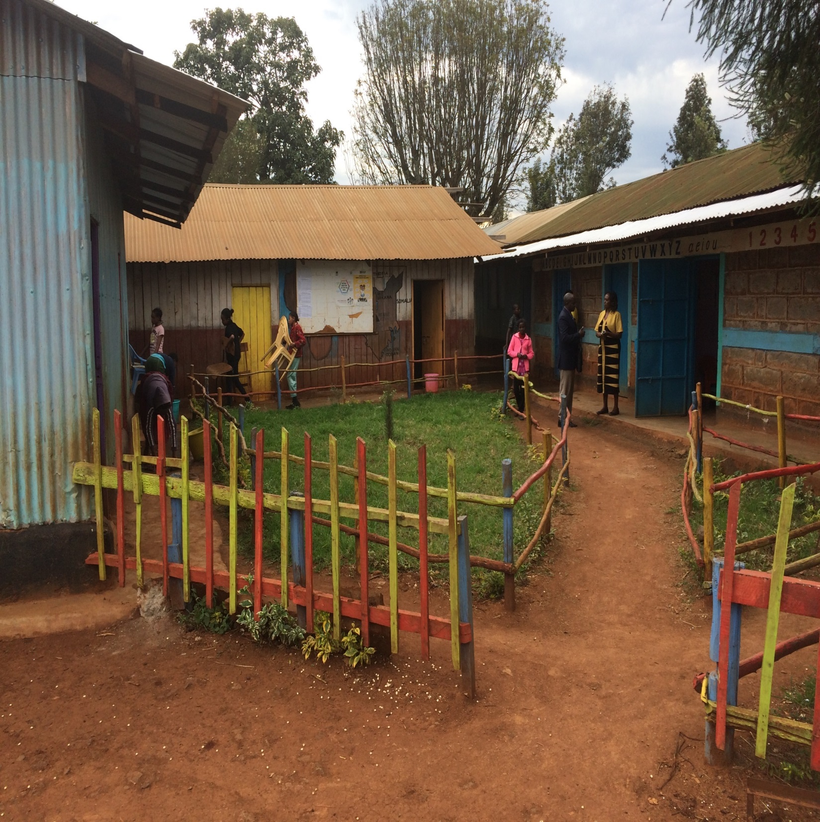

Slide 7
Day 6, Monday, August 22
Met up with Wilson and Brad later that evening at Wilson’s uncle’s house.
Discussed a number of issues with him and his wife: miracles, salvation, the church, the law of Moses, role of men and women, divorce and remarriage, etc.
We stayed there from 6 till 10 p.m., and were fed a very fine meal featuring marmalade sandwiches.

Slide 8
Day 7, Tuesday, August 23
Met with the brethren at Mutath-ini for a series of studies, from 10:30 a.m. till 3:15 p.m.
Three sessions before lunch: Brad on procrastination; I spoke on “Christ Wants You”; Brad discussed why we have all the different denominations and doctrines.
After lunch, I spoke on self-examination; and then Brad did a brief exhortation on Jesus as the Bread of Life. Several non-Christians were present.

Slide 9
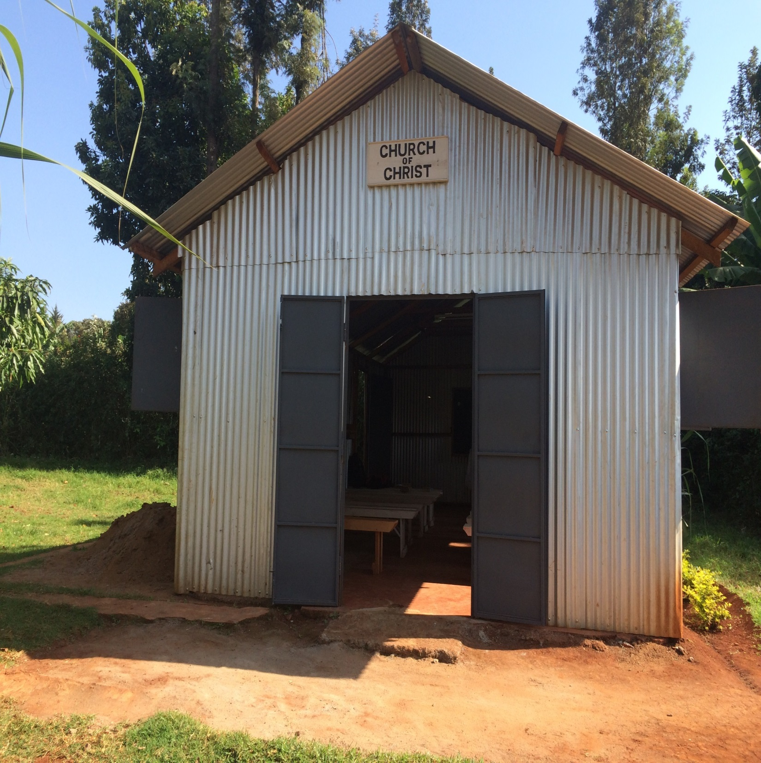

Slide 10
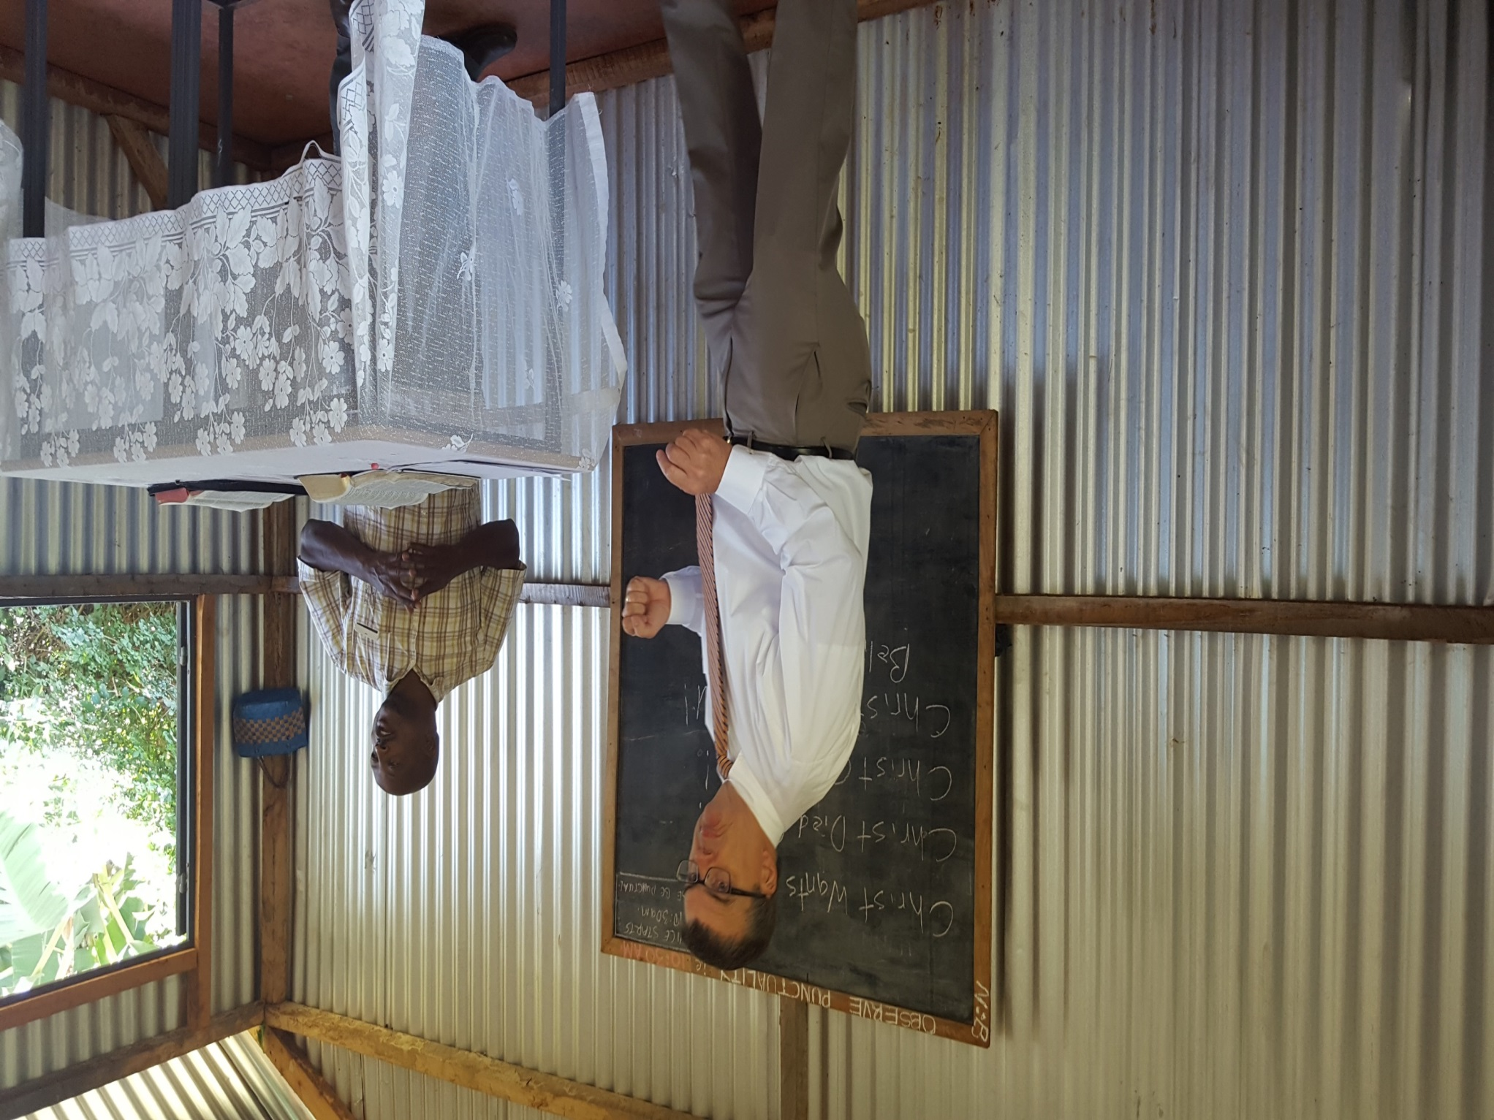

Slide 11
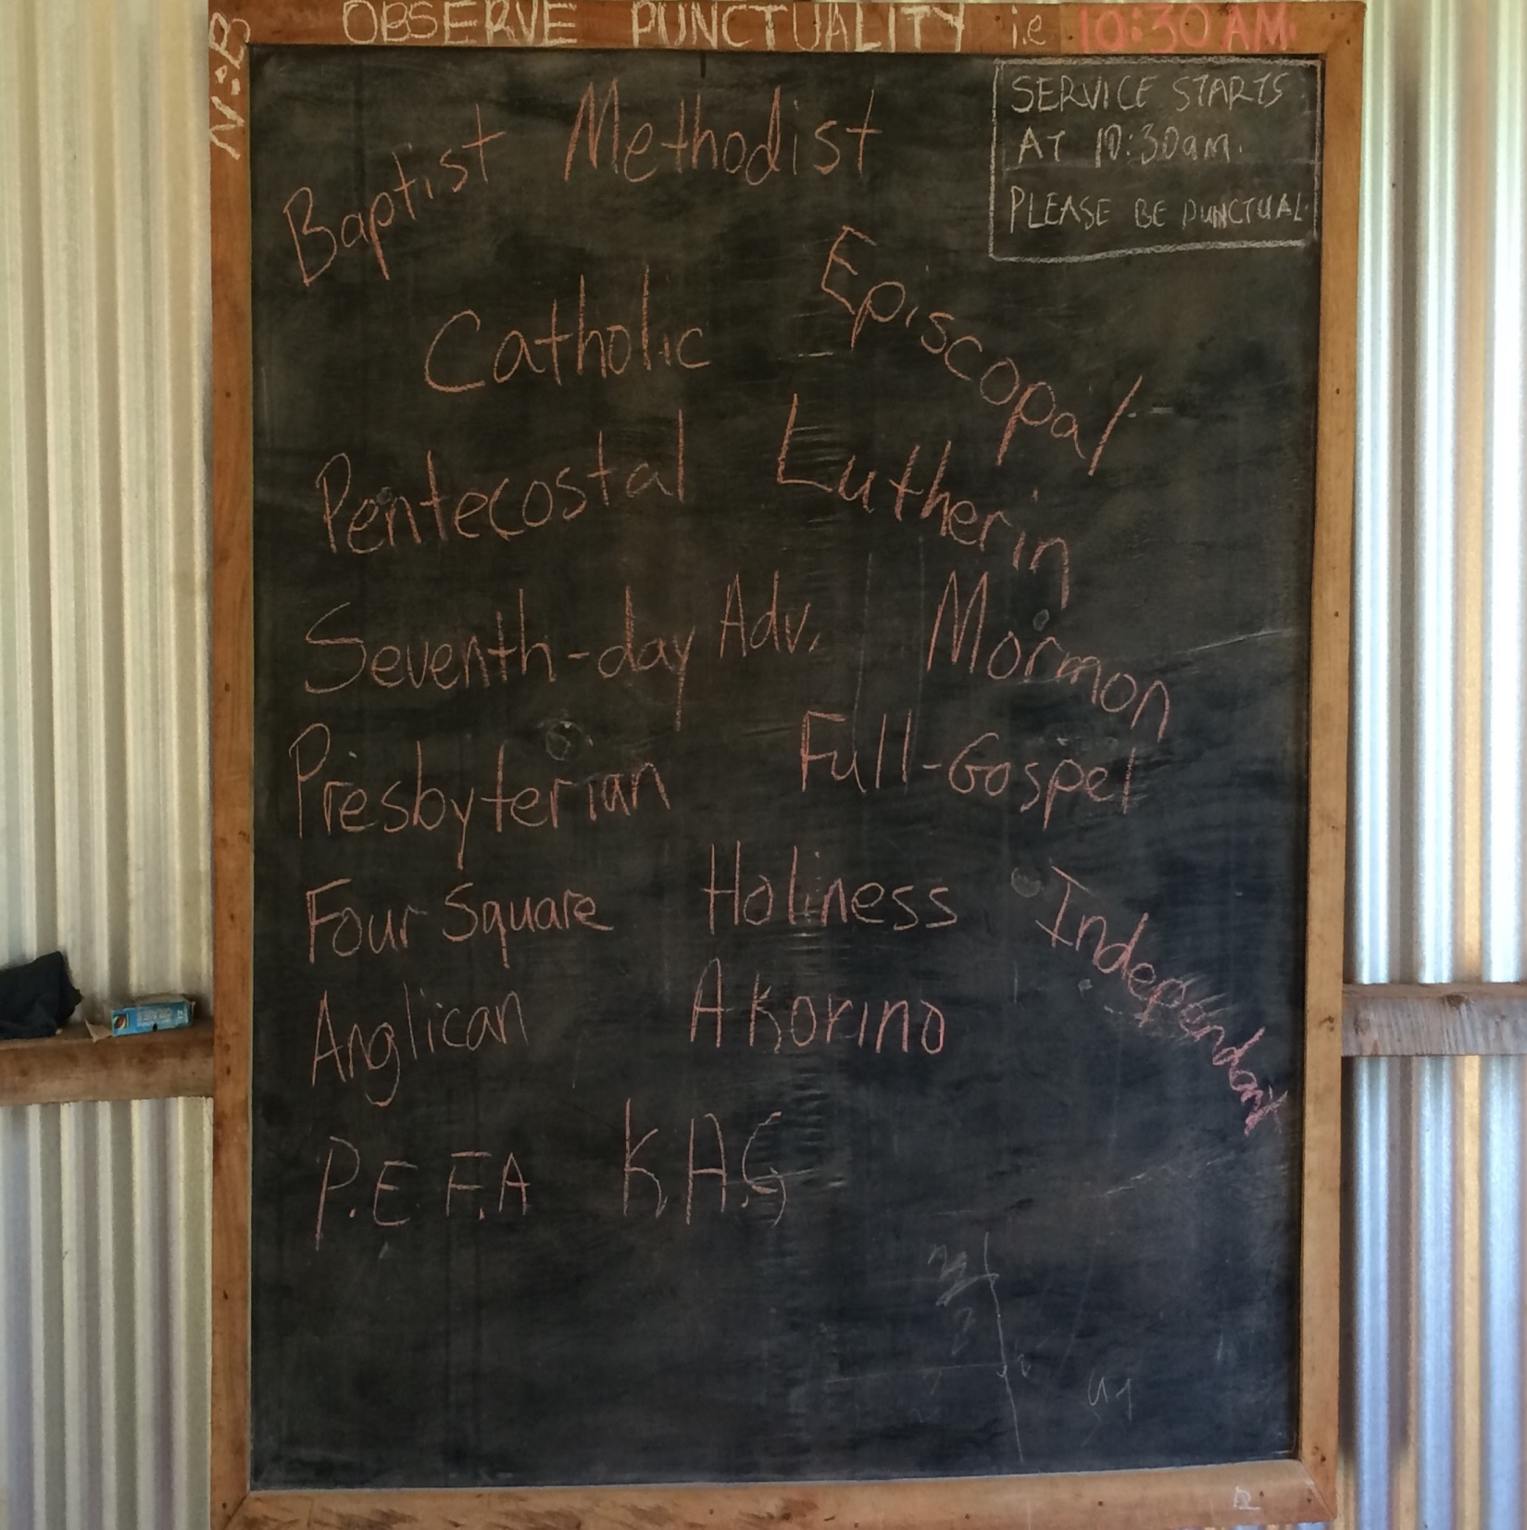

Slide 12
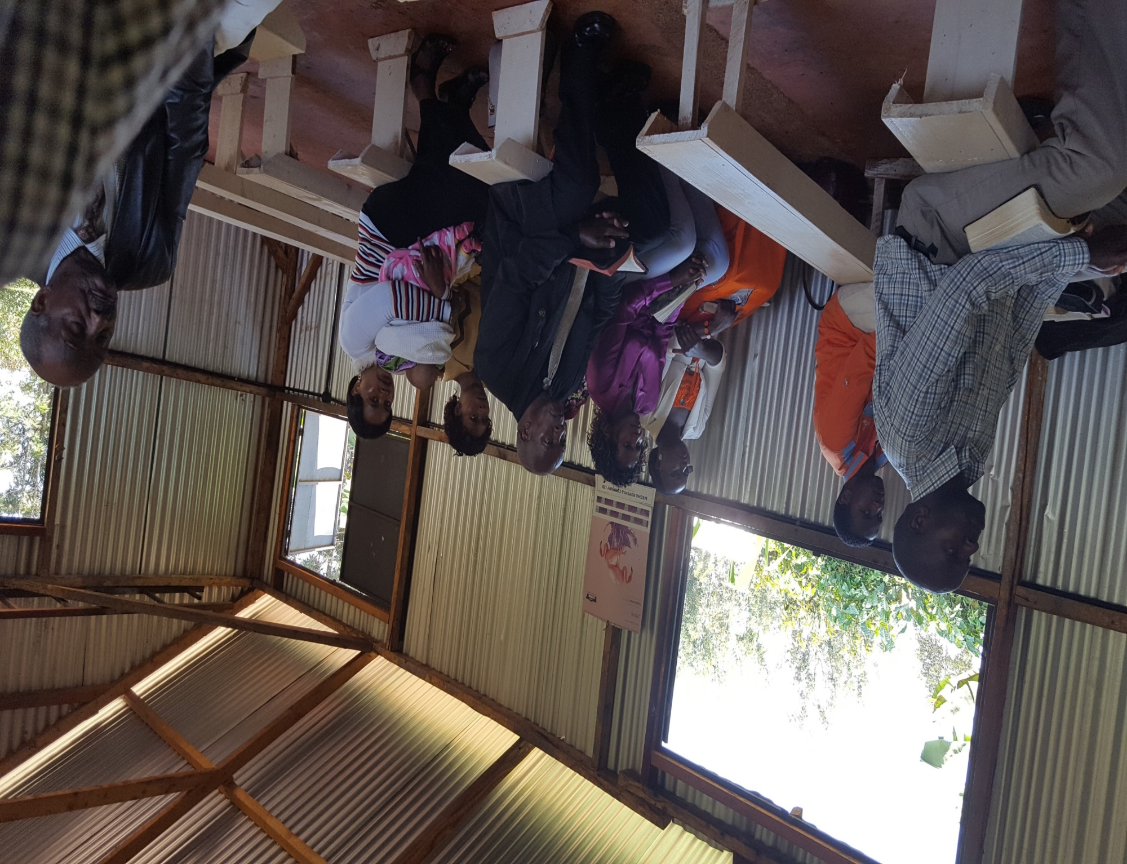

Slide 13
Day 8, Wednesday, August 24
Left about 8:30 to study with brethren at Nyahururu.
Arrived at 10, where we were met by the preacher, Joshua, who directed us to their new meeting place.
Started about 11:30 (Joshua had them ask for forgiveness for being late). Keep in mind that many walked quite a distance to be there, including an 85 year old man who walked about 3 miles.

Slide 14
Day 8, Wednesday, August 24
At Nyahururu
Two sessions before lunch: I spoke on “Why I Need Jesus”; Brad spoke on 1 Samuel 15.
Broke for lunch and then split a one hour session that afternoon. I spoke on the commitment in following Jesus; Brad spoke on the need for more Bible study.

Slide 15
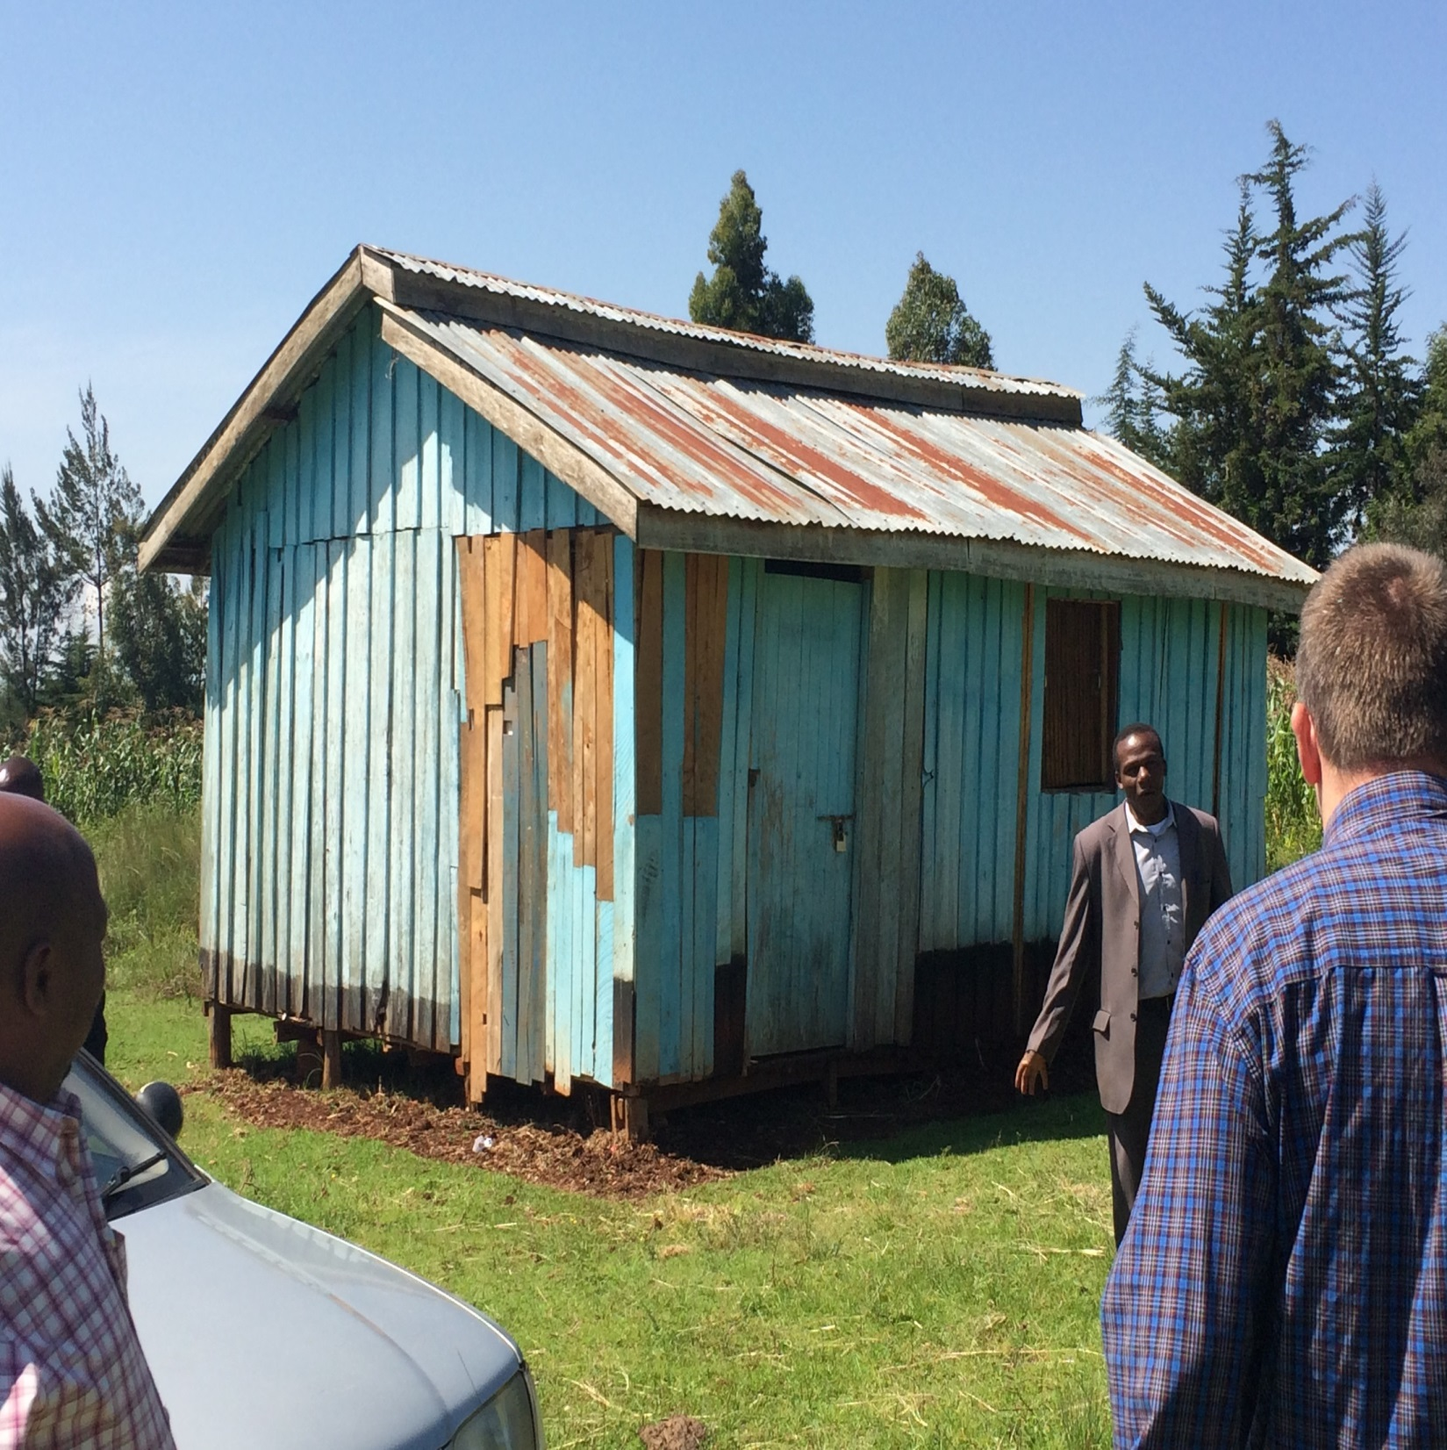

Slide 16
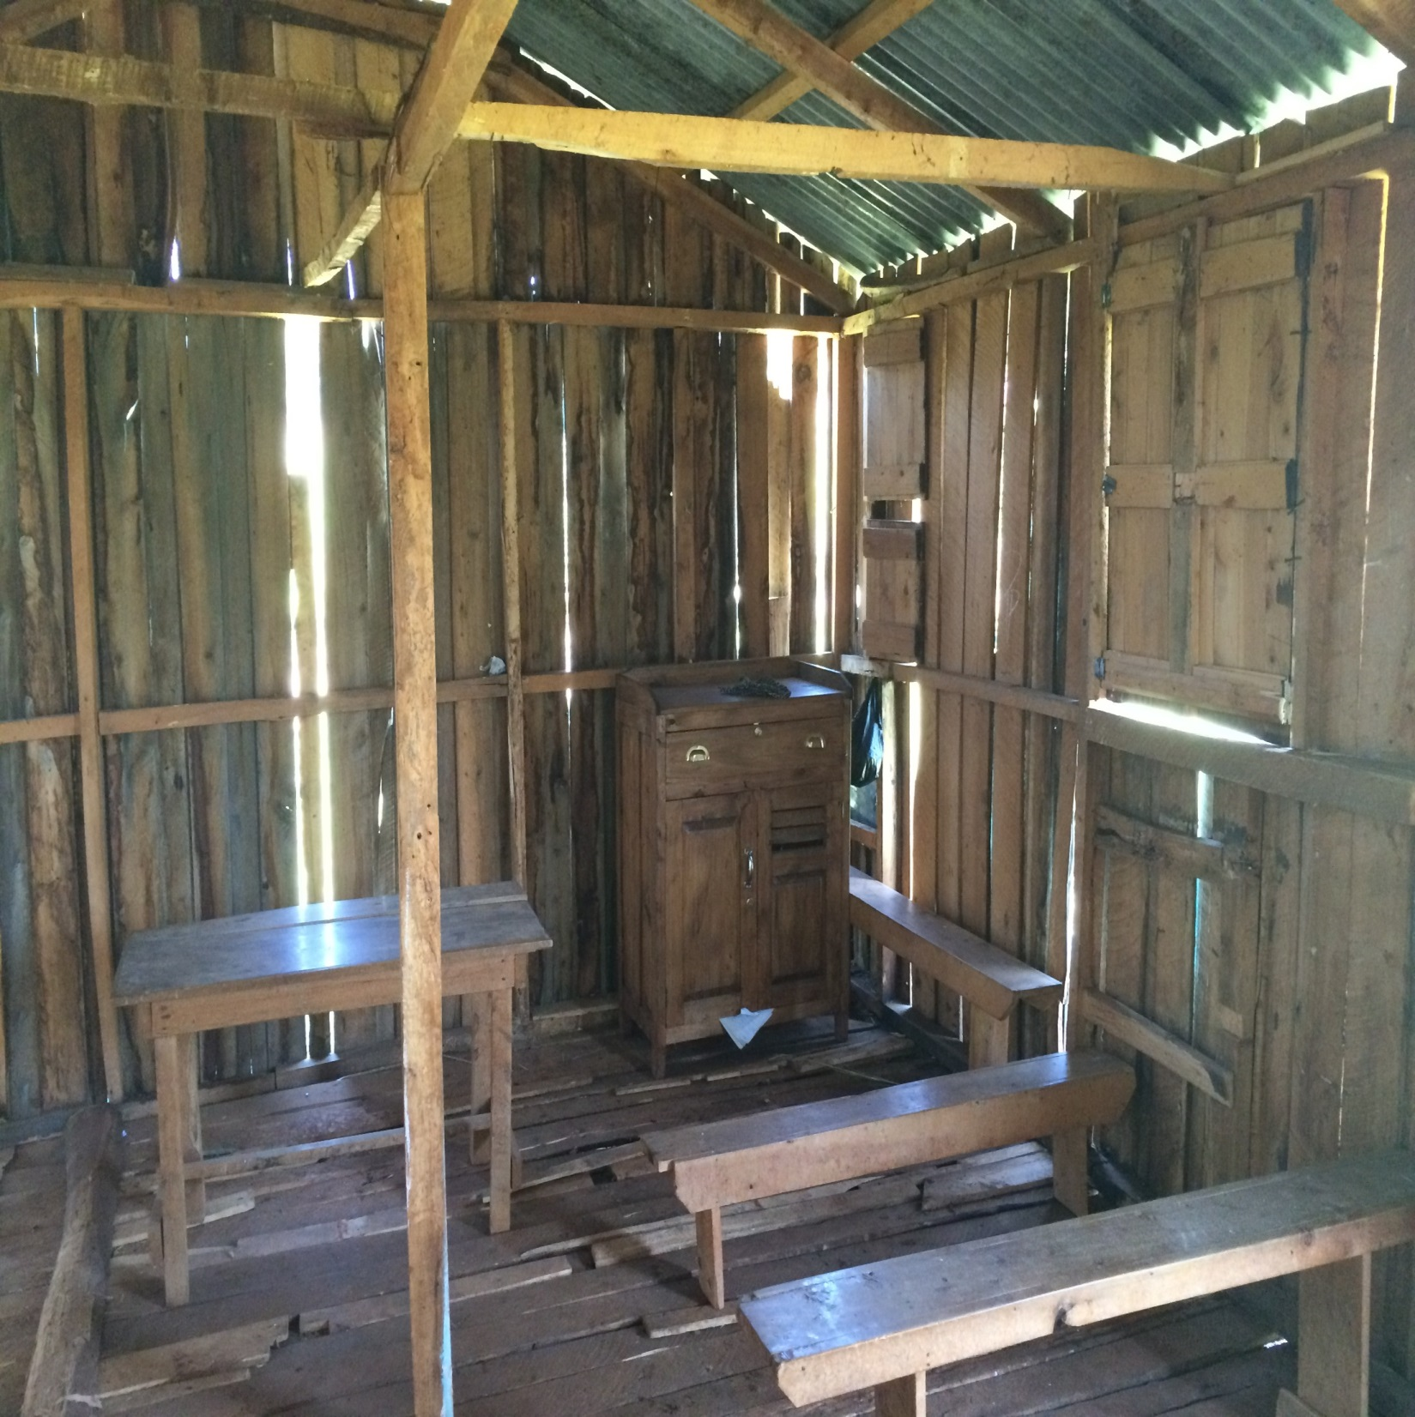

Slide 17
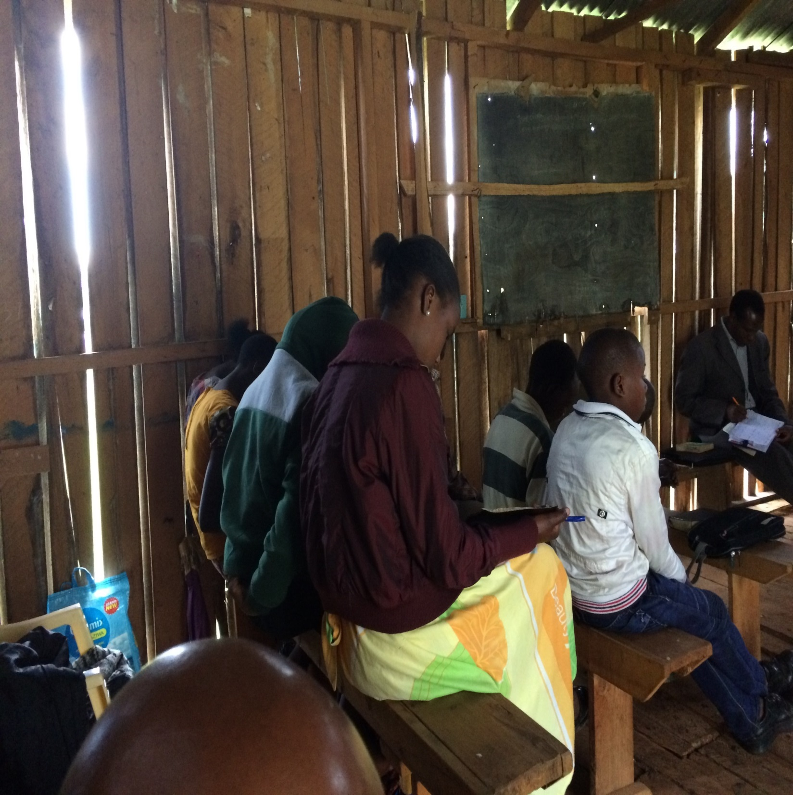

Slide 18
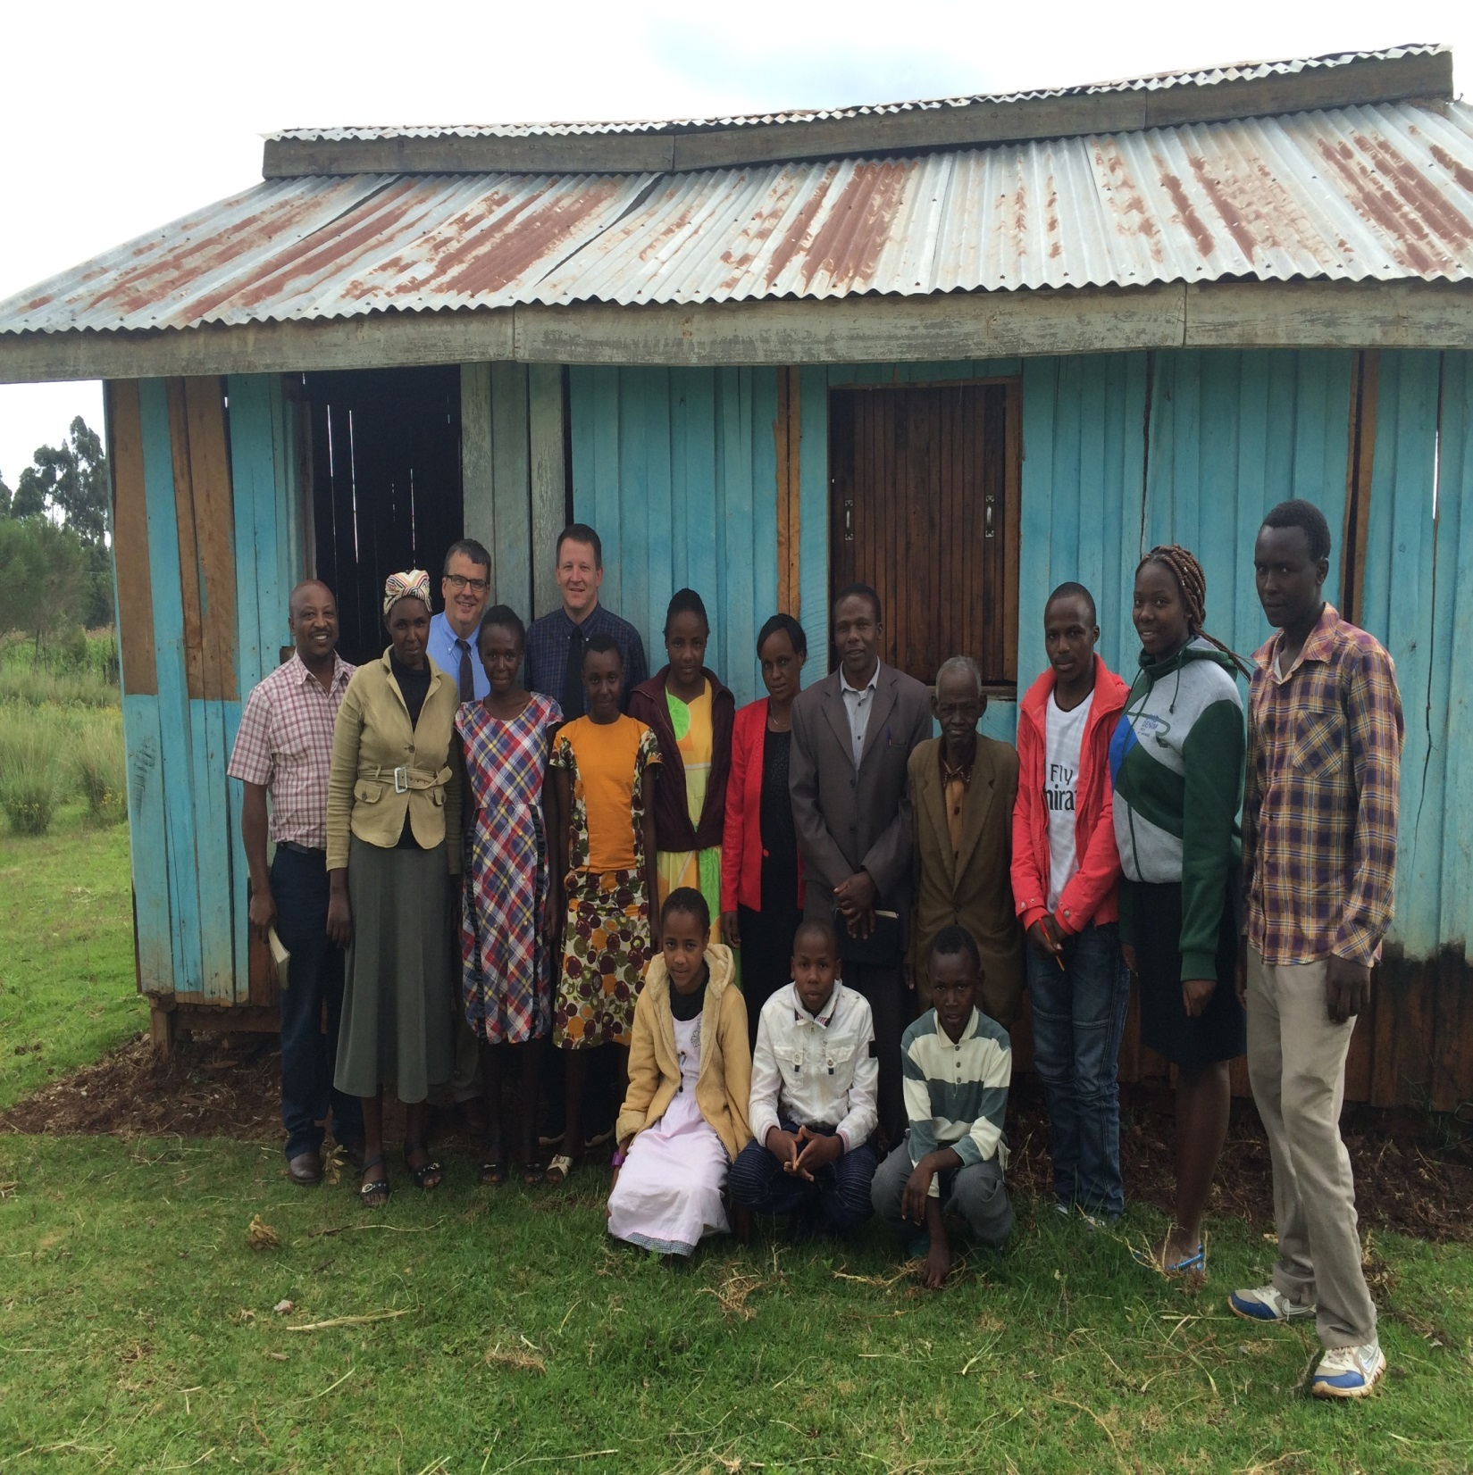

Slide 19
Day 8, Wednesday, August 24
Did some sightseeing on the way back.
Looking for hippos.
Rift Valley and Thomsons Falls.

Slide 20
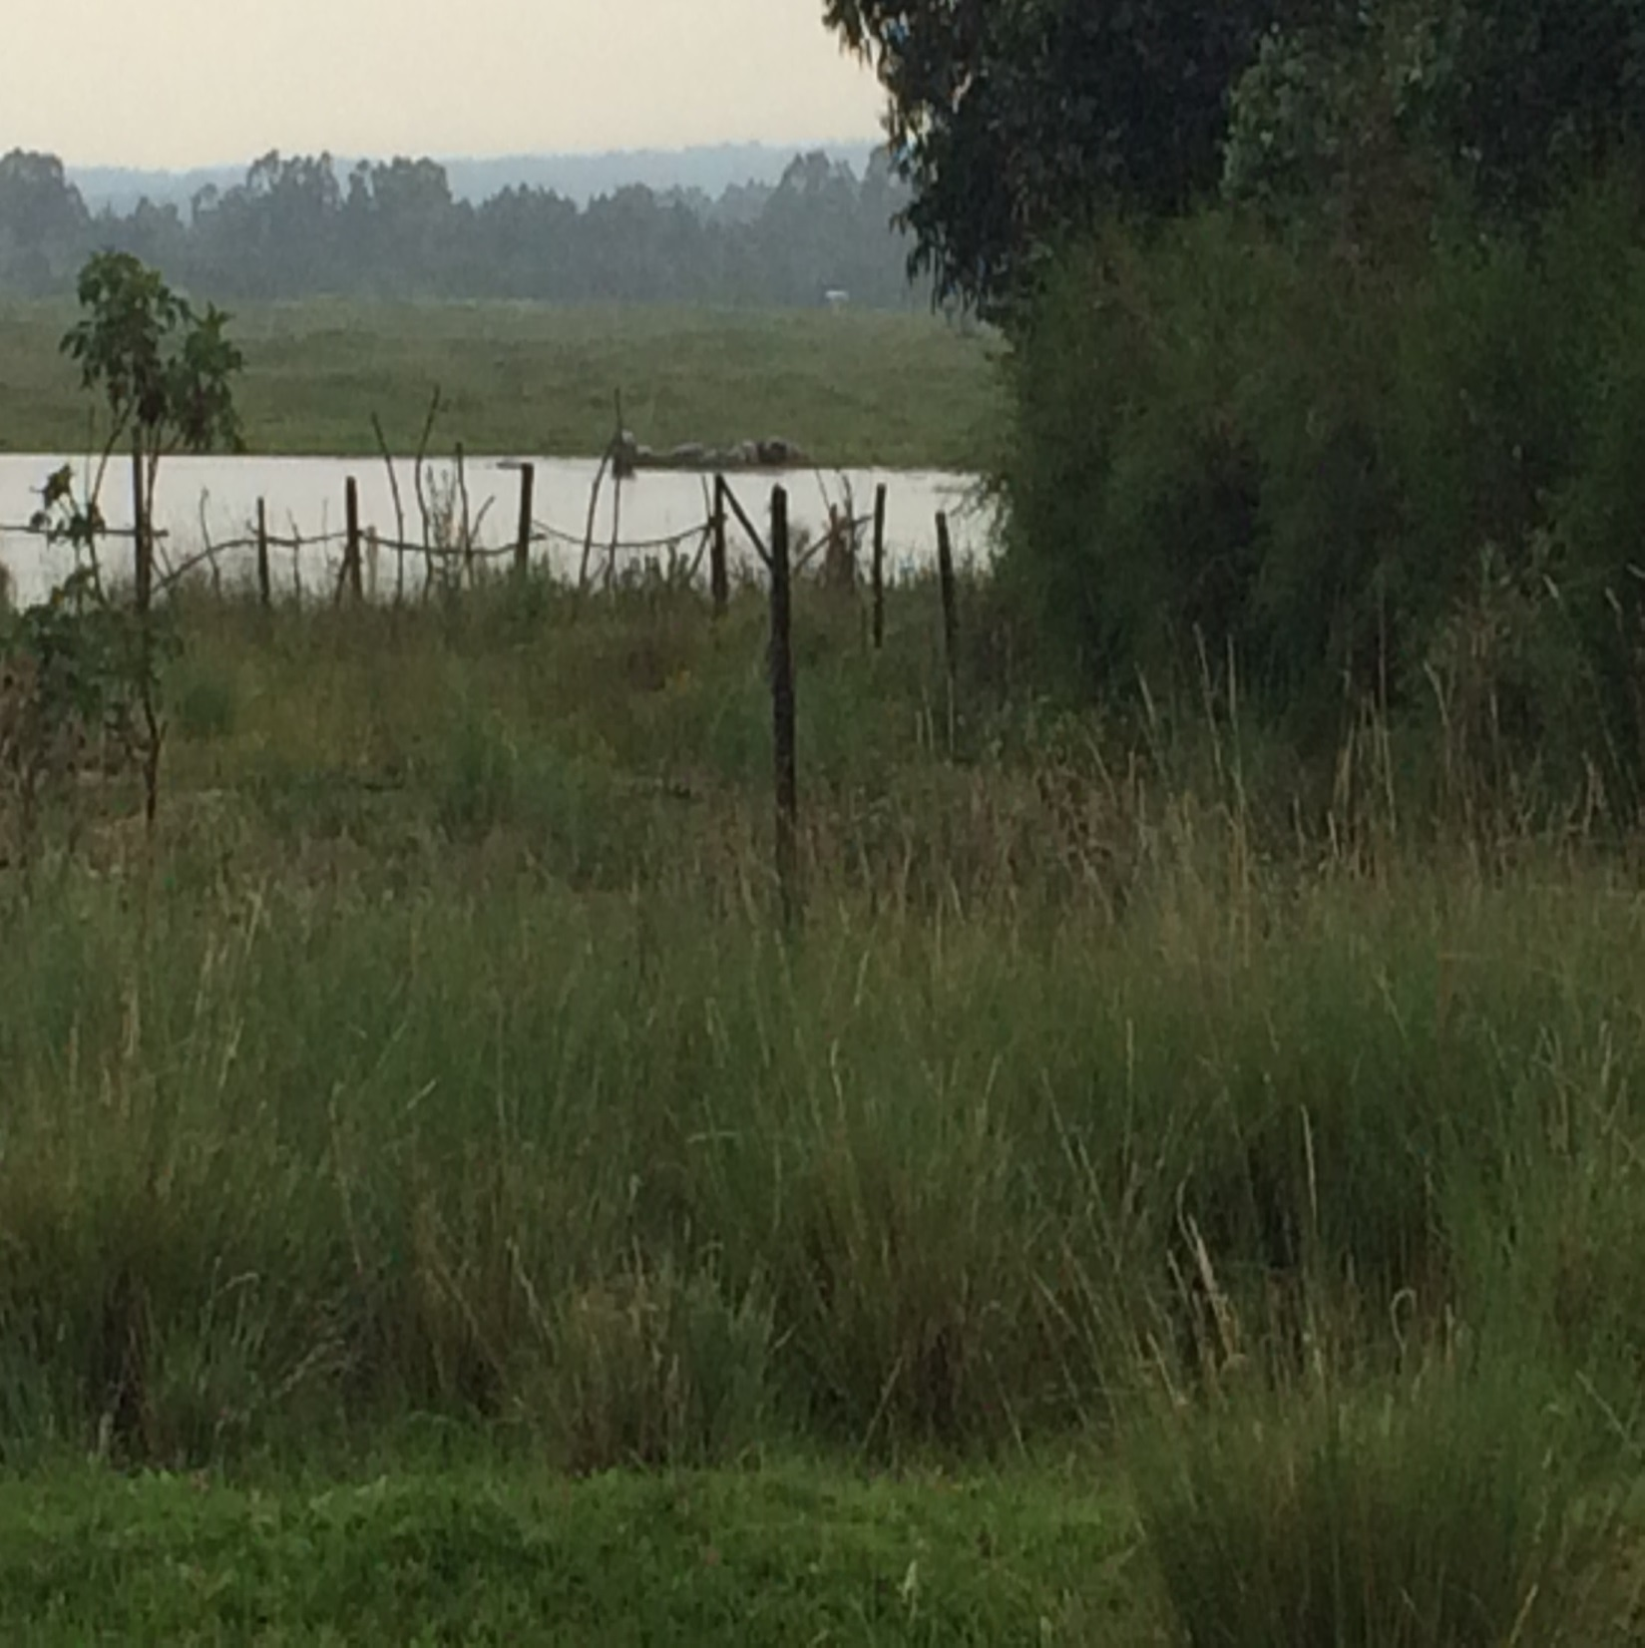

Slide 21
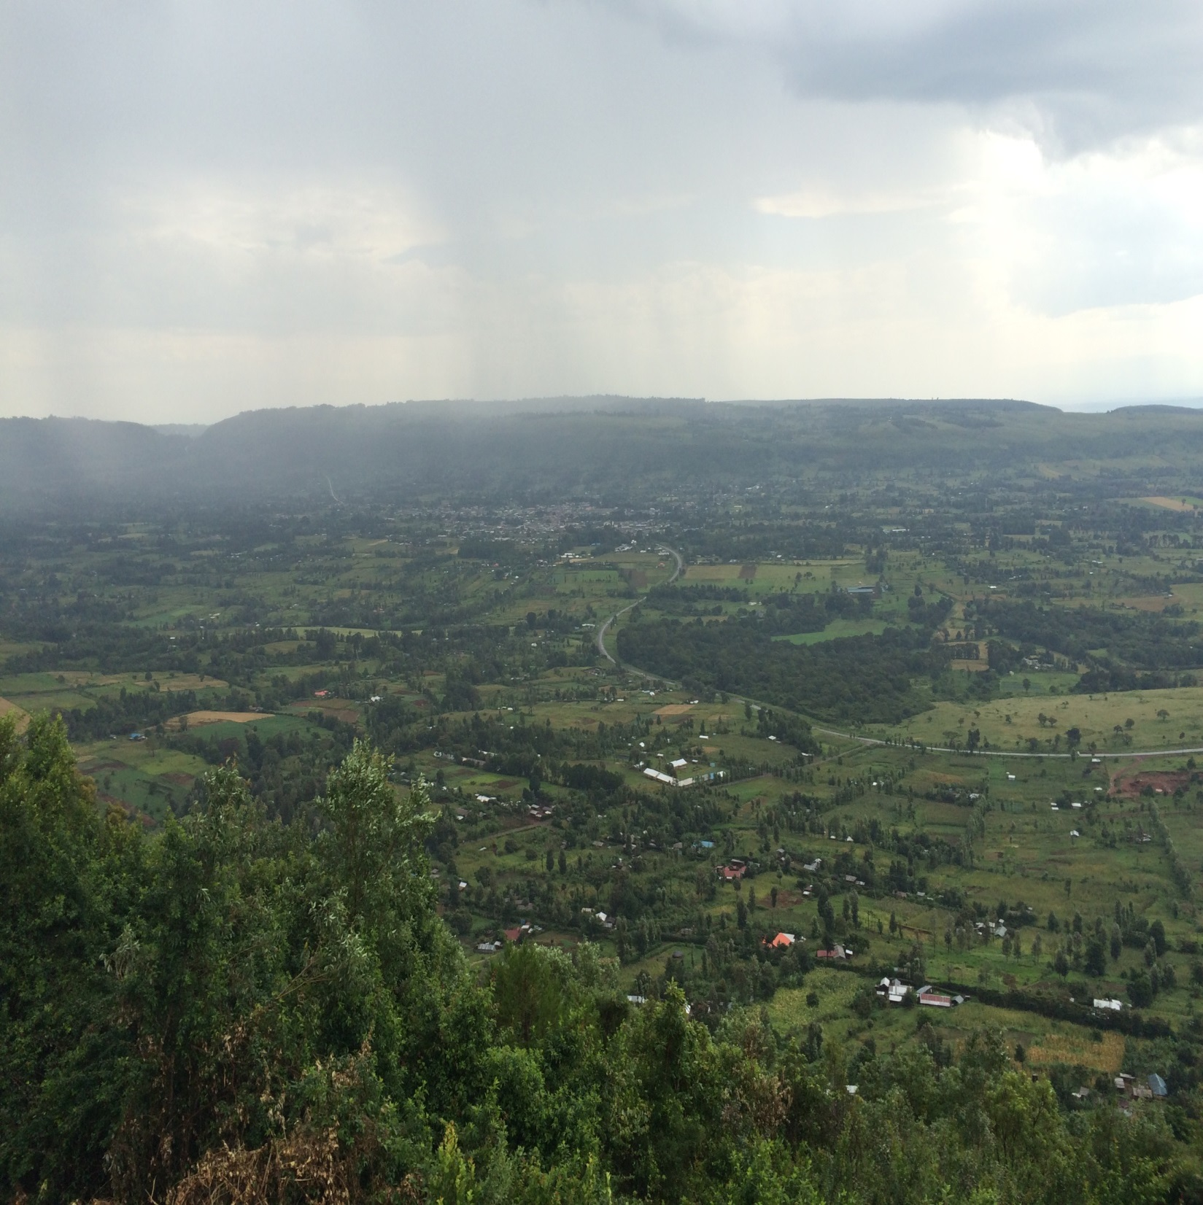

Slide 22
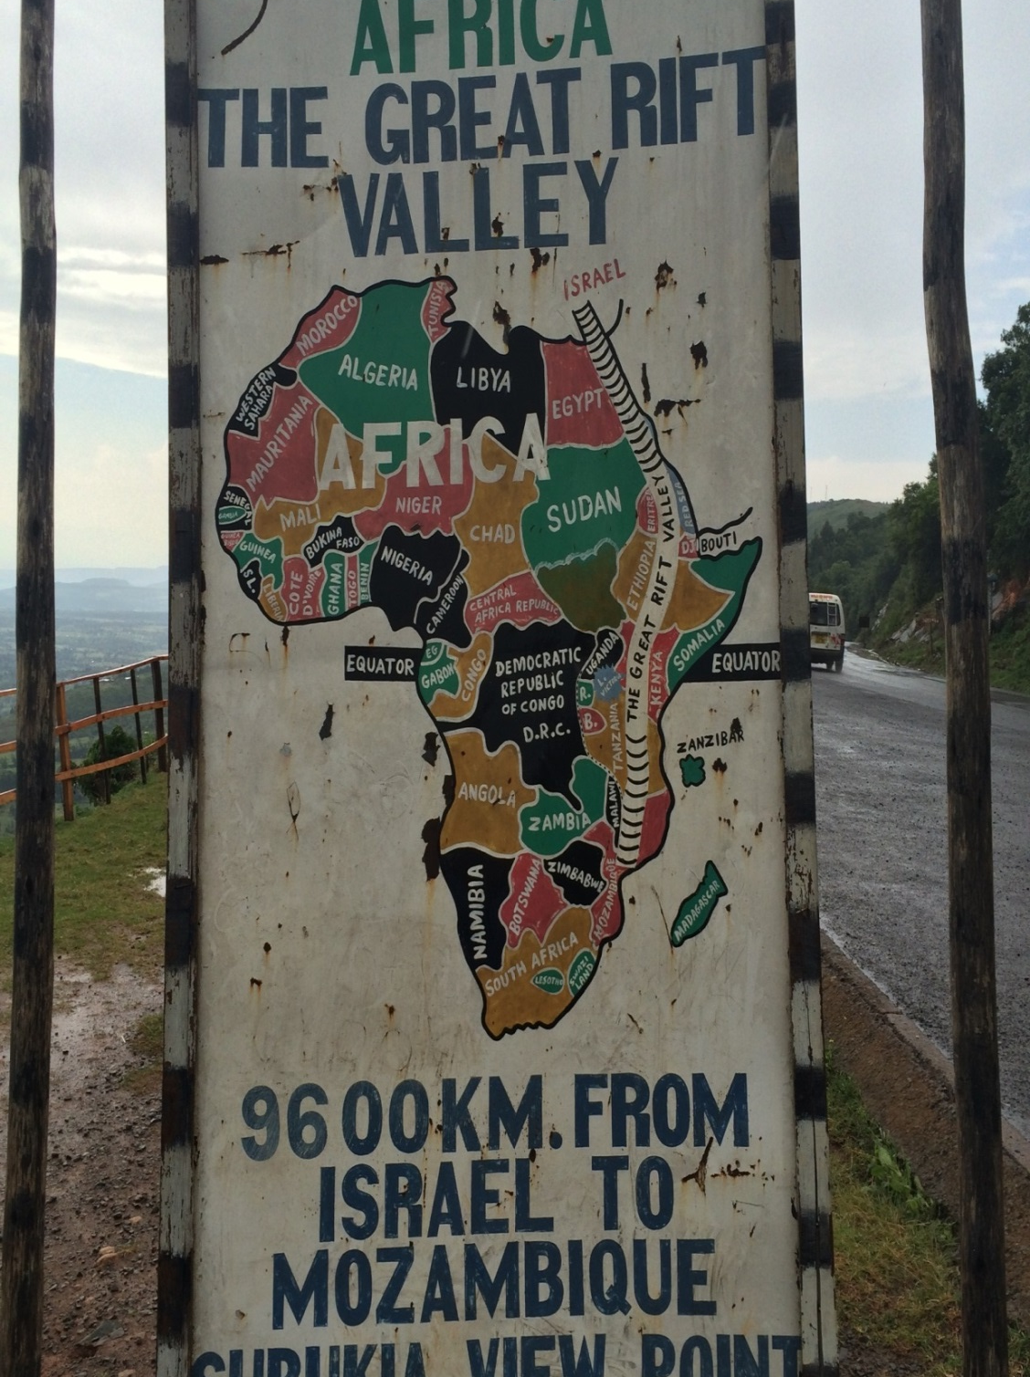

Slide 23
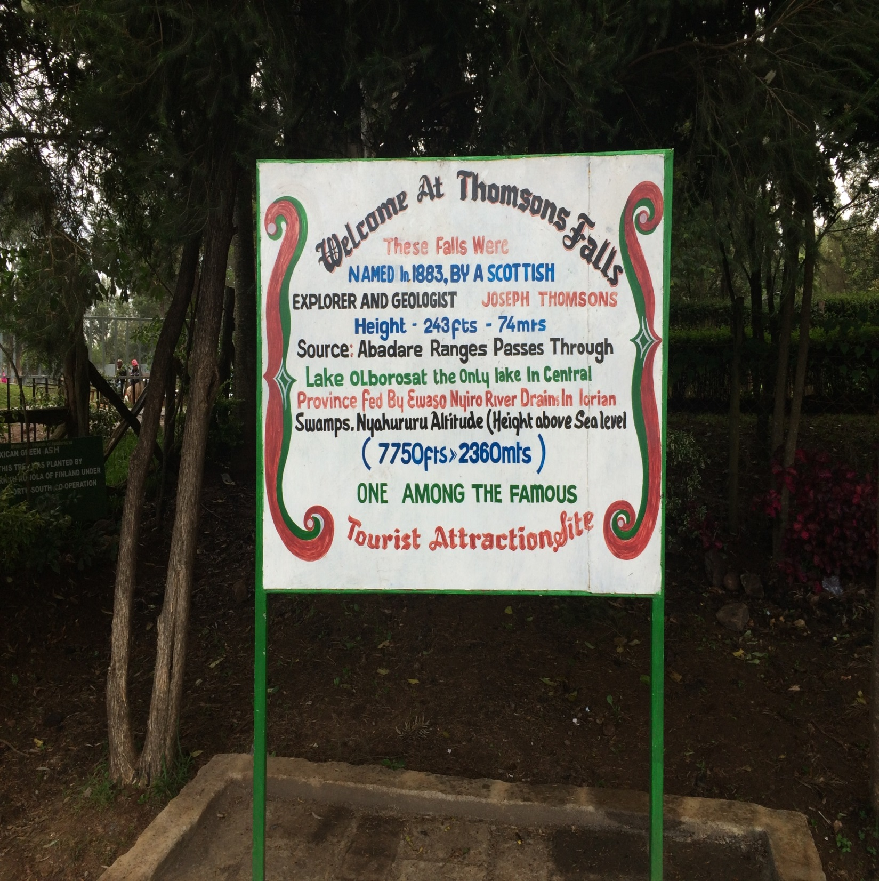

Slide 24
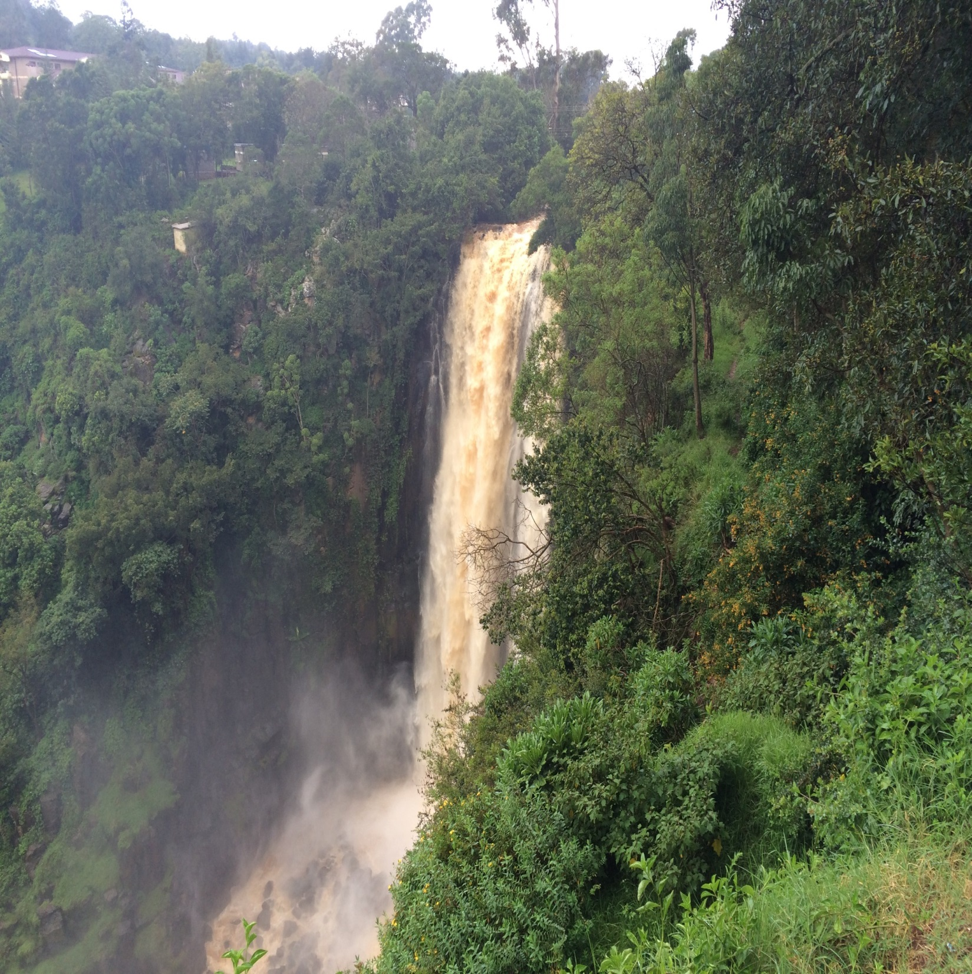

Slide 25
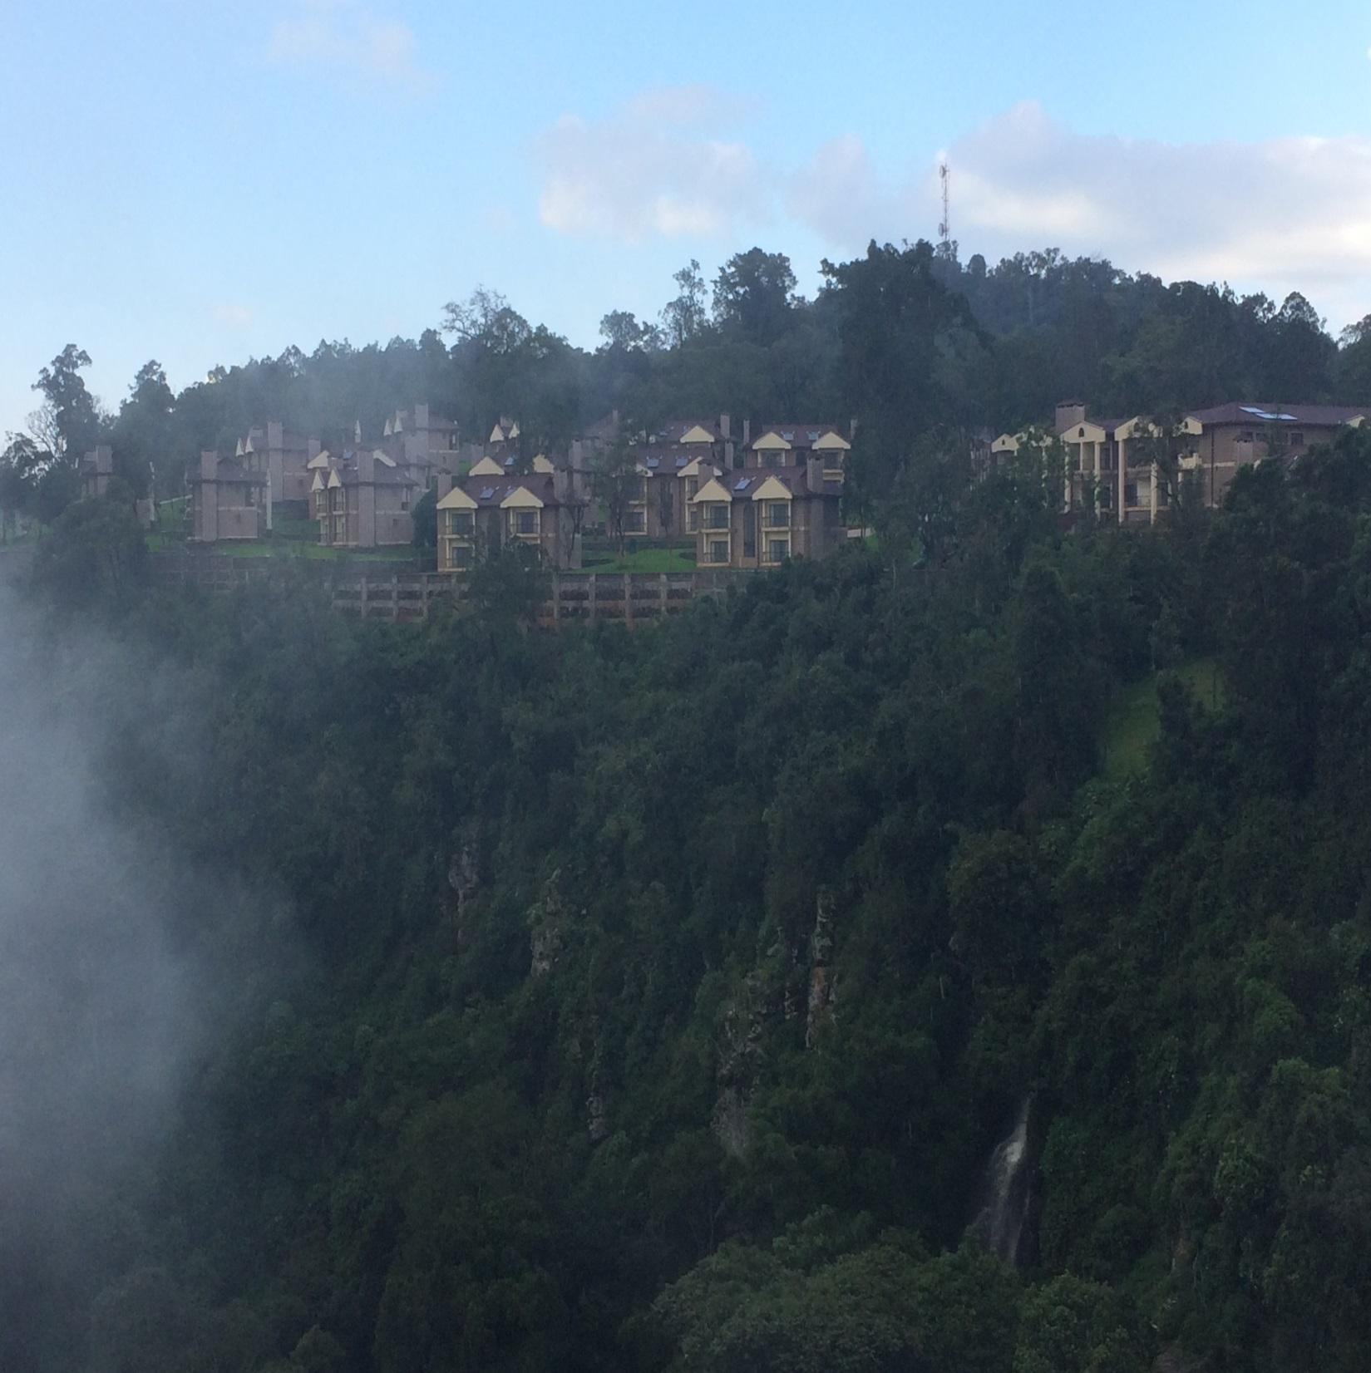

Slide 26
Day 9, Thursday, August 25
Back to Farm View Academy at 9 a.m., this time to speak to an assembly of students, staff, and parents.
Each given 30 minutes to speak. I spoke on how to study the Bible; Brad spoke on making sure that what we believe can be found in the Bible.
One of the staff members, Albert, is a Christian, and he told us that one of the other staff members said he would visit with Gatitu on Sunday.

Slide 27
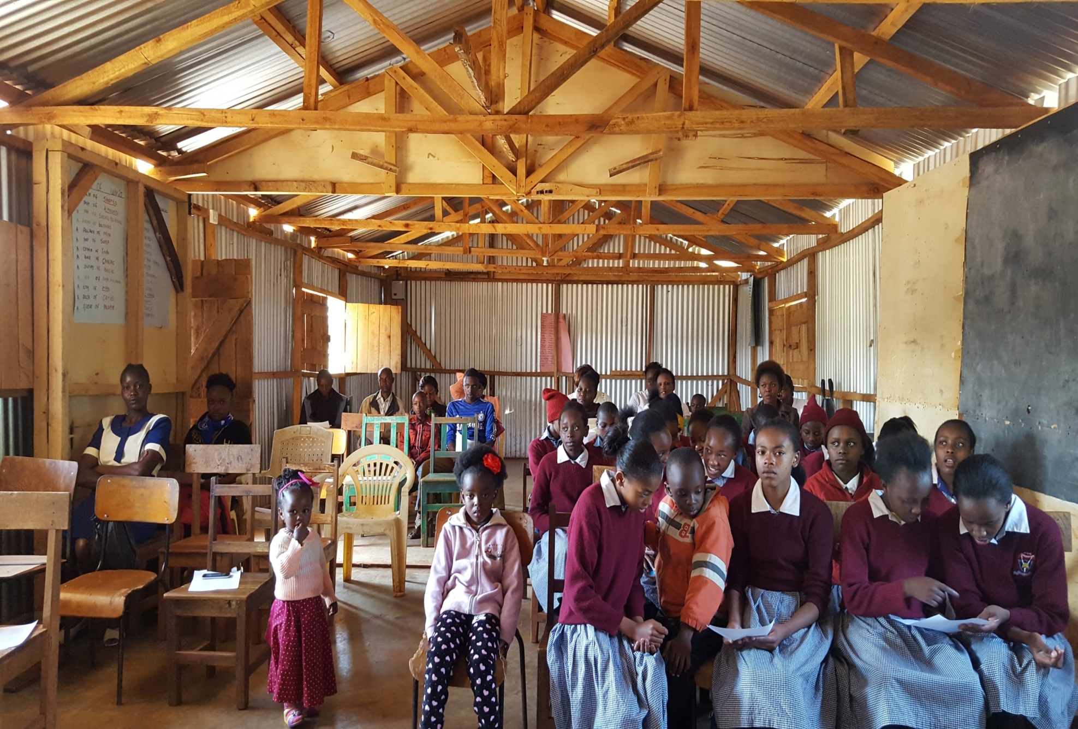

Slide 28
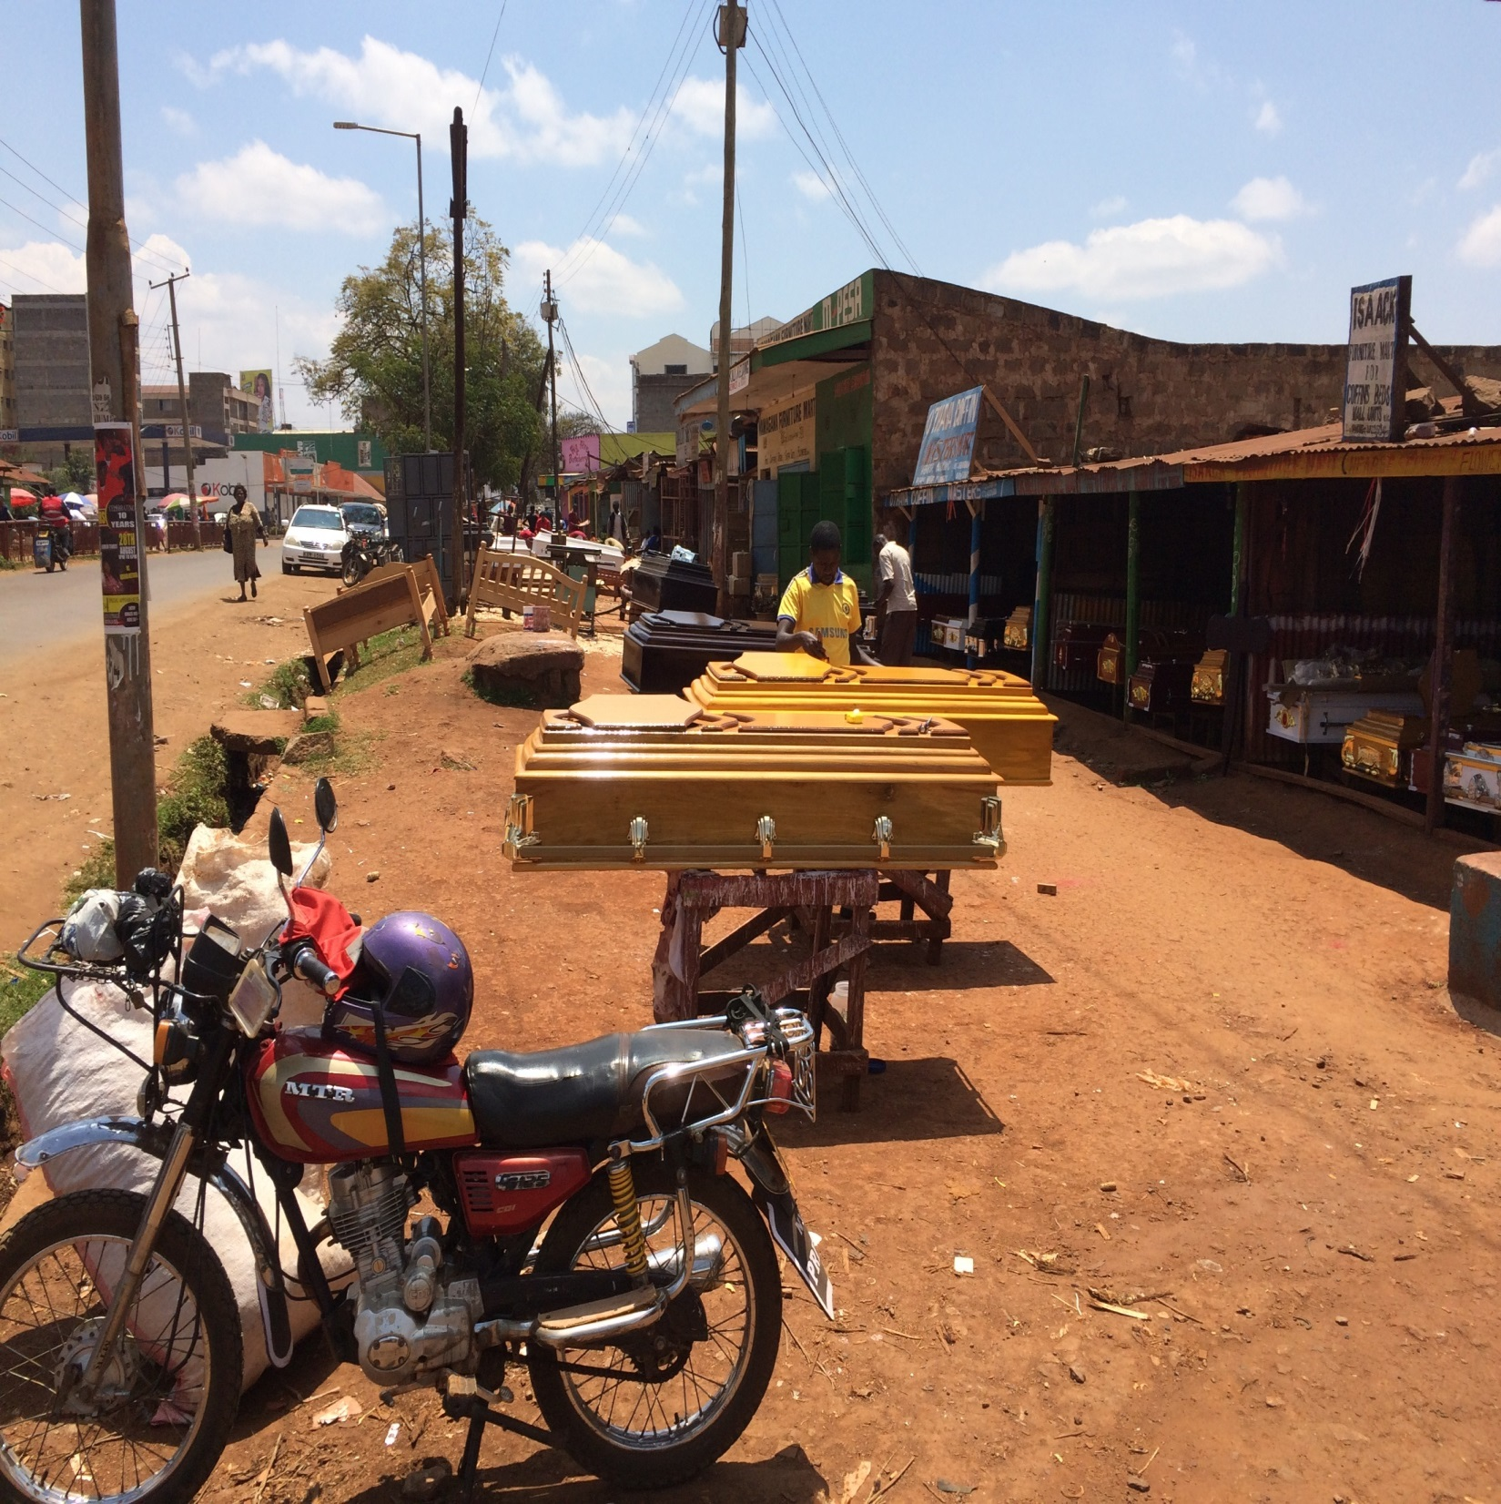

Slide 29
Day 9, Thursday, August 25
Went to Jack’s house at 4, where we studied with several members of Gatitu, and a few non-Christians.
I spoke on the characteristics of the faithful in Revelation; Brad explained how to become a Christian.
Brad and I enjoyed playing with the children before supper.
After supper, a Sabbatarian came and we briefly discussed some issues.

Slide 30
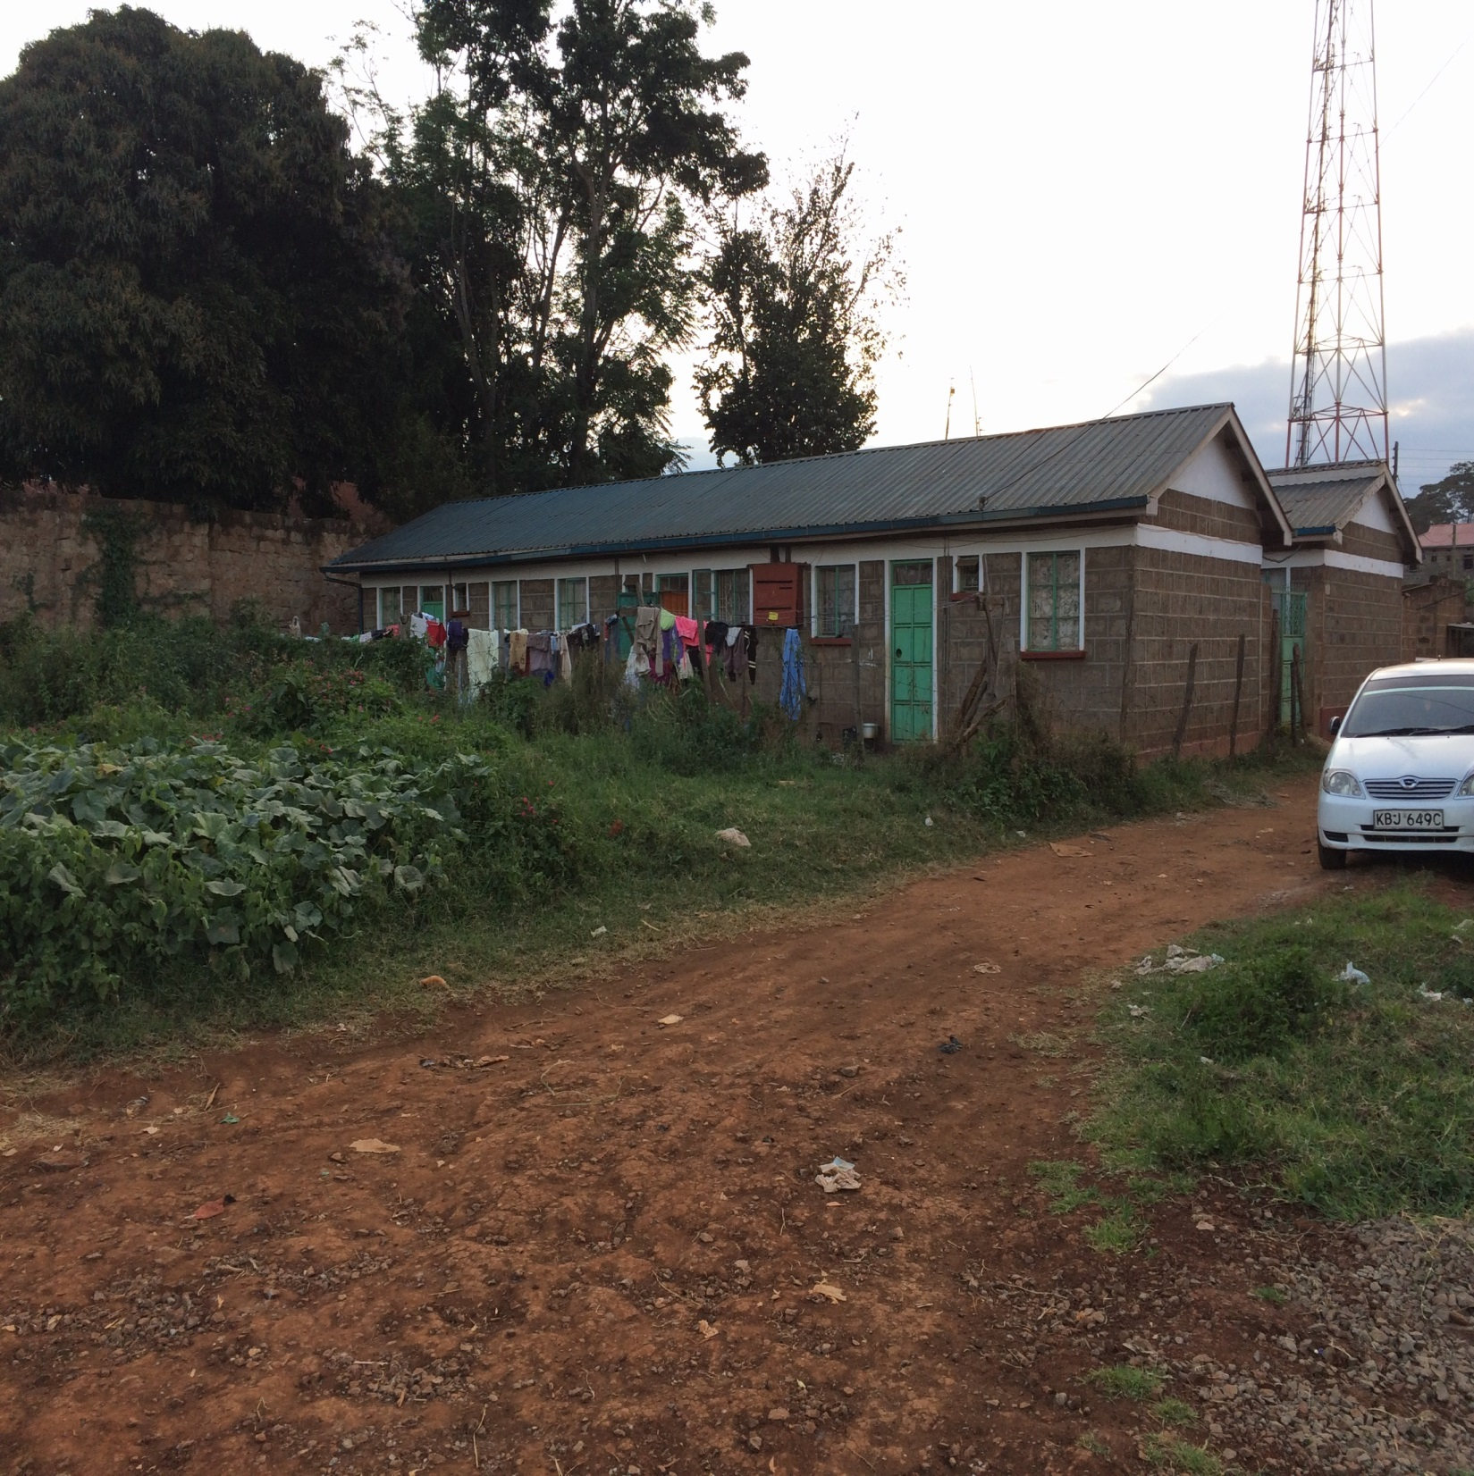

Slide 31
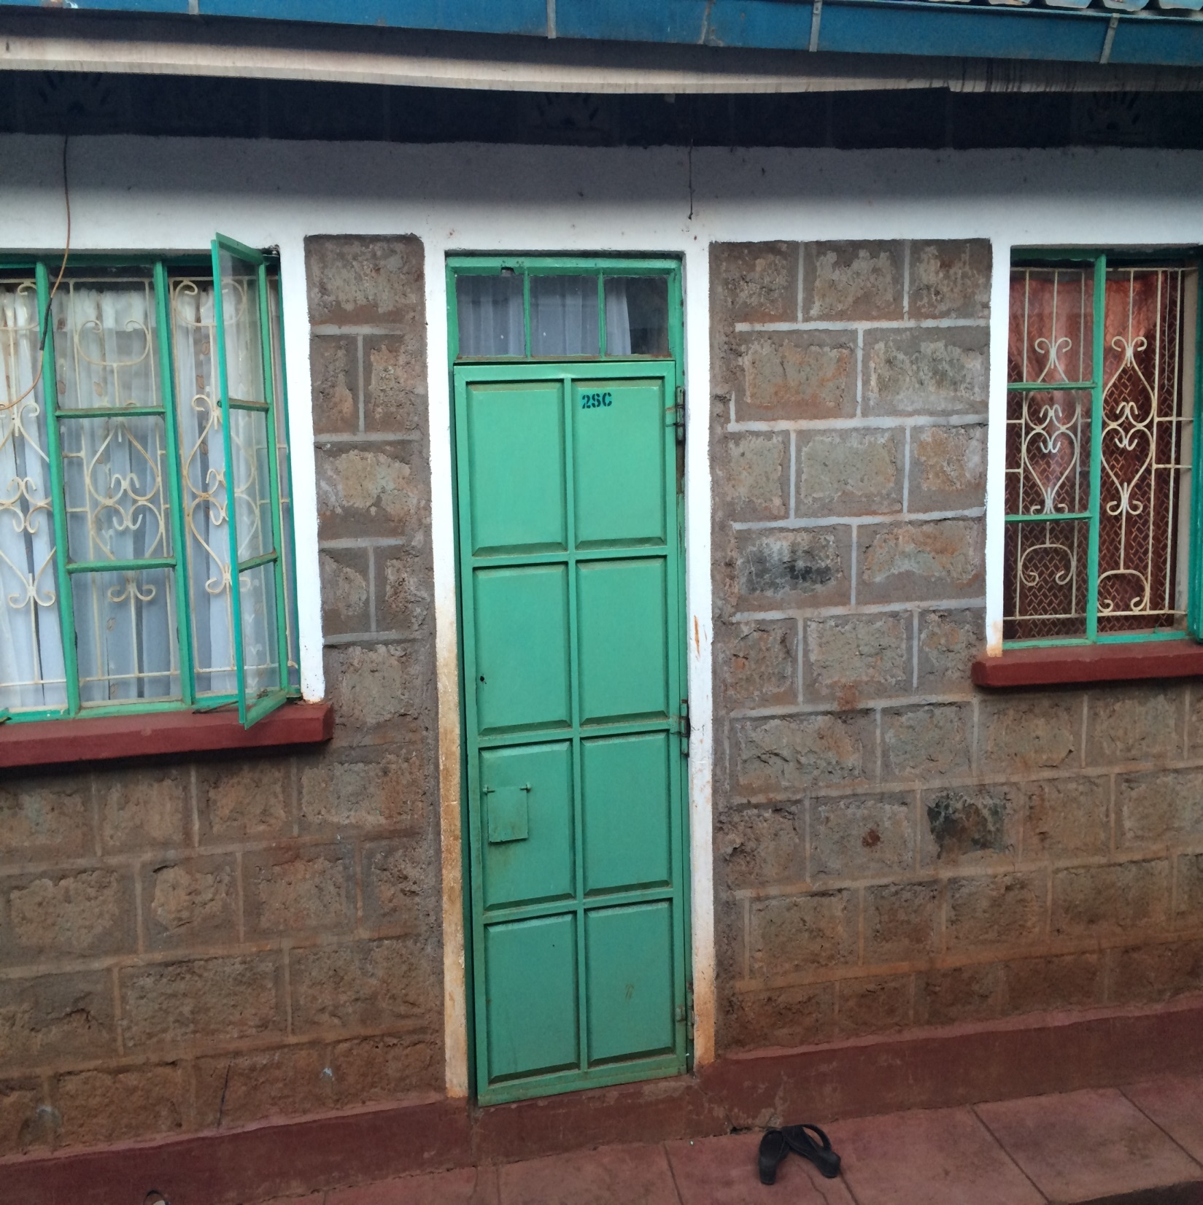

Slide 32
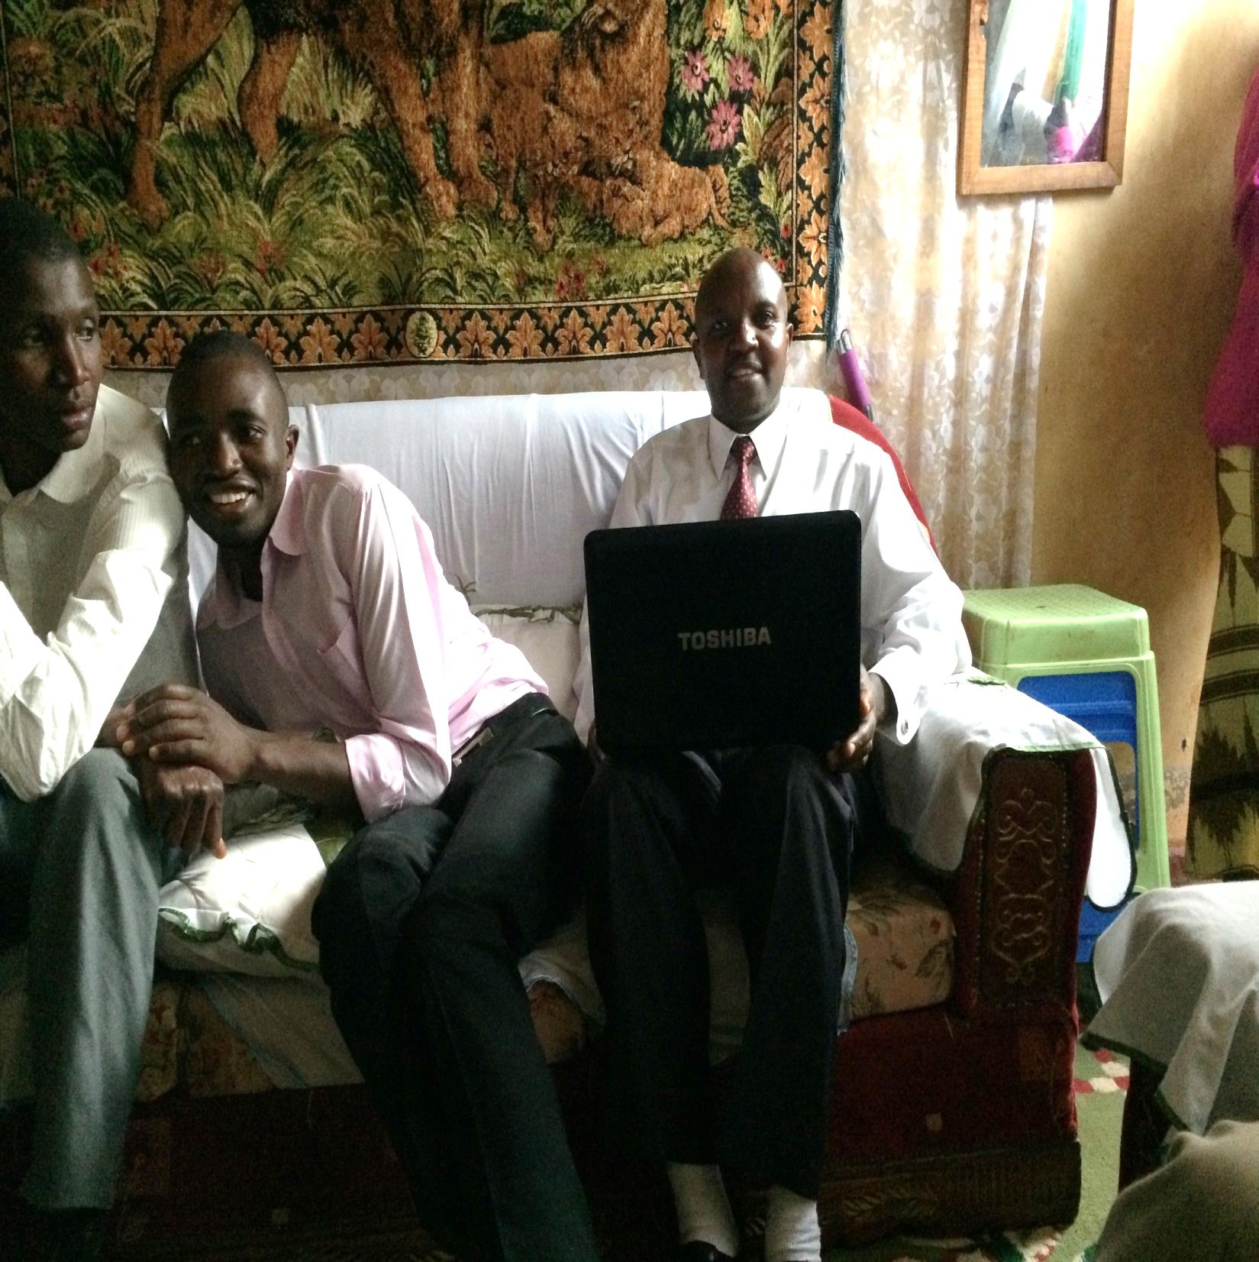

Slide 34
Day 10, Friday, August 26
Took a long trip to Nukuru and back (about a 7 hour round trip).
To investigate a situation with a member from one of the local churches, one with which Jack works regularly.
Suspicions were that while he was working out of town he had married another woman and had children with her. These suspicions were confirmed.
Had a long discussion on our return about church discipline.
The problem of polygamy.

Slide 35
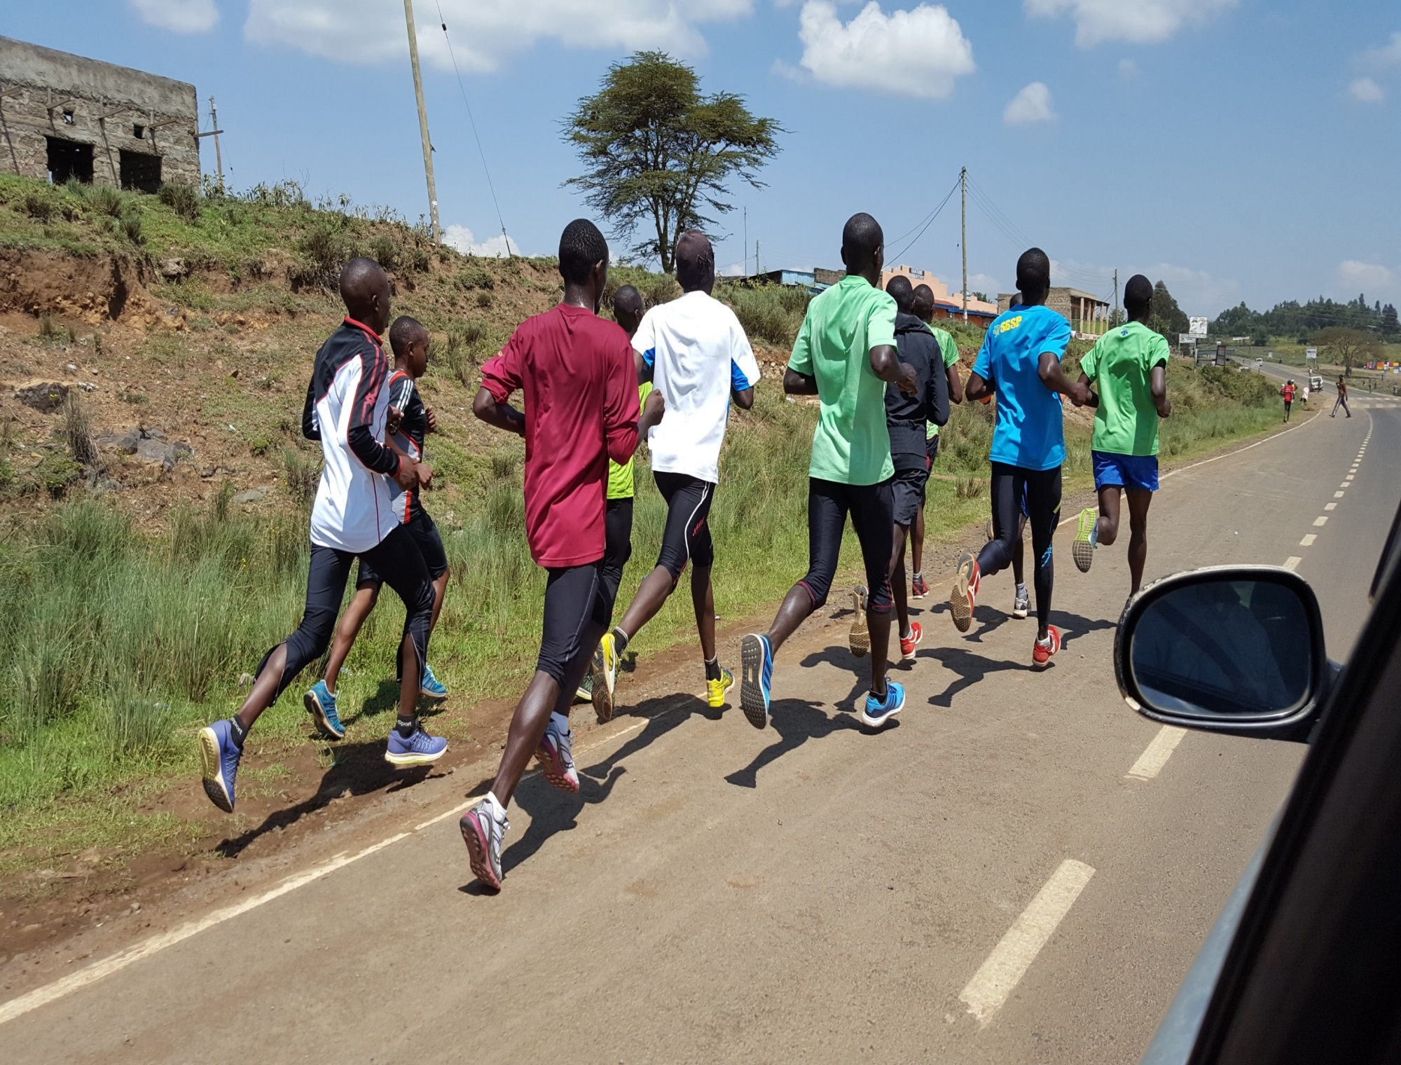

Slide 36
Day 11, Saturday, August 27
Met with brethren at Nanyiki in the morning, from 10:30 till 12:30.
Brad spoke on Luke 14, “You Cannot Be My Disciple”; I spoke on “How Faith Behaves,” from James.
About 15 present, including Alex and Solomon, the two young men baptized the previous Sunday.
Mt. Kenya, a Massai warrior, speed bumps.

Slide 37
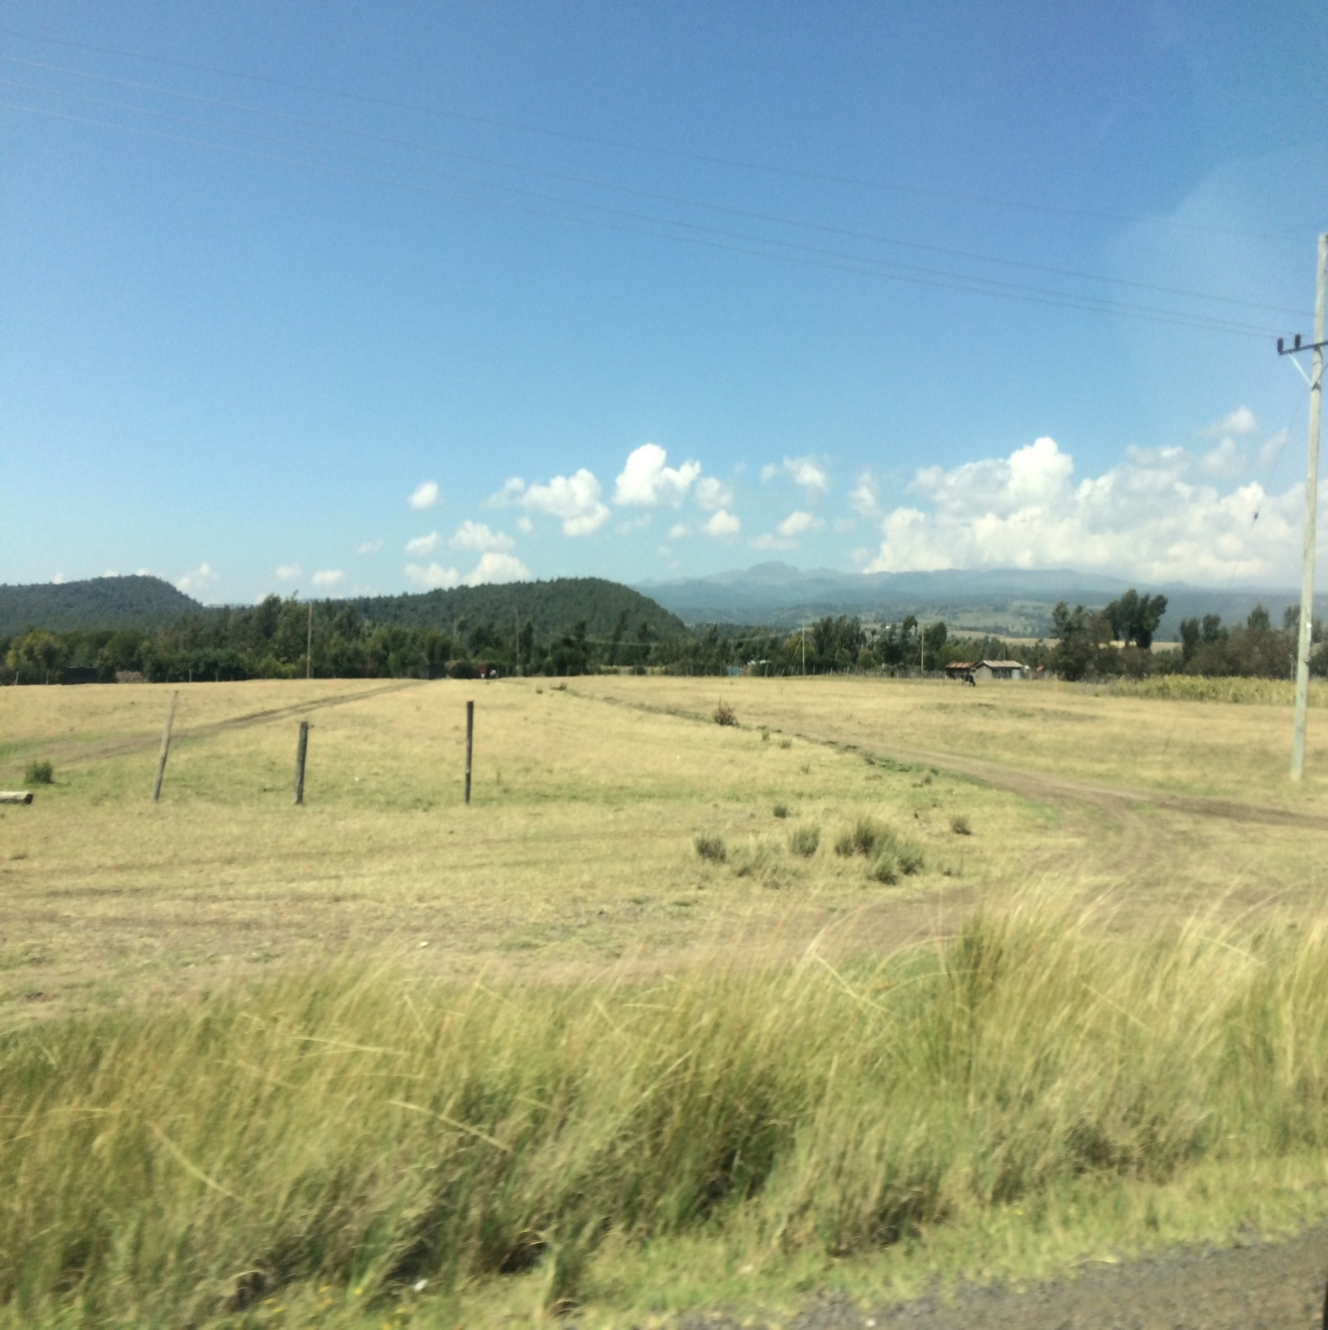

Slide 38
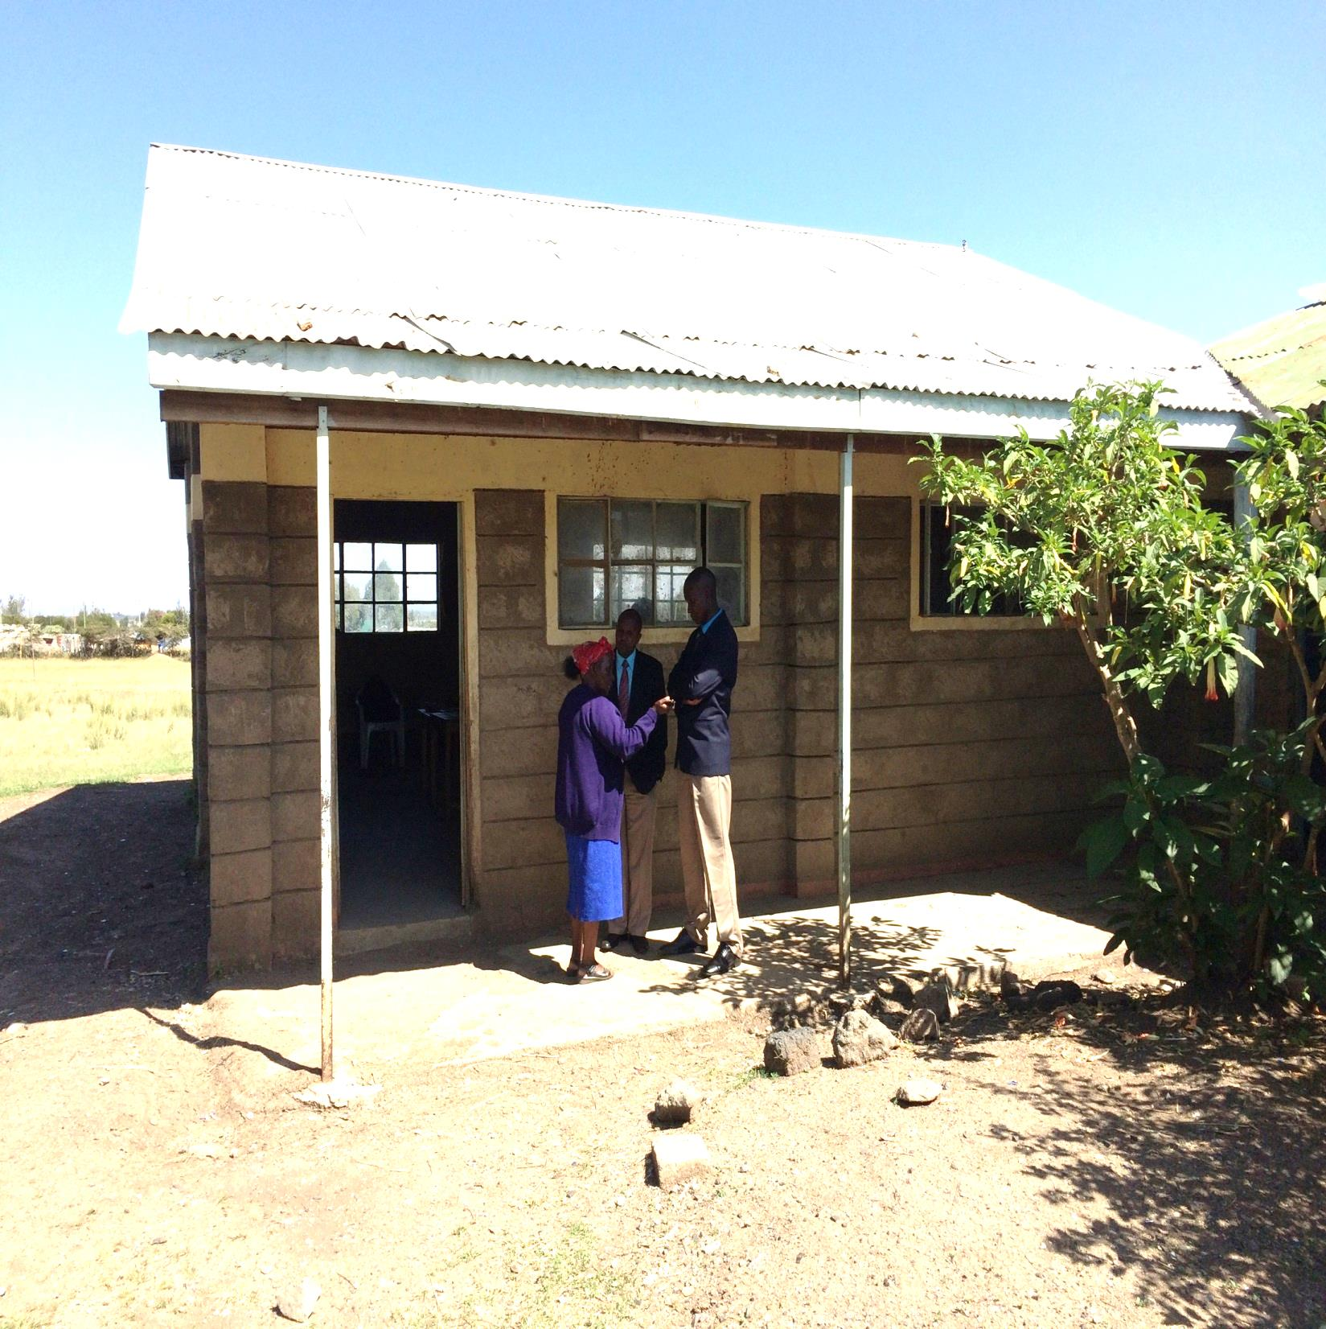

Slide 39
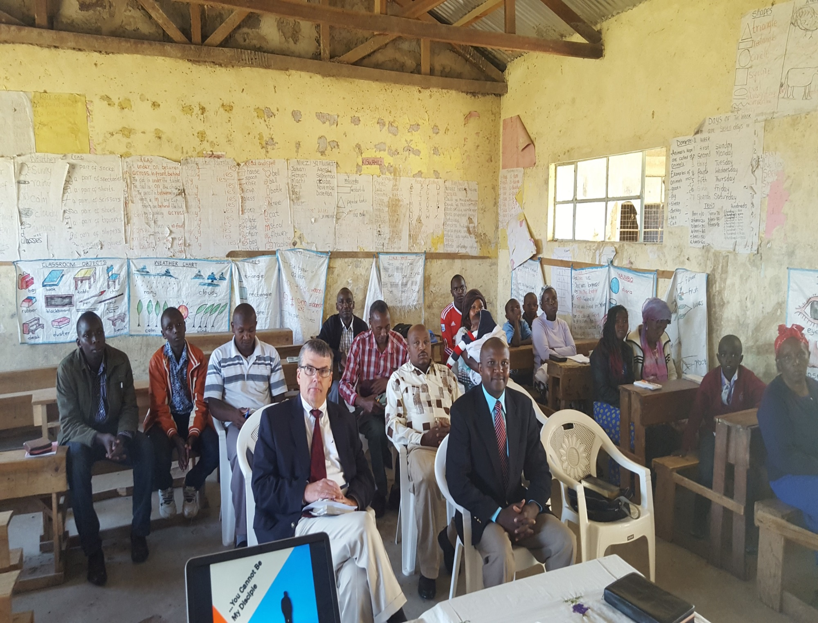

Slide 40
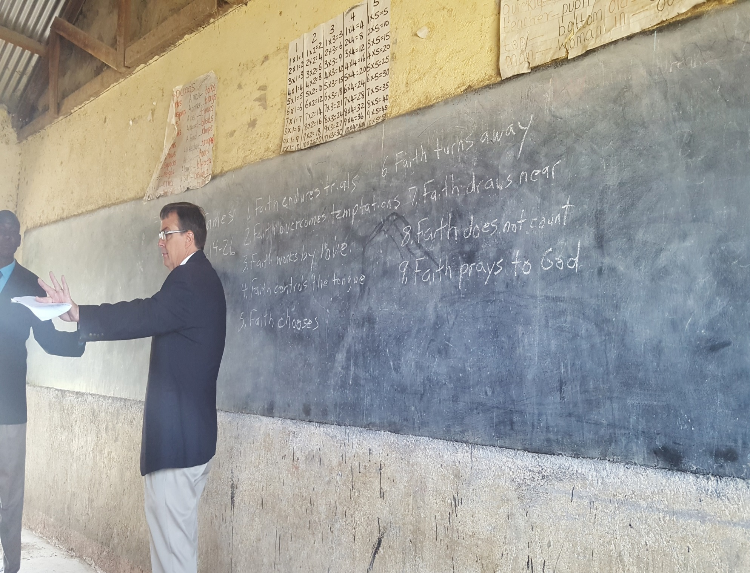

Slide 41
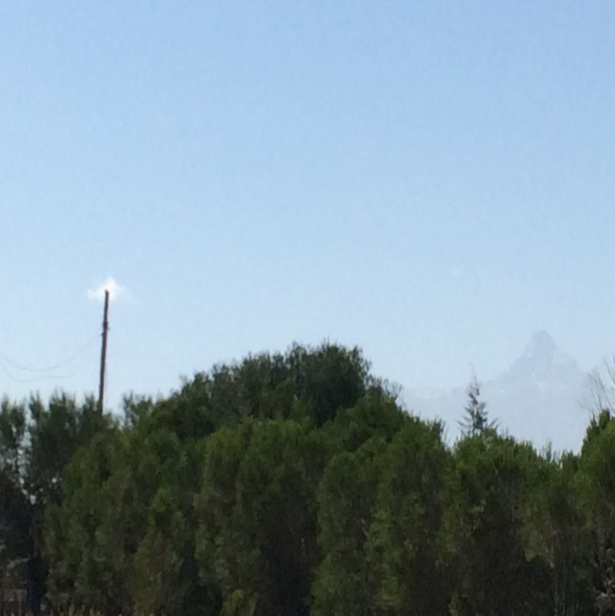

Slide 42
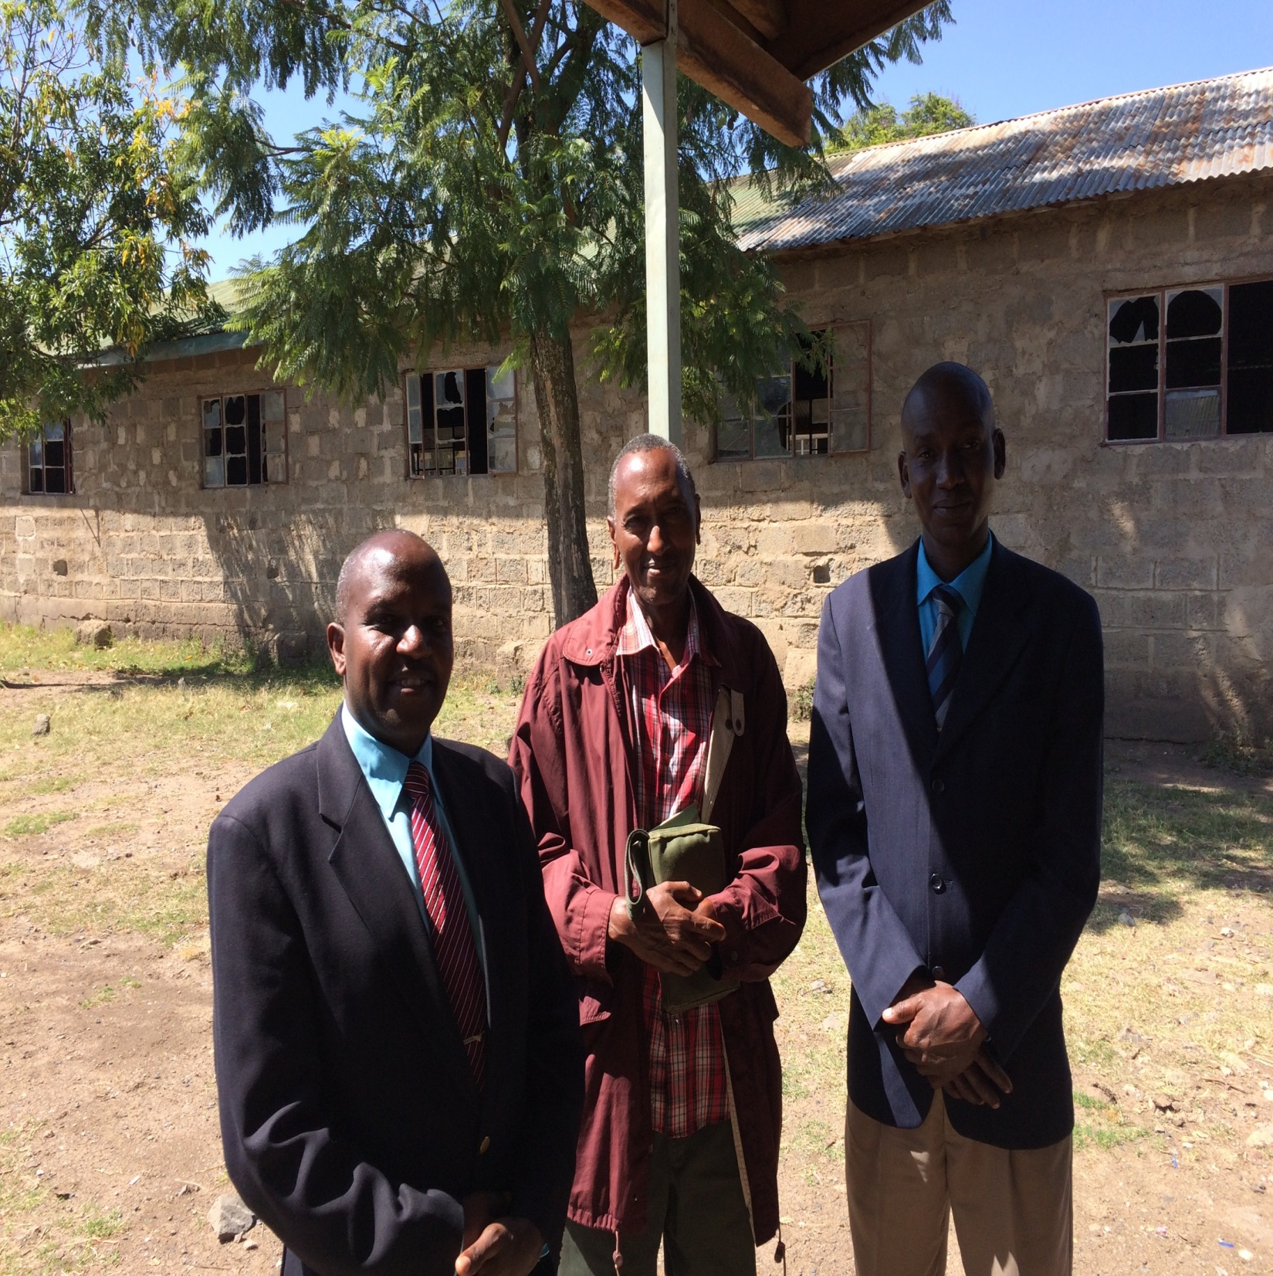

Slide 43
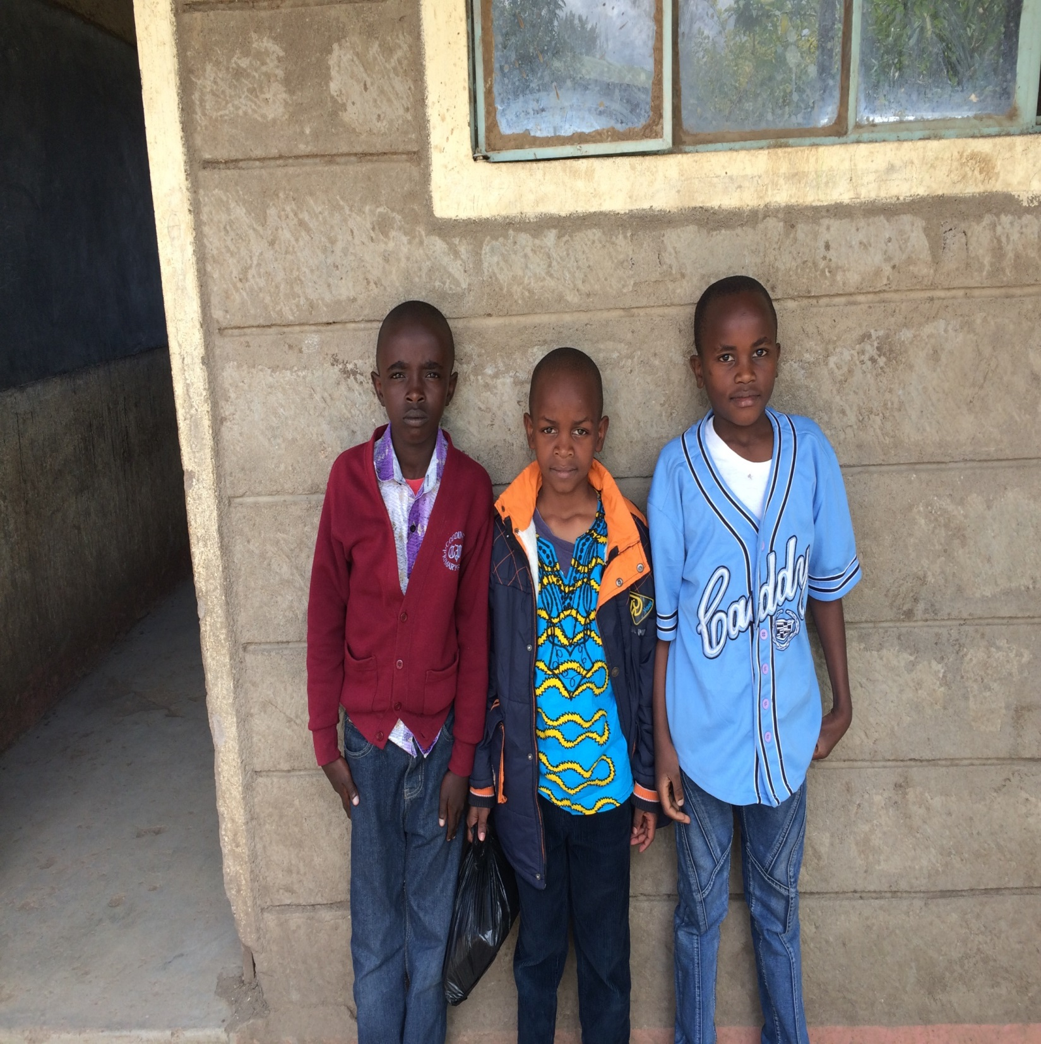

Slide 44
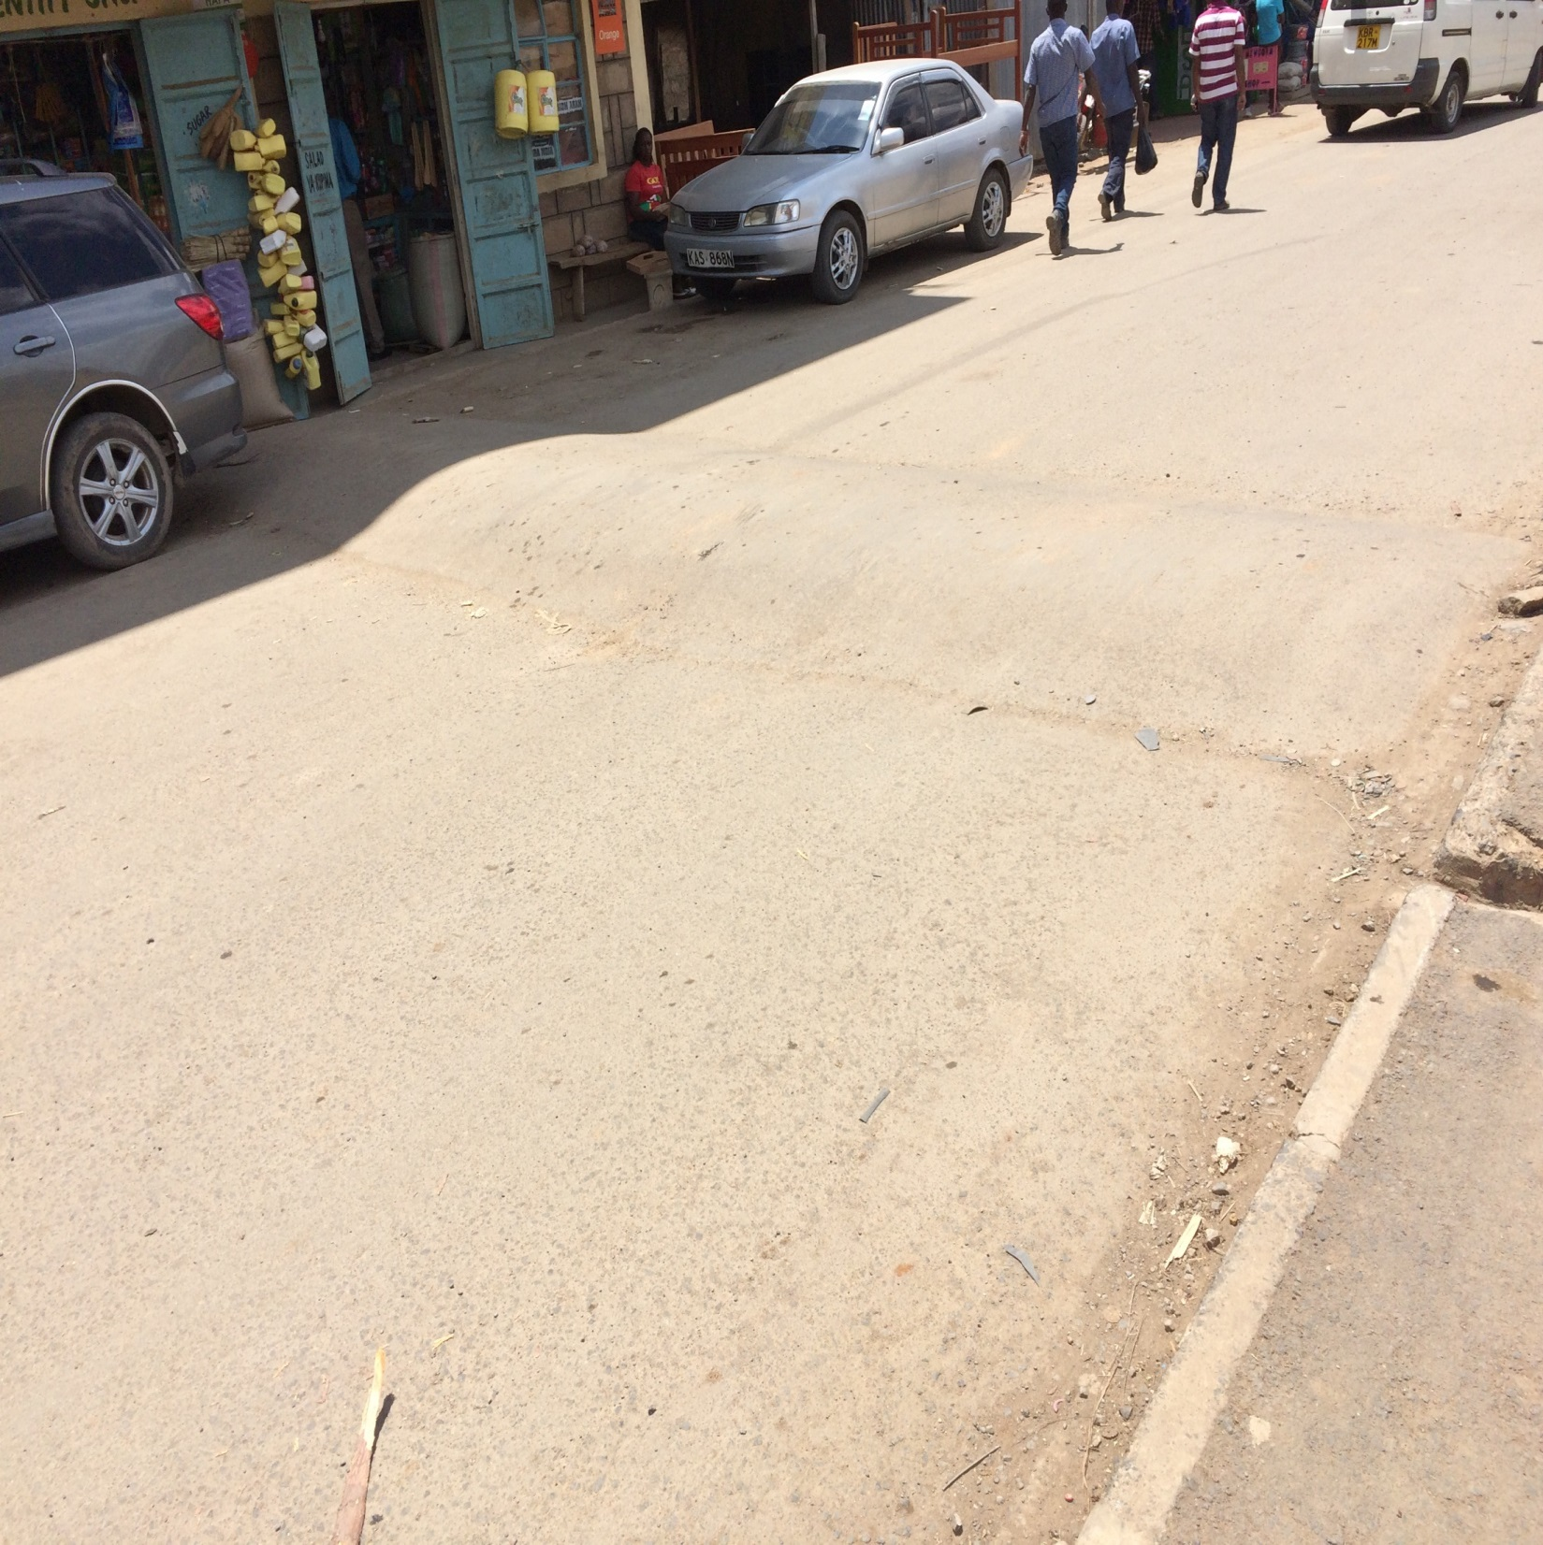

Slide 45
Day 11, Saturday, August 27
Met with brethren at Maruru in the afternoon, from about 2 till 4.
Passed a wildlife preserve on our way, and saw some zebras.
Met with these brethren in a small room, about 12 of us. I spoke on the union of sincerity and truth, and Brad repeated his morning lesson on Luke 14.
Ladies prepared a meal for us, and then we played soccer with some of the kids afterwards.

Slide 46
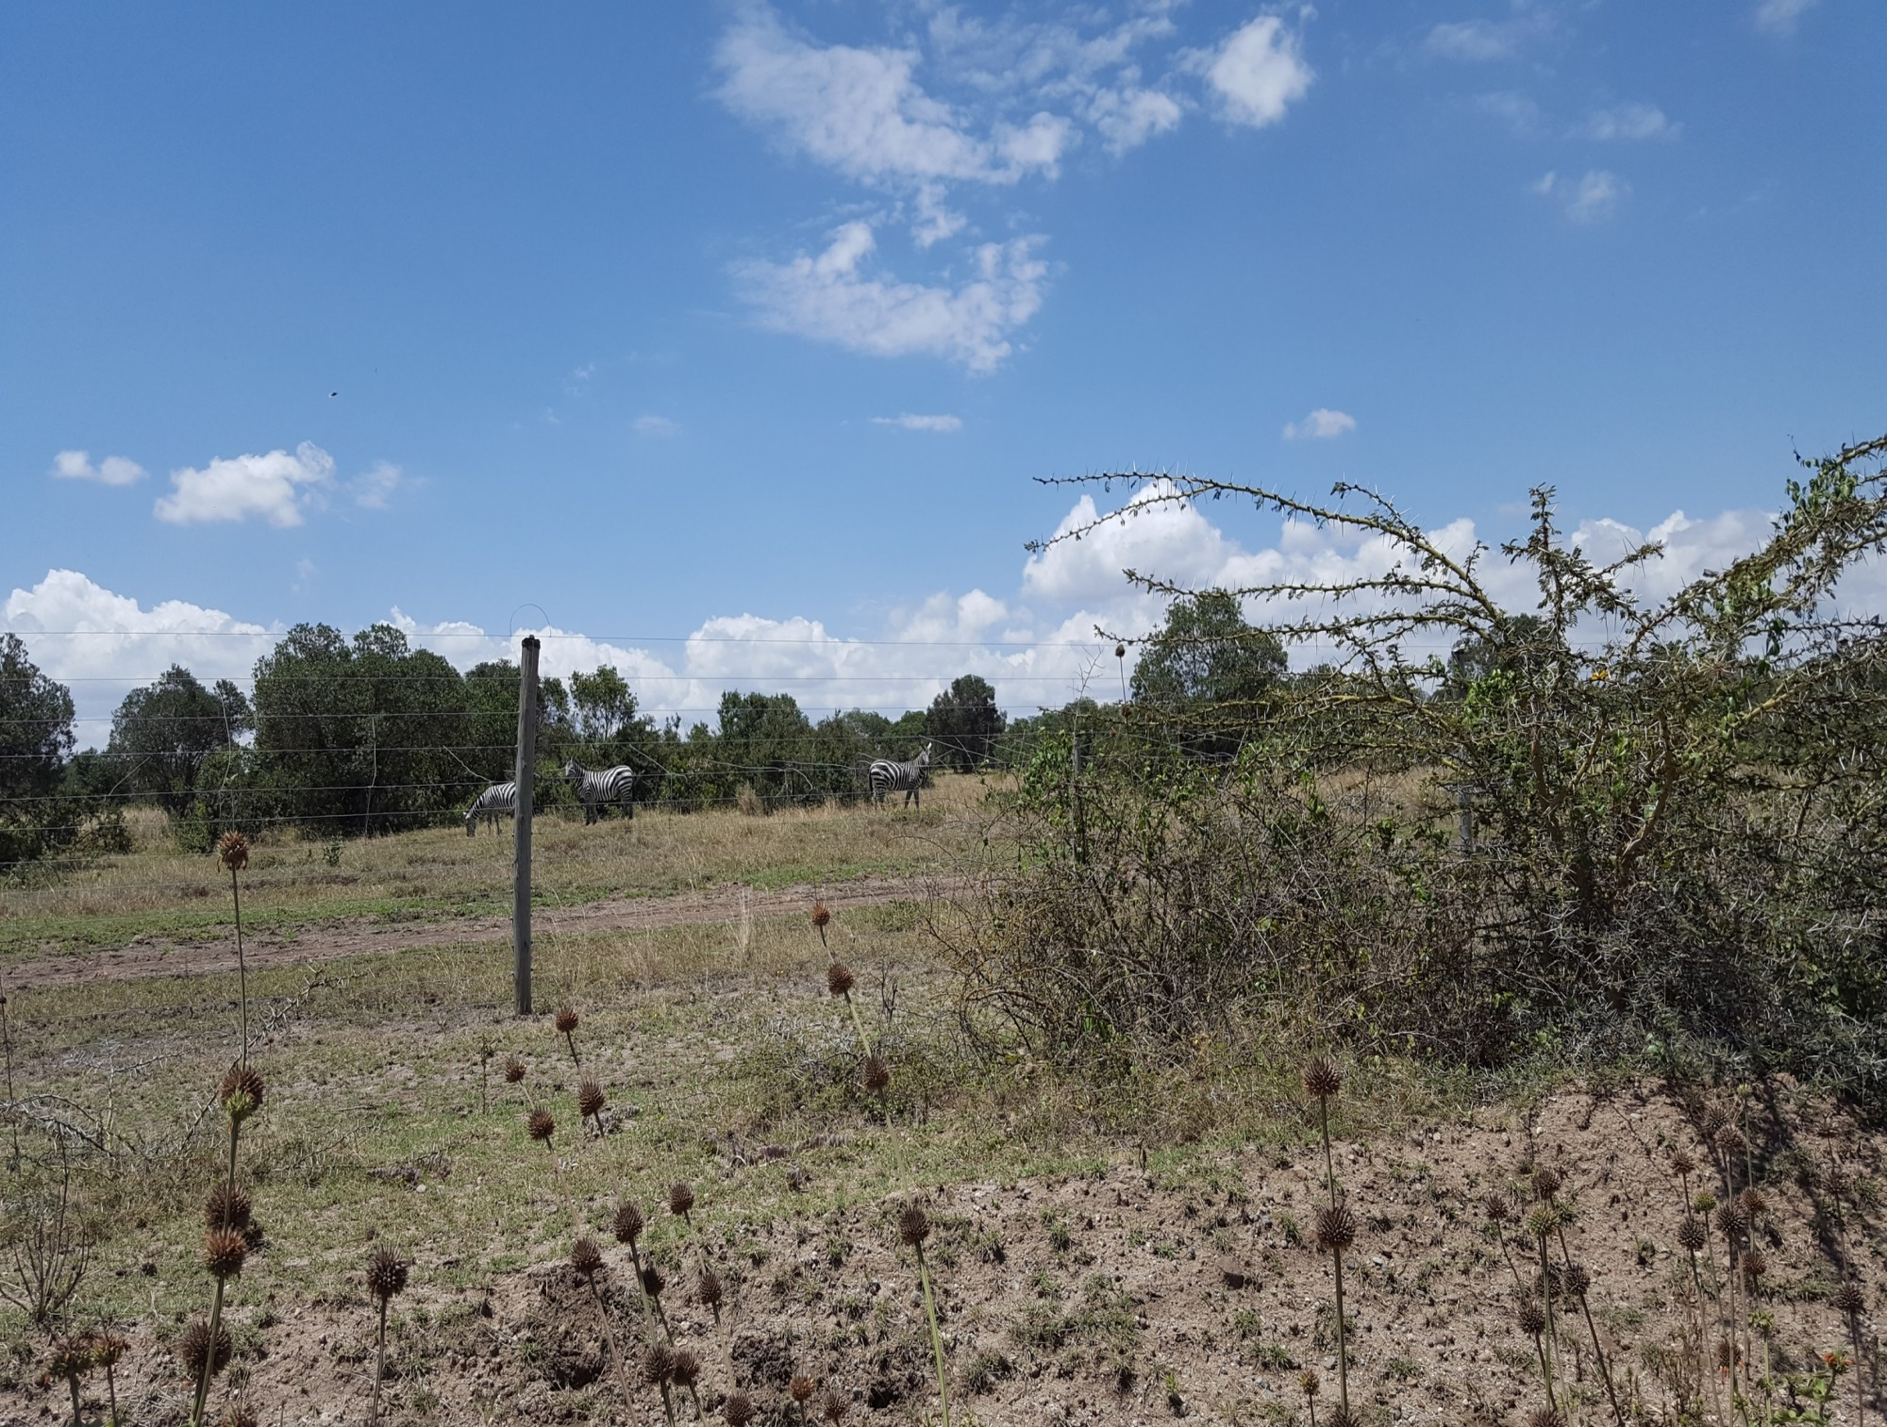

Slide 47
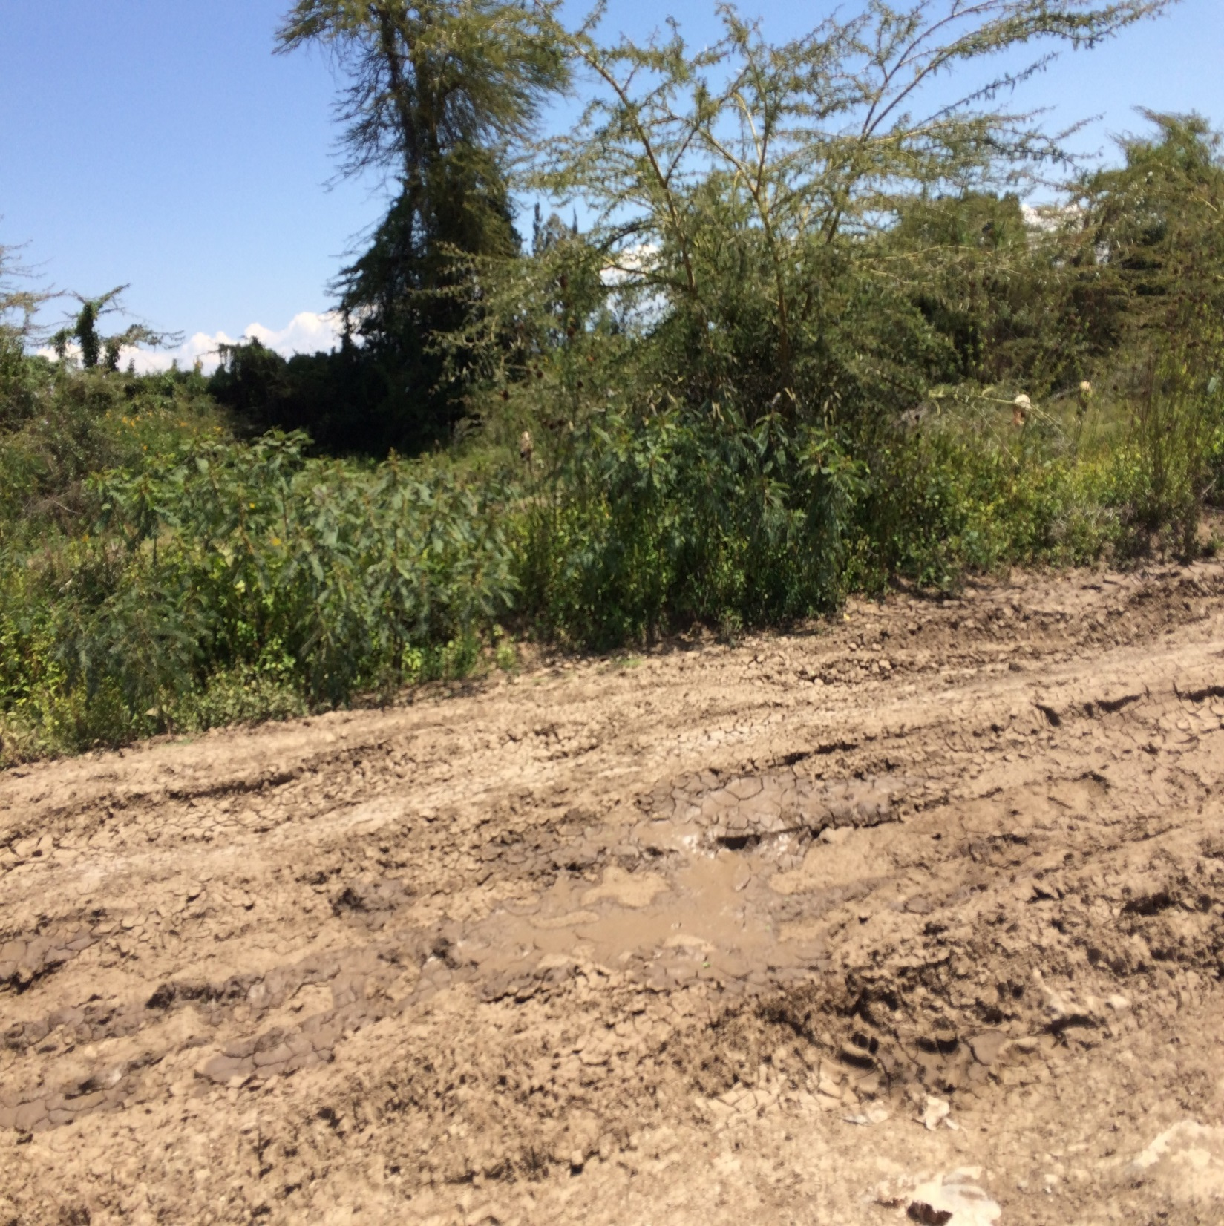

Slide 48
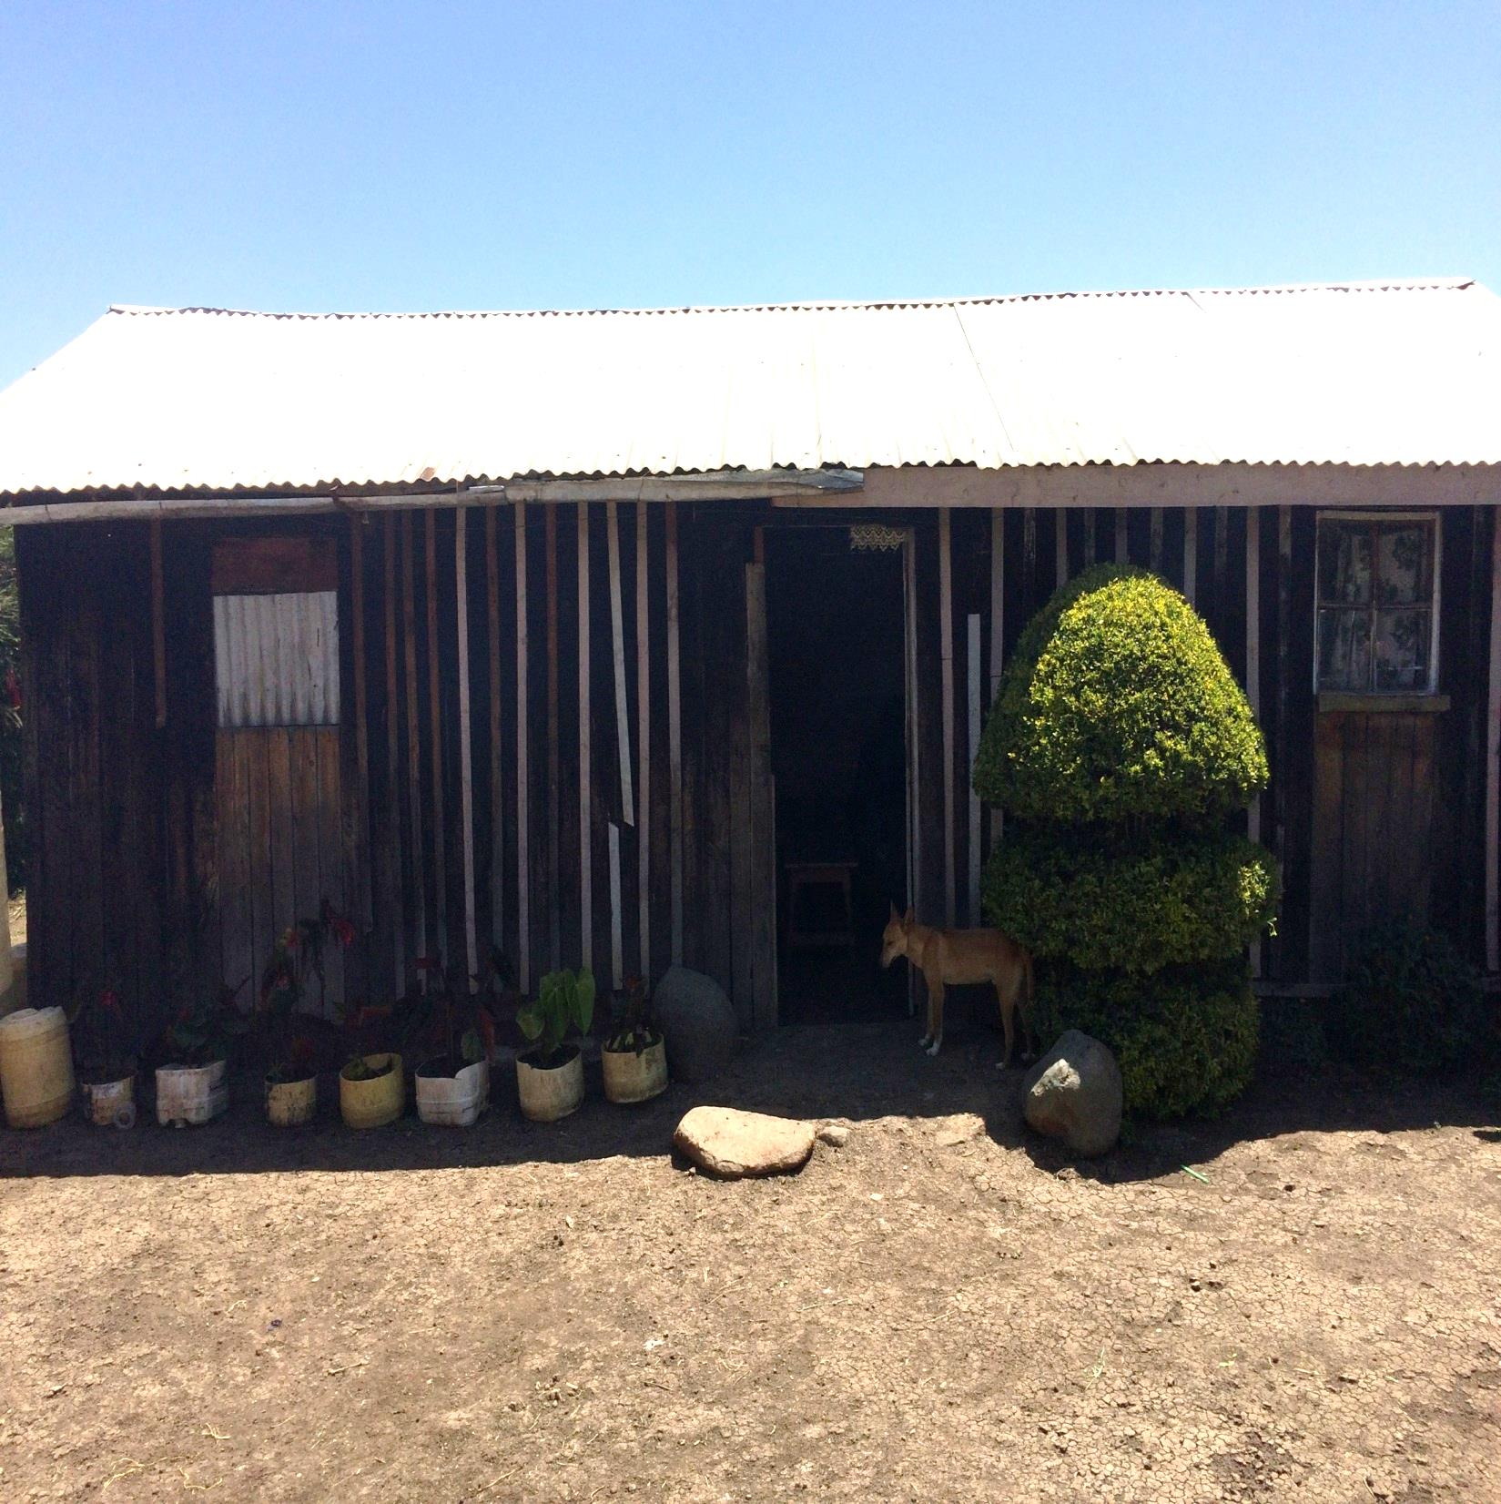

Slide 49
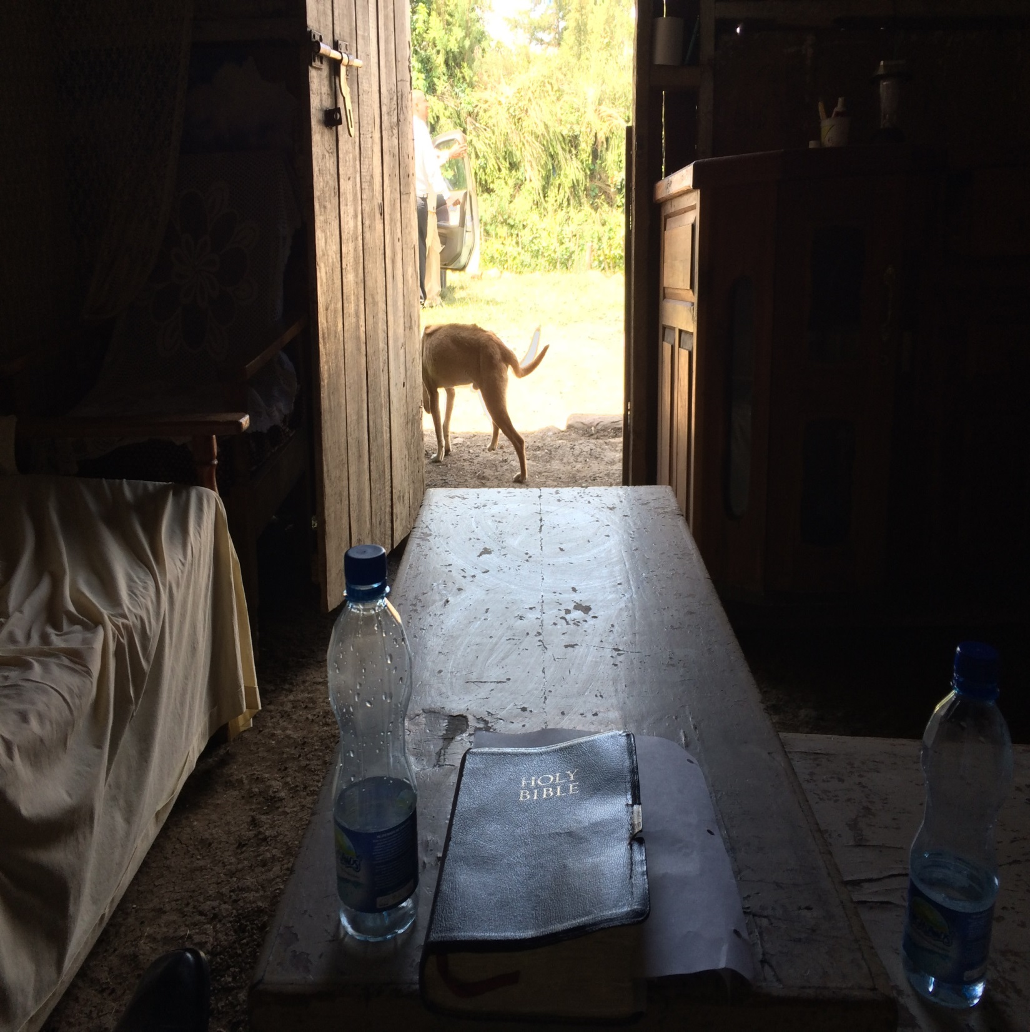

Slide 50
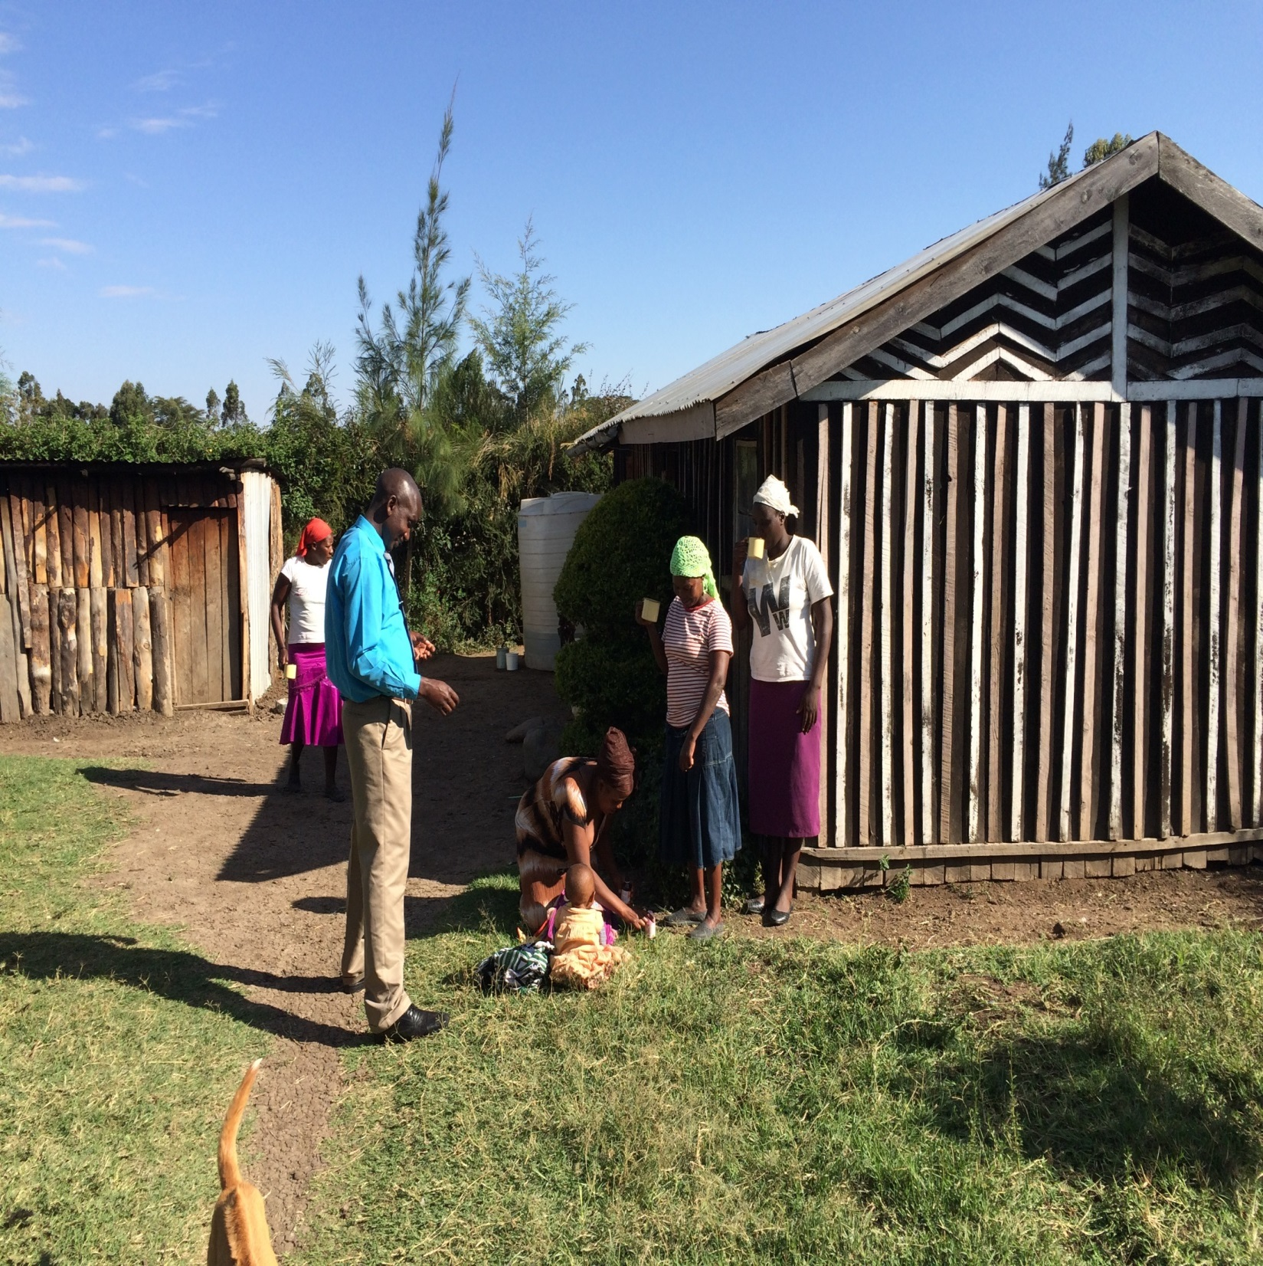

Slide 51
Day 12, Sunday, August 28
Went with Wilson to Mukurwe-ini for worship—not his normal place.
Both Lydia and the elderly woman were present. Lydia was very disturbed about the reaction of her husband.
Had Bible class for about 30 minutes, where I just asked a number of questions about Jesus.
My sermon: What Must I Do After I Become a Christian?

Slide 52
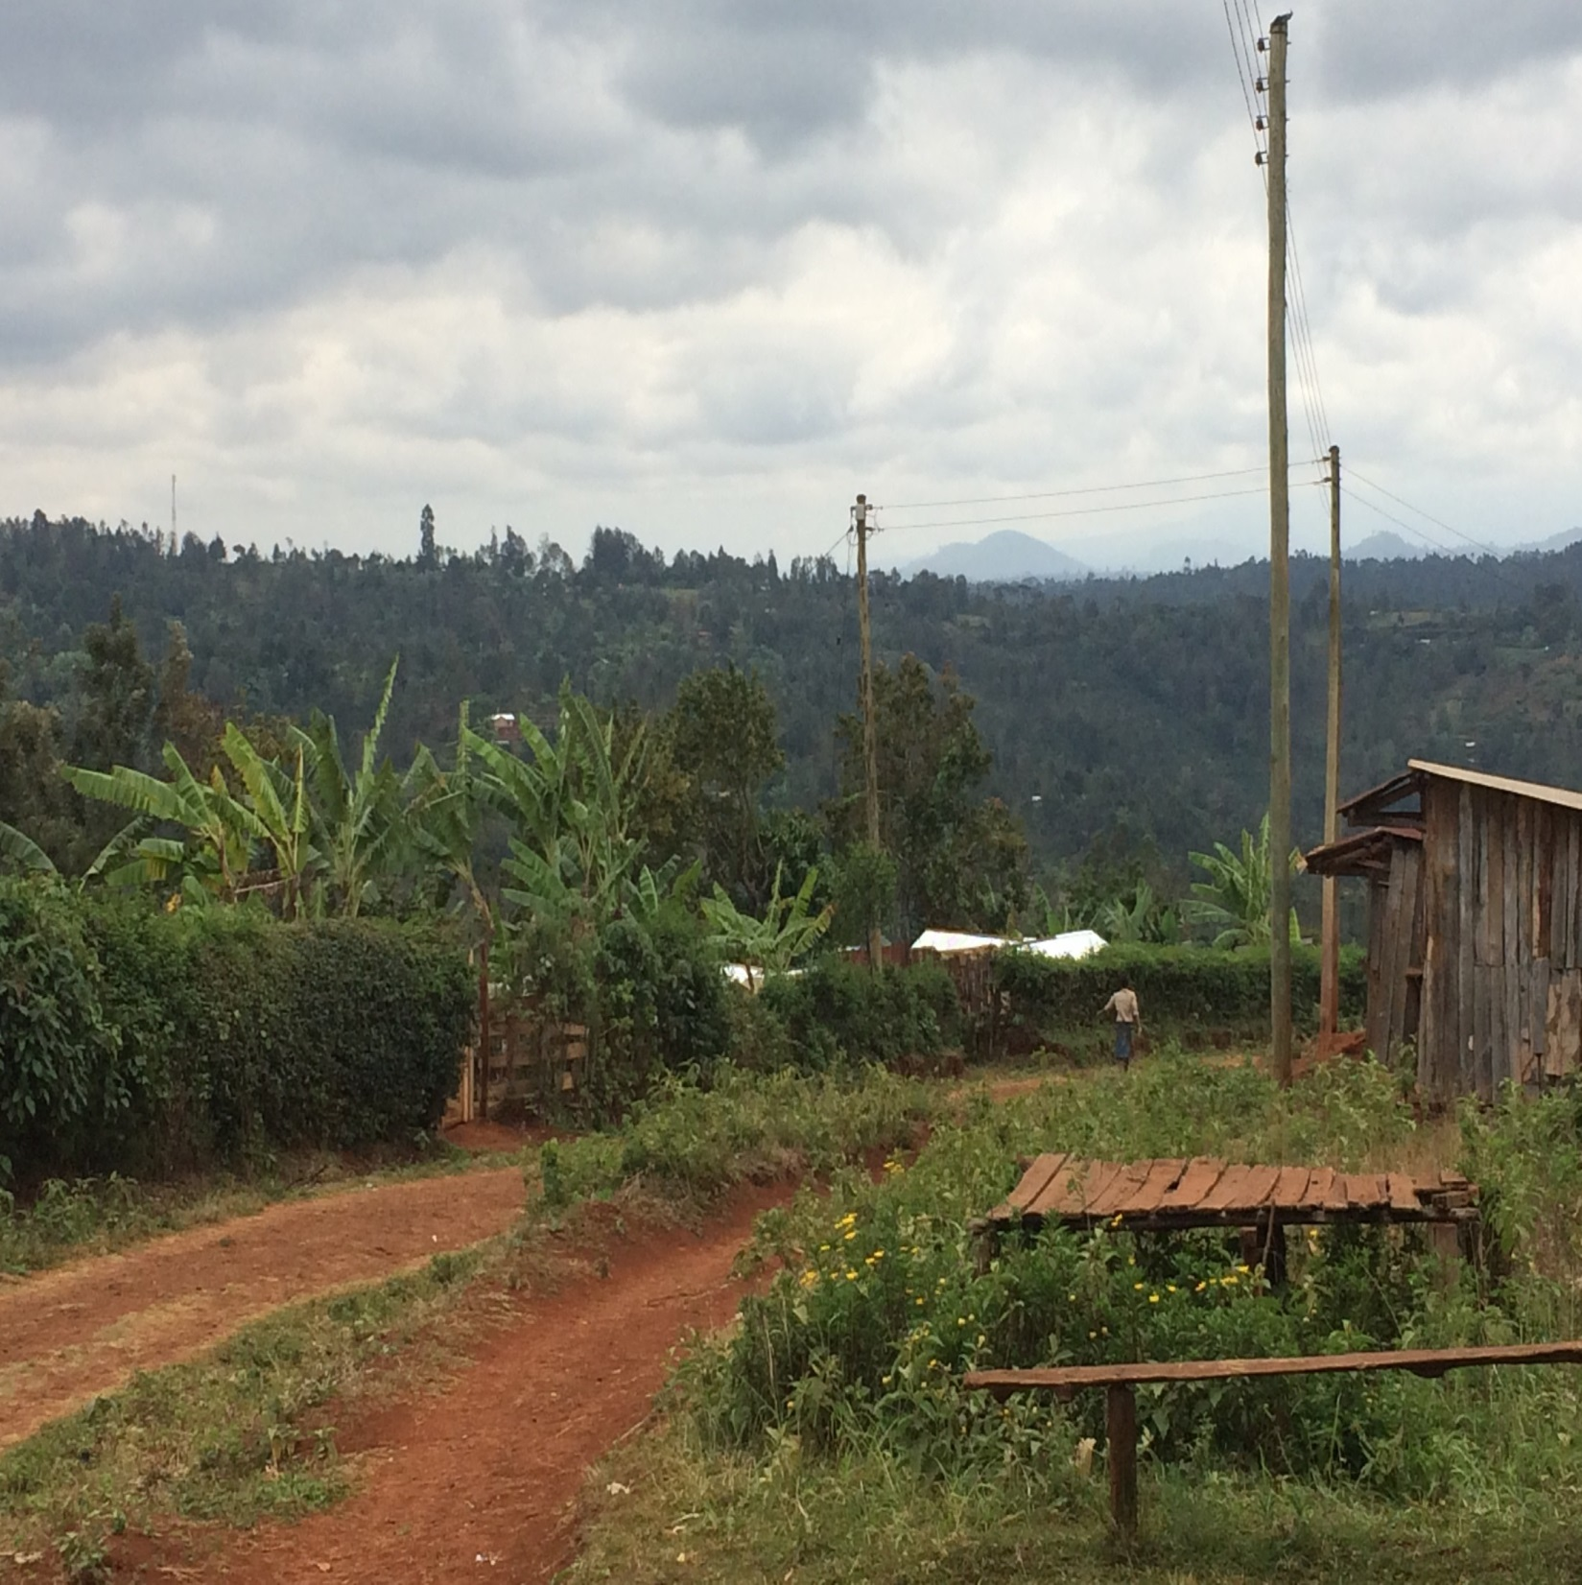

Slide 53
Day 12, Sunday, August 28
Went to Wilson’s house for lunch, where I met Geoffrey, a visiting preacher from Kissi, in West Kenya.
Wilson’s son had been studying with Geoffrey, and about mid-afternoon, said he wanted to be baptized.
We left Wilson’s house about 4:30 to go back to the hotel, where we studied with James, a local denominational preacher.

Slide 54
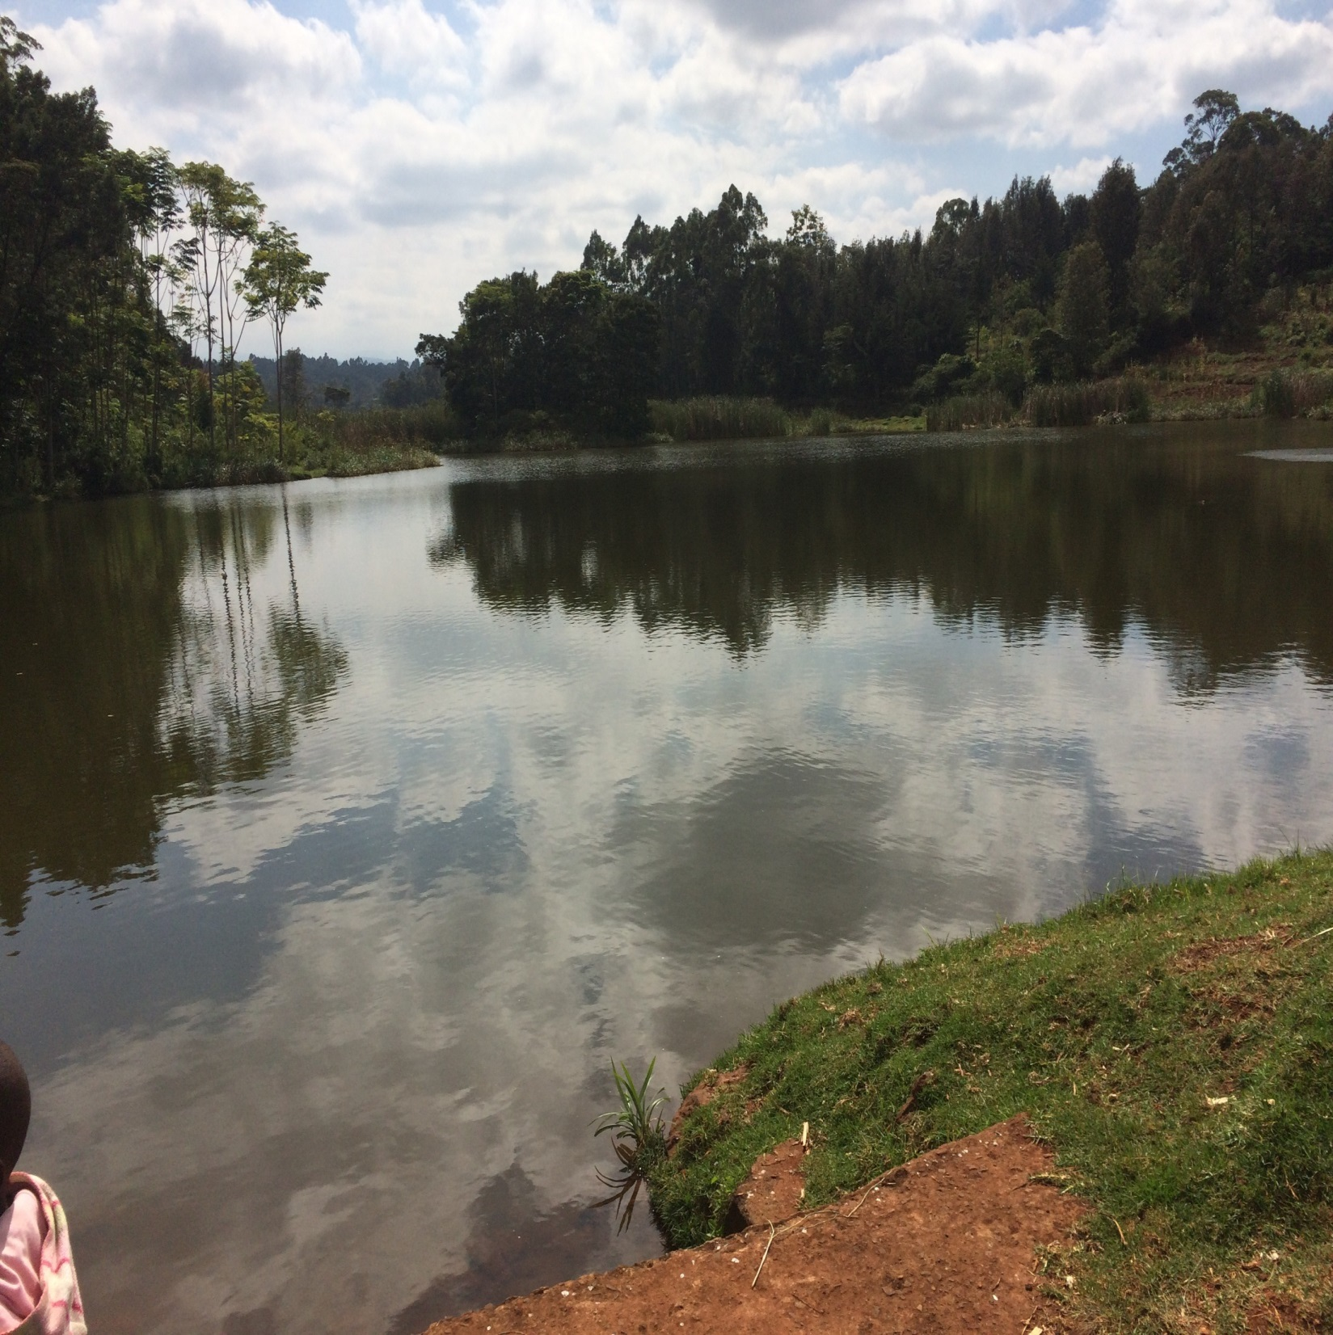

Slide 56
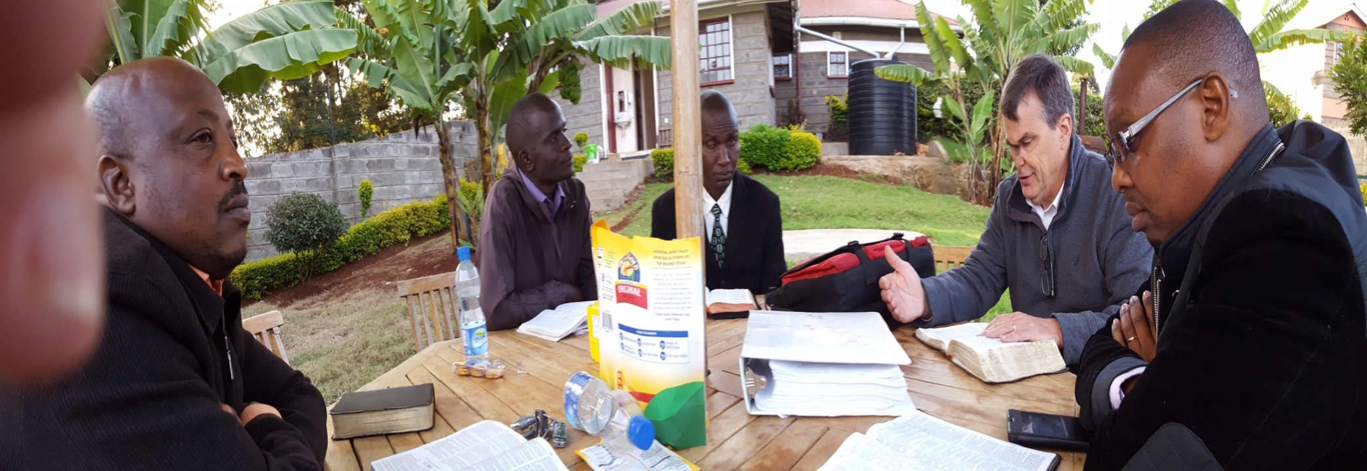

Slide 57
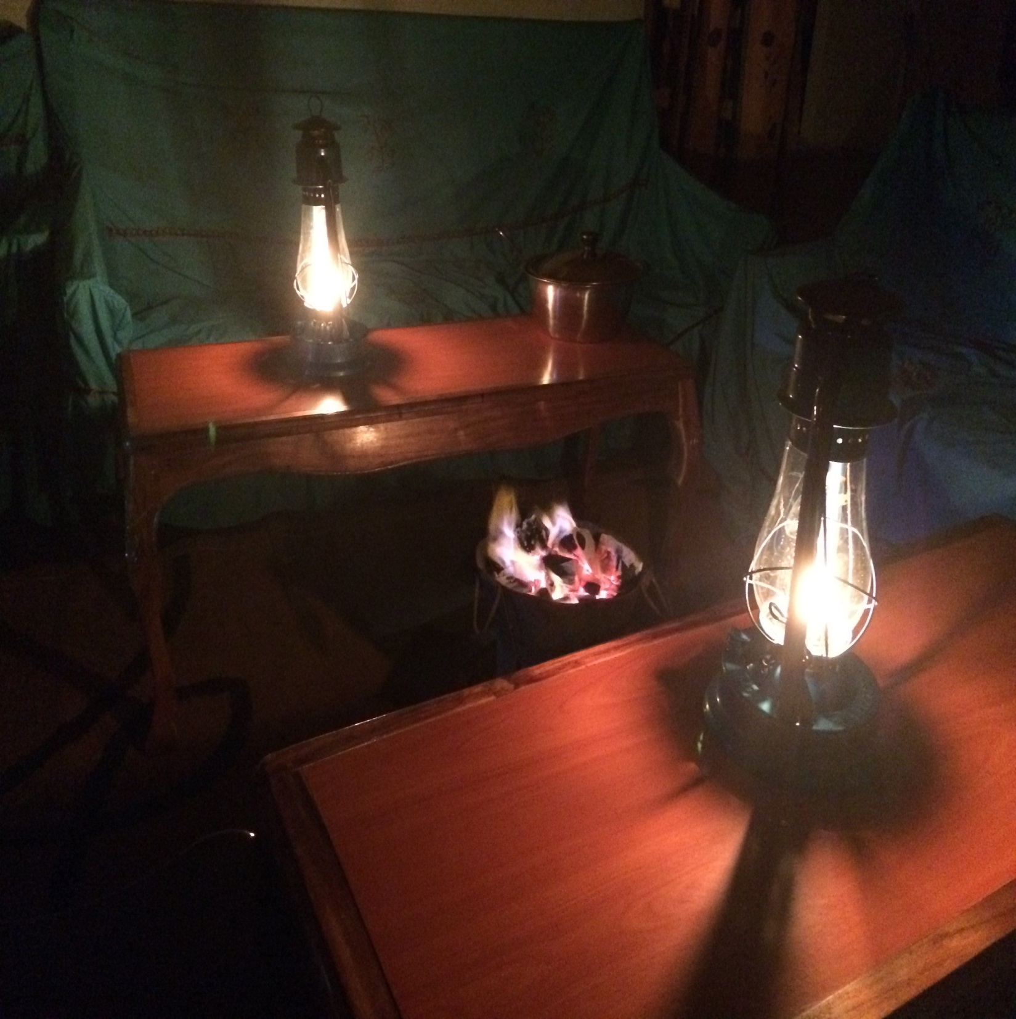

Slide 58
Day 13, Monday, August 29
First day of general Bible classes, where brethren from all around were invited, from 9:30 till 4:00, with a break for lunch.
Three sessions before lunch: Bryan—Survey of Revelation (1); Brad—Survey of Revelation ( 2); Bryan—God’s Blueprint for the Home
Two in afternoon: Brad—What to Look For In a Marriage Companion; Bryan—God’s Description of a Husband and Father.
About 20 present, including a non-Christian (Ann).

Slide 59
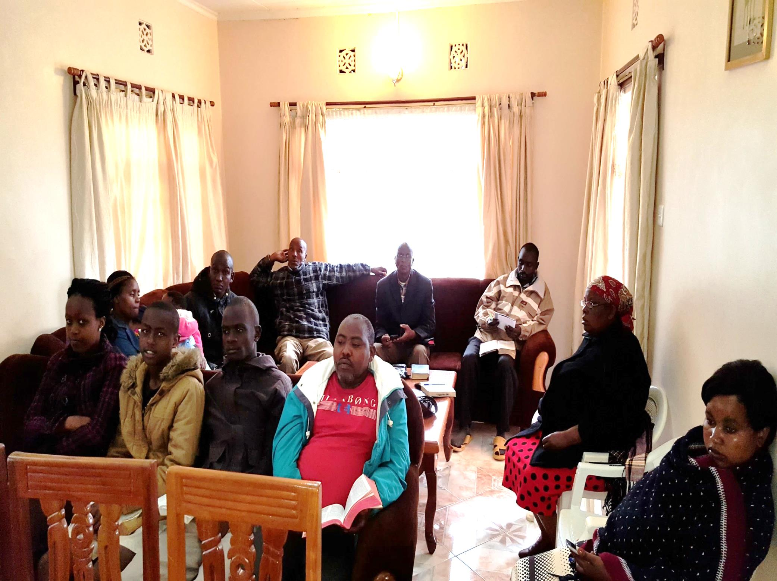

Slide 60
Day 14, Tuesday, August 30
Second day of general Bible classes, from 9:20 till 4, again with a break for lunch.
Three sessions before lunch: Bryan—What Would I Tell My Children?; Brad—God’s Description of a Wife and Mother; Bryan—Church Support for Preachers
Two in afternoon: Churches Need Elders; Bryan—Improving the Lord’s Church.
Ann was present again, and showed great interest.

Slide 61
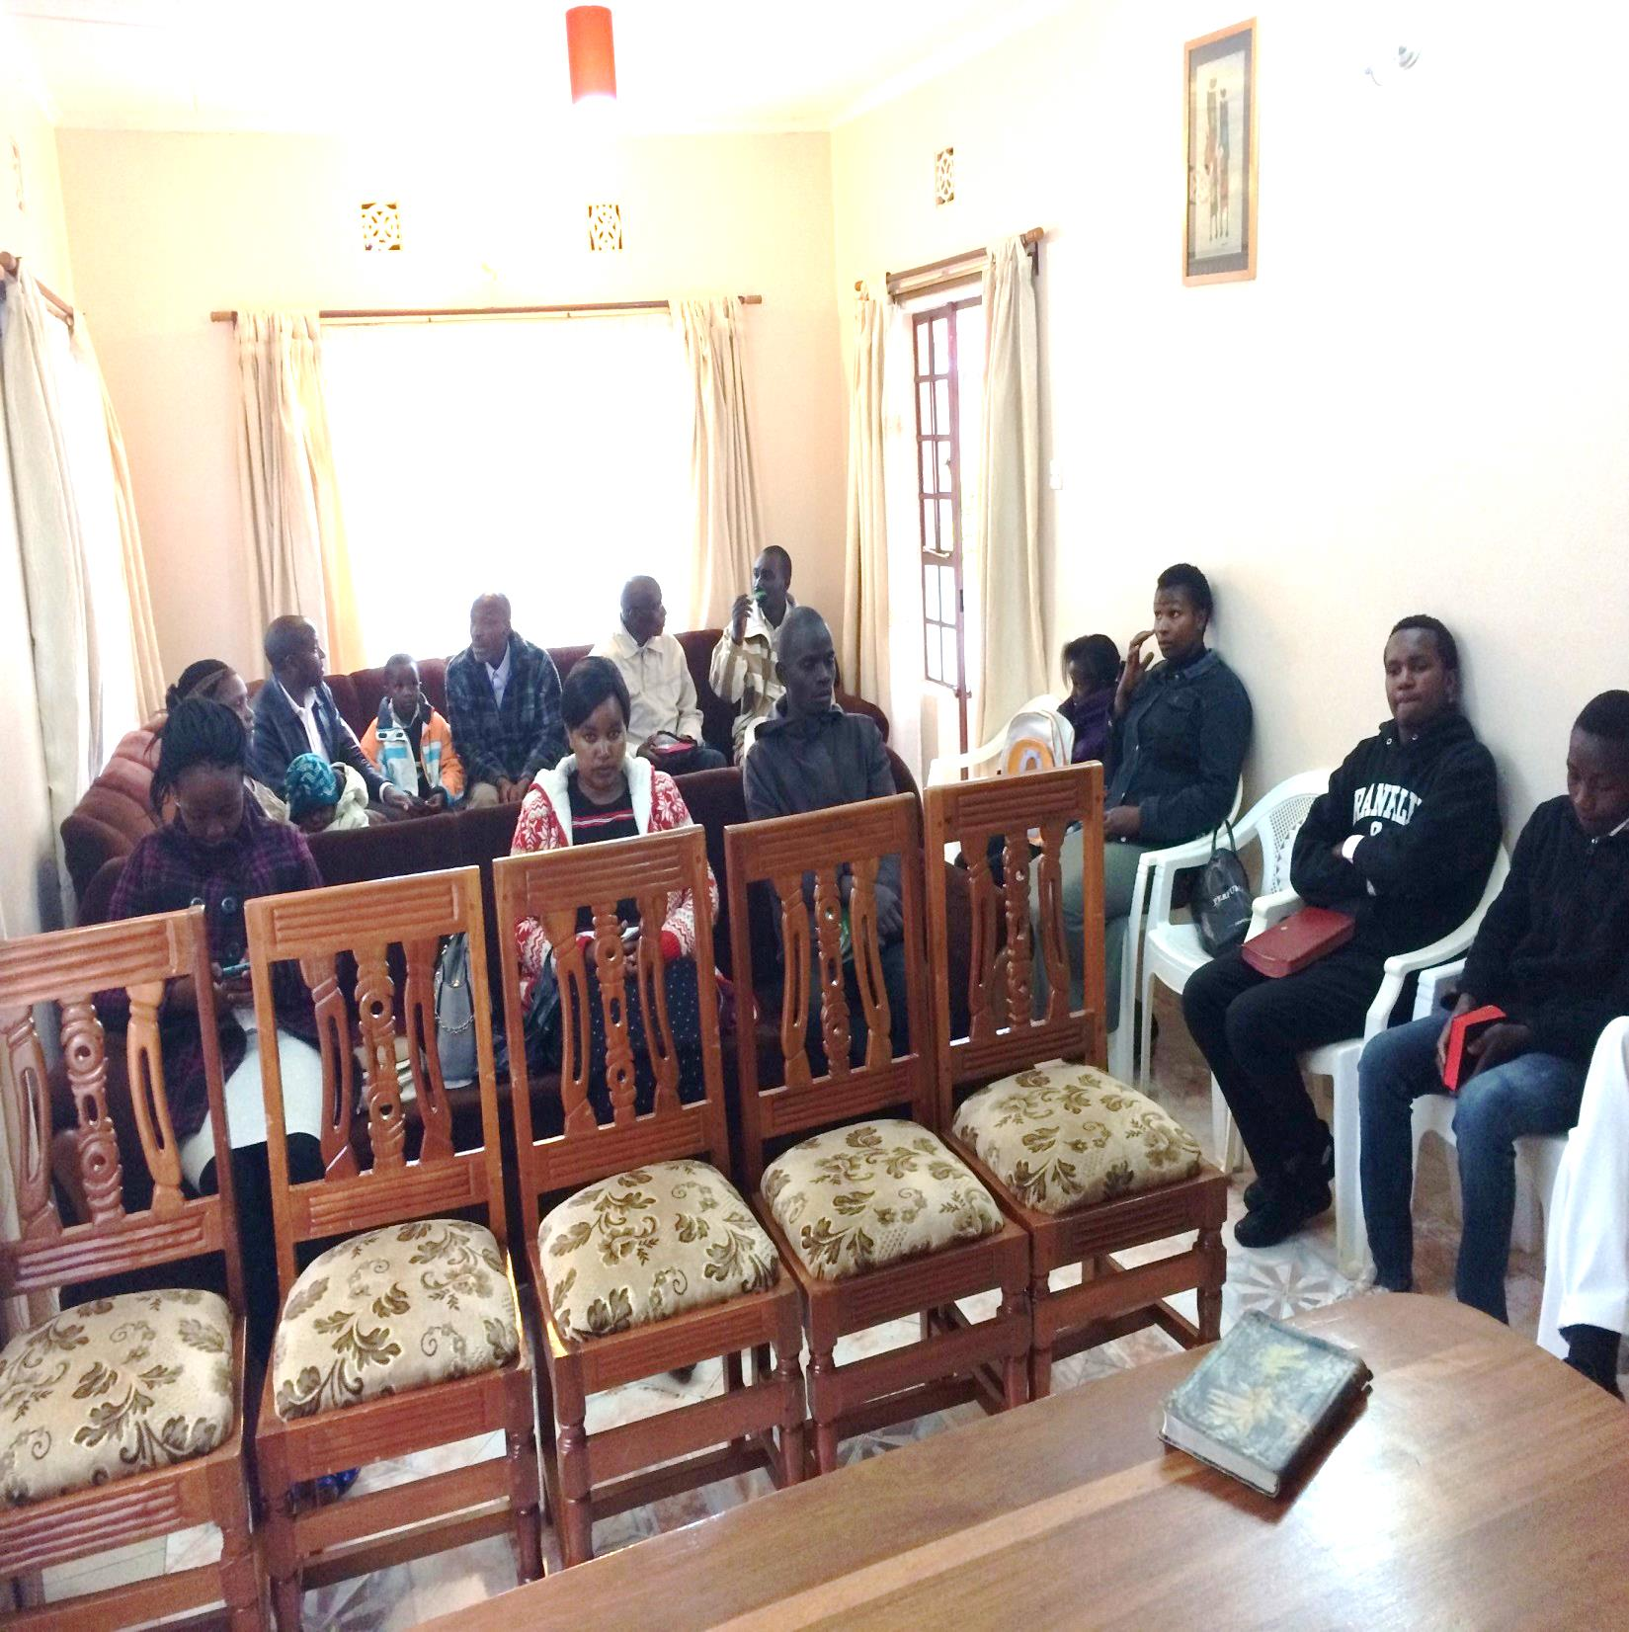

Slide 62
Day 15, Wednesday, August 31
One final day with fellow-preachers, with six sessions of study (11 present, including Solomon).
Three before lunch: Bryan—Jesus, the Master Teacher; Brad—When Brethren Disappoint; Bryan—Lessons on Preaching from 1 and 2 Corinthians.
Three after lunch: Brad—Showing Patience; Bryan— Q and A on Preaching; Bryan and Brad together— other miscellaneous issues (being careful with women; study habits; moving beyond basics, etc.).

Slide 64
Closing Passages
“Do you not say, ‘There are still four months and then comes the harvest’? Behold, I say to you, lift up your eyes and look at the fields, for they are already white for harvest!” (John 4:35).
“The harvest truly is plentiful, but the laborers are few. Therefore pray the Lord of the harvest to send out laborers into His harvest” (Matthew 9:37-38).

