Slide 1
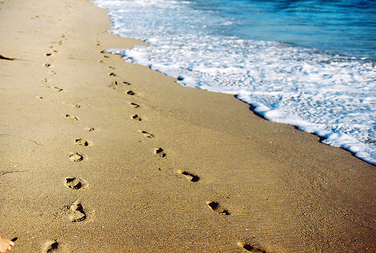
Walking in the Footsteps of Jesus
By Being Submissive

Slide 2
Submission, submit, subject
Translated from the Greek word, hupotasso, which was “primarily a military term” and meant “to rank under” (Vine’s Expository Dictionary).
“Rank” refers to one’s relative standing or position in a chain of command.

Slide 3
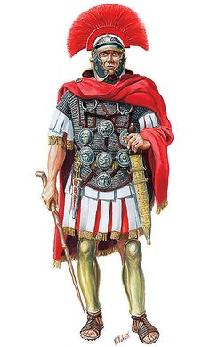
One Who Understood This
Matthew 8:5-10.
He understood the responsibility of those ranked under him.
And He applied this same principle to the rank and authority of the Lord Jesus.

Slide 4
1 Peter and Submission
1 Peter 2:13, 18; 3:1; 5:5.

Slide 5
Reason Given for Submission
1 Peter 2:21.
Followers of Christ are submissive because He was submissive.
Apply this to the passages we just read.

Slide 6
More on His Submission
SAID only what the Father wanted Him to say (John 12:48-49).
DID only what the Father wanted Him to do (John 6:38; 8:29; 14:31).
Even facing a horrible death He prayed, “not My will, but Yours, be done” (Luke 22:42).

Slide 7
More Practical Application
Laws of the land.
Police officers.
Bosses, supervisors, etc.
Others in positions of authority—husbands, parents, teachers, coaches, etc.
Most importantly, to Christ Himself.

Slide 8
Submission to the King of Kings
And the king’s servants said to the king, “We are your servants, ready to do whatever my lord the king commands” (2 Samuel 15:15).

