Slide 1
Jerusalem, circa 30 ad
Luke
23. 50 – 24.1

Slide 2
“on the first day of the week…”
Why were they going to the tomb?
&
What did they expect to find?
Q

Slide 3
next question:
What would have happened-
if that was
what they found?
Q

Slide 4
They would have anointed a corpse
Peter and John would not have run to see the empty tomb
The body would have decayed away
You would never have heard of Jesus of Nazareth
The first book ever printed would not have been printed
The best selling book of all time would never have existed
The pilgrims would not have sailed on the Mayflower
The coins in you pocket would not bear their dates
You would not be a Christian
You would not be here tonight
If your parents or ancestors met at church, you would not be anywhere

Slide 5
John 20-21; Acts 10:39-41; 1Cor.15.1-11
eyewitnesses

Slide 6
Paul
to Corinth
circa 55 AD
1Cor.15.3-8 esv
“ I would remind you, brothers, of the gospel I preached
to you… that Christ died for our sins in accordance with
the Scriptures, that he was buried, that he was raised
on the third day , and that he appeared to Cephas,
then to the twelve. Then he appeared to more
than five hundred brothers at one time,
most of whom are still alive, though
some have fallen asleep. Then
he appeared to James, then
to all the apostles. Last
of all… he appeared
also to me.”
scott smelser / sbsmelser@comcast.net

Slide 7
“we gazed not in
the open tomb…”

Slide 8
1 Peter 3.15
“be ready always to give answer
to every man that asks you
a reason concerning
the hope that lies within you”

Slide 9
the historicity of Jesus of Nazareth
&
his death, burial, and resurrection:
establishing evidence for the skeptic
Scott Smelser
sbsmelser@comcast.net 717 321 3321

Slide 10
THE IDENTITY OF JESUS OF NAZARETH
THE CRUCIFIXION
THE WITNESSES
THE CONV. OF SAUL
THEY BELIEVED
THE TOMB
ESTABLISHING BASIC FACTS
FOR THE SKEPTIC

Slide 11
THE CRUCIFIXION
THE WITNESSES
THE CONV. OF SAUL
THEY BELIEVED
THE TOMB
ESTABLISHING BASIC FACTS
FOR THE SKEPTIC

Slide 12
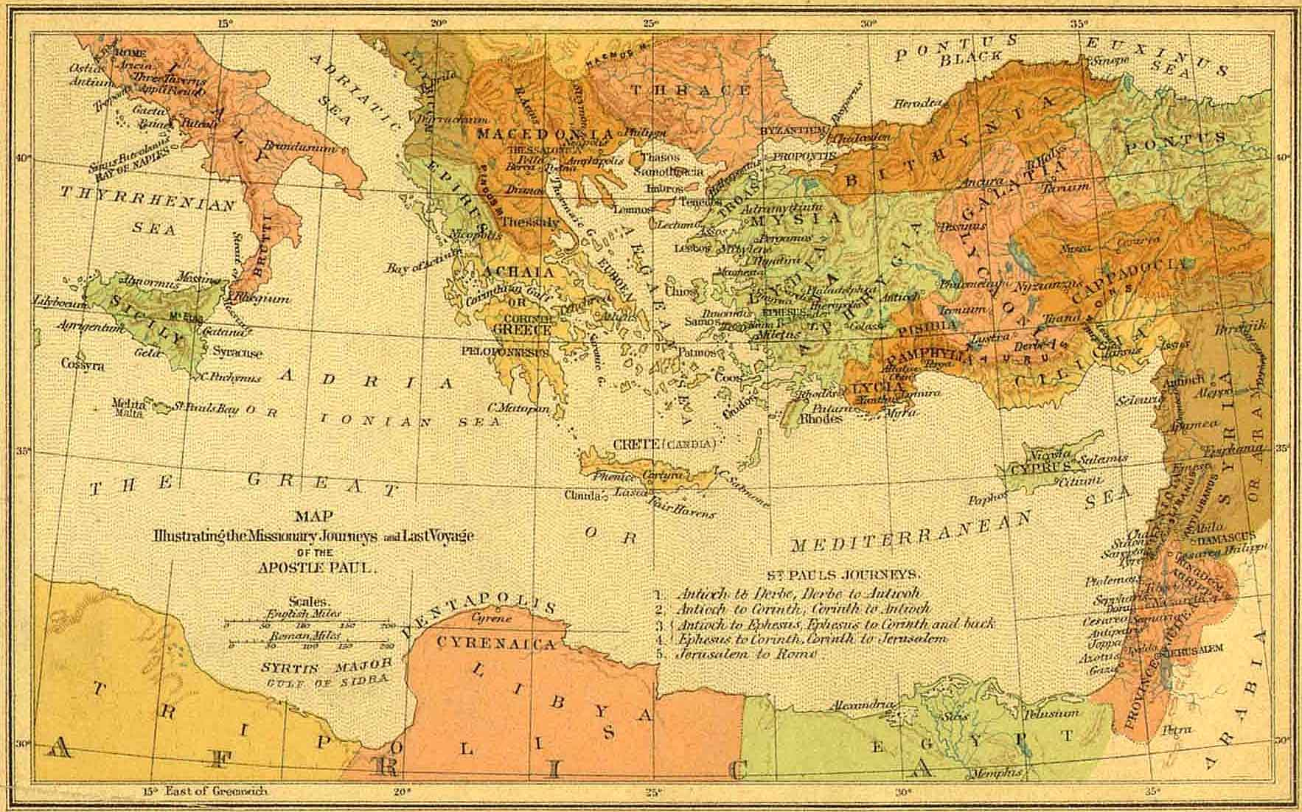
references to the crucifixion of Christ from external sources
ROMAN
empire
In addition to
the NT, what references to Jesus do we have from historical sources?
GREEK
culture
historical context
JEWISH
people
Notes:
Note the contrast:
For those who trust and hope in their own lives (Lk. 18.9), and the Law (Jn.5.39,45), they are trusting in a combination that will be weak, of their own, unto death, and due to their works, despite being called the chosen people.
The disciple who puts his trust i(ie, faith), in grace through Christ, is relying on the POWER of GOD, to SALVATION, for those that TRUST HIM, whether Jew or not.

Slide 13
FACT 1. Jesus of Nazareth, known also as the Christ, was put to death by crucifixion during the reign of Tiberius, at the orders of Pontius Pilate.
Historical attestation is found in Christian, Roman, Greek, and Jewish sources.
Internal
evidence:
BIBLICAL
HISTORY
External
evidence:
SECULAR HISTORY

Slide 14
Tacitus
ROMAN
GREEK
JEWISH
Tacitus Annals XV, 44
Roman Senator & Historian; b. ca. 56 AD
“Nero fastened the guilt and inflicted the most exquisite tortures on a class hated for their abominations, called Christians by the populace. Christus, from whom the name had its origin, suffered the extreme penalty during the reign of Tiberius at the hands of one of our procurators, Pontius Pilate”
- classics.mit.edu/Tacitus/annals.html translated. By A. J. Church & W. J. Brodribb

Slide 15
ROMAN
GREEK
JEWISH
Lucian
Lucian of Samosata The Death of Peregrine, 11-13
Greek satirist, b. ca. 120 AD
“The Christians, you know, worship a man
to this day… who introduced their novel rites, and was crucified on that account.”
lucianofsamosatat.info > The Works of Lucian of Samosata. Tr. by Fowler & Oxford: Clarendon Press. 1905
Lucian of Samosata The Death of Peregrine, 11-13
Greek satirist, b. ca. 120 AD
“these misguided creatures… deny the gods of Greece, and worship the crucified sage,
and live after his laws.”
lucianofsamosatat.info > The Works of Lucian of Samosata. Tr. by Fowler & Oxford: Clarendon Press. 1905

Slide 16
ROMAN
GREEK
JEWISH
external
evidence
Josephus
Josephus, Antiquities of the Jews, XVIII, 3.3.
Jewish historian, b. 37 AD
“Now there was about this time Jesus…
Pilate, at the suggestion of the principal men amongst us, had condemned him to the cross”
note: some embellishments from a later hand (and some additional details from Josephus himself), are not included here. Scholars are in wide agreement that the the original reading did include the crucifixion of Jesus under Pilate
Josephus, Antiquities of the Jews, XX, 9.1.
Jewish historian, b. 37 AD
on the death of James:
“brought before them the brother of
Jesus, who was called Christ,
whose name was James, and some others…
he delivered them to be stoned”
Antiq. XVIII, 3.3.
1st reference:
Jesus
Antiq. XX, 9.1.
2nd reference: James & Jesus
Josephus
a Josephus
+ additions

Slide 17
NT documents

Slide 18
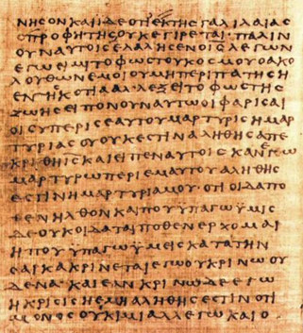
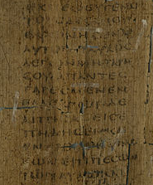
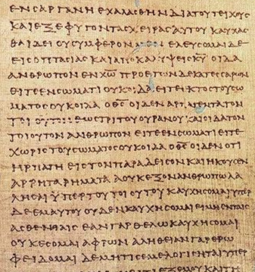
John: “which we have heard, which we have seen with our eyes, which we looked upon and have touched with our hands” 1 John 1:1
Peter: “we are witnesses of all that he did both in the country of the Jews and in Jerusalem.” Ac. 10:39
The most extensive evidences of Jesus are the
NT texts themselves, whose very origin & existence would be inexplicable had Jesus not existed.
includes: narratives of his birth & family; teachings & signs; death & resurrection
includes: conflicts over Jesus between the Jewish senate & the apostles
includes: references to his birth, teaching, betrayal, death & resurrection
GOSPELS
ACTS
LETTERS
P66 Jn. P127 Acts P46 2Cor.

Slide 19
If that had been the end of it - would you
have ever
heard of Jesus ?
Acts
5:36-37
THE CRUCIFIXION
THE WITNESSES
THE CONV. OF SAUL
THEY BELIEVED
THE TOMB
ESTABLISHING BASIC FACTS
FOR THE SKEPTIC

Slide 20
cf. Acts 5.36
Not just death: but the death of the cross.
Beyond death & torture :
what was the purpose of public crucifixion ?
degradation & shame
horror & intimidation

Slide 21
crucifixion & roman subjects
“Whenever we crucify the guilty, the most crowded roads are chosen, where most people can see and be moved by this fear. For penalties relate not so much to retribution, but to their exemplary effect.” – Quintilian Decl. 274 (trans. From LCL 500) -cited in Baker & Green; Recovering the Scandal of the Cross IVPress 2000
“the executioner… and the very word ‘cross,’ let them all be far removed from not only the bodies of Roman citizens but even from their thoughts, their eyes, and their ears… the mere mention of them are unworthy of a Roman citizen and a free man.” -Cicero , pro Rabirio Perd. 16 perseus.uchicago.edu/perseuscgi/citequery3.pl?dbname=PerseusLatinTexts&getid=1&query=Cic.%20Rab.%20Perd.%2019
crucifixion & roman citizens

Slide 22
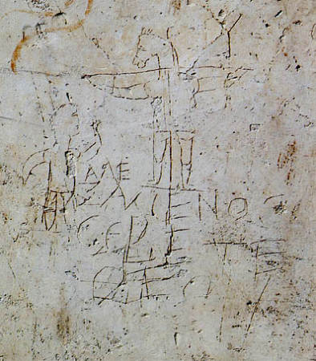
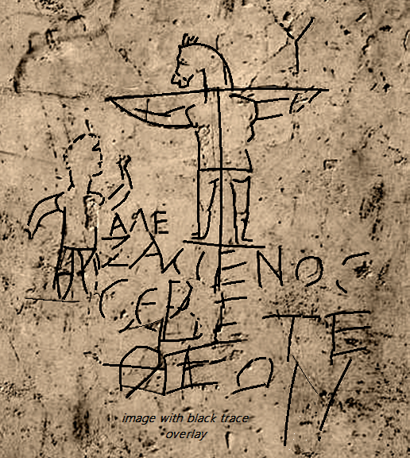
“we preach Christ crucified,
to Jews a stumbling block and to Gentiles foolishness”
1 Cor. 1.23 NASB
ΑΛΕ
ΞΑΜΕΝΟS
CΕΒΕΤΕ ΘΕΟΝ
“ALEXAMENOS WORSHIP(S) HIS GOD”
alexamenos graffito public domain image; wikipedia

Slide 23
THE CRUCIFIXION
THE WITNESSES
THE CONV. OF SAUL
THEY BELIEVED
THE TOMB
ESTABLISHING BASIC FACTS
FOR THE SKEPTIC

Slide 24
FACT 2. The tomb was reported empty
The disciples reported that the tomb was empty and that Jesus rose from the dead
(Mt. 28; Mk 16; Lk 24; Jn 20)
Unbelieving Jews said the tomb was empty because the disciples stole the body (Mt. 28:15b) diametrically opposed as to why the tomb was empty, one point was agreed upon by both explanations: the body was not there.

Slide 25
FACT 2. The tomb was reported empty
The disciples reported that the tomb was empty and that Jesus rose from the dead
(Mt. 28; Mk 16; Lk 24; Jn 20)
Unbelieving Jews said the tomb was empty because the disciples stole the body (Mt. 28:15b) diametrically opposed as to why the tomb was empty, one point was agreed upon by both explanations: the body was not there.

Slide 26
John
19:38-20:10

Slide 27
From the apostle John: cf. John 21.18-24 already in circulation by c.125+/- AD;
John Rylands fragment / P52 ( Jn.18 )
ΟΙ ΙΟΥΔΑΙΟΙ ΗΜΕIΝ ΟΥΚ ΕΞΕΣΤΙΝ ΑΠΟΚΤΕΙΝΑΙ
OYΔΕΝΑ ΙΝΑ Ο ΛΟΓΟΣ ΤΟΥ ΙΗΣΟΥ ΠΛΗΡΩΘΗ ΟΝ ΕΙ-
ΠΕΝ ΣHΜΑΙΝΩΝ ΠΟΙΩ ΘΑΝΑΤΩ ΗΜΕΛΛΕΝ ΑΠΟ-
ΘΝHΣΚΕΙΝ ΙΣΗΛΘΕΝ ΟΥΝ ΠΑΛΙΝ ΕΙΣ ΤΟ ΠΡΑΙΤΩ-
ΡΙΟΝ Ο ΠIΛΑΤΟΣ ΚΑΙ ΕΦΩΝΗΣΕΝ ΤΟΝ ΙΗΣΟΥΝ
ΚΑΙ ΕΙΠΕΝ ΑΥΤΩ ΣΥ ΕΙ O ΒΑΣΙΛΕΥΣ ΤΩΝ ΙΟΥ-
ΔAΙΩN
ΒΑΣΙΛΕΥΣ ΕΙΜΙ ΕΓΩ ΕΙΣ TOΥΤΟ ΓΕΓΕΝΝΗΜΑΙ
ΚΑΙ (ΕΙΣ ΤΟΥΤΟ) ΕΛΗΛΥΘΑ ΕΙΣ ΤΟΝ ΚΟΣΜΟΝ ΙΝΑ ΜΑΡΤY-
ΡΗΣΩ ΤΗ ΑΛΗΘΕΙΑ ΠΑΣ Ο ΩΝ EΚ ΤΗΣ ΑΛΗΘΕI-
ΑΣ ΑΚΟΥΕΙ ΜΟΥ ΤΗΣ ΦΩΝΗΣ ΛΕΓΕΙ ΑΥΤΩ
Ο ΠΙΛΑΤΟΣ ΤΙ ΕΣΤΙΝ ΑΛΗΘΕΙΑ ΚAΙ ΤΟΥΤO
ΕΙΠΩΝ ΠΑΛΙΝ ΕΞΗΛΘΕΝ ΠΡΟΣ ΤΟΥΣ ΙΟΥ-
ΔΑΙΟΥΣ ΚΑΙ ΛΕΓΕΙ ΑΥΤΟΙΣ ΕΓΩ ΟΥΔEΜΙΑΝ
ΕΥΡΙΣΚΩ ΕΝ ΑΥΤΩ ΑΙΤΙΑΝ
...
JOHN

Slide 28
“He is not here, he is risen” Mt.28:6 the stone is rolled back… “he is not here, behold, the place where they laid him!” Mk.16:4-6
“they entered in, and found not the body of Jesus” Lk 24:3
“and behold, the linen cloths lying” Jn.20:6

Slide 29
FACT 2. The tomb was reported empty
The disciples reported that the tomb was empty and that Jesus rose from the dead
(Mt. 28; Mk 16; Lk 24; Jn 20)
Unbelieving Jews said the tomb was empty because the disciples stole the body (Mt. 28:15b) diametrically opposed as to why the tomb was empty, one point was agreed upon by both explanations: the body was not there.

Slide 30
objection
skeptic :
“You base that on Matthew. If I don’t trust its portrayal of Jesus, why would I trust its portrayal of unbelievers?”

Slide 31
Mt.28.15b nasb
“this story was widely
spread among the
Jews, and is to this day”
if
original
audience

Slide 32
two further observations on the empty tomb…

Slide 33
(a.) LOCALE:
The church began in Jerusalem, the city of Jesus’ death & burial.

Slide 34
(b.) Jewish views on female witnesses:
“any evidence which a woman [gives] is not valid...
A robber is qualified to give the same evidence as a woman”
-Talmud, Rosh Hashannah 1.8 (Habermas / Licona 72)
“let not the testimony of women be admitted … it is probable they may not speak the truth, either out of hope of gain, or fear of punishment” -Josephus, Antiquities 4.8.15
If early disciples had made up the story, is it likely that they would make Peter a coward, and make women the first witnesses?

Slide 35

In The Case for the Ressurection of Jesus,
Habermas and Licona lay out a minimal facts case for the resurrection, starting with points that are granted by “virtually all scholars on the subject, even the skeptical ones.” (p.47).
Though the empty tomb is not acknowledged that fully:
“it is accepted as a fact of history by an impressive majority …
Habermas discovered that roughly
75 percent of scholars on the subject accept the empty tomb as historical fact.” (p.70).

Slide 36
an empty tomb does not prove a resurrection
objection

Slide 37

alternate explanations of the empty tomb various other explanations have been offered over the centuries, such as: a.) The tomb was empty because the disciples stole the body b.) The tomb was empty because Jesus was buried alive and recovered c.) The tomb was empty because they mistakenly returned to a different tomb d.)As Mary thought, someone moved the body

Slide 38
alternate explanations of the empty tomb various other explanations have been offered over the centuries, such as: a.) The tomb was empty because the disciples stole the body b.) The tomb was empty because Jesus was buried alive and recovered c.) The tomb was empty because they mistakenly returned to a different tomb
A big problem with this theory is the evidence of the transformed disciples’ conviction; despite beatings, imprisonment and death.
Corpse thieves, by definition, would not be men that believed in the resurrection.
Another issue would be the resurrected appearances. Moving a dead body doesn’t make it appear, converse, eat and drink.
This also apply in the adjusted theory that someone else stole the body.

Slide 39
alternate explanations of the empty tomb various other explanations have been offered over the centuries, such as: a.) The tomb was empty because the disciples stole the body b.) The tomb was empty because Jesus was buried alive and recovered c.) The tomb was empty because they mistakenly returned to a different tomb
scourged (John 19:1)
compelling of Simon (Mark 15:21).
crucified (Mark 15:25).
collapsed and dead (John 19:32-33).
visual clarity of breath or not (v.23).
the spear (John 19:34).
the body was taken down, wrapped, buried, and a large stone was rolled across the door (Mark 15:46).

Slide 40
alternate explanations of the empty tomb various other explanations have been offered over the centuries, such as: a.) The tomb was empty because the disciples stole the body b.) The tomb was empty because Jesus was buried alive and recovered c.) The tomb was empty because they mistakenly returned to a different tomb
the women observed the burial
multiple visitors and at different times (Jn 20:1; Mk 16:2; Jn 20:3-13)
a dead body in a different tomb does not make appearances

Slide 41
more than an empty tomb…

Slide 42
THE CRUCIFIXION
THE WITNESSES
THE CONV. OF SAUL
THEY BELIEVED
THE TOMB
ESTABLISHING BASIC FACTS
FOR THE SKEPTIC

Slide 43

[3.] THE DISCIPLES GAVE WITNESS OF SEEING JESUS ALIVE
John 20 - 21
Acts 2.32;
3.13-15; 10.39-40
1 Cor. 15.1-8

Slide 44
I’ve read that the gospel accounts are legendary and from a later generation.
For what reason should I even believe that the earliest disciples actually even made such claims?
objection

Slide 45
1 Ptr. 3.15
As evidence for the skeptic, the witness list in 1 Cor. 15 is a valuable & dateable starting pt.
Clement 95AD
"Take up the letter of Paul... he gave you spiritual direction regarding himself, Cephas, and Apollos, for even then you were dividing yourselves into parties” ( ISBE VII. p 711 )
1 Cor. is one of the letters accepted even by critics
would make no sense as a fabrication
already known & quoted in 1st cent. (Clement)
1 Cor. 15
THE SKEPTIC VIEW
OF THE DOCUMENTS
the gospels

Slide 46
There is consensus among historians … that Paul is the author of the First Epistle to the Corinthians, classifying its authorship as "undisputed“
…
The letter was written from Ephesus…usually dated as being in the range of 53 to 57 AD.
Wikipedia / First Epistle to the Corinthians
cited not because wikipedia is authoritative, but it tends to reflect general consensus

Slide 47
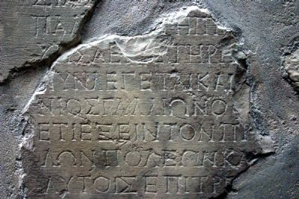
1 Cor. & the Gallio / Delphi inscription
“The inscription dates between April and July A.D., 52, and from it, it can be deduced that Gallio was the proconsul of Achaia in the previous year. Thus Paul’s eighteenth month stay in Corinth (Acts 18:1–18) included the year 51. ”
quotation from, and image courtesy of: www.HolyLandPhotos.org

Slide 48
1Cor. 15 provides early & dateable evidence against the
“later legend” concept

Slide 49
just a
“later legend”?
testimony from an early & dateable text
circa
50 AD
1 CORINTHIANS 15:1-8 esv
I would remind you, brothers, of the gospel I preached to you…
I delivered to you … what I also received: that Christ died for our sins in accordance with the Scriptures, that he was buried, that he was raised on the third day…and that he appeared to Cephas, then to the twelve. Then he appeared to more than five hundred brothers at one time, most of whom are still alive, though some have fallen asleep. Then he appeared to James, then to all the apostles. Last of all … he appeared also to me.

Slide 50

1 COR. written
15.1: reminder of:
ca.
20 yr
gap
ca.
30
ca.
50
ca.
55

Slide 51
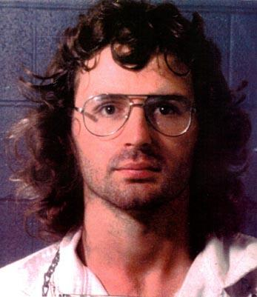
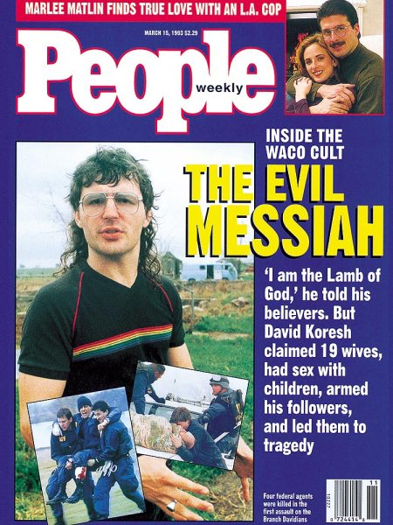
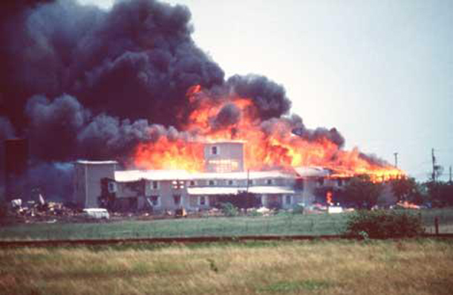
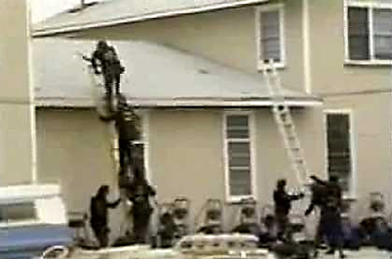
comparing the time frame:
Think backwards 20+ years (early 90’s).
Imagine that a 33 yr. old cult leader had declared himself to be the Son of God.
Imagine he came into conflict with the government.
Imagine he met a violent death.

Slide 52
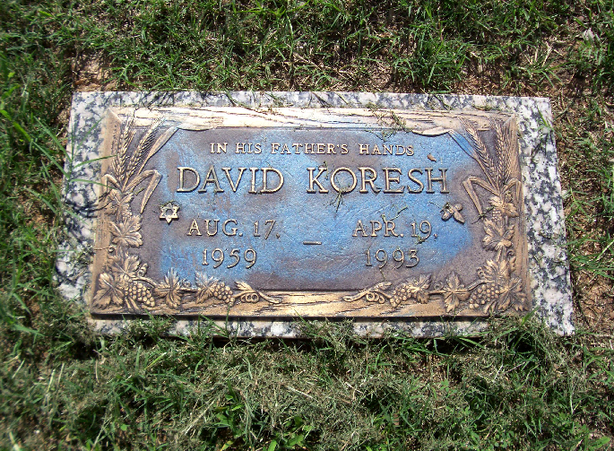
chronology comparison
1959
1993
2017
age 33
ca.24yrs
c.
4BC
c.30
c.55
ca. age 33
ca. 25 yrs

Slide 53
c.25 yr
1 Cor.
7
c.20 yr
71C.15
Gal
1
ca.
30
ca.
50
ca.
55

Slide 54
1Cor. 15:11
“Whether then it be I or they, so we preach, and so ye believed.”
1 Cor. 15 is not a
later generation legend.
It is a witness list.
The later church did not develop the resurrection,
the early church was built on the resurrection.

Slide 55
THE CRUCIFIXION
THE WITNESSES
THE CONV. OF SAUL
THEY BELIEVED
THE TOMB
ESTABLISHING BASIC FACTS
FOR THE SKEPTIC

Slide 56
It was seeing the risen Jesus that transformed the disciples
from fear and despair
to courage and conviction
after his resurrection.
Mk. 14.50-52; Mk. 14.66-72;
Lk.24.21. Jn. 20.19
Ac. 2
Ac. 3
Ac. 4
Ac. 5
Ac. 9

Slide 57
Unbelieving scholars routinely agree that the disciples believed they had seen Jesus. Summing up an overview of more than 1,400 academic sources Habermas reported that :
“perhaps no fact is more widely recognized than that early Christian believers had real experiences that they thought were appearances of the risen Jesus. A critic may claim that what they saw were hallucinations or visions, but he does not deny that they actually experienced something” (p.60).

Slide 58
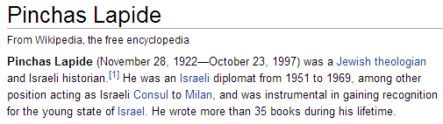
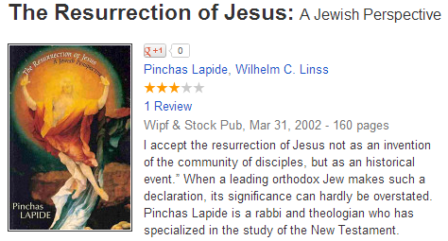
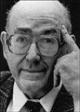
"I accept the resurrection of Jesus not as an invention of the community of disciples, but as an historical event.”
books.google.com/books/about/The_Resurrection_of_Jesus.html?id=1ENrPwAACAAJ

Slide 59
an explosive faith
Acts: 3,000 > 5,000 > multiplied
enemies :
“these that have turned the world upside down” (Acts 17:6) ca. 50 AD “everywhere it is spoken against” (Ac.28:22).
who did Nero choose for a scapegoat?
The phenomenal faith that started in Jerusalem and would out last both Jerusalem and Rome was founded on the disciples’ testimony of Jesus Christ risen from the dead.

Slide 60
faith in Jesus as Lord & risen from the dead
spread across national, cultural & economic lines
the poor & the slaves
(1Cor.1:26; Col.3:22)
Manean, brought up with Herod
(Ac.13:1)
Joannna, the wife of Herod’s steward
(and a witness at the tomb; Luke 24:10 & 8:3)
Erastus, official of the capital of Achaia
(Rom. 16:23)
members of Caesar’s household (Phil. 4:22)

Slide 61
So they believed. What does that prove?
Islamist terrorists believe, and are willing to die.
Does that prove Mohammed a prophet?
Does that prove their 72 virgins?
The jihadist that dies to get 72 virgins is
not a witness. His martyrdom does not demonstrate the validity of
Jihad,
but it does demonstrate his belief in what he has heard
In the case of
Apostolic witnesses,
the case is very different.
They weren’t dying for what they heard.
They died for what they witnessed.
objection

Slide 62
THE CRUCIFIXION
THE WITNESSES
THE CONV. OF SAUL
THEY BELIEVED
THE TOMB
ESTABLISHING BASIC FACTS
FOR THE SKEPTIC

Slide 63
[5.] Paul was radically transformed after a reported encounter with Jesus.
Paul’s testimony is powerful and must be either true or false.
If false: he was deceived or lying (options 1 & 2 below).
If true : then Jesus is the risen Christ (option 3 below).
(1.) Paul’s testimony is false, but he was deceived: (a.) by self (b.) by someone else.
(2.) Paul’s testimony is false, and he knew it. He made it up.
(3.) Paul’s testimony is true. Jesus is the risen Christ.
Acts 9
Acts 22
Acts 26
1Cor 15.9
Gal.1.11-17
Php. 3.4-6
1Tim.1.13-16

Slide 64
[5.] Paul was radically transformed after a reported encounter with Jesus.
Paul’s testimony is powerful and must be either true or false.
If false: he was deceived or lying (options 1 & 2 below).
If true : then Jesus is the risen Christ (option 3 below).
(1.) Paul’s testimony is false, but he was deceived: (a.) by self (b.) by someone else.
(2.) Paul’s testimony is false, and he knew it. He made it up.
(3.) Paul’s testimony is true. Jesus is the risen Christ.
Paul’s testimony is powerful and must be either true or false.
If false, he was deceived or lying (options 1 & 2 below).
If true, then Jesus is the risen Christ (option 3 below).
options:
1.) Paul’s testimony is false, but he was deceived:
(a.) by self (b.) by someone else.
2.) Paul was lying. He made it up.
3.) Paul’s testimony is true. Jesus is the Christ.

Slide 65
WHY?
Why did Saul of Tarsus began proclaiming the very thing he most wanted to destroy?
Why did he give up his acceptance in Judaism for a belief he hated?
Why did he choose to go from persecutor to persecuted?
Why would he devote his life, and sacrifice his liberty and life for what he had utterly opposed?

Slide 66
1 Cor. 9.1
1 Cor. 15.1-11

Slide 67
conclusion
What explanation accounts for these facts?
What is the explanation for the sudden and radical transformation in Saul of Tarsus?
Why was he willing to undergo such hardship?
Why was the tomb reported empty?
Why did the disciples say they saw Jesus?
Why did they believe they saw Jesus?
What transformed them from fear and despair to courage and conviction?
What changed history?
John 20:3-8 Acts 2:32 1 Cor. 15:1-8

Slide 68
JESUS THE RISEN CHRIST
THE CRUCIFIXION
THE WITNESSES
THE CONV. OF SAUL
THEY BELIEVED
THE TOMB
ESTABLISHING BASIC FACTS
FOR THE SKEPTIC

Slide 69
Romans
1.4

Slide 70
1 Peter 3.15
“be ready always to give answer
to every man that asks you
a reason concerning
the hope that lies within you”

Slide 71
Paul
to Corinth
circa 55 AD
1Cor.15.3-8 esv
“ I would remind you, brothers, of the gospel I preached
to you… that Christ died for our sins in accordance with
the Scriptures, that he was buried, that he was raised
on the third day , and that he appeared to Cephas,
then to the twelve. Then he appeared to more
than five hundred brothers at one time,
most of whom are still alive, though
some have fallen asleep. Then
he appeared to James, then
to all the apostles. Last
of all… he appeared
also to me.”
scott smelser / sbsmelser@comcast.net

Slide 72
post script: two arguments from unbelievers

Slide 73
from: debunkingchristianity.blogspot.com -J. Loftus http://debunkingchristianity.blogspot.com/2011/10/assessing-minimal-facts-approach-of.html
Habermas and Licona ignore the fact that a miraculous resurrection is always going to be more improbable than any improbable speculation about what may have happened instead. ... Unless they can show that our “improbable” explanations are more improbable than a miracle (and they never do), their argument can’t even get off the ground.
REPLY: How did life originate? By Creator ? Or by chance?
The atheist rejects the regeneration of life with a purpose,
but accepts the generation of life from without a purpose.
Which is more inexplicable?
Resurrection is unquestionably remarkable. But for those who see in creation the power of the creator, the question is not whether or not he is powerful enough to raise the dead. (cf.Ac.26:9)
Atheists & theists both believe in remarkable things.
The atheist accepts the generation of life from non-life, w/o design.
The Christian believes in the generation of life by God, and the regeneration of life, with design, with a reason.
WHICH OF THOSE BELIEFS LACKS AN ADEQUATE CAUSE?

Slide 74
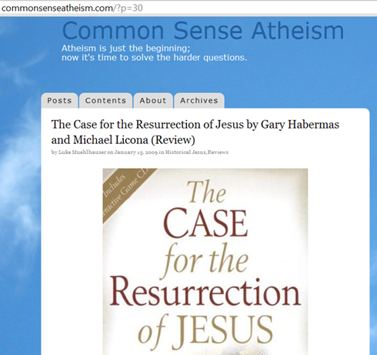
The role of the Resurrection
Believers and skeptics agree: the Christian faith depends on the Resurrection. Paul wrote that “if Christ has not been raised, your faith is futile…” …
But Habermas and Licona want things to work the other way, too. If we have evidence for Jesus’ resurrection, they say, that confirms the truth of Christianity’s claims …
If we have evidence that Jesus rose from the dead, what does that show? That Jesus rose from the dead. And that’s it.
Evidence for the Resurrection would not tell us if Jesus was God or man… Was Jesus even trying to start a religion? These and other questions would remain unanswered by the evidence, even if the resurrection could be proven.

Slide 75
Romans 1.4 declared to be the Son of God by the resurrection from the dead

Slide 76
Paul
to Corinth
circa 55 AD
1Cor.15.3-8 esv
“ I would remind you, brothers, of the gospel I preached
to you… that Christ died for our sins in accordance with
the Scriptures, that he was buried, that he was raised
on the third day , and that he appeared to Cephas,
then to the twelve. Then he appeared to more
than five hundred brothers at one time,
most of whom are still alive, though
some have fallen asleep. Then
he appeared to James, then
to all the apostles. Last
of all… he appeared
also to me.”
scott smelser / sbsmelser@comcast.net

Slide 77
fini

Slide 78
Bibliography
Barret, C.K. (ed.). The New Testament Background: Selected Documents. New York: Harper, 1961
Buttrick, George (ed.). The Interpreter’s Dictionary of the Bible. Nashville: Abingdon, 1962
Habermas, Gary & Licona, Michael. The Case for the Resurrection of Jesus. Kregel: Grand Rapids MI, 2004
Lapide, Pinchas (tr. Linns). The Resurrection of Jesus: A Jewish Perspective. London: SPCK, 1984
Loftus, John W. "Debunking Christianity: Assessing The Minimal Facts Approach of Habermas, Licona, and Craig." Debunking Christianity: Assessing The Minimal Facts Approach of Habermas, Licona, and Craig. N.p., 15 Oct. 2011. Web. http://debunkingchristianity.blogspot.com/2011/10/assessing-minimal-facts-approach-of.html
Orr, James (ed.). The International Standard Bible Encyclopedia. Grand Rapids: Eerdmans, 1939
Tertullian. The Apology of Tertullian. Trans. William Reeves. London: Griffith Farran, 1889.
William Whiston (tr.) The Works of Flavius Josephus. Grand Rapids: Baker, 1979
Wright, N.T. The Resurrection of the Son of God. Fortress Press: Minneapolis, 2003
E.P. Holding (ed.) Shattering the Christ Myth Xulon Press, 2007

Slide 79
[B.] SUGGESTED CHRONOLOGY OF EVENTS AND APPEARANCES
The following is not presented as exhaustive or inerrant. It is hoped that it will be helpful.
1. Several women (perhaps in different homes), make plans to go, or meet at the tomb, around dawn.
2. Mary Magdalene arrives early “while it is yet dark” (John .20:1). Seeing the tomb open, and before finding out what happened, she runs to report the removal of the body.
3. More women arrive “when the sun is risen” (Mark 16:2). They see the angels and hear the message: “He is not here, but is risen.” They depart.
4. Peter and John arrive, look at the grave clothes, and depart (John 20).
5. Mary returns to the tomb. Weeping, and mistaking a man nearby to be the gardener, she asks about the body. When Jesus calls her by name, she turns and sees it is Jesus.
6. Women report the vision of the angels to the disciples (Luke 24).
7. Jesus appears to the women (Matt. 28:9).
8. Jesus appears to two disciples on the road to Emmaus (Luke 24)
9. They report or affirm an appearance to Simon (Luke 24:34; cf. 1 Cor.15:5).
10. Appears to the disciples, late on that first day of the week (Luke 24:36ff.; John 20:19ff).
11. Appears to the disciples again a week later, with Thomas present (John 20:24ff)
12. Appears to the disciples by the Sea of Galilee (John 21)
13. Appears to more than 500, perhaps in Galilee (Matt. 28:10, 16; 1 Cor.15:6)
14. Appears to his brother James (1 Cor. 15:7).
15. Ascends from the Mt. of Olives (Acts 1; Luke 24)
16. Appears to Saul of Tarsus, on the road to Damascus (1Cor. 15:8; cf. Acts 9; 22; 26)
Note: this sequence does not include textual variants which are not present in all the Mss. (Matt. 28:9a [KJV]; Luke 24:12; and Mark 16:9-20). -s.smelser

