Slide 1
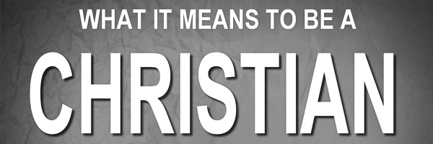
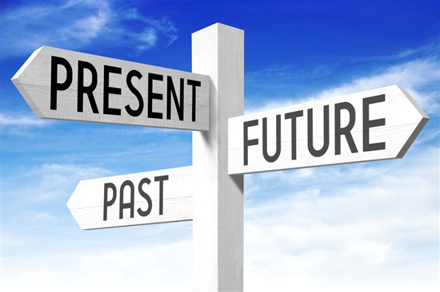

Slide 2
The Past
Our mistakes—our sins—are “past history.”
Good news, because the past can be awful hard to get past.
Richard Nixon: “I am not a crook.”
Criminal record.
What do we often remember about David and Peter?
We can be hard on ourselves, and so can others.

Slide 3
The Past
Thankfully, God forgets! (Heb. 8:12).
People on Pentecost (Acts 2:22-23, 36-38, 41).
Corinthians (1 Cor. 6:9-11).
Paul (1 Tim. 1:12-16).
The past—a place of reference, not of residence.

Slide 4
The Present
What being a Christian doesn’t do:
Remove the consequences of past sins.
Make us immune to sickness, suffering, and heartache.
Provide financial prosperity.
We will make some enemies, and some of them will give us a hard time.

Slide 5
The Present
The positives:
We have the distinct honor of being children of God.
Demonstrates His love for us (1 John 3:1)
Makes us heirs of His inheritance (Romans 8:17).
Grants us the privilege of prayer (Matt. 7:11).
Assurance that present sins will also be forgiven (1 John 1:7-10).

Slide 6
The Future
We don’t have to fear death.
2 Timothy 4:6-8; Philippians 1:19-21.
We may witness the deterioration of our bodies, but we don’t have to do so with despair. 2 Corinthians 4:16-5:4.

Slide 7
The Future
And what a wonderful reward is waiting for us (Rom. 8:18).
An incorruptible inheritance; a place of rest, of glory, honor, and peace; a place where righteousness dwells, where there is no night; an imperishable crown; a crown of righteousness; a crown of life; eternal life and eternal joy.
“Joy without measure will be my treasure; heaven holds all to me.”

Slide 8
The Future
“Often I’m hindered on my way, burdened so heavy I almost fall; then I hear Jesus sweetly say, ‘Heaven will surely be worth it all.’”

