Slide 1
The Providence of God
In the Life of Ezra

Slide 2
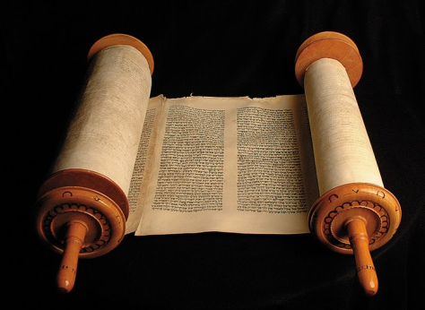
Some Facts About Ezra
He was a priest (7:11)—his lineage is traced back to Eleazar, the son of Aaron (7:1-5).
He was “a skilled scribe in the law of Moses” (7:6), “expert in the words of the commandments of the LORD, and of His statutes to Israel” (7:11).
In the 7th year of King Artaxerxes (458 B.C.), he led a group of Jews from Babylon to Jerusalem, a journey that took four months. About 1500 men were in this group, plus their families (chs. 7-8).

Slide 3
The Character of Ezra
“Prepared his heart to seek the Law of the Lord, and to do it, and teach statutes and ordinances in Israel” (7:10).
When he learned that many of the Israelites, including their leaders, had married foreign women, he was very upset. He confronted them with this sin, challenged them to confess and repent, and had them make a covenant that they would put away their foreign wives (chs. 9-10).
He believed in the power of prayer.
Prayed fervently when he learned about their sin (9:6-10:1).
Prayed in preparation for long journey to Jerusalem (8:21-23).

Slide 4
Providence of God in Ezra’s Life
“Hand of the LORD”
7:6, 9, 28; 8:18, 22, 31.
Let’s look in particular at how God helped Ezra and his fellow-Israelites on this journey to Jerusalem.
He helped provide servants for the house of God (8:15-20).
He guided them on their journey to Jerusalem and protected them from harm (8:21-23, 31).
He influenced King Artaxerxes to provide them all the assistance they needed—and then some (7:6, 11-26).

Slide 5
Providence of God in Ezra’s Life
Assistance from the king
Gave permission to all the Israelites to go with Ezra, including the priests and Levites.
He and his counselors gave them silver and gold to buy animals, grain offerings, and drink offerings, to be used in temple sacrifices. They could also use whatever else they could find in Babylon, along with the free will offerings of the people.
Whatever was left, they could use as they saw fit.
If anything else was needed, they could pay for it from the king’s treasury.
Treasurers on the other side of the river to provide whatever else they needed, up to 3 ¾ tons of silver, 600 bushels of wheat, 600 gallons of wine, 600 gallons of olive oil, and salt without limit.

Slide 6
Providence of God in Ezra’s Life
Assistance from the king
Whatever God prescribes concerning the house of God, let it be done.
Made all the temple workers exempt from taxes.
Appoint magistrates and judges who know the law of God, and for those who don’t know, teach them.
Punish severely those who don’t keep the law of God or the law of the king.
No wonder Ezra was so thankful to God.
7:27-28.

Slide 7
Conclusions
When I read the Book of Ezra, especially chs. 7-10, I’m impressed with Ezra, but I’m even more impressed with God.
I want the “good hand of our God” to be upon me, too.
And so I need to become more like Ezra—I need to prepare my heart to learn the will of God, obey the will of God, teach the will of God, and pray fervently to God.

