Slide 1
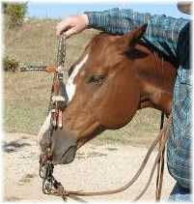
“If anyone among you thinks he is religious, and does not bridle his tongue but deceives his own heart, this one's religion is useless” (James 1:26).

Slide 2
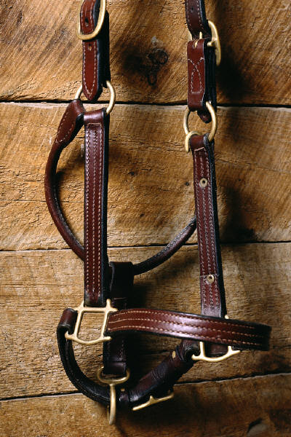
A Good Way to Bridle Our Speech
“So then, my beloved brethren, let every man be swift to hear, SLOW TO SPEAK, slow to wrath” (James 1:19).

Slide 3
Examples of Unbridled Speech
Claiming faith when our life says otherwise. 1:26; 2:14; 1:22.
Speech that reveals partiality or respect of persons. 2:8; 2:1-4, 8-9, 12-13.
Teaching done merely to impress others. 3:1, 13-14.

Slide 4
Examples of Unbridled Speech
Praying for personal advantage. 4:1-3.
Speaking evil of brethren. 4:11-12; 5:19-20.
Boasting of great plans, with no mention of God. 4:13-17.

