Slide 1
Lesson 8: Jeremiah 11-13
“Can the Ethiopian change his skin or the leopard his spots? Then also you can do good who are accustomed to do evil” (13:23). *9:5*

Slide 2
Key Ideas
Jeremiah’s Chore (Part 1)
Jeremiah’s Consent
Jeremiah’s Crisis
Jeremiah’s Complaint
Jeremiah’s Chore (Parts 2, 3)
Jeremiah’s Call to Contrition

Slide 3
Jeremiah’s Chore (Part 1)
What chore is Jeremiah given at the beginning of chapter 11?
11:1-3, 6
What could be found in the cities of Judah and the streets of Jerusalem? (11:11-13).
Anything about these other “gods” in the covenant given at Mount Sinai? Exodus 20:1-6.
See also 13:24-27 (part of the answer to, “Why have these things come upon me?”—13:22)

Slide 4
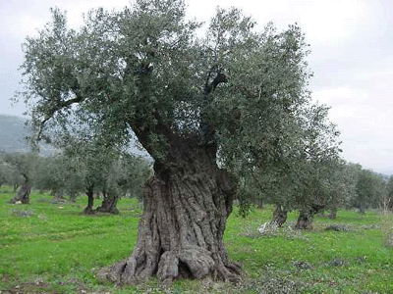
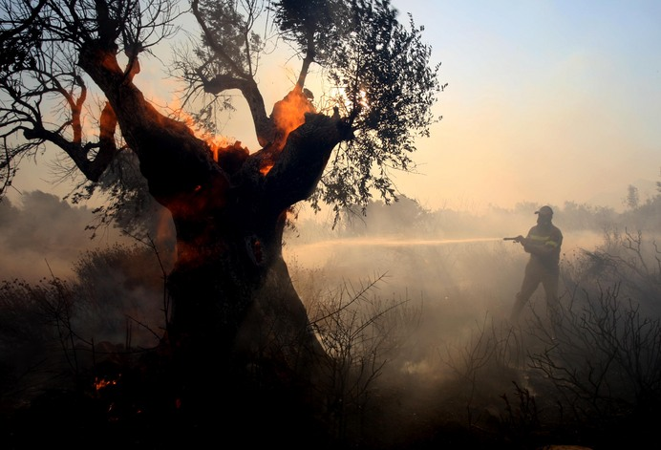
A Fruitful Tree Destroyed (11:15-17)

Slide 5
What else did God call His people?
“My beloved” (11:15); “My heritage” (12:7, 8, 9); “the dearly beloved of My soul” (12:7); “My vineyard” (12:10); “My (pleasant) portion” (12:10); “My people” (12:14, 16; 13:11).

Slide 6
Jeremiah’s Consent
How does Jeremiah respond to this chore assigned to him by God?
“And I answered and said, ‘So be it, LORD’” (11:5).

Slide 7
Jeremiah’s Crisis
“Moreover, the LORD made it known to me…” (11:18). What is IT?
Related to 11:9?
How did the men of Anathoth verbalize this threat? (11:19, 21).

Slide 8
Jeremiah’s Complaint
What complaint does Jeremiah present to the LORD at the beginning of chapter 12?
Going to get better or worse for Jeremiah? (12:5-6).
Who else is deeply hurt (and angered) by the actions of these people? (12:7-13).
Who else is going to be punished, besides Judah and Jerusalem? (12:14-17).

Slide 9
Jeremiah’s Chore (Parts 2, 3)
What additional chore is Jeremiah given at the beginning of chapter 13?
And then what word is he told to speak to the people, beginning in 13:12?

Slide 10
Jeremiah’s Call to Contrition
What does Jeremiah plead with them to “hear”? (13:15-16).
And what will he do if they don’t? (13:17).

