Slide 1
Lesson 16
Ezekiel 27-28

Slide 2
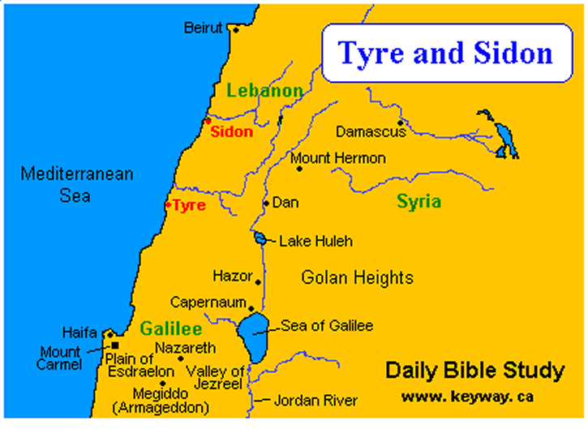

Slide 3
Outline
A Lamentation for Tyre (27)
A Lamentation for the King of Tyre (28:1-19)
Judgment Against Sidon (28:20-24) *25 mi.*
A Much Better Outcome for Israel (28:25-26)

Slide 4
Something the Lord Hates
“Pride goes before destruction, and a haughty spirit before a fall” (Proverbs 16:18). *27:2-3*
“Your heart is lifted up…” (28:2-5, 17).
In Deut. 8:11ff God warned Israel about this very thing, before they entered the promised land.
“Arise, O LORD, do not let man prevail; let the nations be judged in Your sight. Put them in fear, O LORD, that the nations may know themselves to be but men” (Psalms 9:19-20). *28:9*

Slide 5
More on Pride
Acts 12:20-23.
“Let another man praise you…not your own mouth; a stranger, and not your own lips” (Proverbs 27:2).
“It is not good to eat much honey, nor is it glory to search out one’s own glory” (Proverbs 25:27, NAS).

Slide 6
What This Section is All About (25-32)
“And for the house of Israel there shall be no more a brier to prick or a thorn to hurt them among all their neighbors who have treated them with contempt. Then they will know that I am the Lord GOD” (28:24).
God is NOT going to let these nations keep Him from accomplishing His purpose.

Slide 7
Chapter 27
1-26: Let’s go over in detail what fine things you have.
27-36: But now let’s talk about what’s going to happen to all of it.

Slide 8
More Detail
You are the finest ship made of the finest material, constructed by the finest craftsmen. You have some of the finest merchandise, for which you traded with many countries/cities for some of their finest materials. You have the finest mariners/oarsmen and the finest pilots. And your army is formed by the best of the best (1-26).
Anything catch your eye in what they received?
But…verses 27-36.

Slide 9
Chapter 28: The King of Tyre
You say you are a god, but in the hand of your slayer, you’ll be nothing but a man (1-10).
Consider the position I put you in, and the many advantages I gave you (11-15).
Instead of being thankful, you were filled with violence, multiplied your sins, corrupted the gifts I gave you (16-19).

Slide 10
Questions
Where was Tyre situated and what was she to the isles? (27:2).
Specifies many different cities from many different nations with which she traded (one of those nations covered in question #3).
And yet, this is what the LORD told Ezekiel: “Take up a lamentation for Tyre” (27:2).

Slide 11
Questions
T F (#1) Tyre did not think too highly of herself.
“I am perfect in _________” (27:3).
Tyre is likened to what vessel?
Built with the finest materials from all over the world (4-7), with the finest crew and army possible (8-11).
What did Tyre “spread forth to be thy sail”? (27:7).

Slide 12
Questions
In what did Syria trade with Tyre? (27:16).
“Her commercial glory is enhanced both by the number of different nations and cities with which she trades as well as the wide range of merchandise in which she deals” (Harkrider, p. 65).
Did Judah do business with Tyre? (27:17).
Main point in v. 25: “You were filled and very glorious in the midst of the seas” (27:25).
So filled, so overloaded that what happened?

Slide 13
Questions
What would fall into the midst of the sea? (27:27).
This beautiful ship is now a sinking ship.
Your oarsmen brought you into many waters, but the east wind broke you in the midst of the seas” (27:26).
What lamentation would be said by the mariners when Tyre fell? (27:29-36, esp. v. 32).

Slide 14
Questions
Let’s do the following two questions together.
T F (#3) Tyre set its heart as the heart of God.
What was the primary sin of Tyre? (28:2-9).
“heart lifted up”—same was said of Uzziah (2 Chron. 26:16); Hezekiah (2 Chron. 32:25); Nebuchadnezzar (Daniel 5:20).

Slide 15
Questions
What comparison is made between Daniel and the king of Tyre? (28:3).
Or at least so he thought.
Job, to his friends: “No doubt you are the people, and wisdom will die with you” (Job 12:2).

Slide 16
Questions
Why was Tyre’s heart lifted up? (28:4-5).
“Your heart was lifted up because of your beauty” (28:17).
Why was Paul thankful for his thorn in the flesh? (2 Cor. 12:7-10).

Slide 17
Questions
T F (#4) Tyre had iniquity in her from the day of her creation.
“You were perfect in your ways from the day you were created, till iniquity was found in you” (28:15).

Slide 18
Questions
What final state did Ezekiel prophesy for Tyre? (28:18-19).
We talked about this in the previous lesson, from 26:13-14, 19-21.

Slide 19
Questions
What would Sidon know from God’s judgment? (28:22-24).
“They shall know that I am the LORD”—16 times in chs. 25-32.
T F (#5) The house of Israel would be gathered from the people among whom they are scattered.
28:25-26.

