Slide 1
Ezekiel 35-36
Lesson 21

Slide 2
Against Neighboring Nations (Ezekiel 25)
Against Ammon (25:1-7)
Against Moab (25:8-11)
Against Edom (25:12-14)
Against Philistia (25:15-17)

Slide 3
Against Tyre and Sidon (Ezekiel 26-28)
Destruction of Tyre (ch. 26)
Lamentation Over Tyre (ch. 27)
Judgment Against Tyre’s Prince (28:1-19)
Prophecy Against Sidon (28:20-26)

Slide 4
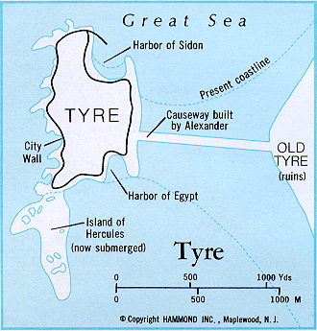
Against Tyre and Sidon (Ezekiel 26-28)
Destruction of Tyre (ch. 26)
Lamentation Over Tyre (ch. 27)
Judgment Against Tyre’s Prince (28:1-19)
Prophecy Against Sidon (28:20-26)

Slide 5
Themes (Ezekiel 25-28)
“They shall know that I am the LORD”—16 times in 25-32.
Not just the targets of destruction, but also those who heard of the destruction.
“Inasmuch as you showed disdain for My people, you showed disdain for Me.”
“Fonzie is not as cool as we thought.”

Slide 6
Against Egypt (Ezekiel 29-32)
Sins of Egypt (29:1-16)
Nebuchadnezzar the Instrument (29:17-21)
Judgment Speedy and Complete (30:1-19)
Arm of Pharaoh Will be Broken (30:20-26)
Egypt Will Fall Like a Great Cedar (ch. 31)
Lamentation for Pharaoh (32:1-16)
Burial of the King and His Subjects (32:17-32)

Slide 7
Themes (Ezekiel 29-30)
“It’s all mine!”
“Lean on me”—NOT!
Destroy…scatter…restore
A gift for Nebuchadnezzar
“The day of the LORD is near”
“I’m having trouble holding this sword”

Slide 8
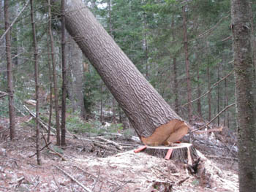
Themes (Ezekiel 31-32)
“Timberrrr”—the sound of a great tree falling
“Cry, Cry, Cry”
“Misery Loves Company” —in the grave

Slide 9
Themes (Ezekiel 33)
“I’ve got some good news and some bad news.”
“Is their blood on my hands?”
“Toot your own horn.”
“Not fair, you say?”
“This land is (was) your land.”
“Play me another song.”

Slide 10
Themes (Ezekiel 34)
“I am the good Shepherd…they are not!”
Did NOT strengthen the weak, heal the sick, bind up the broken, seek the lost, etc.
David (descendant of David) will be their king and shepherd.

Slide 11
Ezekiel 35-36
Bad News for _____?
Good News for ______?

Slide 12
Key Points—Ezekiel 35-36
Edom’s hatred toward Israel
Goes back how far?
Edom’s attitude: 35:5-6, 11, 14-15; 36:5.
Hateful words from Edom and other nations: 35:10, 12-13; 36:2-4, 13-15.

Slide 13
Key Points—Ezekiel 35-36
Contrast in fates for Edom and Israel
“I am against you” (35:3)…“I am for you” (36:9).
“Make you most desolate…lay your cities waste” (35:3-4)…“I will multiply men…cities shall be inhabited…ruins rebuilt” (36:10).
In sharp contrast to Edom, Israel will be populated, productive, and peaceful.

Slide 14
Key Points—Ezekiel 35-36
The spiritual renewal of Israel (36:16-38)
“I will cleanse you…” (v. 25).
“I will give you a new heart…a new spirit” (v. 26).
“I will put My Spirit within you…” (v. 27).
“deliver you from…uncleannesses” (v. 29).
“You will loathe yourselves” (v. 31).
“Be ashamed and confounded…” (v. 32).

Slide 15
Key Points—Ezekiel 35-36
“Concern for My holy name” (36:21).
His name would be vindicated when he made Edom desolate (35:4, 9, 11-12, 15).
His name would be vindicated when He returned Israel to their land (36:10-11, 20-23, 35-36, 38).

