Slide 1
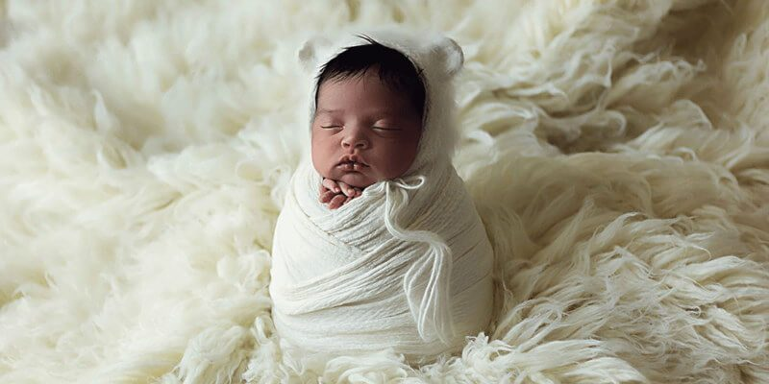
Prayers For A Newborn Child
11 Prayers, Each Introduced by One or More Passages of Scripture

Slide 2
Scriptures
Jacob, concerning his children: “The children whom God has graciously given your servant” (Gen. 33:5).
Hannah, on the birth of Samuel: “For this child I prayed, and the LORD has granted me my petition which I asked of Him” (1 Samuel 1:27).

Slide 3
Prayer
“God of all grace, for this child whom You have graciously given us, we give You thanks. Thank You for hearing and answering our prayers for a child.”

Slide 4
Scriptures
“A woman, when she is in labor, has sorrow because her hour has come; but as soon as she has given birth to the child, she no longer remembers the anguish, for joy that a human being has been born into the world” (John 16:21).
“I have no greater joy than to hear that my children walk in truth” (3 John 1:4).

Slide 5
Prayer
“Our loving God, we thank You for the great joy this child has already given us, and may our joy become even greater in the future when we see our child walking in the truth.”

Slide 6
Scriptures
“Unless you are converted and become as little children, you will by no means enter the kingdom of heaven…whoever humbles himself as this little child is the greatest in the kingdom of heaven” (Matthew 18:3-4).
“Let the little children come to Me, and do not forbid them; for of such is the kingdom of heaven” (Matthew 19:14).

Slide 7
Prayer
“Holy Father, help us as parents to develop the same purity and innocence, the same humble dependence our child possesses, because what we see in our child is what You want to see in us.”

Slide 8
Scriptures
“They (Zacharias and Elizabeth) were both righteous in the sight of God, walking blamelessly in all the commandments and requirements of the Lord (Luke 1:6).

Slide 9
Prayer
“O righteous heavenly Father, help us to set the right example for our child, help us strive to walk blamelessly in all your commandments and requirements.”

Slide 10
Scriptures
“O LORD, I know the way of man is not in himself; it is not in man who walks to direct his own steps” (Jeremiah 10:23).
Manoah, concerning the soon to be born Samson: “O my Lord, please let the Man of God whom You sent to us come again and teach us what we shall do for the child who will be born” (Judges 13:8).

Slide 11
Prayer
“Our great and awesome God, who possesses infinite wisdom, it is not in us to know what’s best for our child, so please show us in Your word what we need to do to raise this child.”

Slide 12
Scriptures
“And the child Samuel grew in stature, and in favor both with the LORD and men” (1 Samuel 2:26).
“And Jesus increased in wisdom and stature, and in favor with God and men” (Luke 2:52).

Slide 13
Prayer
“God of heaven and earth, we pray the very same for our child, that our child will increase in stature and wisdom, and in favor first and foremost with God, but also with men.”

Slide 14
Scriptures
Hannah, concerning Samuel: I will give him to the LORD all the days of his life” (1 Samuel 1:11).
“Behold what manner of love the Father has bestowed on us, that we should be called children of God!...now we are children of God; and it has not yet been revealed what we shall be, but we do know that when He is revealed, we shall be like Him, for we shall see Him as He is” (1 John 3:1-2).

Slide 15
Prayer
“Help us, Father, to give this child back to you, by teaching our child to become Your child, by instilling in this child the hope of eternity, the hope of one day being in Your very presence, to see You as You are.”

Slide 16
Scriptures
“Fathers…bring them up in the training and admonition of the Lord” (Ephesians 6:4).
“From childhood you (Timothy) have known the Holy Scriptures” (2 Timothy 3:15).
“For whom He foreknew, He also predestined to be conformed to the image of His Son” (Romans 8:29).

Slide 17
Prayer
“Help us, eternal Father, to train this child in Your ways, to diligently teach our child the Scriptures from the very beginning, to mold our child into the image of your Son.”

Slide 18
Scriptures
“He who spares his rod hates his son, but he who loves him disciplines him promptly” (Prov. 13:24).
“Chasten your son while there is hope, and do not set your heart on his destruction” (Prov. 19:18).
“Fathers, do not provoke your children, lest they become discouraged” (Colossians 3:21).

Slide 19
Prayer
“Help us, Almighty God, to be firm in our discipline, so that our child learns respect for authority, obedience, and self-control; but keep us from being too impatient, too harsh, lest we discourage our child. Help us, please, to develop the proper balance.”

Slide 20
Scriptures
“Do not be deceived: Evil company corrupts good habits” (1 Corinthians 15:33).
“He who walks with wise men will be wise, but the companion of fools will be destroyed” (Prov. 13:20).

Slide 21
Prayer
“Father, we understand that friendships have the potential to make us or break us, so please help our child to choose wisely.”

Slide 22
Scriptures
“To the saints who are in Ephesus, and faithful in Christ Jesus” (Ephesians 1:1).
“When Aquila and Priscilla heard him (Apollos), they took him aside and explained to him the way of God more accurately” (Acts 18:26).

Slide 23
Prayer
“It may be many years off, but faithful God, please help our child to find a faithful Christian to marry, someone equipped to help our child reach their full potential in the kingdom of God.”

Slide 24
Conclusion
This is not just about what we pray—it’s about the priorities we set for raising our children, the goals we have for them.
Nothing matters more than the things we talked about in this lesson.

