Slide 1
Togetherness
Very evident among the early Christians.
Acts describes them as being together, of one accord, of one heart and one soul (2:44, 46; 4:24, 31-32; 5:12; 12:12; 14:27; 15:30; 20:7-8).
This togetherness (fellowship) grew out of their fellowship with the Father and the Son (John 17:20-21).

Slide 2
Togetherness in the Lord
Especially as it relates to attendance, or coming TOGETHER to study and engage in other spiritual activities.

Slide 3
Key Element in God’s Eternal Plan
“To gather TOGETHER in one all things in Christ” (Eph. 1:10). Ephesians 2:16.
Speaks to the togetherness we have in the one body, the fellowship we have with all the saints in every place and from every age.
What a wonderful blessing this is!

Slide 4
God’s Plan for Togetherness
Goes beyond the TOGETHERNESS in one body.
Acts 20:6-8
1 Corinthians 14:23.
NOT the universal church, or the one body…
But a local church, here the church at Corinth.

Slide 5
Together When Not Together
“Joined TOGETHER in the same mind and in the same judgment” (1 Cor. 1:10); “with one mind striving TOGETHER for the faith of the gospel” (Phil. 1:27); “knit TOGETHER in love” (Col. 2:2).
TOGETHER, then, in heart, purpose, and conviction.

Slide 6
People who are this TOGETHER…
Look forward to the times when they can actually be TOGETHER, in the same location.
And isn’t it great when the “whole church” (every member) comes together?
A local church is a TEAM of saints who work and worship TOGETHER.
Need ALL the team members to make this work.

Slide 7
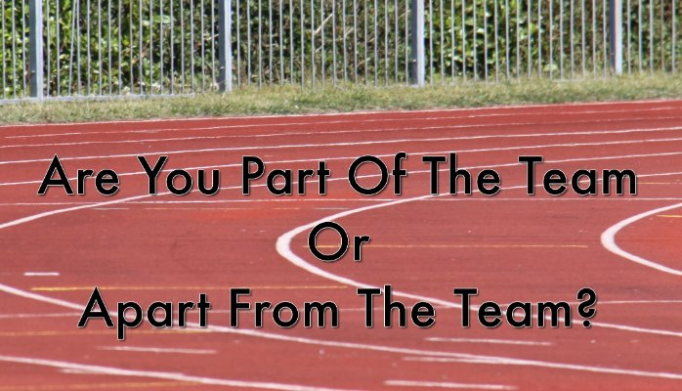

Slide 8
“Team” Activities
When the church assembles TOGETHER in one place, I need to be there TOGETHER with them—for several reasons.
On the first day of the week, we can sing and pray TOGETHER, study TOGETHER, eat the Lord’s supper TOGETHER, and give to the Lord while we reflect TOGETHER on how much He has given to us.
What about the Bible classes, and the other periods of worship?

Slide 9
“Team” Activities
When the church assembles TOGETHER in one place, I need to be there TOGETHER with them.
Occasions like these actually draw us closer TOGETHER.
“When we meet in sweet communion where the feast divine is spread, hearts are brought in closer union while partaking of the bread.”
“May we all in spirit—all with one accord, take this cup of blessing, given by the Lord.”

Slide 10
“Team” Activities
When the church assembles TOGETHER in one place, I need to be there TOGETHER with them.
It’s a great opportunity to build up team members.
“And let us consider one another in order to stir up love and good works, not forsaking the assembling of ourselves TOGETHER, as is the manner of some…” (Heb. 10:24-25).
Romans 1:11-12; 15:30, 32.

Slide 11
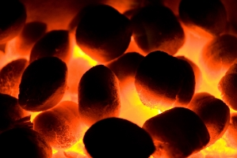
“Team” Activities
When the church assembles TOGETHER in one place, I need to be there TOGETHER with them.
Isolation from the team makes our love grow cold.
“The whole body, joined and knit TOGETHER by what every joint supplies…” (Eph. 4:16).

Slide 12
What Did I Miss?
The TOGETHERNESS the Lord longs to see in His people, spiritual fellowship in activities designed to glorify His name and edify us all.
A young Christian give his first talk, wait on the table, lead singing, lead a prayer the first time.
A baptism, the enthusiastic singing which followed, the long line waiting afterwards to encourage this new Christian.

Slide 13
What Did I Miss?
The knowledge and wisdom gained from our studies TOGETHER.
An opportunity to encourage the non-Christians who visited.
Updates on the work of the church.
Updates on my brethren—needs they have which I might could have filled.
Seeing people who came in spite of great difficulty.

Slide 14
The Final Gathering
“Now, brethren, concerning the coming of our Lord Jesus Christ and our gathering TOGETHER to Him…” (2 Thess. 2:1).
Will we be gathered TOGETHER with the other saints then, if we lack the desire to gather TOGETHER with them now?
It’s hard to see the value of this fellowship in eternity when we don’t see the value of this present fellowship.

