Slide 1
Luke
Lesson 4 – Chapter 3

Slide 2
Luke 3
History:
Ministry of John the Baptist 3:1-22
Tiberius Caesar began in ~14AD
His 15th year makes it ~26 - 29AD
Pontius Pilate – current Roman Governor of Judea
Herod Antipas (son of Herod the Great) over Galilee.
Philip (son of Herod the Great) over regions east of the Jordan
Lysanias (not family of Herod) over a small area north of Philip’s region

Slide 3
Luke 3
History:
Ministry of John the Baptist 3:1-22
Dated while Annas and Caiaphas were high priests” v2
John began preaching in the region by the Jordan
John preached the baptism of repentance v3
Multitudes came for baptism v7
John preached repentance is a prerequisite to this baptism

Slide 4
Luke 3
History:
Ministry of John the Baptist 3:1-22
Many were baptized including Jesus v21
At the baptism of Jesus, God confirmed Jesus as His Son. v22
Additionally, John rebuked Herod Antipas for his improper marriage and his evil leadership which caused John to be put in prison v20
This is the beginning of what leads to John’s execution.

Slide 5
Luke 3
Observations:
Ministry of John the Baptist 3:1-22
“While Annas and Caiaphas were high priests” v2
John 18:13, 24; Acts 4:5-6
And they led Him away to Annas first, for he was the father-in-law of Caiaphas who was high priest that year.
Then Annas sent Him bound to Caiaphas the high priest. – John 18:13, 24
And it came to pass, on the next day, that their rulers, elders, and scribes, as well as Annas the high priest, Caiaphas, John, and Alexander, and as many as were of the family of the high priest, were gathered together at Jerusalem. - Acts 4:5-6

Slide 6
Luke 3
Observations:
Ministry of John the Baptist 3:1-22
Luke records the civil authorities and the spiritual authorities of the day as unrefuted time markers
According to v7, multitudes sought John’s baptism
Who were these people according to Matthew?
What did John call them and why?

Slide 7
Luke 3
Observations:
Ministry of John the Baptist 3:1-22
John’s baptism required repentance. How does John help us understand what repentance looks like?
Give a coat to someone who needs a coat
Give food to someone who needs food v11
Be honest with others v13
Be content with wages (Who did this benefit?)
Stop stealing from the people
Would people notice such actions?
These changes would be visible

Slide 8
Luke 3
Observations:
Ministry of John the Baptist 3:1-22
John was the fulfillment of Isaiah
The people wondered if John was the Christ. v15
Jesus was mightier than John and you need to be ready for Him v16-17
There were people looking for the Christ
Luke’s book is about Jesus and this section is there to help us understand why Luke writes this book.

Slide 9
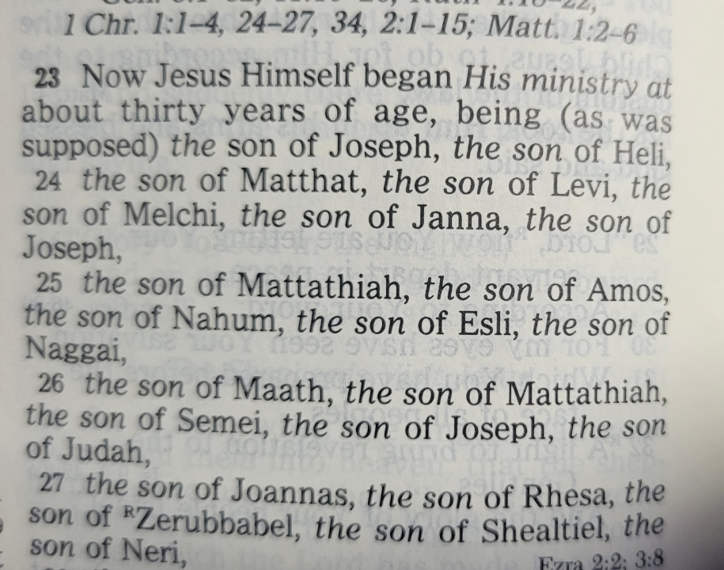
Luke 2
Genealogy of Jesus 3:23-38
Starts with Jesus and goes back to God through Adam.
Why does Matthew have a different lineage?
The italicized words

Slide 10
Luke 3
Genealogy of Jesus 3:23-38
Starts with Jesus and goes back to God through Adam.
Why does Matthew have a different lineage?
The italicized words
Why does Matthew stop at Abraham?
Matthew: David > Solomon
Luke: David > Nathan (3rd son with Bathsheba)
Why important?
Is every generation named?
No, Luke and Matthew skip some generations

Slide 11
Luke 3
Next week: Lesson 5 – Chapter 4
Jesus tempted by the Devil
Jesus begins His ministry

